Slide 1
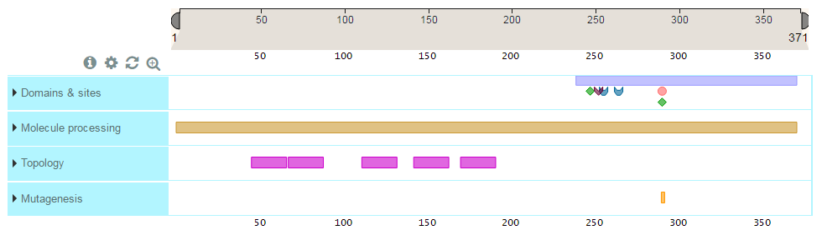
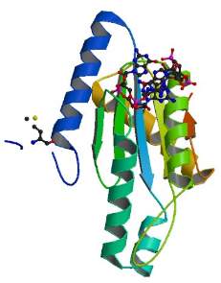
Bioinformatics tools for proteins
http://bioinf.uab.es/ocs/PROTEINPRED/
Sequence Based:
NCBI
UNIPROT
PFAM
prediction tools
Structure Based:
PDB
Dali server
MAESTROweb
Swiss-Model
Pymol

Slide 2
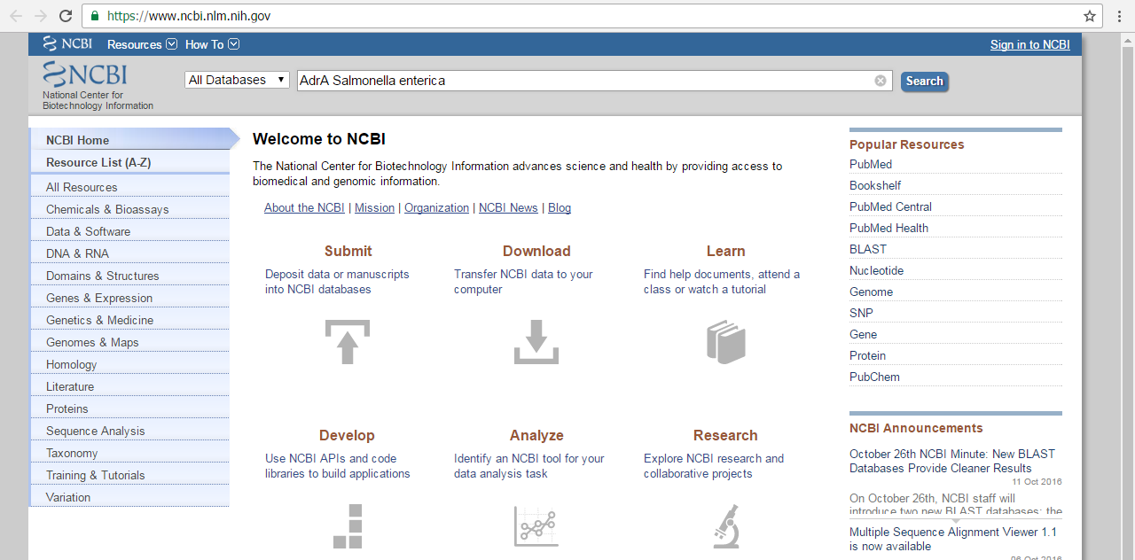

Bioinformatics tools for proteins: Sequence
Let’s do a brief review of the common Databases and search engines.
We start searching for the AdrA protein from Salmonella enterica

Slide 3
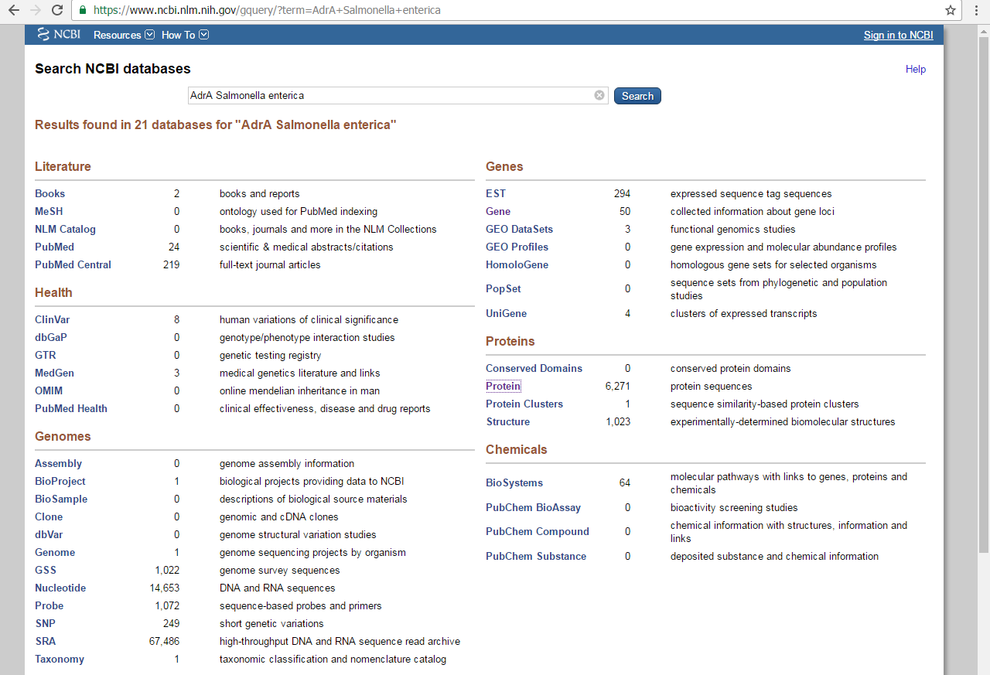
Sequence: NCBI
We could go for protein, but it is better to start with gene, in ncbi it acts as information hub. From the gene section we can jump to protein easily, however, the opposite path is not always as clear

Slide 4
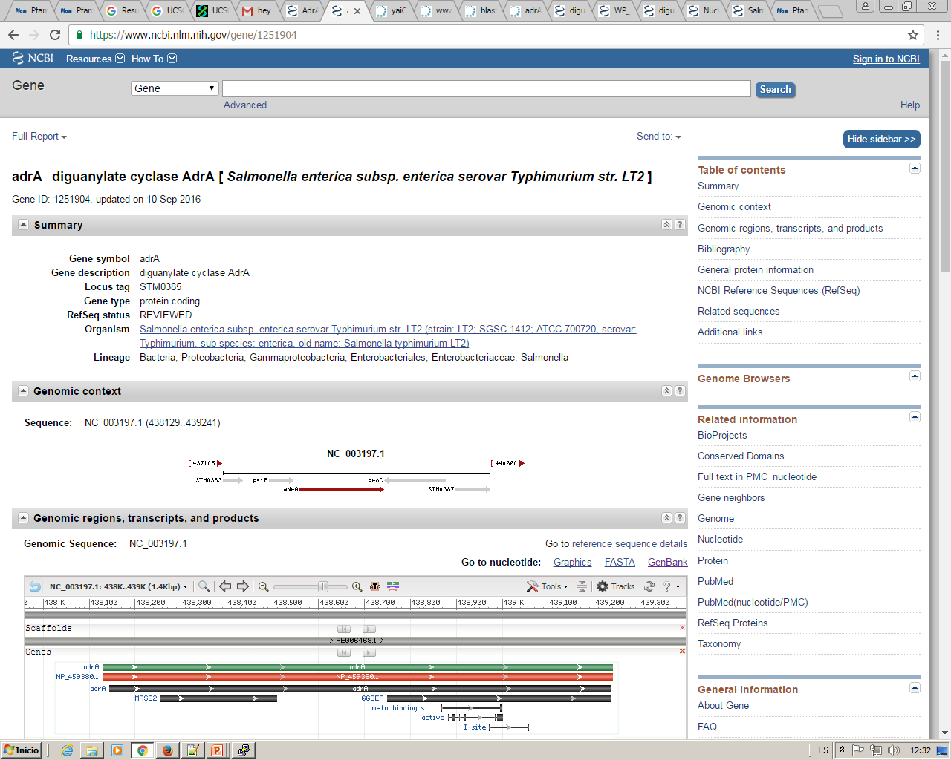
Sequence: NCBI(gene)
From here we can “connect” with other databases and related information

Slide 5
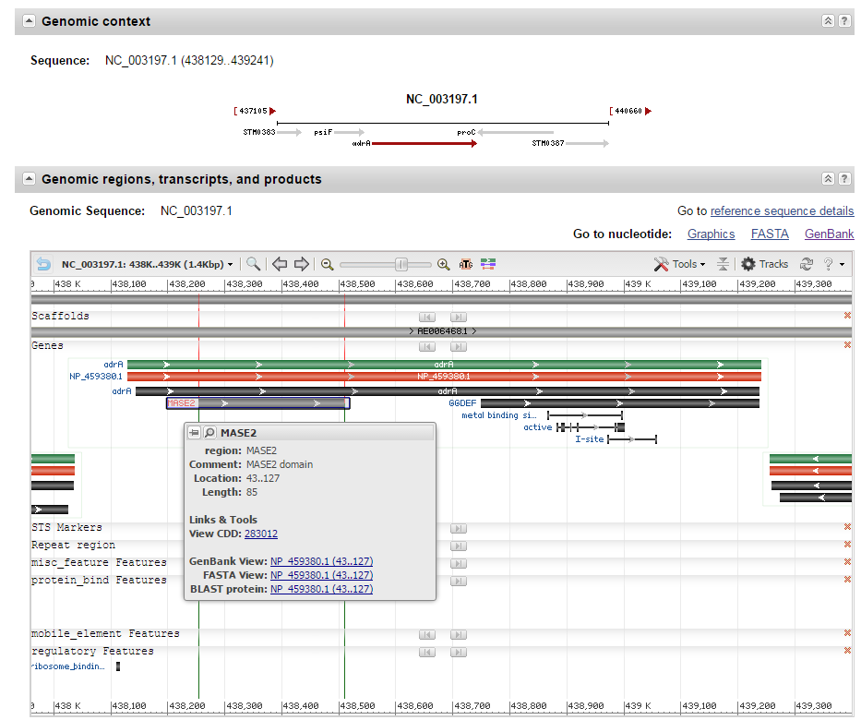
Sequence: NCBI(gene)
Annotation of the gene in the sequenced fragment.
2. Text view in gb format
3
2
1
Graphical view of annotated regions and features

Slide 6
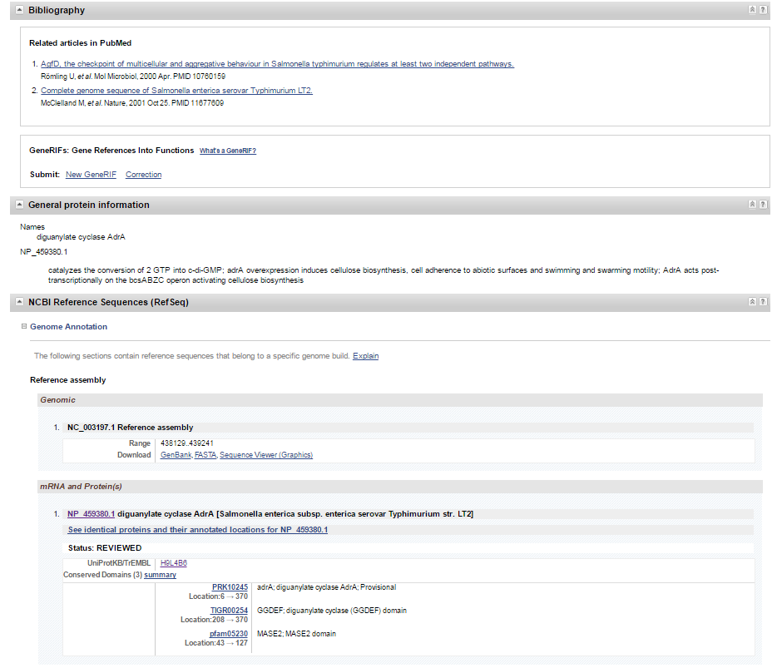
Sequence: NCBI(gene)
“Jump” To protein databases and protein related information:
NCBI data in gp text format (with links)
UNIPROT data in graphical format
1
2

Slide 7
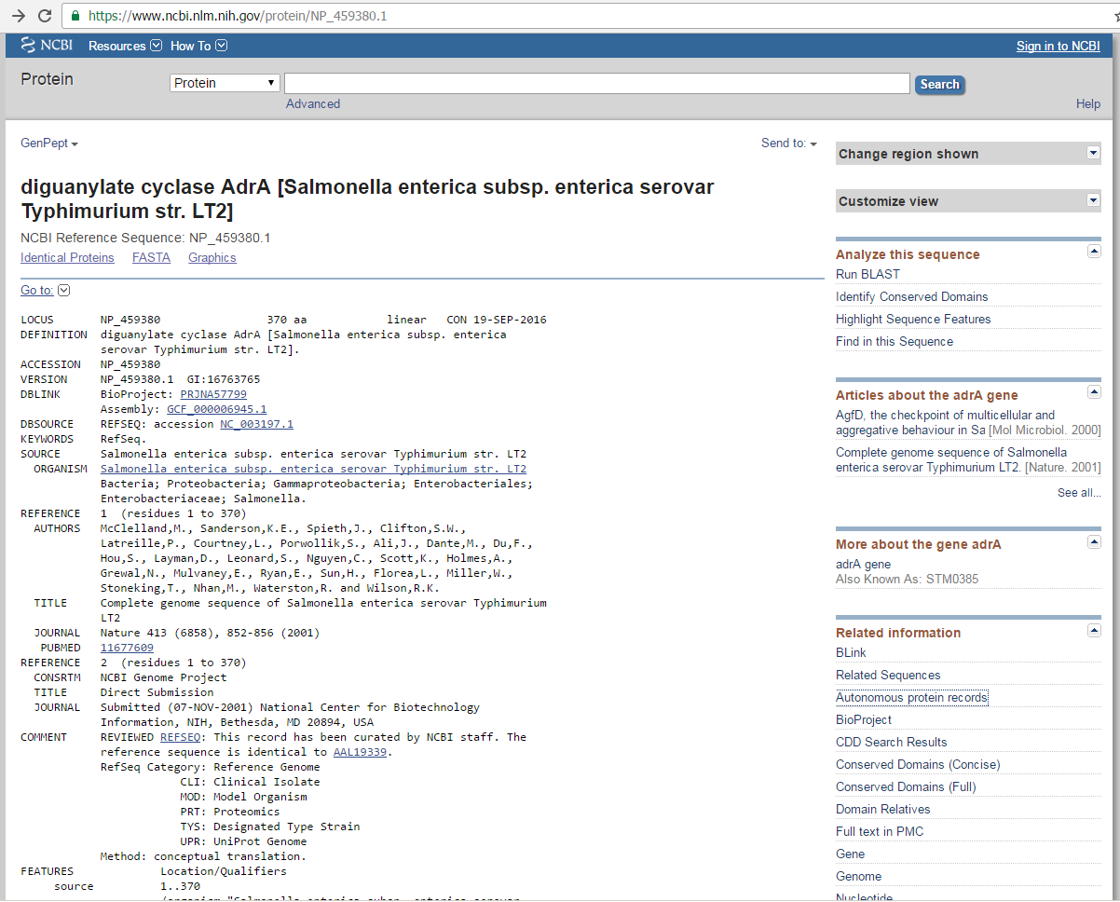
Sequence: NCBI(proteins)
Description and general information
“Connections”

Slide 8
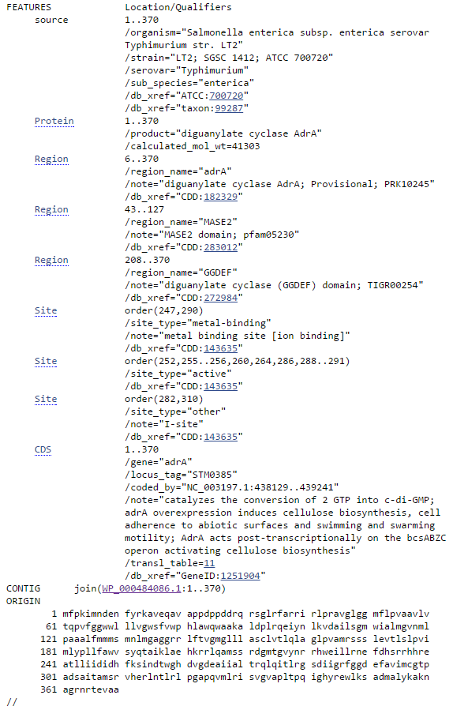
Sequence: NCBI(proteins)
Specific information about the sequence
Regions, domains, sites, annotations, etc.

Slide 9
Sequence: NCBI(gene)
2
Link UNIPROT database

Slide 10
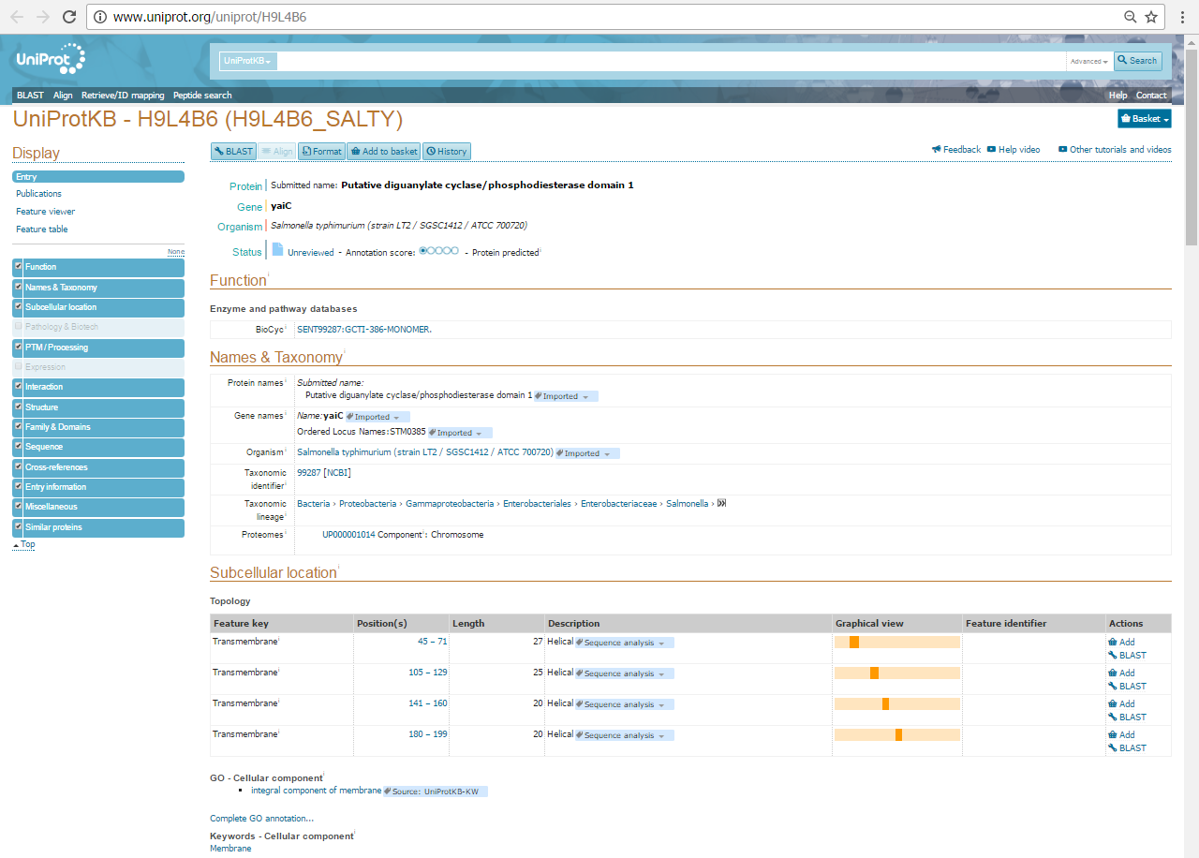
Sequence: UNIPROT
Go to desired information
Presented information
Uniprot DATABASE pretends to store all the information that it is known about a protein.
Publications
Function
Topology
Structure
Interactions
Known protocols
Sequence analysis tools
Links to other DB (domains, orthologs …)
…

Slide 11
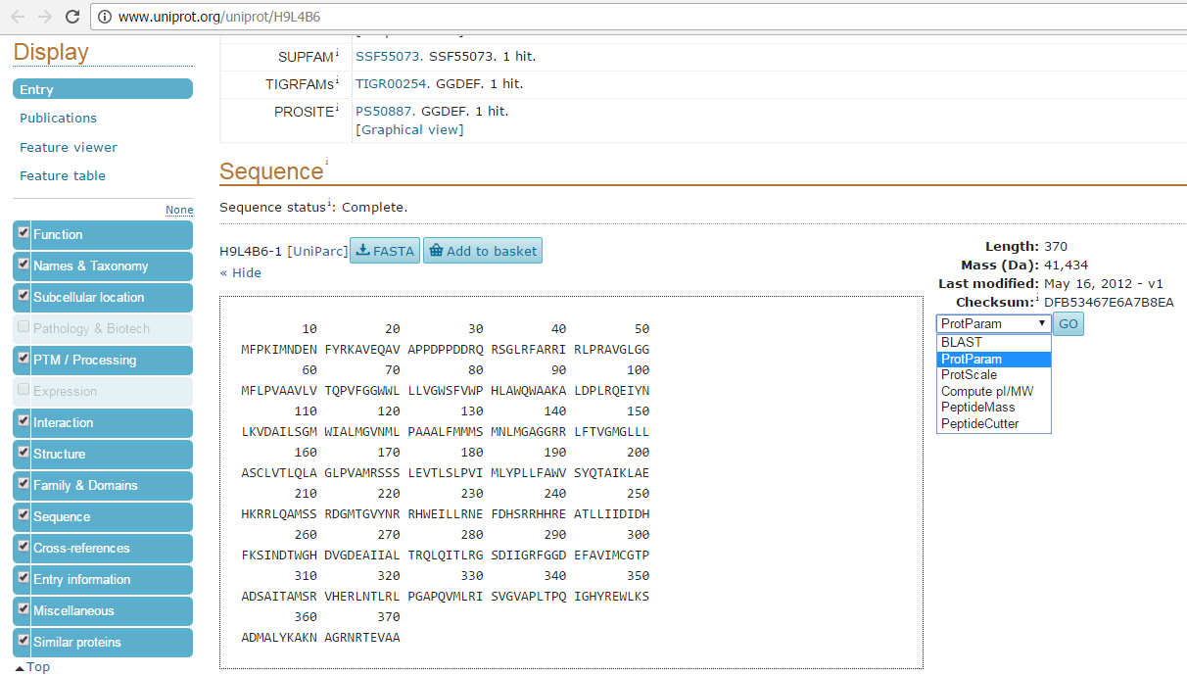
Sequence: UNIPROT
Run a search in different sequence based analysis tools directly from the database entry
1
3
2

Slide 12
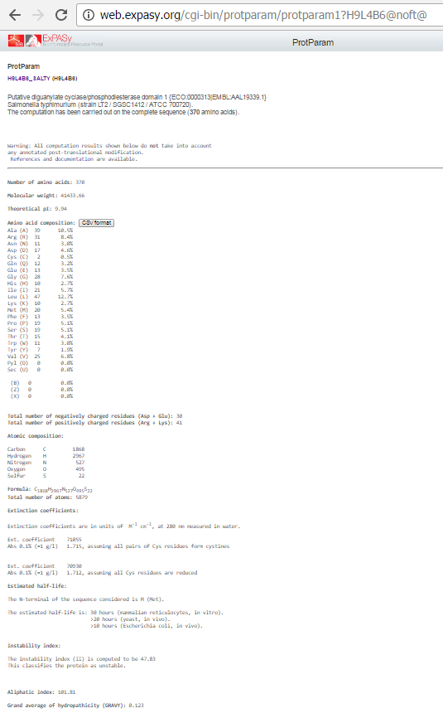
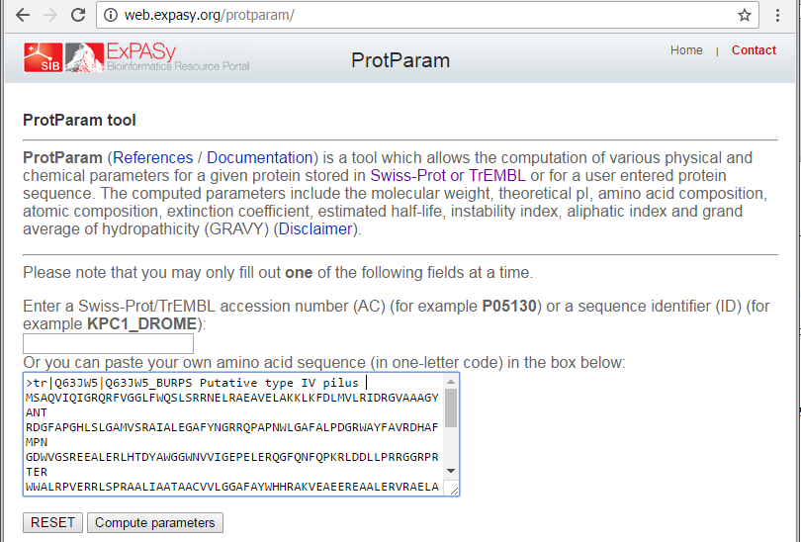
Sequence: ProtParam
Different parameters that can be calculated from the sequence:
Sequence size
Molecular weight
Theoretical isoelectric point
Amino acid composition
…
We can also use ProtParam with a sequence as input

Slide 13
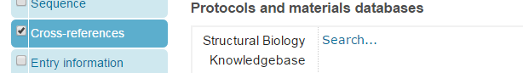
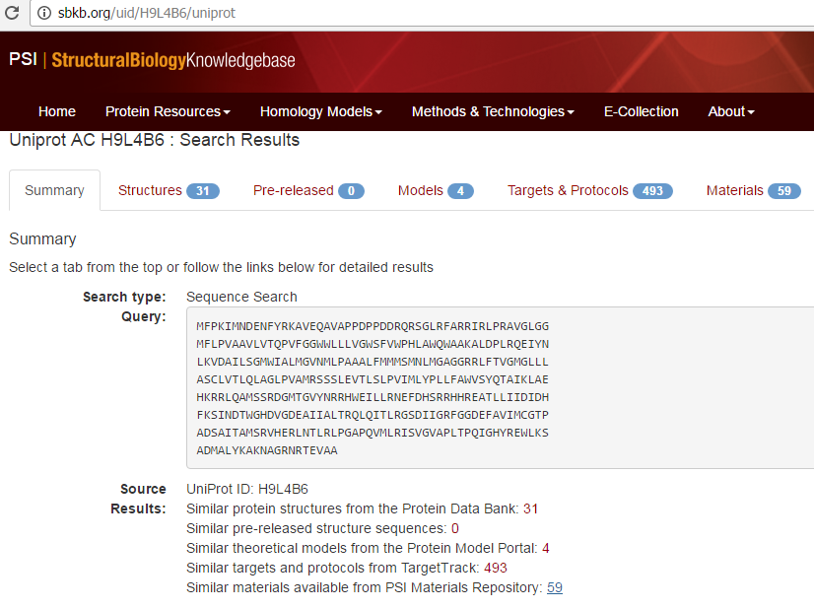
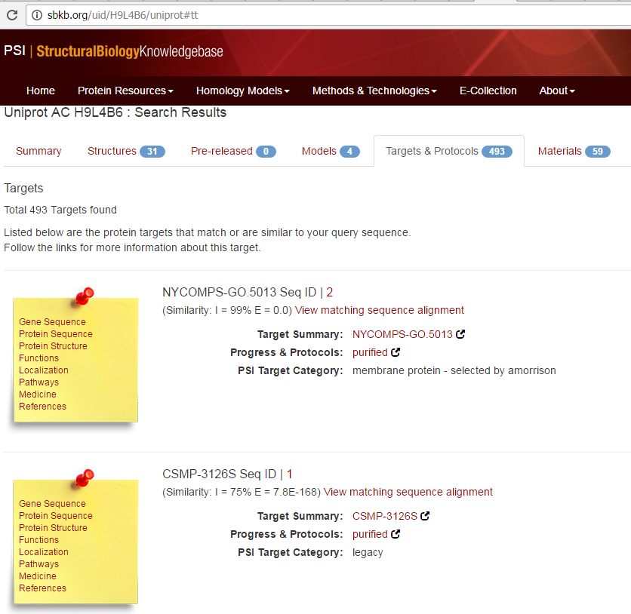
Sequence: UNIPROT – Structural Biology Knowledgebase
Search for known protocols for this protein or similar ones

Slide 14
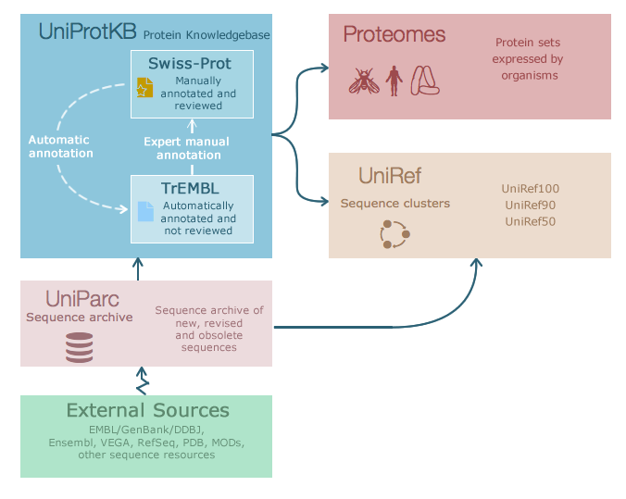
Sequence: UNIPROT
Uniprot is a DataBase made of different databases. The most important:
SwissProt: Contains ALL Reviewed sequences
Trembl: Contains automatically annotated, not reviewed sequences (it use to be ALL, but now they are trying to remove redundancies)

Slide 15
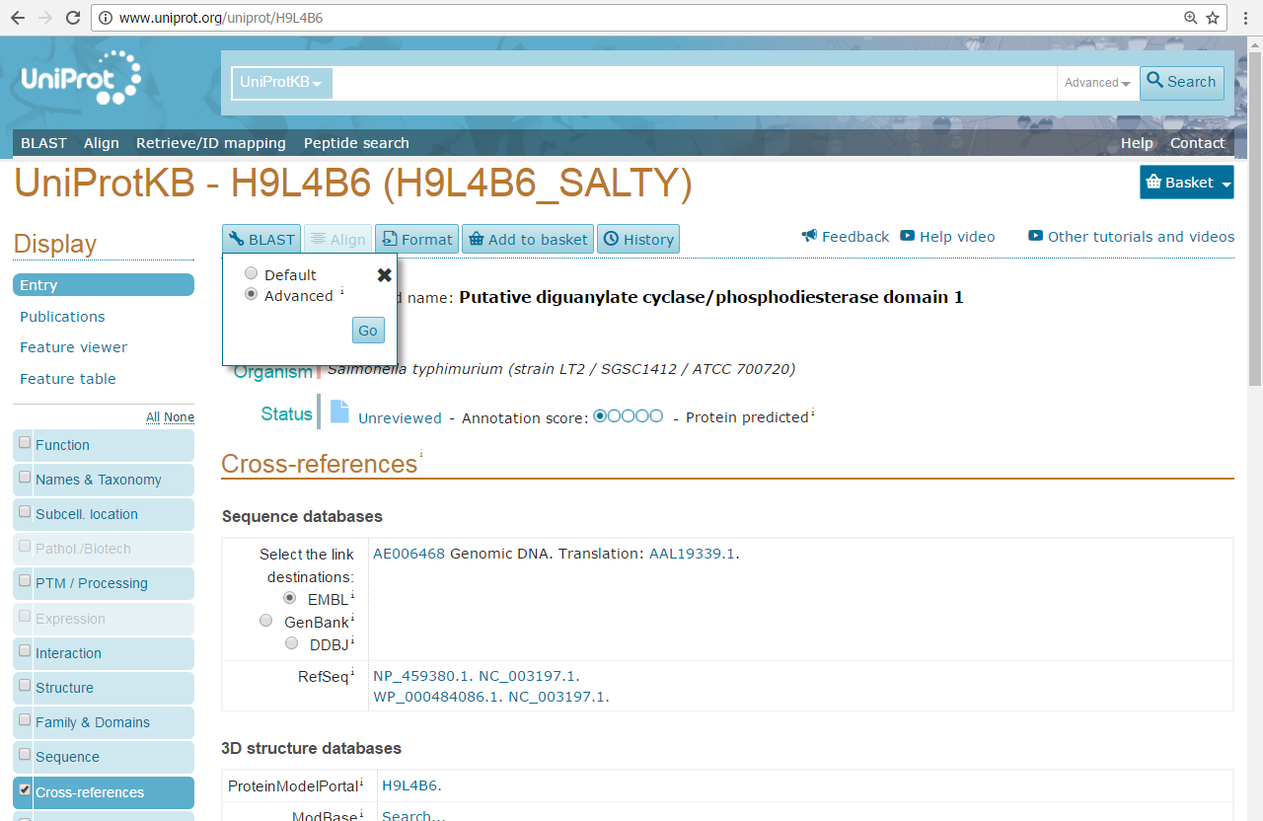
Sequence: UNIPROT(blast)
1
2
3

Slide 16
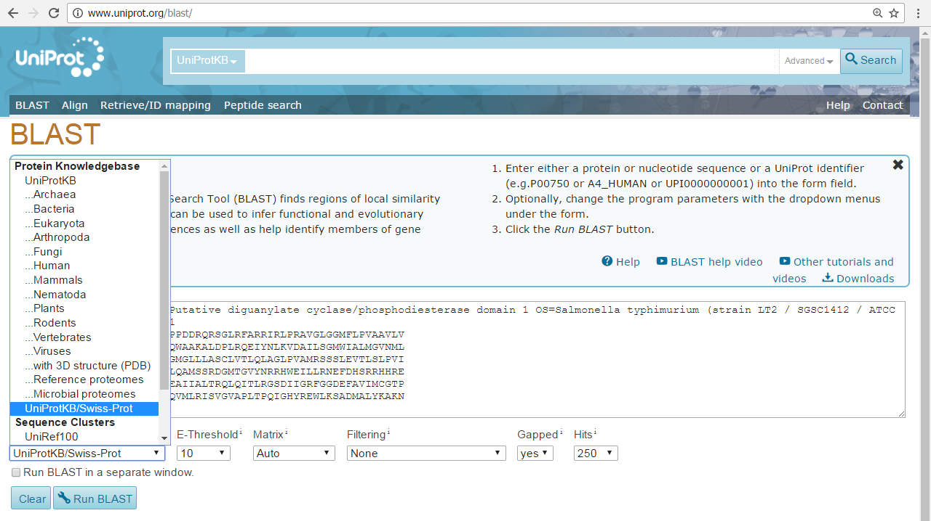
Sequence: UNIPROT(blast)
We will make a blast of our protein against Swiss-Prot database, looking for well known proteins. (Better annotated, used in multiple publications, expressed and purified, structure solved, etc)
2
3
1
4

Slide 17
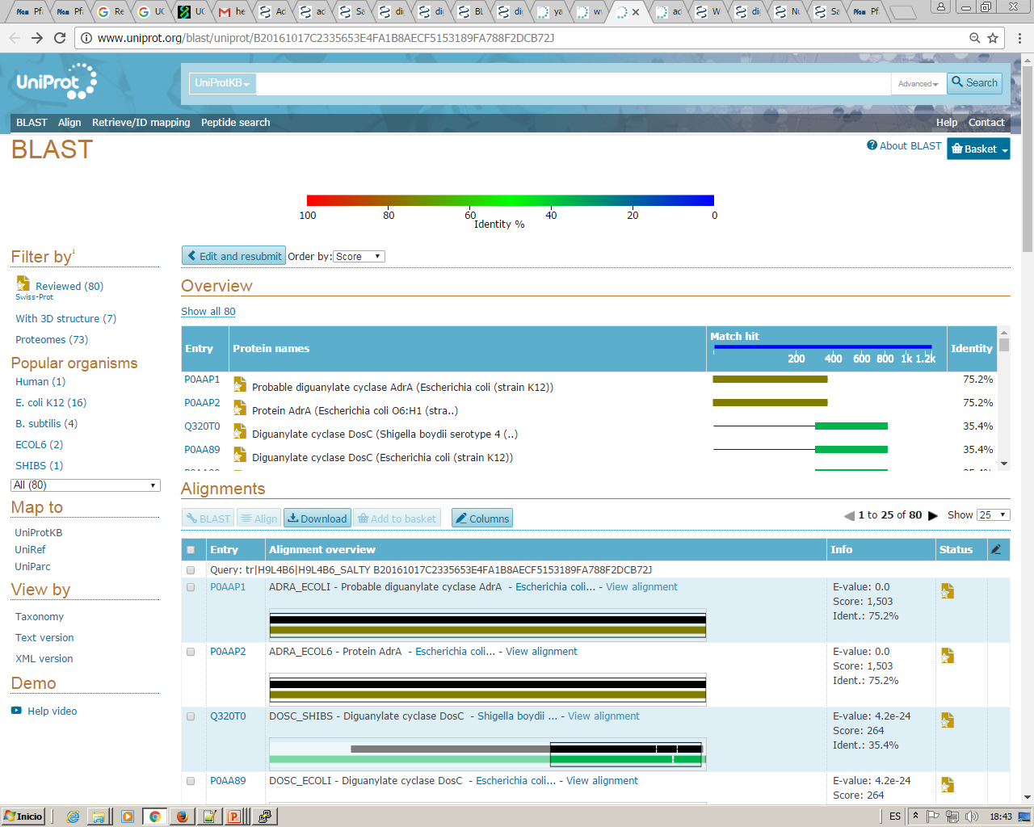
Sequence: UNIPROT(blast)
1
2
3

Slide 18
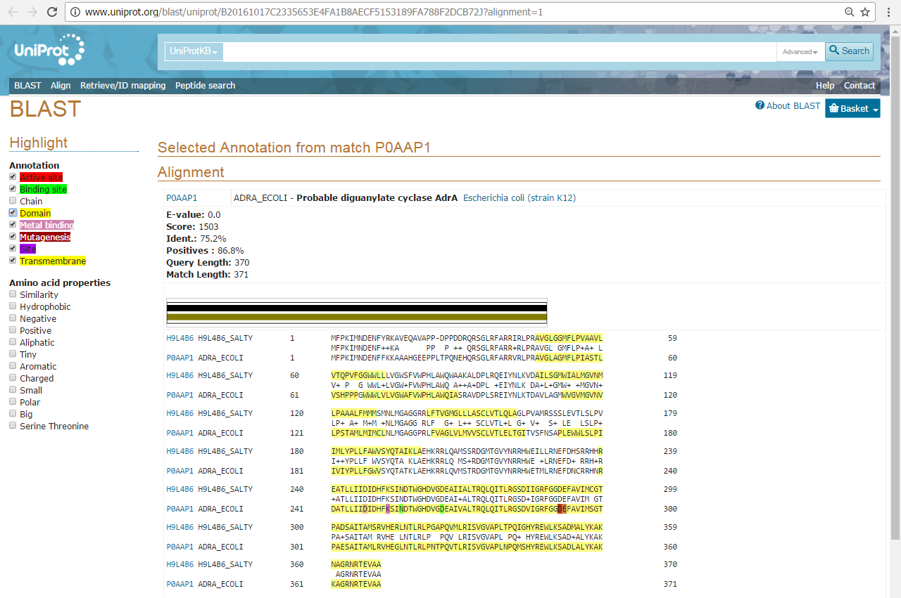
Sequence: UNIPROT(blast)

Slide 19
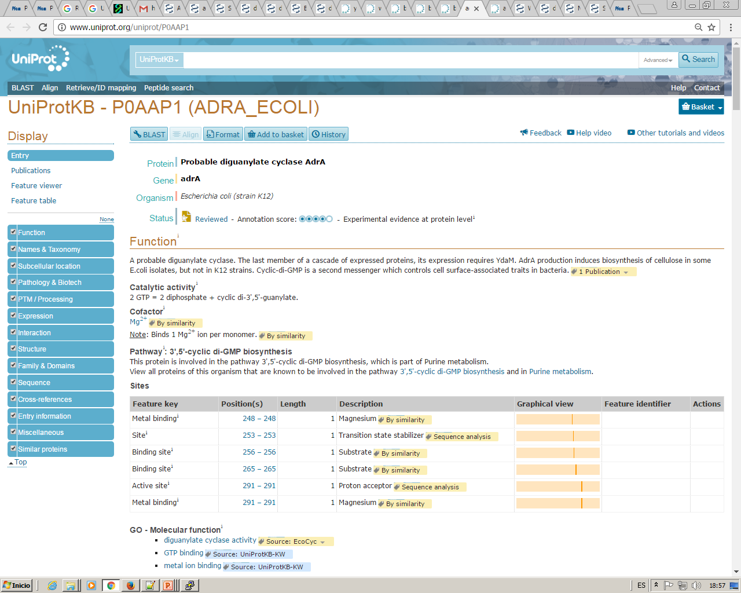
Sequence: UNIPROT(Swiss-Prot)
In a Swiss-prot entry we will find much more information than in an trembl one, specially related publications
1
2

Slide 20
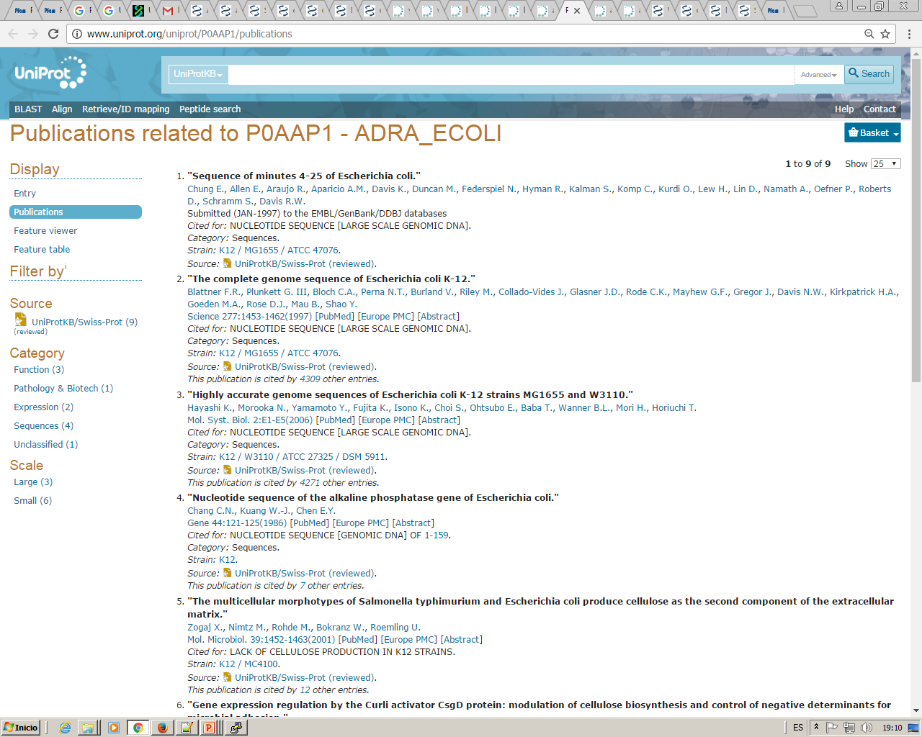
Sequence: UNIPROT(Swiss-Prot)

Slide 21
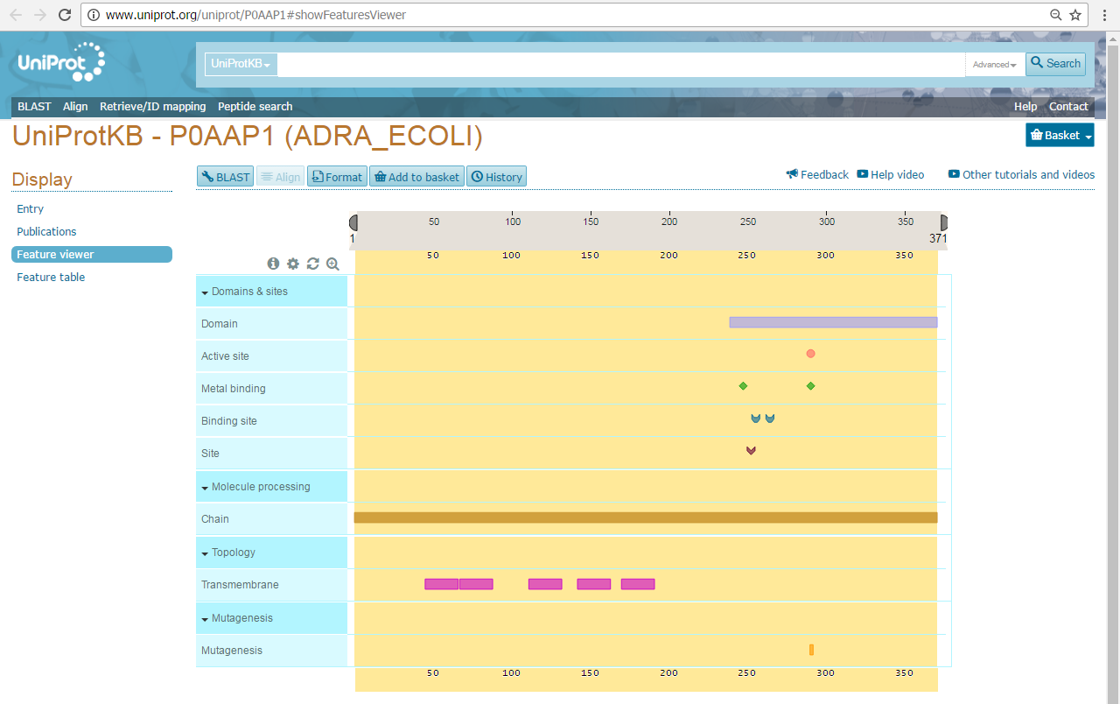
Sequence: UNIPROT(Swiss-Prot)

Slide 22
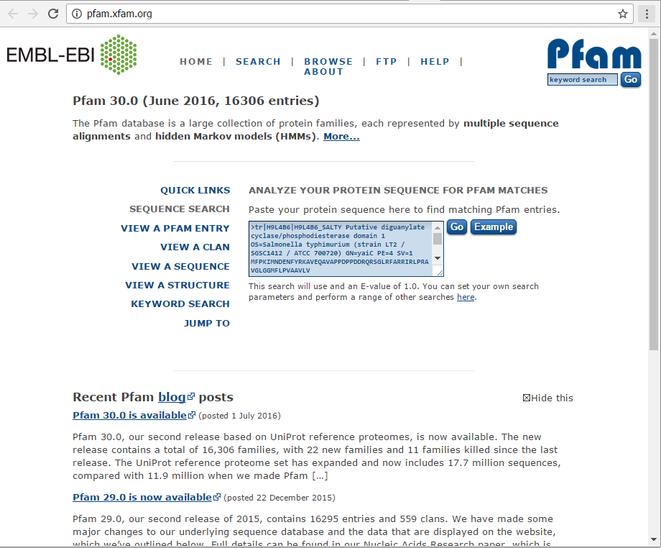
Sequence: PFAM
Database of protein domains families, based on manually curated alignments of known domains

Slide 23
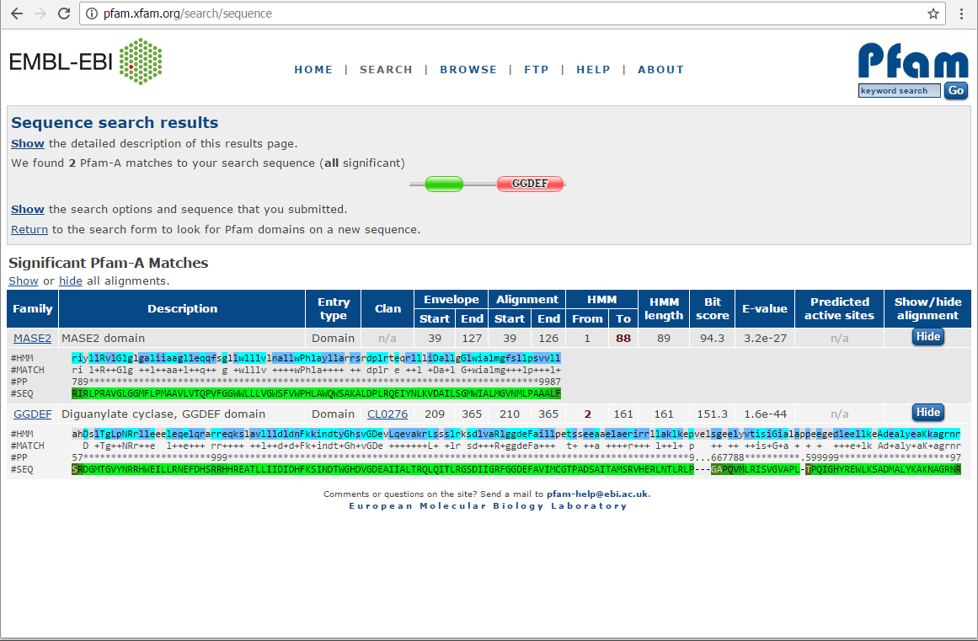
Sequence: PFAM
3
4
1
2

Slide 24
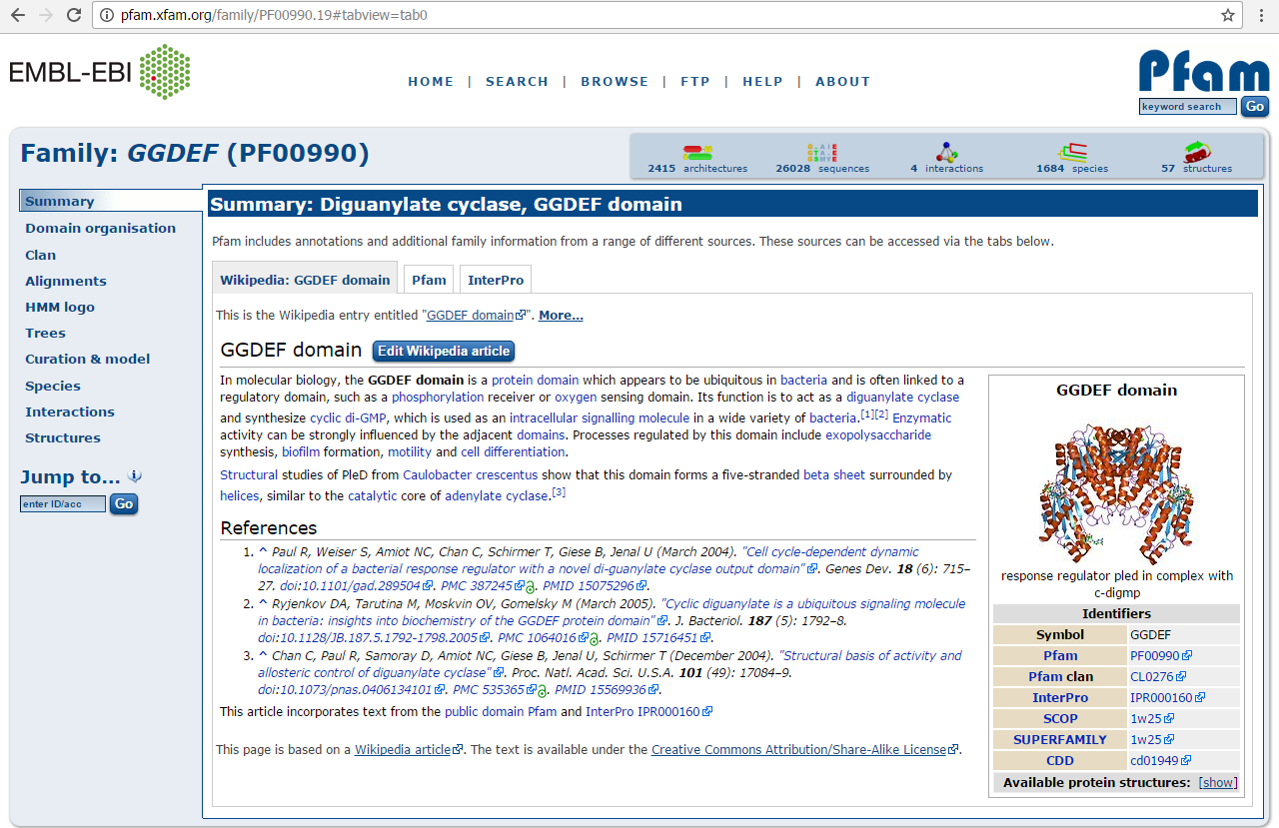
Sequence: PFAM
Name
ID

Slide 25
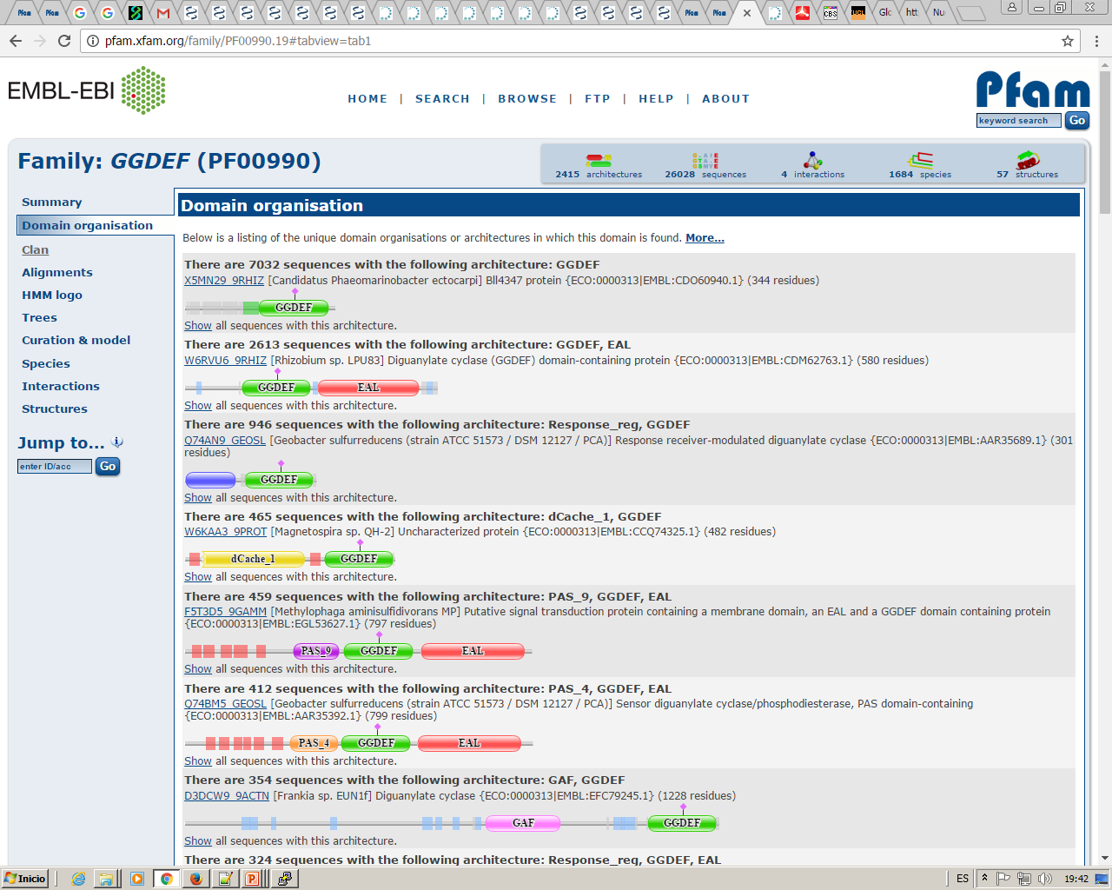
Sequence: PFAM

Slide 26
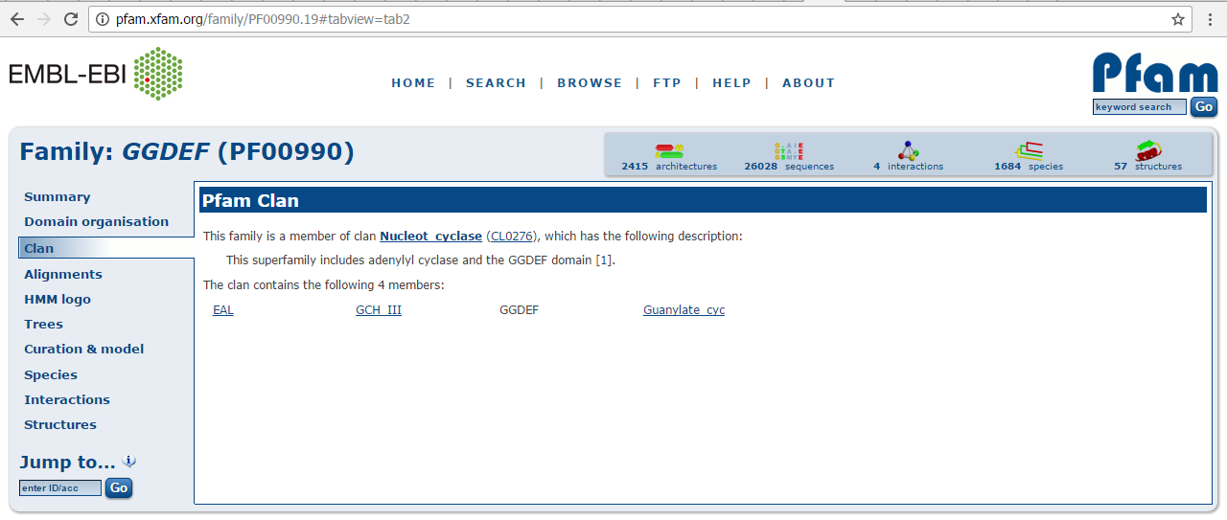
Sequence: PFAM
This family is similar to others and they are grouped in a “Clan”

Slide 27
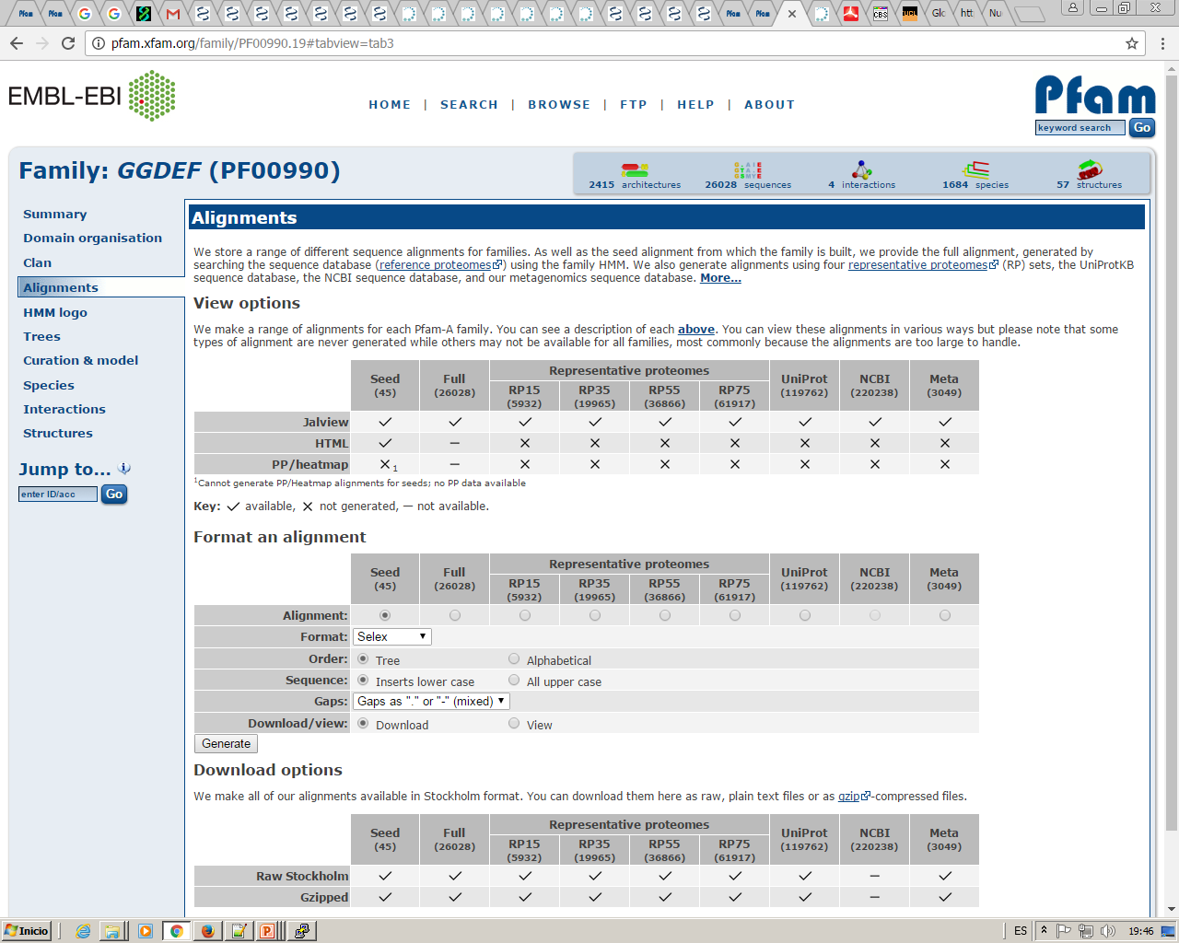
Sequence: PFAM
You can visulize or download many different alignments for proteins in this family:

Slide 28
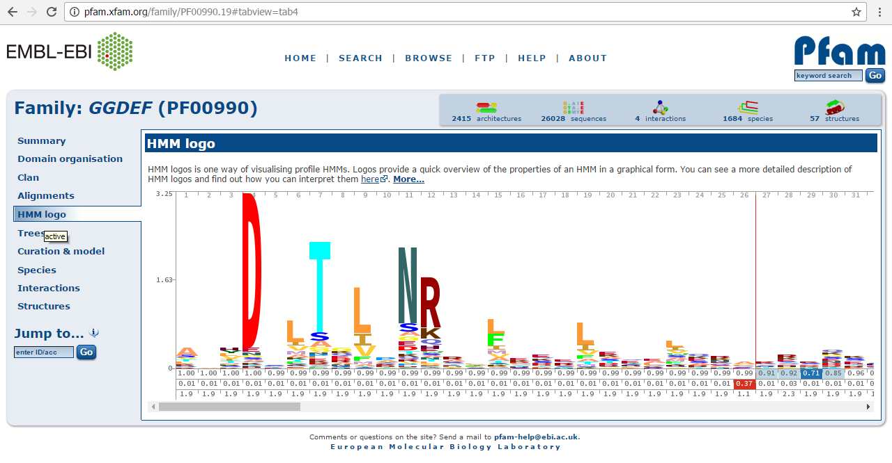
Sequence: PFAM
Using the “Logo” the conservation degree for each position in the domain can easily be seen:

Slide 29
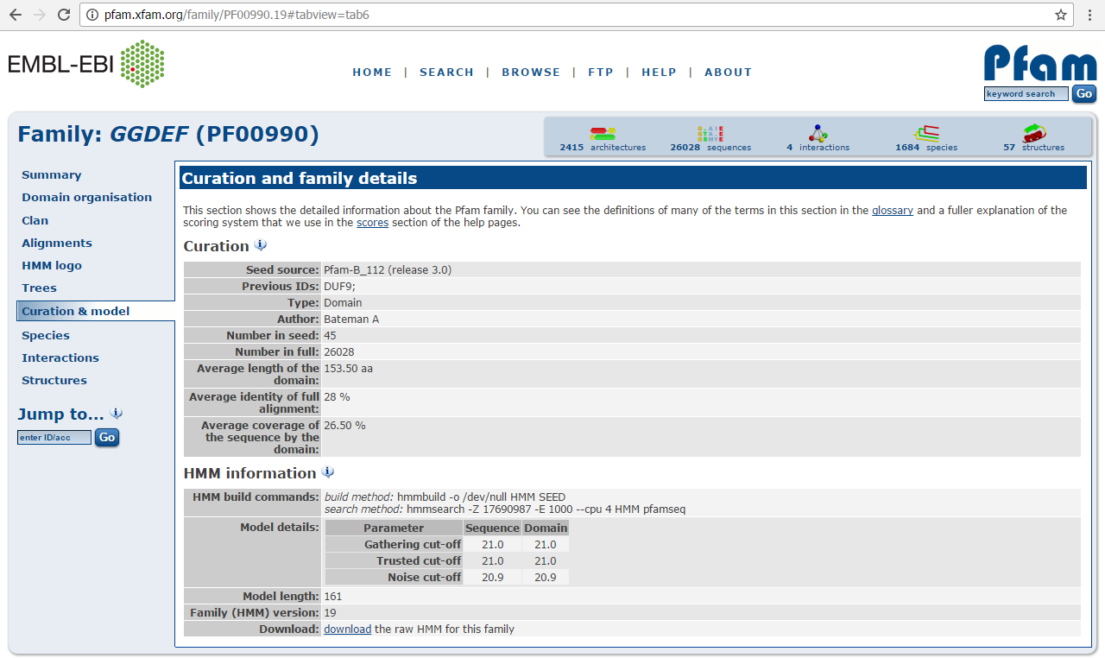
Sequence: PFAM
The HMM profile derived from the seed alignment which defines this domain can be downloaded:. This way we can use it to create highly reliable multiple alignments

Slide 30
Sequence: Prediction tools
Based in the protein sequence and using different methods and algorithms we can predict several features about our protein which could be extremely helpful when trying to produce and / or purify a protein:
A good starting point: http://www.expasy.org/tools/
* Secondary structure, domains and disorder
- PSIpred
*Unstructured / Globular regions
- FoldIndex
- DisEMBL
- GlobPlot
* Aggregation regions
- aggrescan
*Surface accessibility
- NetSurfP
* Transmembrane helix
- TMHMM
* Lots of predictions in one tool
- PredictProtein
We are going to make all this predictions for this protein:
http://www.uniprot.org/uniprot/Q63JW5.fasta

Slide 31
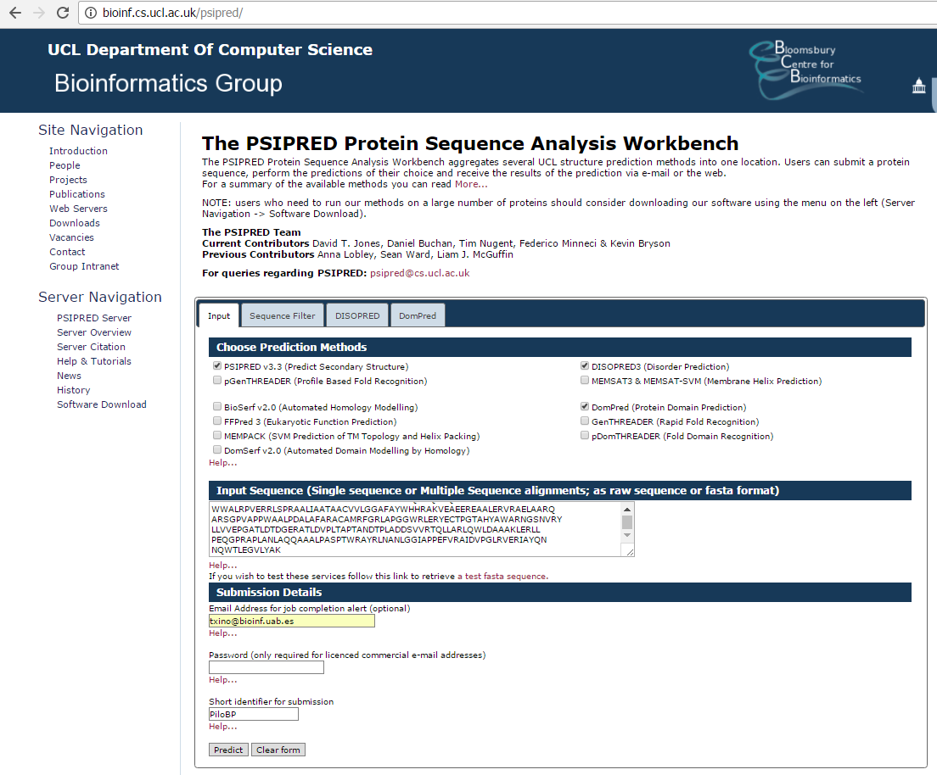
Sequence: PSIPRED

Slide 32
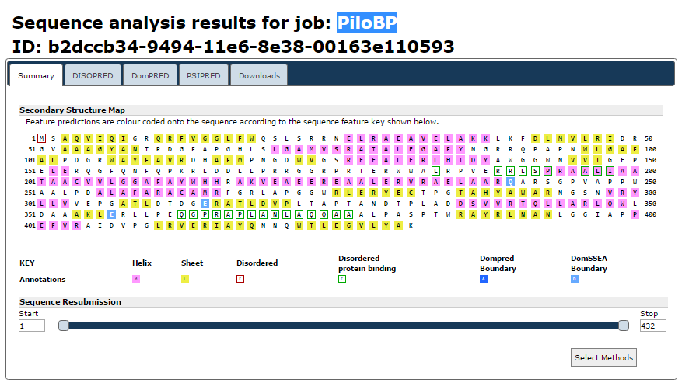
Sequence: PSIPRED

Slide 33
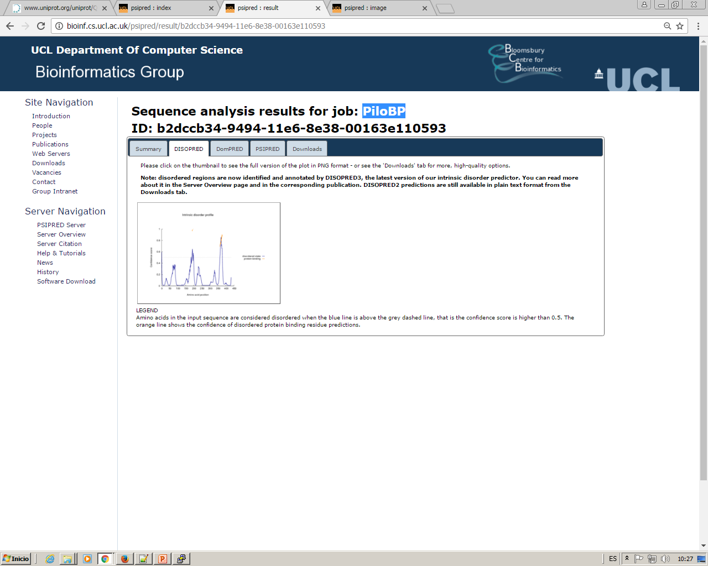
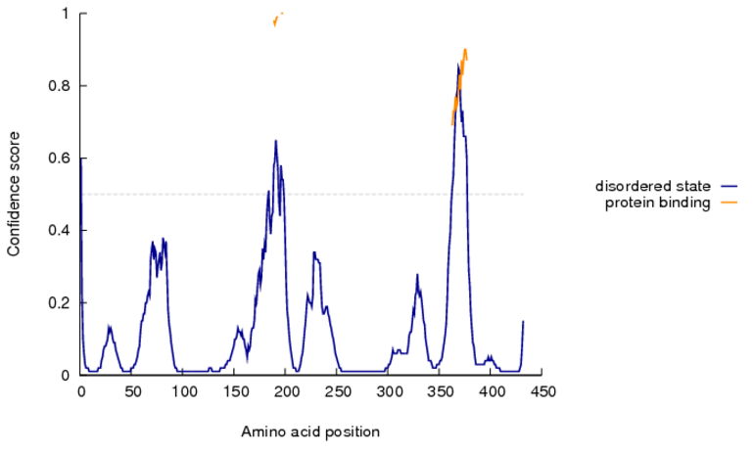
Sequence: PSIPRED

Slide 34
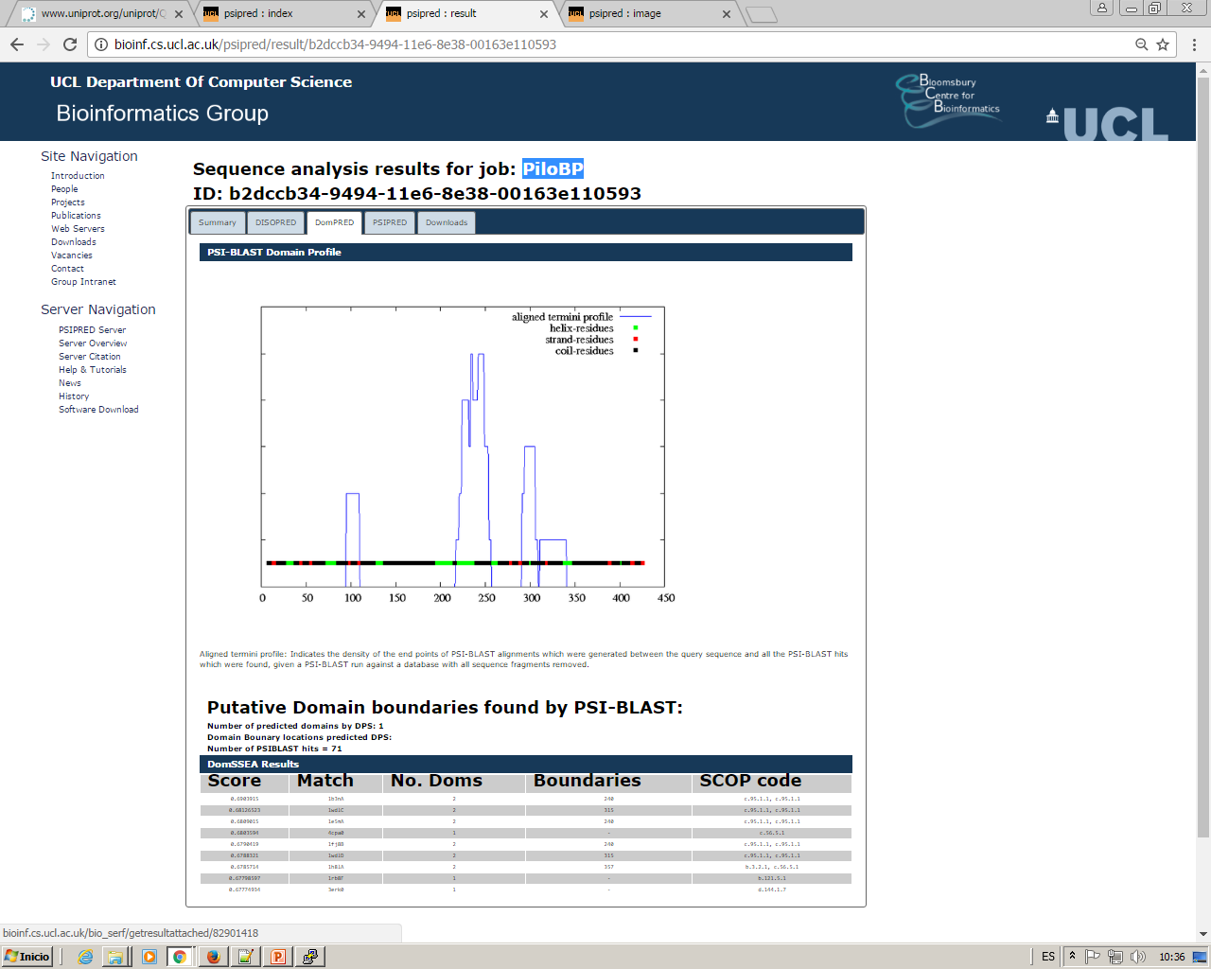
Sequence: PSIPRED

Slide 35
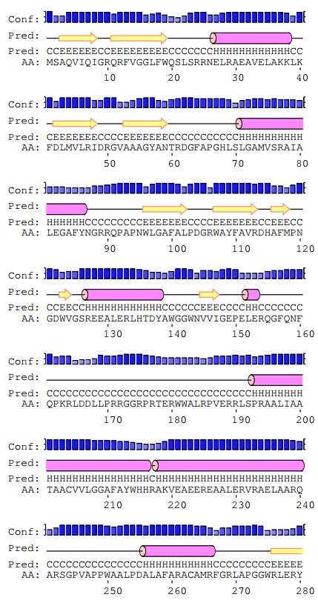
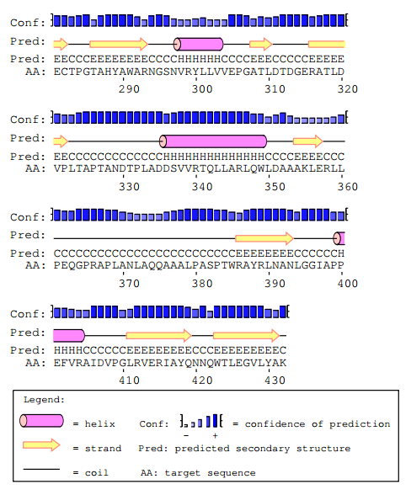
Sequence: PSIPRED

Slide 36
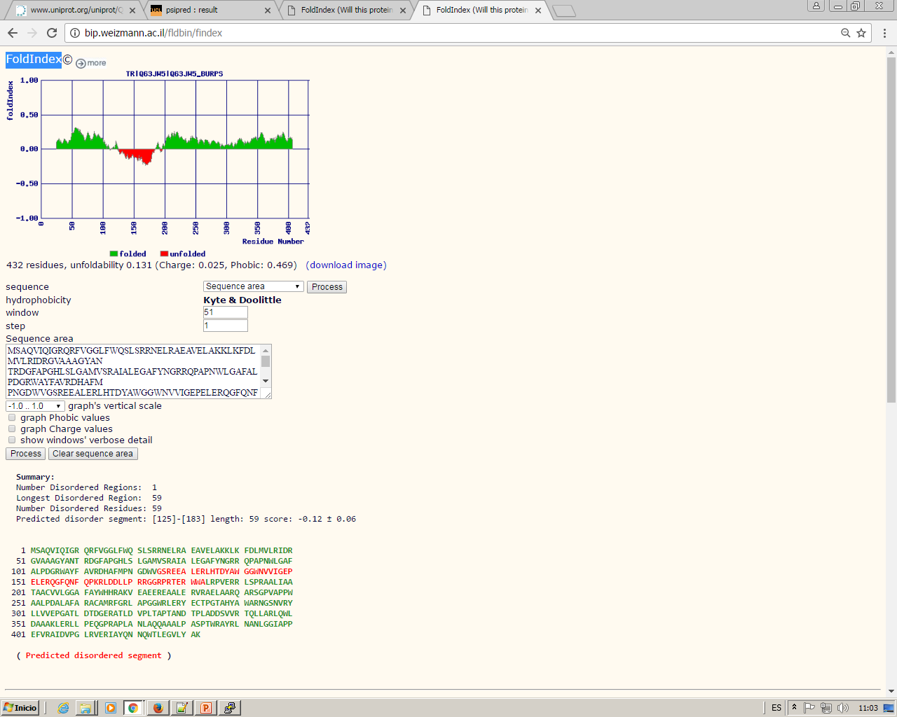
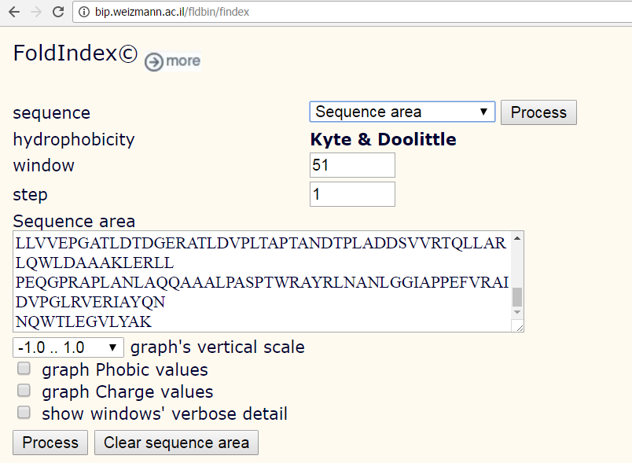
Sequence: FoldIndex
Unstructured regions

Slide 37
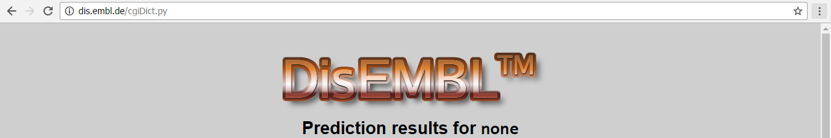
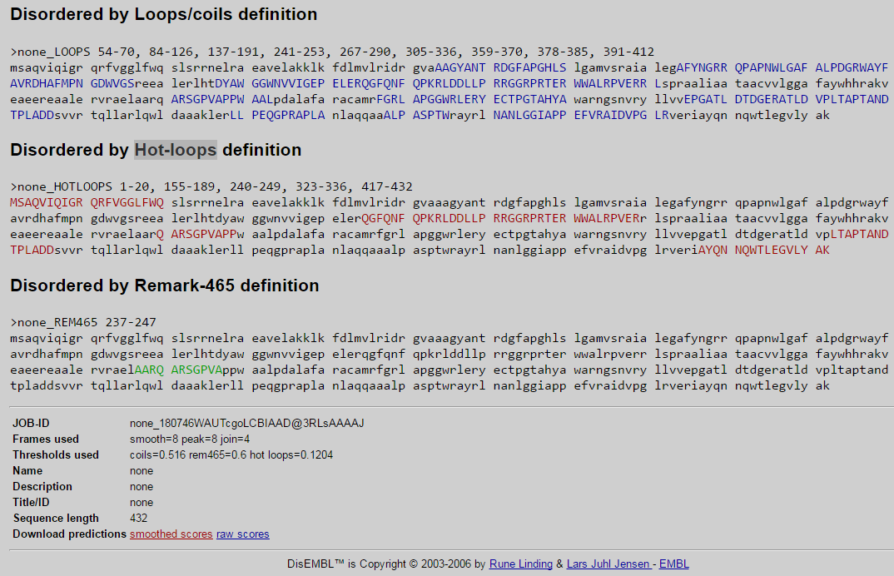
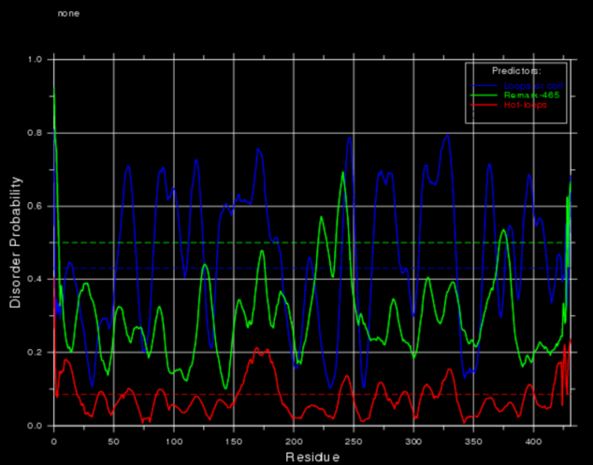
Sequence: DisEMBL
Unstructured regions

Slide 38
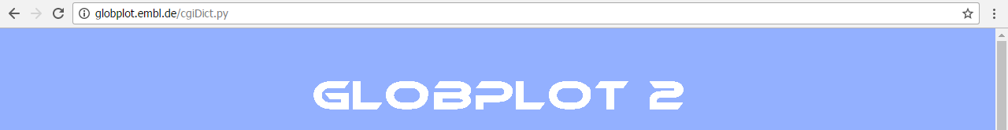
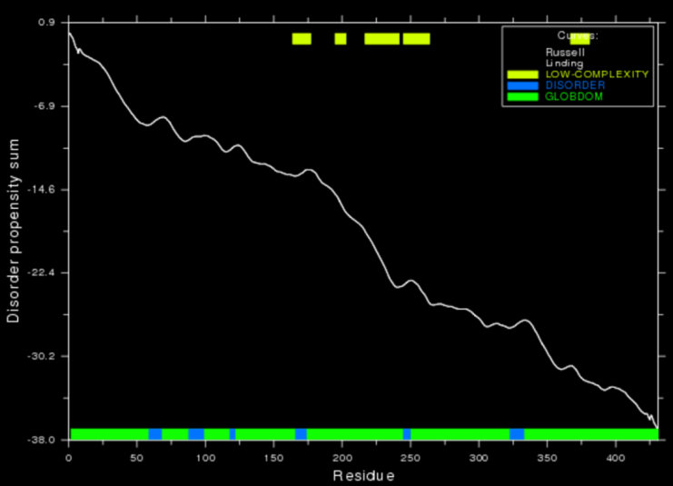
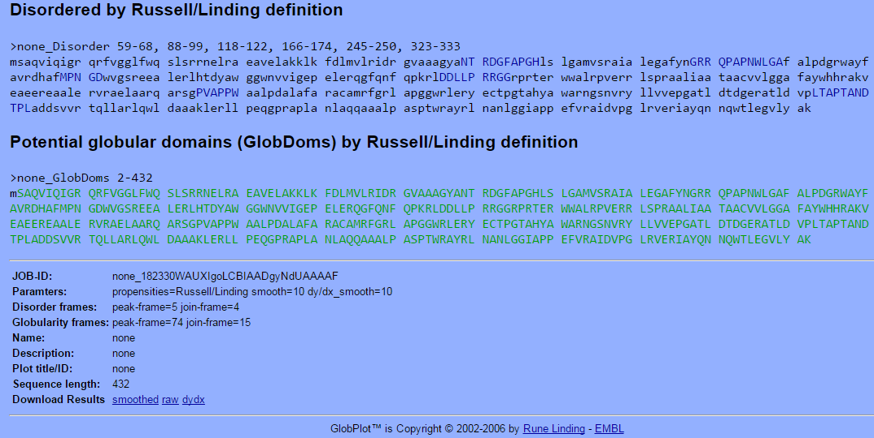
Sequence: GLOBPLOT
Globular and Unstructured regions

Slide 39
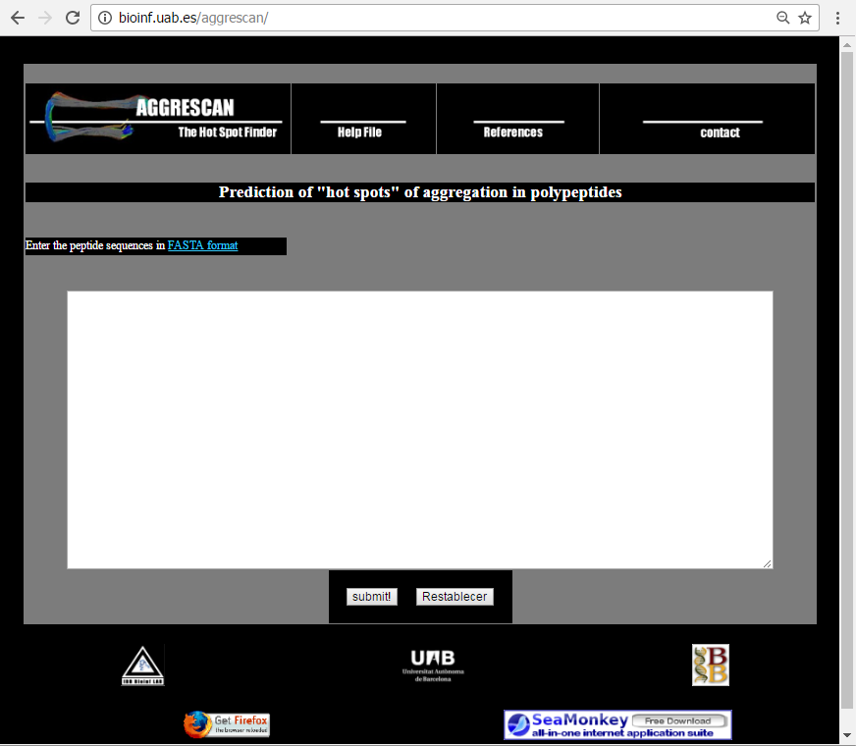
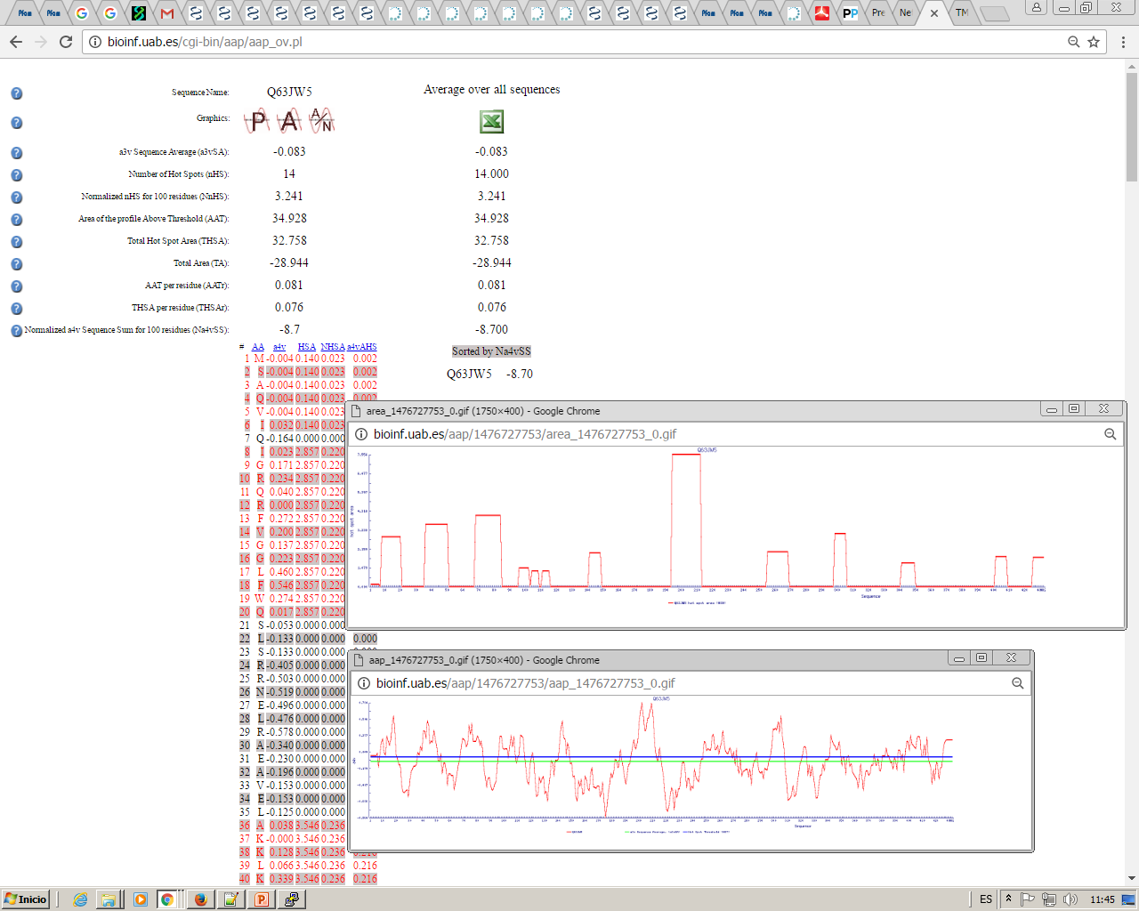
Sequence: Aggrescan
Aggregation Hot-Spots

Slide 40
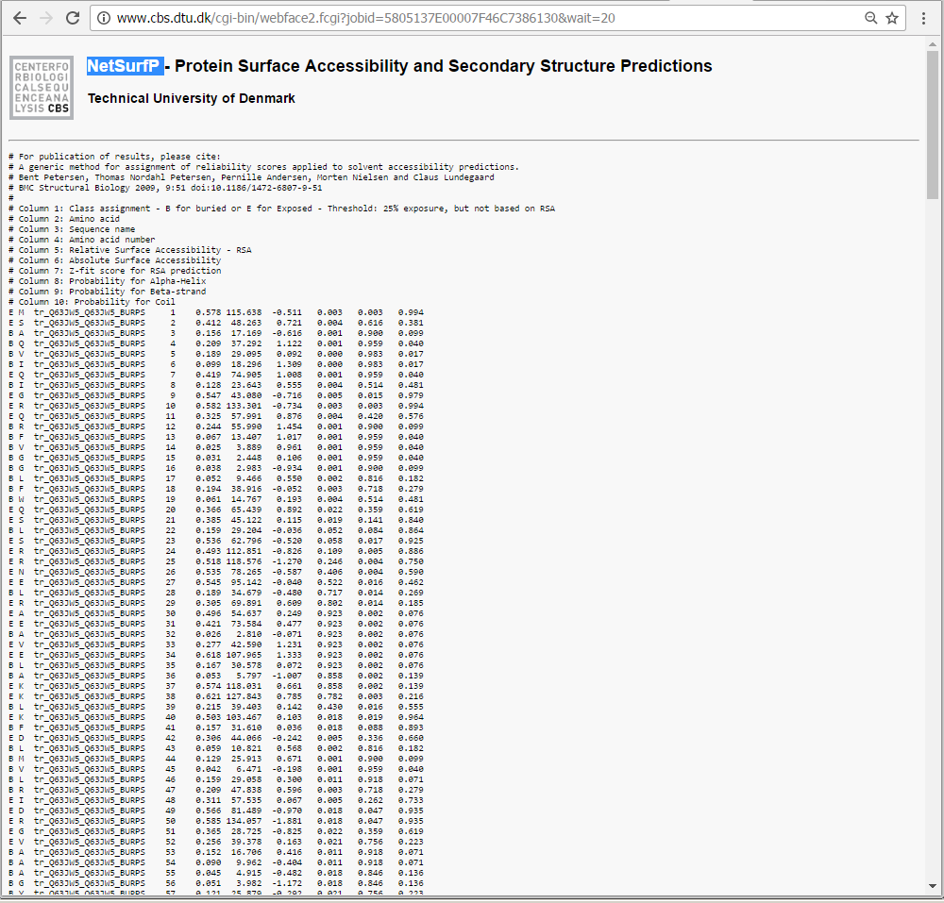

Sequence: NetSurfP
Surface Accessibility

Slide 41


Sequence: TMHMM
Transmembrane helices

Slide 42
Sequence: Prediction Sumary
We have added several predictions in the following exel:
http://bioinf.uab.es/ocs/PROTEINPRED/PilO2Bp_predictions.xlsx
We can see that GlobPlot and DisEMBL do not agree much.
Around residue 200 (approx.) FoldIndex predicts an unstructured region
Aggrescan also predicts a huge Hot-Spot in this region
NetSurfP predicts possible residues exposed in the same Hot-Spot region
TMHMM shows a possible transmembrane in the same region (although it is not accepted)
Looking Back at GlobPlot we can see a “Low complexity” region there
Psipred shows a large Helix in this region and a predicted domain boundary
So with all this information what could we do?

Slide 43

Sequence: Prediction Sumary
We can split the protein in two parts which we consider putative domains and express them independently:
Residues from 1 to 192 were produced and purified and its structure solved: PDB 4BYZ
We were not able to produce the other domain :(

Slide 44


Sequence: PredictProtein
All in one
Integrates several predictors.
Data is presented graphically and together.
It is not free, but recently they provide an “open” version.

Slide 45
Bioinformatics tools for proteins
Sequence Based:
NCBI
UNIPROT
PFAM
prediction tools
Structure Based:
PDB
Dali server
MAESTROweb
Swiss-Model
Pymol

Slide 46



Structure: PDB
THE Database
PDB stores proteins (and DNA, lipids, small molecules …) with their structures solved. These means that we know the coordinates X,Y and Z of their atoms. So we can see their “shape” and KNOW which residues are buried, which are exposed, the distance between them, their interactions, etc.
Every structure deposited has a 4 digit code which starts with a number and then has 3 other characters which are normally letters. They currently have no meaning, although the first ones did (Ex 4CPA = CarboxyPeptidase A)
Apart from the coordinates it also has information derived from them, from the state in which the protein was when preparing it for solving its structure or the experiment conditions when its structure was solved (catalytic, binding and allosteric sites, ligands, secondary structures, mutations, etc.)

Slide 47

Structure: PDB
THE Database
We will use 4BYZ structure as an example

Slide 48

Structure: PDB
Structure Summary
Expression system
View the structure interactively (rotate, zoom, cartoons, surface, etc
Publications:
View this pubmed entry
Search PDB by this pubmed reference

Slide 49

Structure: PDB
Structure Summary
All proteins (chains) present in this structure
(links to uniprot)
Different known and predicted features
Ligands present in this structure (their structure is also solved)

Slide 50

Structure: PDB
Structure Summary
We download the structure in a text file with “pdb” format (the most standard, all software reads this format)
We can download the structure as it was solved in the experiment (PDB format)
or
As it works in the nature (Biological Assembly). We can have several structures here because sometimes this is not clear or if the protein works as a monomer but it was solved as a multimer

Slide 51
Structure: PDB
Structure Sunmary
We have to take care when downloading the “FASTA” sequence, this is not necessarily nor the protein sequence nor the sequence with the X,Y,Z coordinates for its atoms in the pdb file. This is the sequence that the experimentalist who solved the structure used.
It can contain mutations, be just a fragment or include tags used for purification that are not present in the real protein.
At the same time, perhaps not all atoms and / or all residues could have the X,Y,Z coordinates determined, so not all the AA in the sequence have their structure solved

Slide 52

Structure: PDB
Structure Sunmary
What can be downloaded can also be displayed

Slide 53
Structure: PDB
PDB file
This :
https://files.rcsb.org/view/4BYZ.pdb
#---------------------------------------------------------------------------
#Field | Column | FORTRAN |
# No. | range | format | Description
#---------------------------------------------------------------------------
# 1. | 1 - 6 | A6 | Record ID (eg ATOM, HETATM)
# 2. | 7 - 11 | I5 | Atom serial number
# - | 12 - 12 | 1X | Blank
# 3. | 13 - 16 | A4 | Atom name (eg " CA " , " ND1")
# 4. | 17 - 17 | A1 | Alternative location code (if any)
# 5. | 18 - 20 | A3 | Standard 3-letter amino acid code for residue
# - | 21 - 21 | 1X | Blank
# 6. | 22 - 22 | A1 | Chain identifier code
# 7. | 23 - 26 | I4 | Residue sequence number
# 8. | 27 - 27 | A1 | Insertion code (if any)
# - | 28 - 30 | 3X | Blank
# 9. | 31 - 38 | F8.3 | Atom's x-coordinate
# 10. | 39 - 46 | F8.3 | Atom's y-coordinate
# 11. | 47 - 54 | F8.3 | Atom's z-coordinate
# 12. | 55 - 60 | F6.2 | Occupancy value for atom
# 13. | 61 - 66 | F6.2 | B-value (thermal factor)
# - | 67 - 67 | 1X | Blank
# 14. | 68 - 70 | I3 | Footnote number
#---------------------------------------------------------------------------
#
# 1 2 3 4 5 6
#12345678901234567890123456789012345678901234567890123456789012345678
#--------------------------------------------------------------------
#@<<<<<@>>>> @<<<@@<< @@>>>@ @>>>>>>>@>>>>>>>@>>>>>>>
#ATOM 1751 N GLY C 250 32.286 1.882 43.206 1.00 22.00
#ATOM 31 P POM 3 8.010 4.280 1.939
#ATOM 3000 SE MSE A 401 -1.600 -14.228 65.136 0.70 15.94 SE
Is a pdb file, it contains a header with all the info present in the web page (sequence, ligands, binding site, Uniprot code, etc.
And the XYZ coordinates for the atoms of the molecules present in the structure
with the following format:
http://www.wwpdb.org/documentation/file-format
http://www.wwpdb.org/documentation/file-format-content/format33/v3.3.html

Slide 54

Structure: PDB
Annotations

Slide 55

Structure: PDB
Sequence
Here we can view the sequence for all chains and all features annotated in the pdb file

Slide 56

Structure: PDB
Sequence
Change the sequence displayed:
Sequence used by the experimentalist to solve this structure
Sequence in Uniprot for this protein
Mouse over a residue to see the residue and its number (numeration in PDB is not necessary the position in the sequence) this can be a cause for confusion

Slide 57

Structure: PDB
Sequence similarity
In this case no other protein has a similar sequence (over 30% )

Slide 58

Structure: PDB
Structure similarity
Here we can see those structures that have a domain similar to any domain that ours has.
In this case 4BYZ has two structural domains.
Interestingly there is a protein which has both domains quite similar to ours: BfpC

Slide 59

Structure: Operations
Pairwaise Structure superposition
1
2
We have seen that BfpC shares two structural domains with our protein, we can superpose both proteins (all solved structure, not just by domains) to see if they are really similar
3
6
4
7
5

Slide 60
Structure: Operations
Pairwaise Structure superposition
1
2
3
6
4
7
5

Slide 61

Structure: Operations
Pairwaise Structure superposition
We can see that both structures are very similar (RMSD=2.90A) in spite of having a very low sequence identity (11.6%)

Slide 62

Structure: Operations
Pairwaise Structure superposition

Slide 63

Structure: Operations
Database Structure search
We can search against the whole pdb database using a structure, not a sequence, with
Dali server
This way we can find similar proteins that, using just a sequence search method, could not be found.

Slide 64

Structure: Operations
Database Structure search
2
3
1

Slide 65


Structure: Operations
Database Structure search
We can visualize the sequence alignment and the structure superposition.
But both results are obtained using only structural data, not the sequence.

Slide 66

Structure: Operations
Effects of point mutations in stability
With MAESTROweb we can perform an “in silico” mutation scan of our protein and detect if a residue will have a significant effect on the protein stability.
We can also perform a desired single point mutation or a combination of them.

Slide 67

Structure: Operations
Effects of point mutations in stability

Slide 68

Structure: Operations
Effects of point mutations in stability

Slide 69

Structure: Operations
Effects of point mutations in stability

Slide 70


Homology modelling
Similar sequences => Similar Structures
This way we can transfer the ATOMs x,y,z coordinates from a sequence with a known structure (Template) to a similar sequence with an unknown structure (Target)

Slide 71
Homology modelling: aproaches
Automatic (click, click, click …)
Semiautomatic (search for templates, click: look and decide, click: look and decide, click: look and decide…)
Semimanual (search for templates, manually perform the alignments, send the alignments, click: look and decide, click: look and decide…)
Fully manual (search for templates, manually perform the alignments, run the models, evaluate, decide, superpose, etc. NO CLICKS HERE)
Swiss-Model
(and other web tools)
Modeller
(and other command line tools)

Slide 72

Homology modelling: Automatic
Click, Click, Click …
Paste a sequence
Build a model
Download and visualize the model

Slide 73

Homology modelling: Exercise 1
In this exercise and all the others we are going to model AdrA protein from Salmonella enterica, a protein involved in antibiotic resistance (http://journals.plos.org/plosone/article?id=10.1371/journal.pone.0144802)
Go to ncbi (https://www.ncbi.nlm.nih.gov/)database and download in fasta format the following code WP_039589453.1 (S. enterica AdrA ncbi code)
Open the downloaded file and copy the sequence to the clipboard
Go to Swiss-Model (https://swissmodel.expasy.org/) web page and press “Start Modelling”
Paste your sequence and press “Build Models”
When the build ends, look at the result page, identify the resulting model, observe it. Try to understand all given information. Download the results, uncompres and view them locally.

Slide 74


Homology modelling: Semiautomatic
Click: look and decide …
Blast vs PDB
Paste sequence in Swiss-Model
Search templates
Select templates
Build Model
Compare different results from selected templates

Slide 75



Homology modelling: Exercise 2.0
Go to Swiss-Model web page and press “Start Modelling”, paste your sequence and press “Search for Templates”
In Paralel go to ncbi blast (protein), select database PDB, check “show results in new window” paste your AdrA sequence and press BLAST
When both programs end and present results, observe what has been found. Can we model the whole sequence? Which template(s) would you choose? Why?

Slide 76

Homology modelling: Exercise 2.1
Go to the Sequence Similarity tab and observe the different clusters (mouse over the circles). Would you say the structures differ?

Slide 77
Homology modelling: Exercise 2.2
Go back to the Templates tab and select 3bre.1.B (already selected) and 3ign.1.A (best blast match)
Go to the Sequence Similarity tab, on the right side there is a structure representation, press the “detach” button and turn the structure around (keep left mouse button pressed while moving the mouse). This is a superposition of both templates, observe the differences specially in loops.
What will this differences involve? How will they influence our models?

Slide 78

Homology modelling: Exercise 2.3
Go to the Alignment of Selected Templates tab and observe the alignments of both templates with your target sequence
Now press the “Build Models” button

Slide 79


Homology modelling: Exercise 2.4
From the left panel using the help buttons “?” try to understand the different data presented as results. Which model would you chose? Why?
From the right panel (after selecting both models) observe the differences, would you say one is better than the other?
3
Both highlighted
1
2

Slide 80

Homology modelling: Exercise 2.5
With the “detach” vision try to reproduce the left picture.
There is a clear misalignment between both models, and this can not happen Explanation: they come from different templates, so they can have different structure, but they both have the same sequence (our target) so all residues must be perfectly aligned.
With this data which model should we choose? But… is this the right alignment? If both templates had the right alignment would we still be choosing the same model?

Slide 81

Homology modelling: Exercise 2.6
As a final step download the complete report, uncompres it and visualize it locally.
We should be asking ourselves if the misalignment problem can be solved. Can we find the right alignment?
Yes we can: align target-template ourselves and use the Semimanual approach

Slide 82


Homology modelling: Semimanual
Search, align, click: look and decide …
Blast vs PDB
Search in PFAM
Identify domains
Align according to these domains
Paste alignment in Swiss-Model
Build Model
Compare different results from selected templates

Slide 83



Homology modelling: Exercise 3.0
Go to pfam database and search your sequcene
Check results, how many known pfam domains your sequence contains? All your sequence is included in a domain? (if not, will we be able to align this part of the sequence?)
Identify those domains which have at least one known structure
2
3
1

Slide 84

Homology modelling: Exercise 3.0
Now we know those structures belong to pfam domain, so we should align the sequence using their domain profile to guide the alignment.
This profile has been created using the full protein sequence, so we won’t use the structure sequence, we download the uniprot sequence of the full protein. We will trim later the part that has no structure from the alignment.
We download the hmm profile that defines our domain

Slide 85


Homology modelling: Exercise 3.1
Concatenate all three fasta sequences (AdrA, 3ignA, 3breB) in a single file called AdrA_UP.fst
In a computer with hmmer installed (http://hmmer.org/) we align those three sequences against the hmm profile previously downloaded with the following command:
hmmalign -o AdrA_UP.sto PF00990.hmm ArdA_UP.fst
Then we load the resulting alignment in jalview (http://www.jalview.org/) and we select and delete all residues in lower case letters in the N and C terminal tails (these residues are not aligned against the profile, so we can not use them)

Slide 86


Homology modelling: Exercise 3.2
We export this alignment to a clustal formatted one and we manually edit the names to change them to the pdbcode with the chain.
You can download this alignment from here:
http://bioinf.uab.es/ocs/HOMOLMOD/AdrA-3BRE_3IGN.aln
We open 2 tabs to swiss-model, we press Start Modelling and select “Target-Templet Alignments” and we paste the alignment in both tabs.
Then we select with which template we want to make a model (one for each tab) and we press “Validate Target-Template Alignment”
2
1
3

Slide 87



Homology modelling: Exercise 3.3
In case there are several models and chains for the template structure we must press “Build Model” in the one we want to use, in this case 3bre.1.B.
After a while we see the results
Compare the given scoring values with those obtained by automatic and semi-automatic . What do you think, are they better or worse?

Slide 88

Homology modelling: Exercise 3.4
After downloading both models (and rename them with the template used for each one) we need to superpose them, for that we are going to use “CLICK server” (http://mspc.bii.a-star.edu.sg/minhn/click.html) (better with firefox)
We can see now that the region where we had previously identified a missalignment is perfectly aligned.

Slide 89


Homology modelling: Exercise 3.4
The two loops with different structures remain misaligned, but here is where there are the most important differences between the three sequences, so probably none of the alignments are correct, so probably none of the models are correct in these regions. There are other methods for “loop modelling” that could be applied here, but you really would never know if the obtained structure is correct.

Slide 90
Homology modelling: Final thoughts 1
So… after all of this…
Which model, from which approach, would you choose as the best one?
Depends on what you want it for.
A nice picture (in a publication)
Try to understand the structure and function
Mutagenesis studies
Predict interactions with other proteins (without high detail)
Predict interactions with other proteins (with high detail)
Predict interactions with small molecules

Slide 91



Homology modelling: Final thoughts 2
Homology modeling ends up generating a X,Y,Z coordinate for each atom, like in a high resolution NMR or X-ray experimentally obtained structure, but …
How much should I believe about the predicted model?
(IMMO, but this numbers are fully illustrative)
99..85% identity
70..60% identity
50..40% identity

Slide 92

Structure: Visualize
Pymol
We can visualize and make several operations with structures using pymol software (and lots of others), pymol can be downloaded from here:
https://www.pymol.org/
We are going to visualize with Pymol the structure 4BYZ previously downloaded

Slide 93

Structure: Visualize
Pymol
Now we Display the sequence.
And then go to the right menu.
Click on every letter to discover the meaning (A,S,H,L,C)

Slide 94

Structure: Visualize
Pymol
Show-> as -> Cartoon
(all selected is presented as cartoons)

Slide 95

Structure: Visualize
Pymol
Drag the mouse while pressing left button over the sequence to select some residues.
Go to the new tab in the right menu call (sele)
Show-> lines
(all selected is presented as lines, but previous representation is still present)
Now go to
Action-> delete selection

Slide 96

Structure: Visualize
Pymol
We can easily draw a “nice” picture.
Action -> preset -> publication

Slide 97



Structure: Visualize
Pymol
We can use pymol to view the residues colored by their hydrophobicity, visualizing this way if there is a region in the surface that could be a problem when producing this protein. For that we need an external script, instructions for it are here:
http://www.protein.osaka-u.ac.jp/rcsfp/supracryst/suzuki/jpxtal/Katsutani/en/hydrophobicity.php
You can download the script here:
http://www.protein.osaka-u.ac.jp/rcsfp/supracryst/suzuki/jpxtal/Katsutani/color_h.py
Once it is loaded (file -> run) execute in the command prompt: color_h
And in the right menu: Show -> as -> surface

Slide 98




Structure: Visualize
Pymol: final exercice
Download this file and unzip it (not just open, unzip it!):
http://bioinf.uab.es/ocs/PYMOL/PYMOL_SCRIPT.zip
Edit the file called “m12.pms” with notepad, wordpad, notepad++ or any other text editor (DO NOT USE WORD!!!) and change the location of the files mod1.pdb and mod2.pdb for the location wherever you have download and unzip them.
Go to pymol, file -> run -> m12.pms
Unzoom over the visualized structures (right mouse)
Unselect mod1 and mod2 from the right panel
Now look back at the mod12.pms file and try to understand the script instructions

