Slide 1
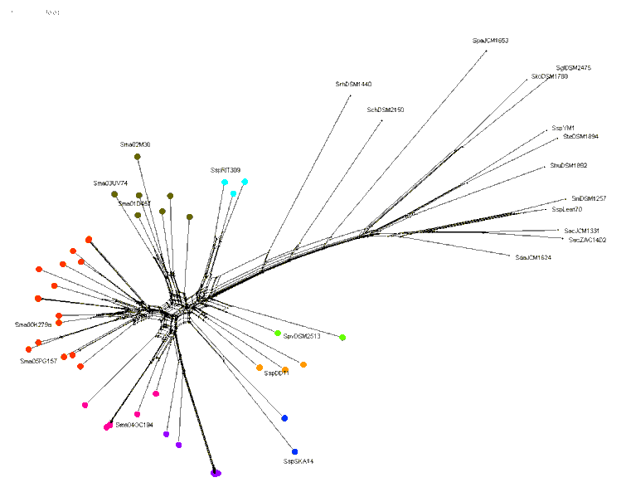
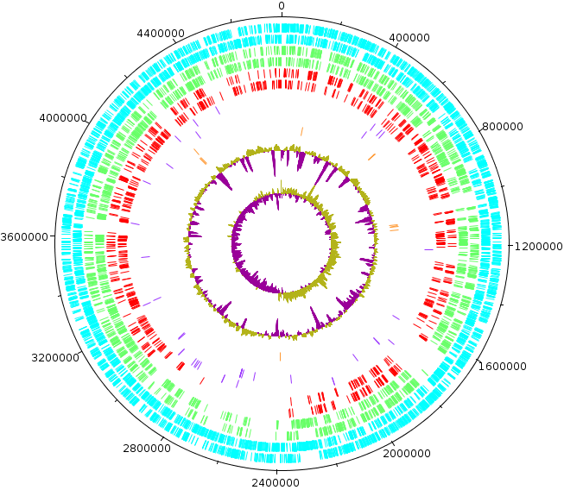
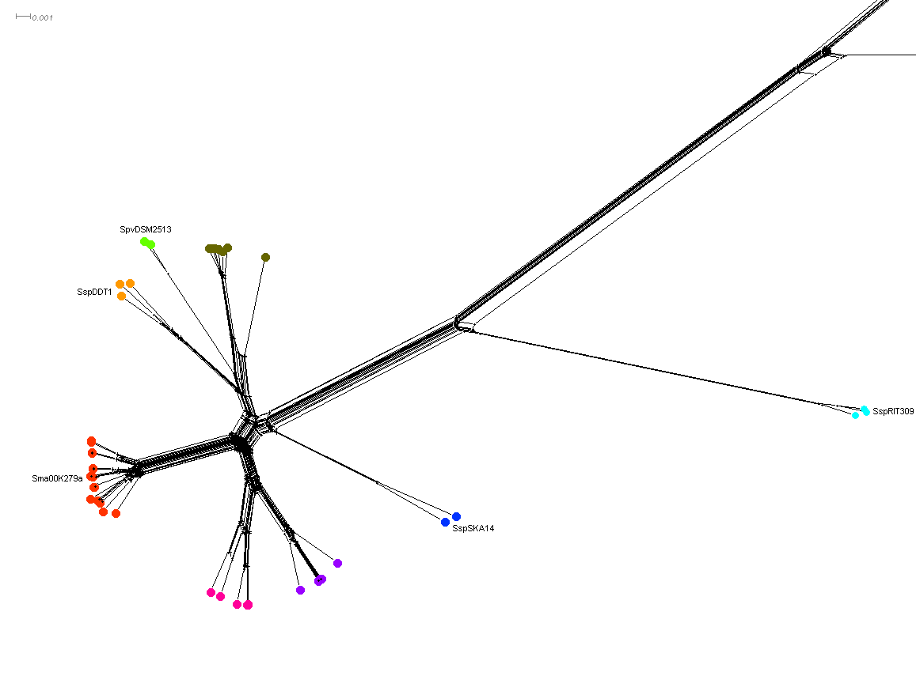
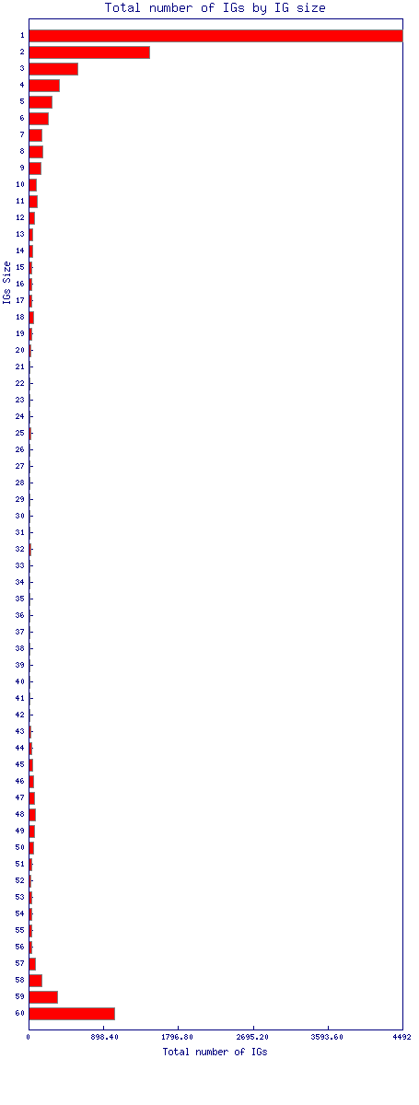
A comparative genomic strategy for target discovery and evolutionary inferences in pathogenic bacteria: Stenotrophomonas sp. as a case study

Slide 2
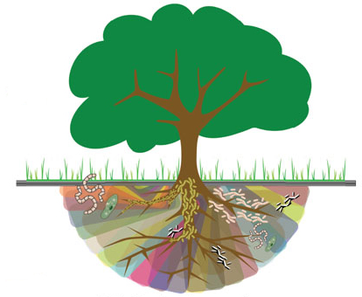
Stenotrophomonas
Soil and plants are their main reservoirs
Beneficial interactions with plants
Gamma proteobacteria > Xanthomonadaceae
12 identified species with sequenced genomes

Slide 3

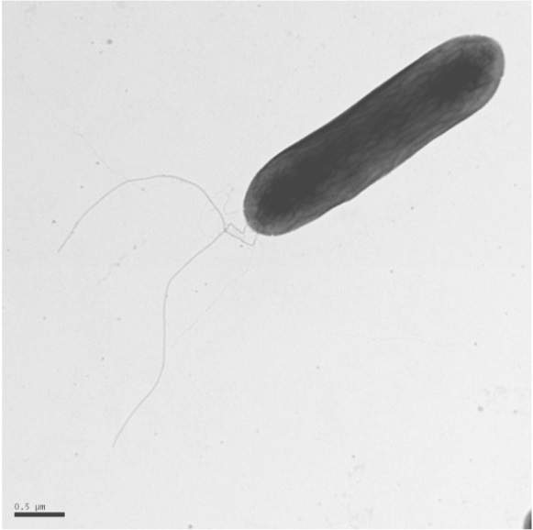
S. maltophilia
Human oportunistic pathogen (colonization rather than infection)
High level of natural antibiotic resistance
Secretion of proteases, lipases, etc
Quorum-sensing regulation
Adherence, motility and biofilm formation
High GC content genome coding for ∼ 4.3k proteins
High genetic variability and horizontal gene transfer (this makes a troubled taxonomy for this group)

Slide 4
Objectives
Clarify phylogenetic relationships inside Stenotrophomonas genus
Identify shared proteins between clusters of relevant species / strains
Identify S. maltophilia coreproteome
Identify virulence / drug resistance factors

Slide 5
Massive comparative genomics at CDS level
Species | code | Selected genomes
S. maltophilia | Sma | 43
S. sp | Ssp | 5
S. acidaminiphila | Sac | 2
S. ginsengisoli | Sgi | 1
S. humi | Shu | 1
S. koreensis | Sko | 1
S. panacihumi | Spa | 1
S. chelatiphaga | Sch | 1
S. nitritireducens | Sni | 1
S. daejeonensis | Sda | 1
S. pavanii | Spv | 1
S. terrae | Ste | 1
S. rhizophila | Srh | 1
All vs All
Proteome
Comparison
(UCSC Blat)
Total = 60

Slide 6
“In-house” sequenced clinical strains
Strain | Features | Genes | CDS | Contigs
M30 | Epidemic European clone, human disease associated, virulent in worms, RpfF-2 variant, adaptive resistance mechanism, avid biofilm former | 4525 | 4445 | 193
 |  | 4534 | 4459 | 179
UV74
OC194 | MDR, fatal human disease associated, virulent in worms, avid biofilm former | 4312 | 4210 | 202
PG157 | MDR, non-virulent in worms, avid biofilm former | 4576 | 4481 | 76
- Conchillo-Solé O, Yero D, Coves X, Huedo P, Martínez-Servat S, Daura X, Gibert I. 2015. Draft genome sequence of Stenotrophomonas maltophilia strain UV74 reveals extensive variability within its genomic group. Genome Announc 3(3):e00611-15. doi:10.1128/genomeA.00611-15.
- Huedo P, Conchillo-Solé Ó, Yero D, Martínez-Servat S, Daura X, Gibert I. 2014. Draft genome sequence of Stenotrophomonas maltophilia strain M30, isolated from a chronic pressure ulcer in an elderly patient. Genome Announc. 2(3):e00576-14. doi:10.1128/genomeA.00576-14.
Reference Clinical Strains
Strain | Features | Genes | CDS | Scaffolds
K279a | First genome sequenced complete, main reference strain | 4458 | 4371 | 1
D457 | Multi Drug Resistant (MDR) model strain | 4381 | 4272 | 1

Slide 7
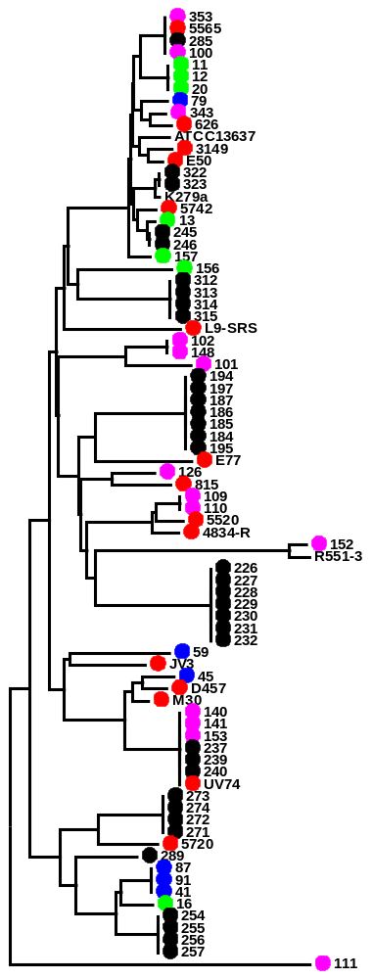
S. maltophilia strain panel under study in our lab
Total | Source (n) | Country and Year
15 | Bronchial aspirate or sputum (9) Wounds or ulcers (3) Oropharyngeal swab (2) Hospital environment (1) | Barcelona; 1998-2011
33 | Oropharyngeal swab (7) Perineal swabs (26) | Berlin; 2012
14 | Oropharyngeal swab (8) Perineal swabs (6) | Belgium; 2012
7 | Oropharyngeal swab (4) Perineal swabs (3) | Slovenia; 2011-2012
6 | Oropharyngeal swab (4) Perineal swabs (2) | Paris; 2011-2012
Hospital Municipal De Badalona
Hospital Universitari Germans Trias i Pujol, Barcelona
European collaborative project (SATURN)

Slide 8
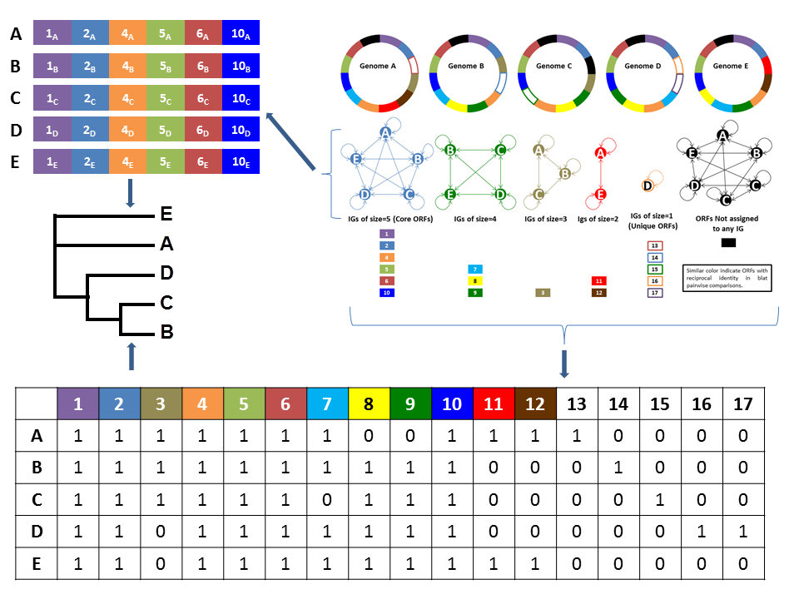
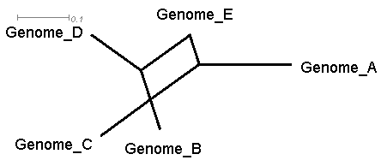
Putative Orthologous proteins detection

Slide 9
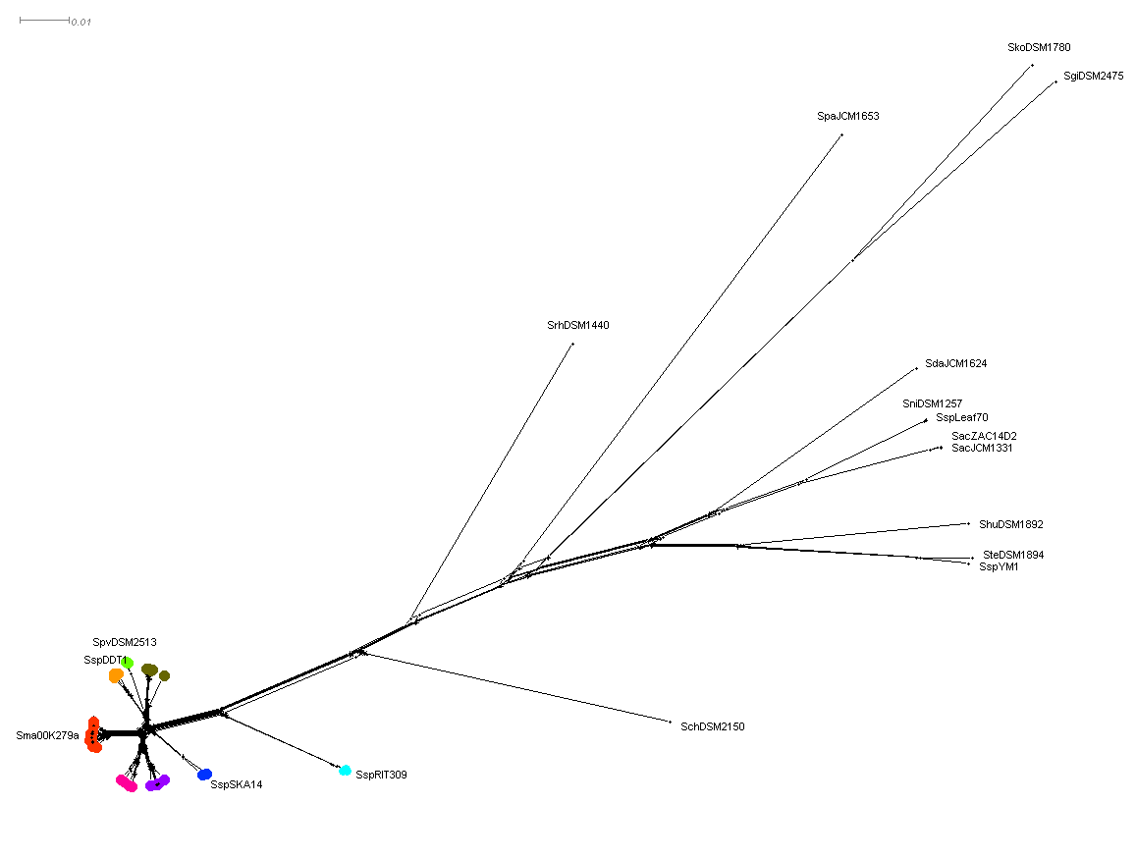
Point mutations in coreproteome

Slide 10
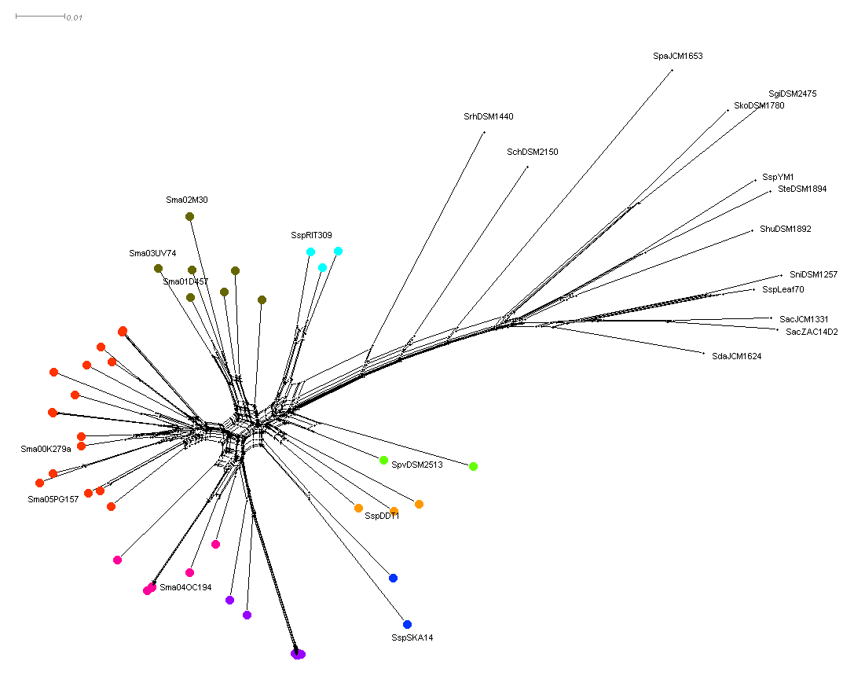
Shared proteins

Slide 11
Results in numbers
Proteome S. maltophilia D457* | 4272
Core proteome S. maltophilia (47) | 2307
Core proteome Stenotrophomonas | 1024
Exclusive proteome S. maltophilia | 41
Exclusive proteome D457_group | 13
D457
* D457 genome used as reference. (Lira et al J Bacteriol. 2012 Jul; 194(13):3563-4. doi: 10.1128/JB.00602-12.)

Slide 12
Exclusive proteome (only present in S. maltophilia, but in ALL strains)
Target Cathegory | How many
Antibiotic resistance | 7
Unknown | 6
Unknown in putative operons | 5
Membrane proteins | 6
Transporters (includes drug and virulence factors) | 6
Transcription regulators | 3
Stress response | 4
Virulence factors | 4
Total=41
Identified proteins in operon | how many operons | total number of proteins
2 | 6 | 12
7 | 1 | 7
Total=19

Slide 13
S. maltophilia exclusive. Selected Examples
Description | Coments
Membrane protein
Transcriptional regulator, XRE family | Multi Regulator (phague, development, modification proteins, antitoxin, methylases)
Chaperone HchA(Heat shock protein HSP31) | Next to LuxR, Stress response
TetR family transcriptional regulator | Control of multidrug efflux pumps, biosynthesis of antibiotics, osmotic stress, toxic chemicals, catabolic pathways, differentiation processes, pathogenicity
Transmembrane protein (Transport protein)
Membrane protein
Hypothetical exported protein (Membrane protein)
Putative lipoprotein (Phosphonate ABC transporter phosphate-binding periplasmic component) | P uptake as virulence factor
Putative lipoprotein
ABC-type antimicrobial peptide transport system. Permease component (Multidrug ABC transporter substrate-binding protein)
Zinc-binding protein | Metal uptake as a virulence factor
Uncharacterized protein (MerC mercury resistance) | Metal uptake as a virulence factor
Azaleucine resistance protein AzlC, Branched-chain amino acid ABC transporter permease | Peptidic antibiotic resistance
Putative transmembrane amino acid transporter protein, Branched-chain amino acid transport | Peptidic antibiotic resistance
Uncharacterized protein (GCN5-related N-acetyltransferase, Spermidine N(1)-acetyltransferase) | Intervenes in many process including stress
AraC family transcriptional regulator, HTH-type transcriptional activator rhaS | Stress and pathogenesis

Slide 14
D457 group Exclusive proteome (only present D457 group)
Target Cathegory | How many
Movement / adhesion | 4
Antibiotic synthesis | 1
Transporter (including drugs) | 1
DNA / RNA interaction | 1
Antibiotic resistance | 2
Virulence factors | 2
Unknown | 2
Total=13
Identified proteins in operon | how many operons | total number of proteins
3 | 3 | 9
Total=9

Slide 15
D457 group (only present D457 group) Selected Examples
Description | Comments
Uncharacterized protein ( ACR family protein PARTIAL_MATCH:TadE family protein (pili related) ) | cold shock protein, possible role in extracellular sugar processing
Uncharacterized protein (VERY_LOW_SCORE_PARTIAL_MATCH:Flagellar biosynthesis protein FliJ) | ALL THREE movement / anchor RELATED
Uncharacterized protein (Lipoprotein, VERY_LOW_SCORE_PARTIAL_MATCH:Beta-propeller domain-containing protein, ) | ALL THREE movement / anchor RELATED
Uncharacterized protein (MULTIDOMAIN Adhesin, PARTIAL Bacterial Ig-like domain family protein, PARTIAL Biofilm-associated ) | Adhesion
Membrane translocator, serine/threonine protein kinase, Lanthionine synthetase | Antibiotic sinthesis
ABC transporter (ABC-type multidrug transport system, ATPase and permease component)

Slide 16

Accomplished Objectives:
Clarify phylogenetic relationships inside Stenotrophomonas genus
Identify shared proteins between clusters of relevant species / strains
Identify S. maltophilia coreproteome
Identify virulence / drug resistance factors
Everything done with a single program (and its helper scripts):
FiShORF (Find Shared ORF)

Slide 17
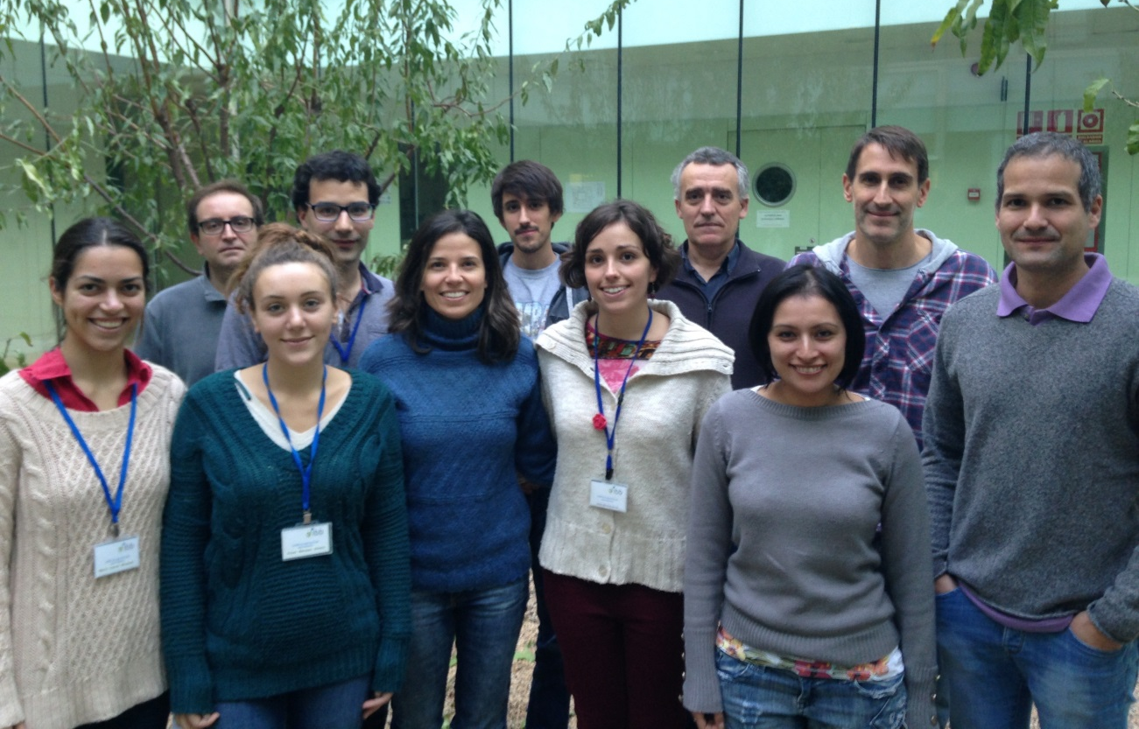




Thanks to:
Daniel Yero
Sònia Martínez Servat
Xavi Coves
Isidre Gibert
Aniol Valera
Xavier Daura
And everybody else in the group

Slide 19
Exclusive proteome (only present in S. maltophilia, but in ALL strains)
Description | Coments | Rec | Psel
Uncharacterized protein (Beta-lactamase, Cag pathogenicity island protein Cag5,SnoaL-like (biosynthesis of polyketide antibiotics)) |  | yes | no
Putative esterase, Beta-lactamase (Esterase estB) |  | no | yes
Lana protein |  | no | no
Uncharacterized methyltransferase YbaJ, Methyltransferase type 11 |  | yes | yes
Membrane protein |  | no | yes
Uncharacterized protein |  | no | no
ABC transporter permease |  | yes | yes
Membrane protein |  | yes | yes
Transcriptional regulator, XRE family | Multi Regulator (phague, development, modification proteins, antitoxin, methylases) | no | yes
Chaperone protein HchA (Heat shock protein HSP31) | Next to LuxR, Stress response | yes | no
TetR family transcriptional regulator | Control of multidrug efflux pumps, biosynthesis of antibiotics, osmotic stress, toxic chemicals, catabolic pathways, differentiation processes, pathogenicity | no | yes
Transmembrane protein (Transport protein) |  | yes | yes
Uncharacterized protein |  | no | yes
Putative transmembrane protein (Membrane protein) |  | no | no

Slide 20
Description | Coments | Rec | Psel
Membrane protein |  | no | no
Hypothetical exported protein (Membrane protein) |  | yes | yes
Putative lipoprotein (Phosphonate ABC transporter phosphate-binding periplasmic component) | P uptake as virulence factor | yes | yes
Putative lipoprotein |  | no | yes
ABC-type antimicrobial peptide transport system,permease component (Multidrug ABC transporter substrate-binding protein) |  | yes | yes
Zinc-binding protein | Metal uptake as a virulence factor | yes | no
Uncharacterized protein (MerC mercury resistance) | Metal uptake as a virulence factor | no | yes
Azaleucine resistance protein AzlC, Branched-chain amino acid ABC transporter permease | Peptidic antibiotic resistence | yes | no
Putative transmembrane amino acid transporter protein, Branched-chain amino acid transport | Peptidic antibiotic resistence | no | no
Uncharacterized protein (GCN5-related N-acetyltransferase, Spermidine N(1)-acetyltransferase) | Intervines in many process including stress | no | no
AraC family transcriptional regulator, HTH-type transcriptional activator rhaS | stress and pathogenesis | no | no
Glyoxalase/bleomycin resistance protein/dioxygenase, Lactoylglutathione lyase |  | no | yes
Uncharacterized protein |  | no | no
Membrane protein |  | no | no
Uncharacterized protein |  | no | no
Conserved hypothetical exported protein |  | no | no
Uncharacterized protein |  | no | yes
Peptidase (Subtilisin-like serine protease) | plant pathogenesis? | no | no
Uncharacterized protein |  | no | no

Slide 21
Description | Coments | Rec | Psel
PhnB protein putative DNA binding 3-demethylubiquinone-9 3-methyltransferase domain protein | Ecoli:Rifampicin resistance, Pseudomonas: pseudomonas quinolone signal (PQS) main regulator | no | no
Hypothetical exported protein (Gliding motility lipoprotein GldB) |  | no | yes
Uncharacterized protein (uroporphyrin-III c-methyltransferase) | Vitamin synthesis | no | no
Uncharacterized protein (Tellurite resistance protein TerB) | Antibiotic resistance | no | no
General stress protein, Stress-induced protein, KGG, repeat-containing protein (pyridoxamine 5'-phosphate oxidase stress protein) | Oxidative stress | no | no
Uncharacterized protein |  | no | no
Conserved hypothetical exported protein (LOW_SCORE: Topoisomerase II, Beta-lactam-inducible penicillin-binding protein) |  | no | no
ADP-ribosylating transferase, (HISCORE:Rifampin ADP-ribosyl transferase) | antibiotic resistance | no | yes

Slide 22
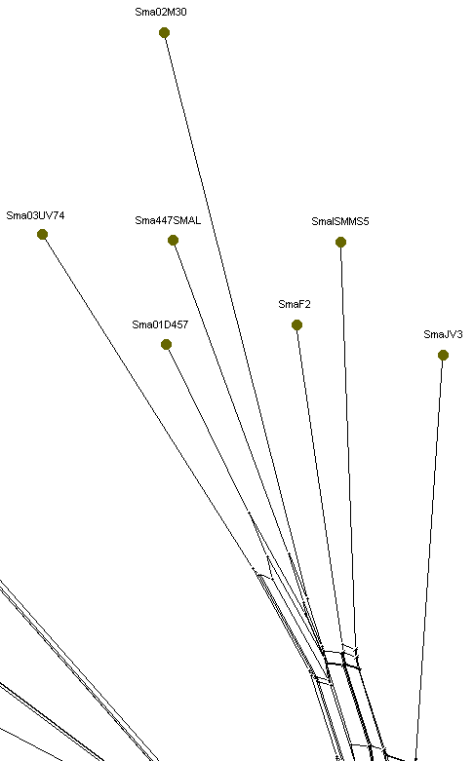
D457 group Exclusive proteome (only present D457 group)
In: | description | Comments
7 | Uncharacterized protein ( ACR family protein PARTIAL_MATCH:TadE family protein (pili related) ) | cold shock protein, possible role in extracellular sugar processing
7 | Uncharacterized protein (VERY_LOW_SCORE_PARTIAL_MATCH:Flagellar biosynthesis protein FliJ) | ALL THREE movement / anchor RELATED
7 | Uncharacterized protein (Lipoprotein, VERY_LOW_SCORE_PARTIAL_MATCH:Beta-propeller domain-containing protein, ) | ALL THREE movement / anchor RELATED
7 | Uncharacterized protein (MULTIDOMAIN Adhesin, PARTIAL Bacterial Ig-like domain family protein, PARTIAL Biofilm-associated ) | Adhesion
7 | Membrane translocator, serine/threonine protein kinase, Lanthionine synthetase | Antibiotic sinthesis
7 | ABC transporter (ABC-type multidrug transport system, ATPase and permease component)
6 | superfamily I DNA/RNA helicase protein
5 | NAD-dependent / UDP-glucose epimerase | Antibiotic resistance (ciclopirox)
5 | Uncharacterized protein ( Putative membrane protein, LOWER_SCORE:Putative sugar transferase, TPR repeat-containing ) | virulence
5 | Bactoprenol-linked glucose translocase -O antigen modification- (GtrA family protein) | virulence
4 | Uncharacterized protein
4 | Uncharacterized protein
4 | Uncharacterized protein (Membrane protein) | Antibiotic (Vancomycin) resistance
M30
UV74
D457
JV3

