Slide 1
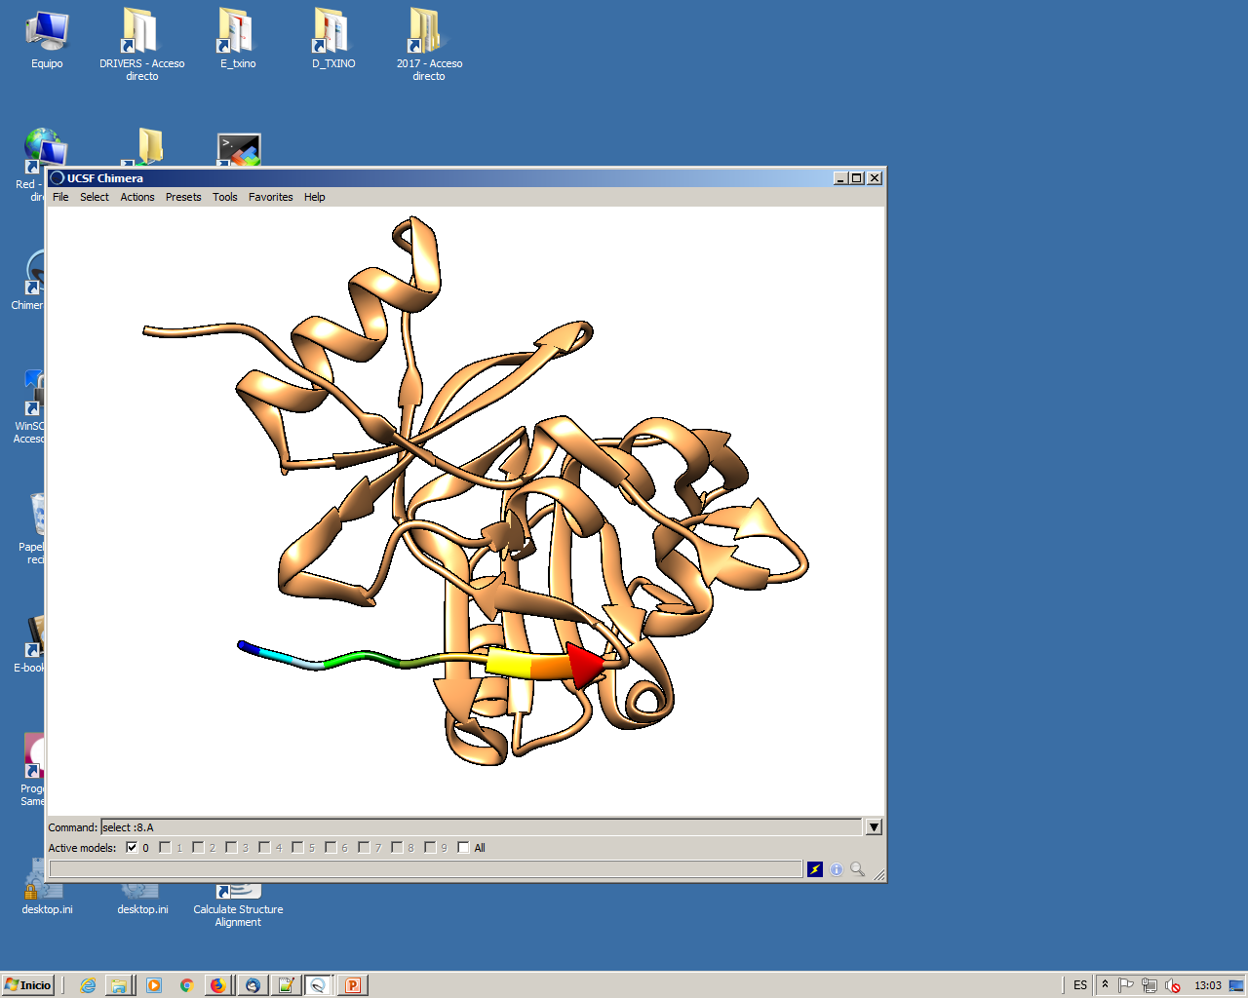
Proteins are Made by a sequence of smaller elements called “Amino acids”.
Amino acids can be represented by letters.
A protein can be represented by a sequence of letters.
Amino acid
name
Tyrosine
Threonine
Methionine
Serine
Alanine
Glutamine
Valine
Isoleucine
Glutamine
Isoleucine
One letter
code
T
Y
M
S
A
Q
V
I
Q
I
Sequence
TYMSAQVIQI…
Protein sequences
in different species
>Human
TYMSAQVIQI
>Dog
TLMSAEVLI
Sequence Alignment
Human TYMSAQVIQI
T MSA+V+ I
Dog TLMSAEVL-I

