Slide 1
Protein-protein Docking
With
HADDOCK

Slide 2
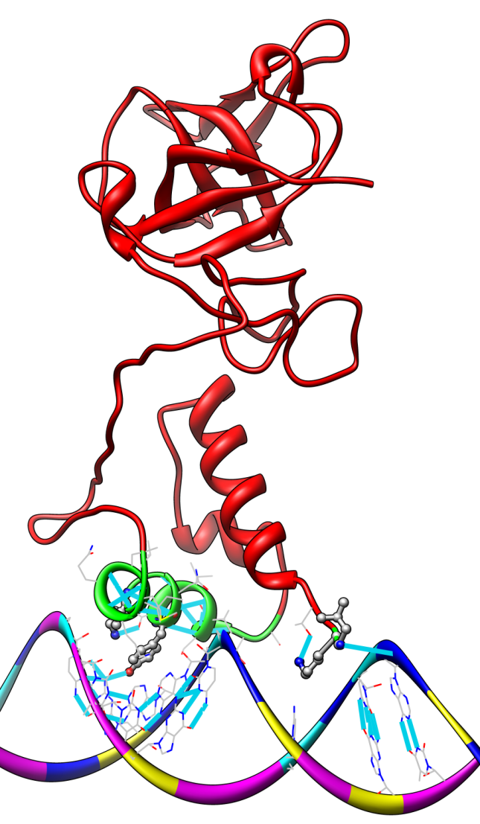
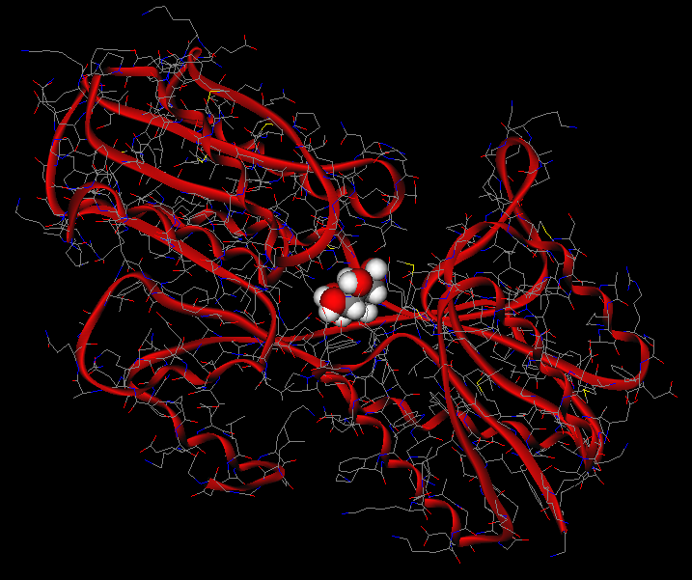
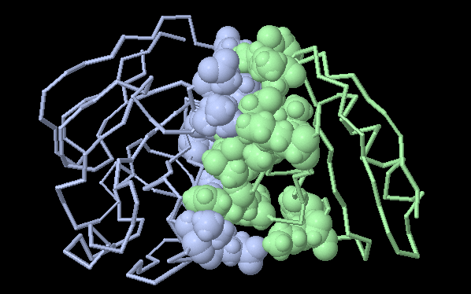
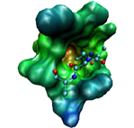
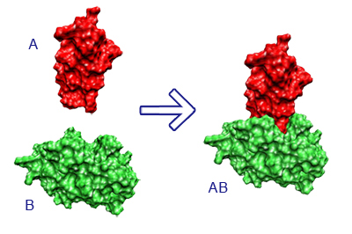
Different kinds of Docking

Slide 3
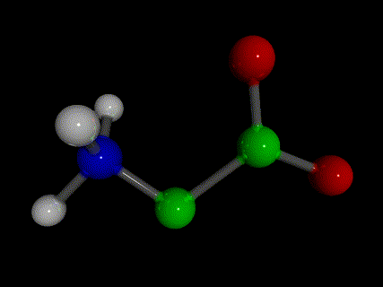
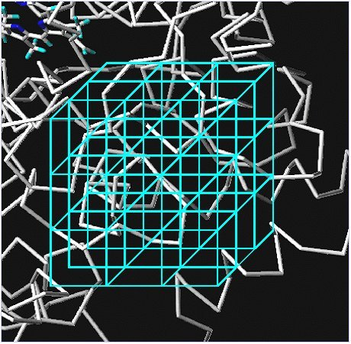
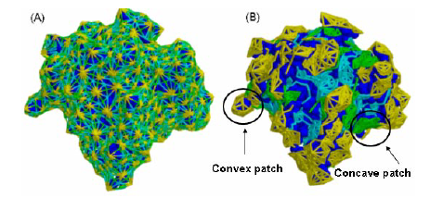
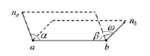
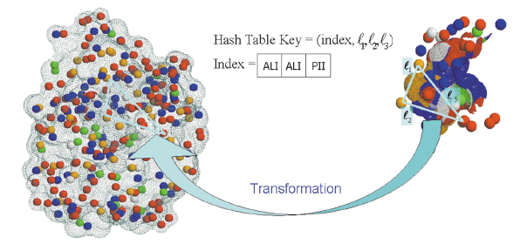
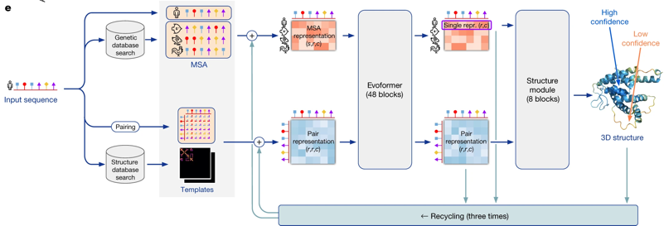
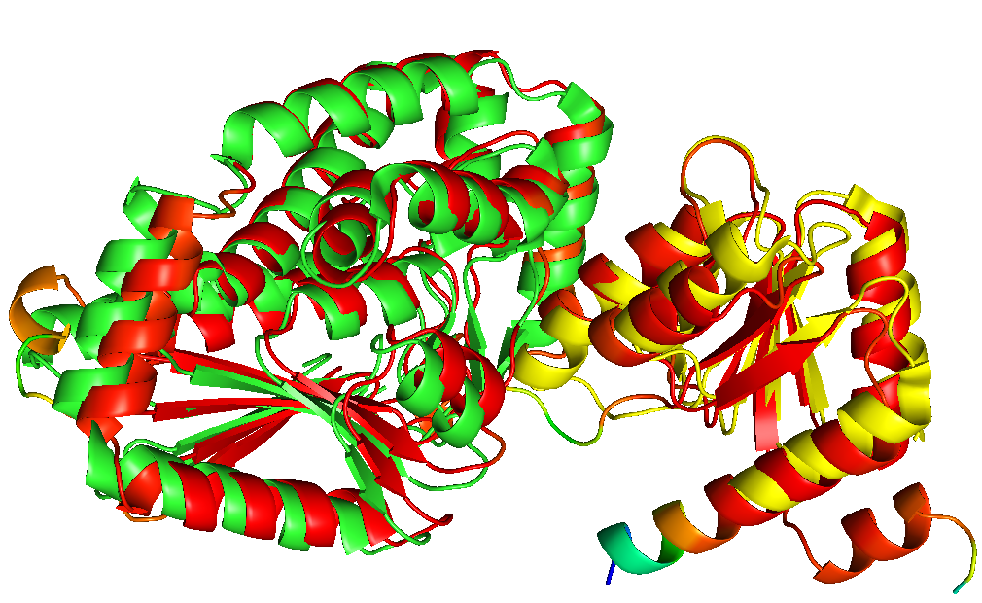
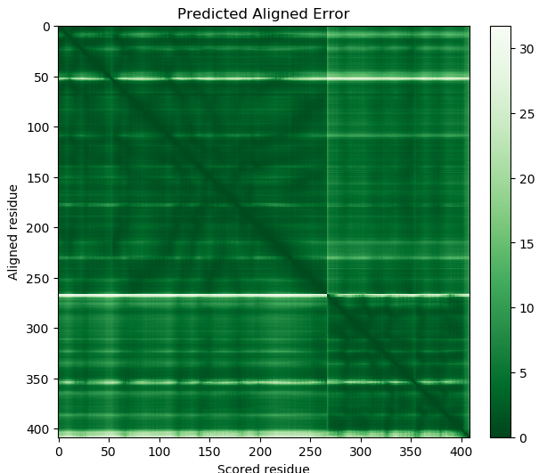
Grid
Different Algorithms
MD
Shape
complementarily
IA

Slide 4
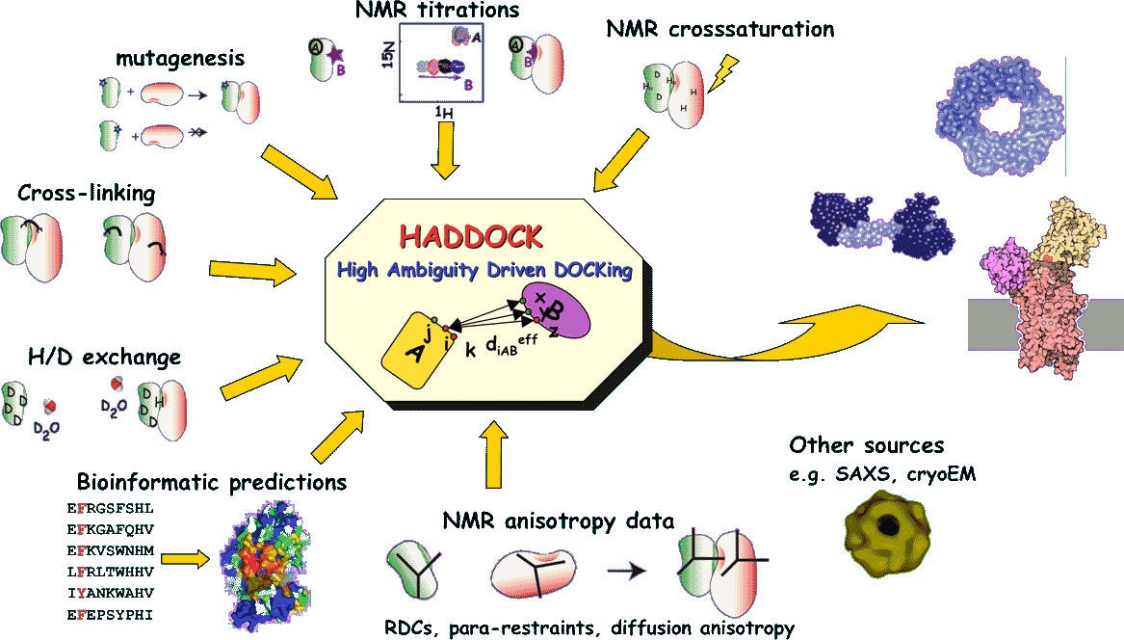
HADDOCK (High Ambiguity Driven biomolecular DOCKing) is an approach to the structure determination of protein-protein and protein-DNA complexes that makes use of biochemical and/or biophysical interaction data.
Cyril Dominguez, Rolf Boelens and Alexandre M.J.J. Bonvin (2003).
HADDOCK: a protein-protein docking approach based on biochemical and/or biophysical information.
J. Am. Chem. Soc. 125, 1731-1737.

Slide 5
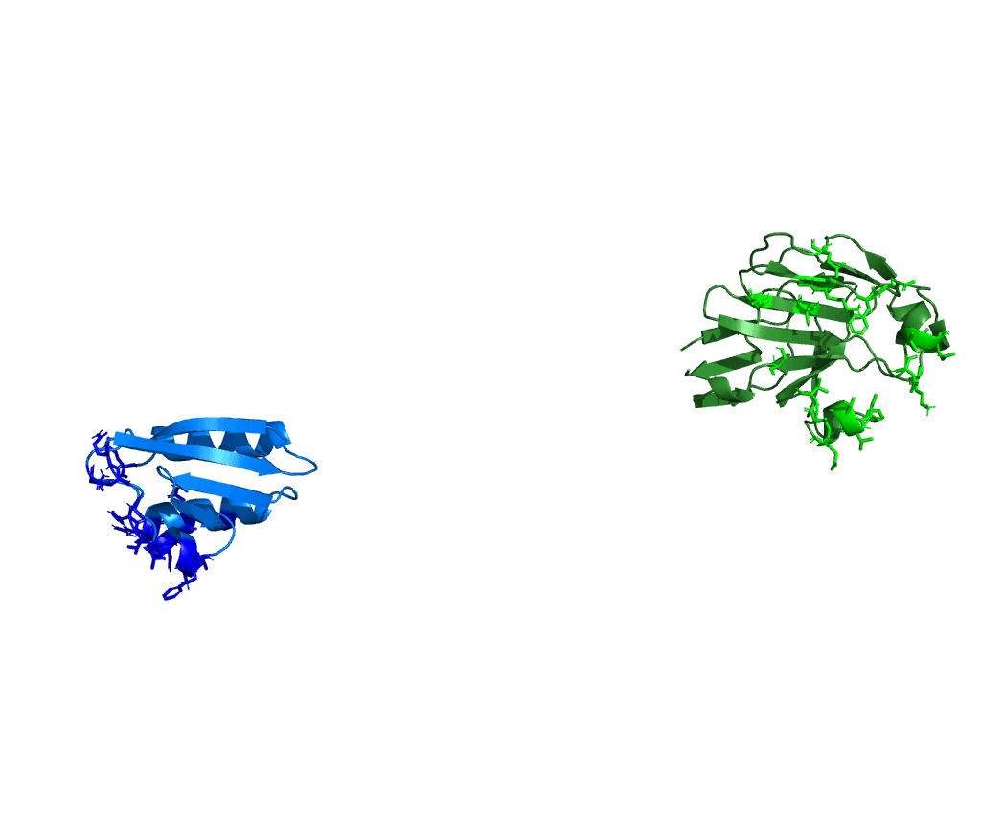
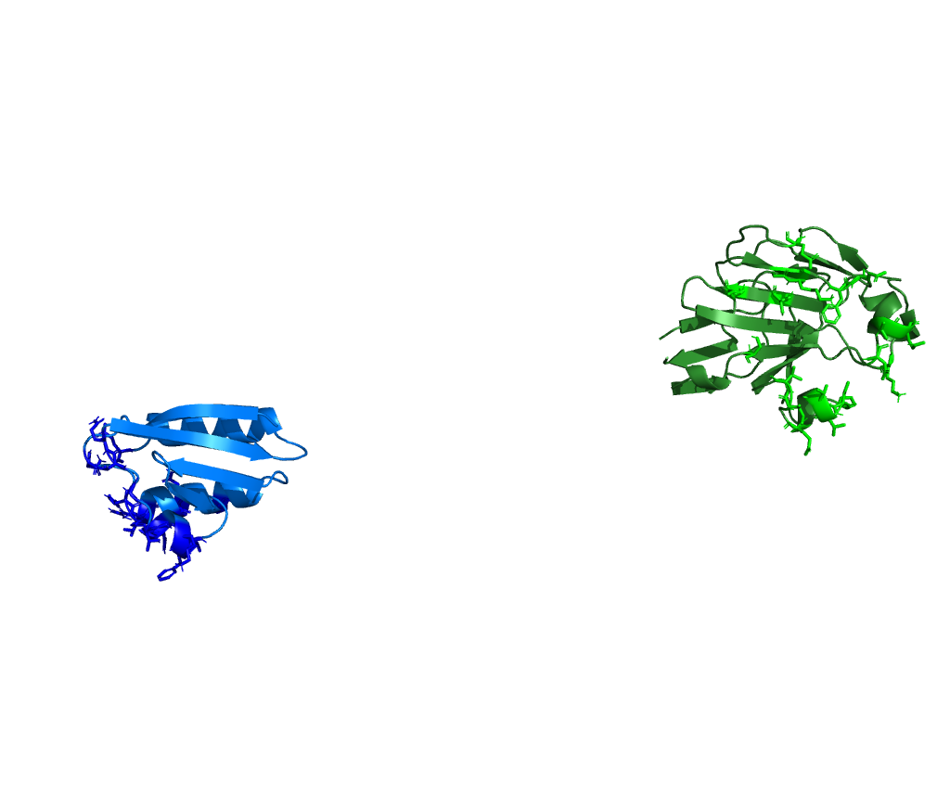
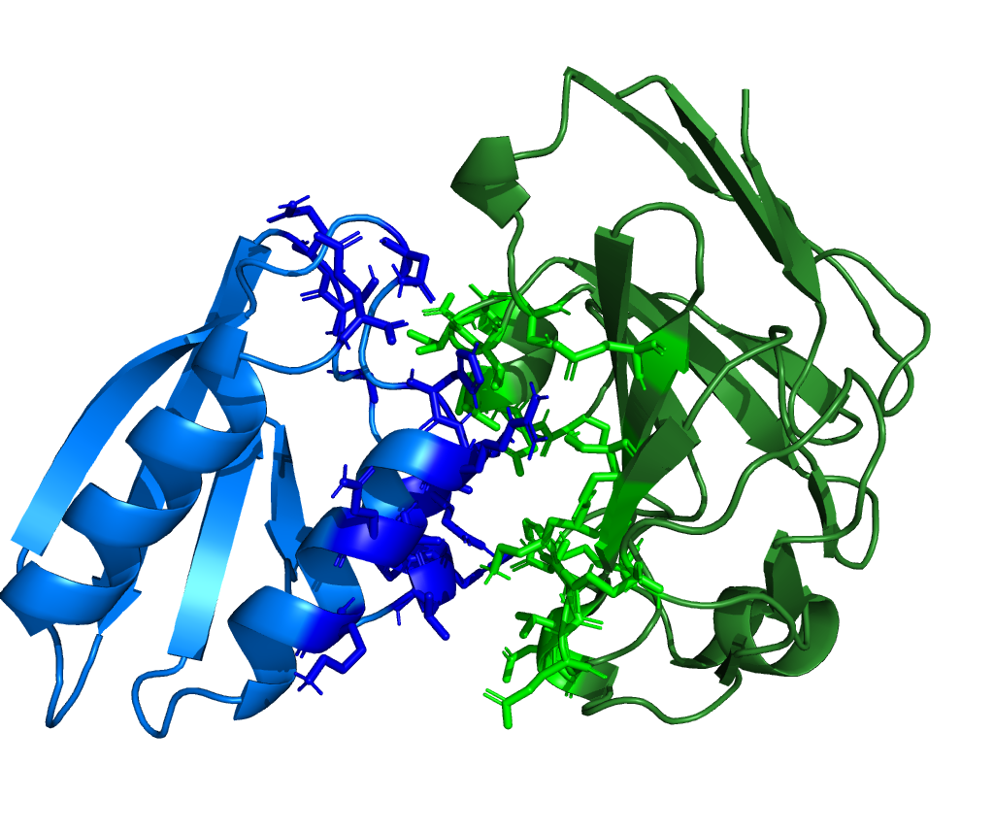
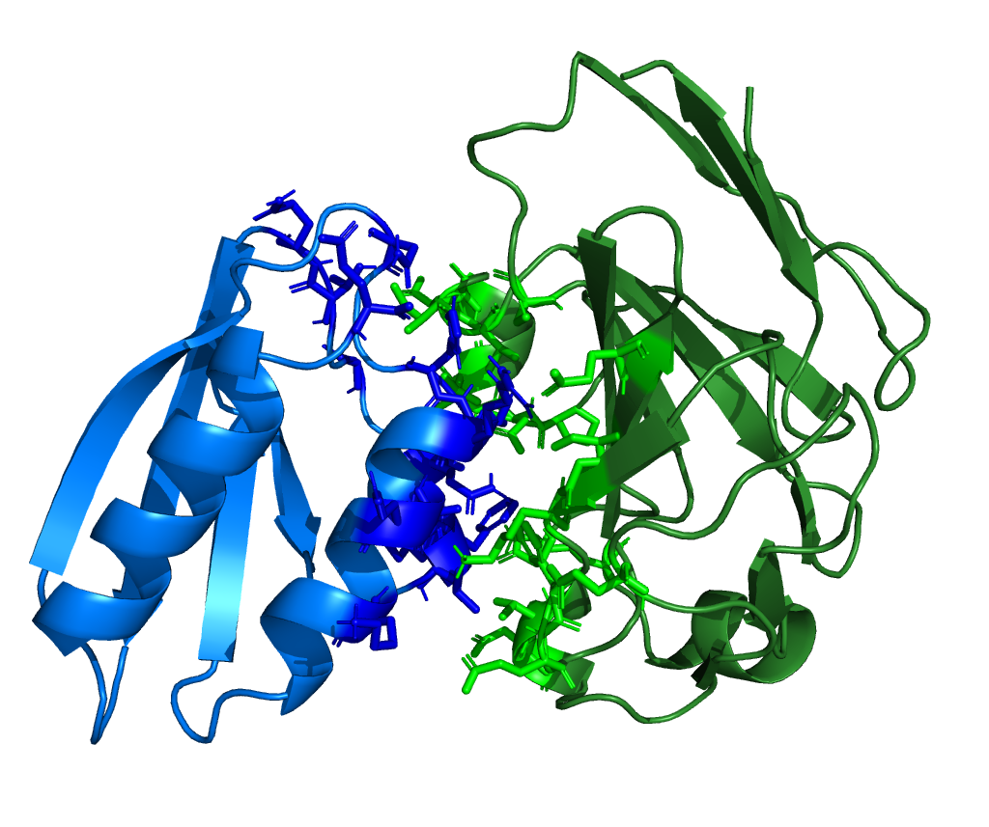
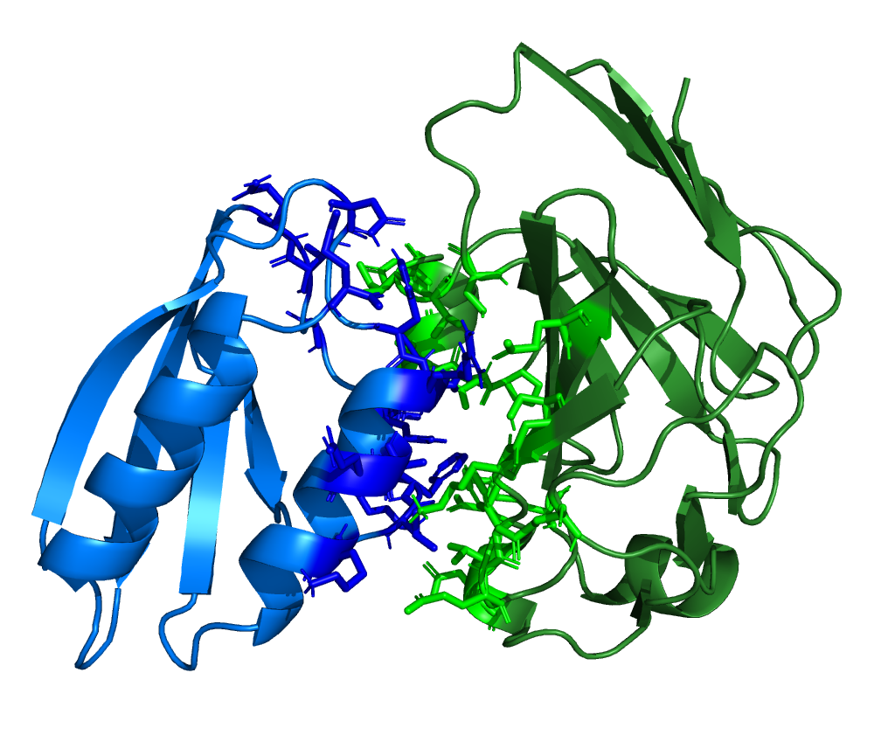

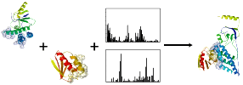

HADDOCK consists of a collection of python and csh scripts that setup, analyze and score CNS inputs and outputs in order to make CNS produce the best complex structures.
CNSsolve has been designed to provide a flexible multi-level hierachical approach for the most commonly used algorithms in macromolecular structure determination.
Randomization & rigid body docking
Semi & fully flexible simulated annealing
Final refinement with explicit solvent
analyze, score, select &
setup
analyze, score, (select) &
setup
analyze & score
setup
HADDOCK
HADDOCK
HADDOCK
HADDOCK
csh
csh
csh
csh

Slide 6
HADDOCK: now you do it!
http://bioinf.uab.es/ocs/MSCB/MOD4/
Here you can find:
- This PPT
- A file with the tutorial we are going to follow in this class
- All necessary files to follow this tutorial
http://www.nmr.chem.uu.nl/haddock2.0/tut_e2a-hpr-csp.html
https://web.archive.org/web/20080101191054/http://www.nmr.chem.uu.nl/haddock2.0/tut_e2a-hpr-csp.html
Here you can find the original and complete version of this tutoral

