Slide 1
Preface
Tools in Bioinformatics could be slow
Before beginning we are going to get results from some of them that we are going to use later. So keep the emails with the results they will send to you.
We are going to obtain results for:
- A search with Dali Server
- A prediction with psipred

Slide 2

Structure: Dali
Database Structure search
http://ekhidna2.biocenter.helsinki.fi/dali/
We can search against the whole pdb database using a structure, not a sequence, with
Dali server
This way we can find similar proteins that, using just a sequence search method, could not be found.
Make sure you delete all the text, leaving only this: 4byzA
Your email here, not mine!

Slide 3
Sequence: PSIPRED
http://bioinf.cs.ucl.ac.uk/psipred_new/
Paste here the sequence from this protein:
http://www.uniprot.org/uniprot/Q63JW5.fasta
Your email here, not mine!

Slide 4
Bioinformatics tools for proteins
Sequence Based:
NCBI
UNIPROT
PFAM
prediction tools
Structure Based:
PDB
Dali server
MAESTROweb
Swiss-Model
Pymol

Slide 5
Bioinformatics tools for proteins: Sequence
Let’s do a brief review of the common Databases and search engines.
We start searching for the AdrA (AKA: yaiC) protein from Salmonella enterica str. LT2

Slide 6
Sequence: NCBI
We could go for protein, but it is better to start with gene, in ncbi it acts as information hub. From the gene section we can jump to protein easily, however, the opposite path is not always as clear

Slide 7
Sequence: NCBI(gene)
From here we can “connect” with other databases and related information (please, try it)

Slide 8
Sequence: NCBI(gene)
Annotation of the gene in the sequenced fragment.
3
2
Graphical view of annotated regions and features
1

Slide 9
Sequence: NCBI(gene)
“Jump” To protein databases and protein related information:
NCBI data in gp text format (with links)
UNIPROT data in graphical format
1
2

Slide 10
Sequence: NCBI(proteins)
Description and general information
“Connections”

Slide 11
Sequence: NCBI(proteins)
Specific information about the sequence
Regions, domains, sites, annotations, etc.

Slide 12
Sequence: NCBI(gene)
2
Link UNIPROT database

Slide 13
Sequence: UNIPROT
https://www.uniprot.org/uniprot/H9L4B6

Slide 14
Sequence: UNIPROT
http://www.uniprot.org
1
2

Slide 15
Go to desired information
Sequence: UNIPROT
Presented information
Uniprot DATABASE pretends to store all the information that it is known about a protein.
Publications
Function
Topology
Structure
Interactions
Known protocols
Sequence analysis tools
Links to other DB (domains, orthologs …)
…

Slide 16
Sequence: UNIPROT
Run a search in different sequence based analysis tools directly from the database entry
1
3
2

Slide 17
We don’t want a segment we want the full sequence, so we click submit
Sequence: ProtParam
Different parameters that can be calculated from the sequence:
Sequence size
Molecular weight
Theoretical isoelectric point
Amino acid composition
…
We can also use ProtParam with a sequence as input

Slide 18
Sequence: UNIPROT
Uniprot is a DataBase made from, and divided in, different databases. The most important is UniprotKB, which is divided in:
SwissProt: Contains ALL Reviewed sequences
Trembl: Contains automatically annotated, not reviewed sequences (it use to be ALL, but now they are trying to remove redundancies)
Information available in other databases for sequences in SwissProt and Trembl is compiled in UniprotKB

Slide 19
Sequence: UNIPROT(blast)
1
2
3

Slide 20
Sequence: UNIPROT(blast)
We will make a blast of our protein against Swiss-Prot database, looking for well known proteins. (Better annotated, used in multiple publications, expressed and purified, structure solved, etc)
2
3
1
4

Slide 21
Sequence: UNIPROT(blast)
1
2
3

Slide 22
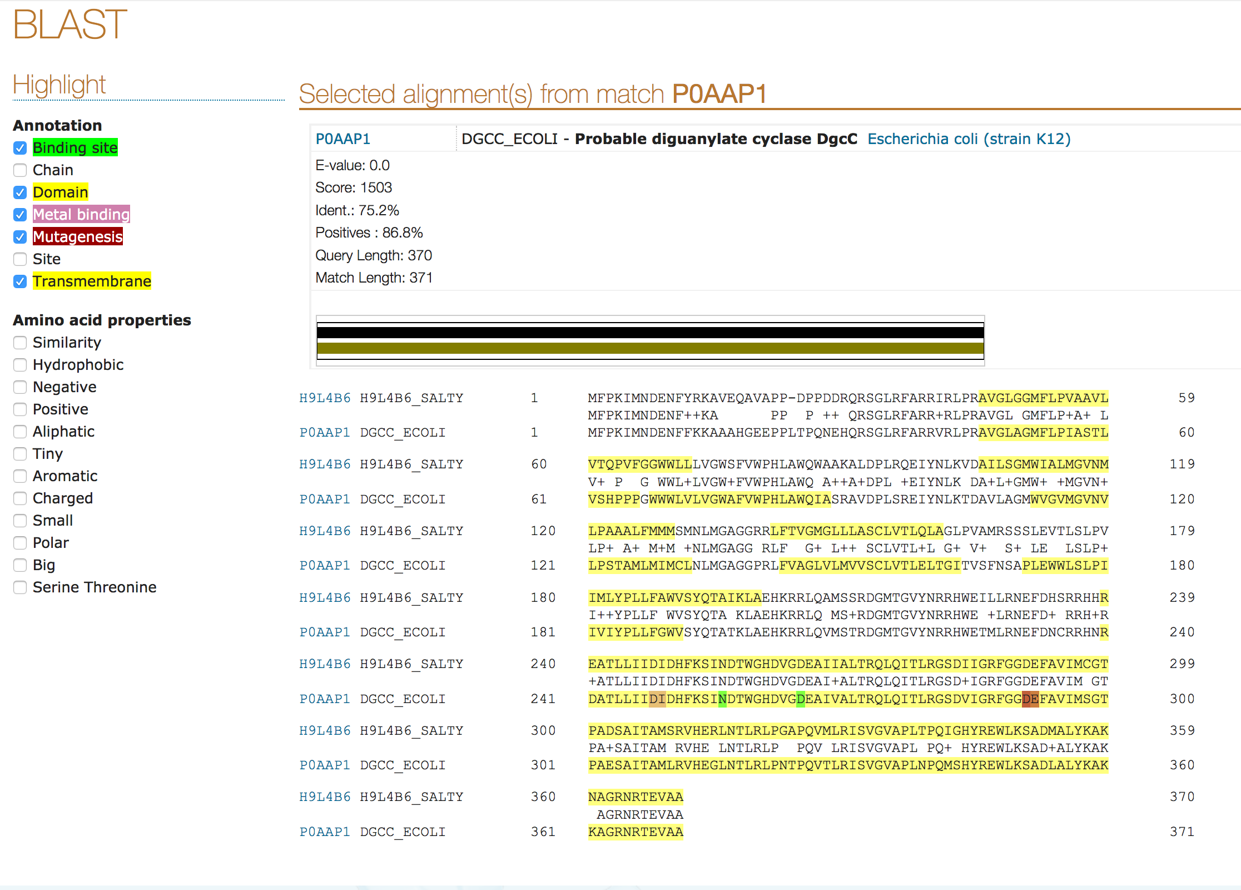
Sequence: UNIPROT(blast)
We can visualize information annotated in the main uniprot page for each sequence.
Since Swissprot sequence will usually contain more information, we can “transfer” this information through the alignment.
Example: Binding site, Metal binding, etc.
1
6
2
3
4
5

Slide 23
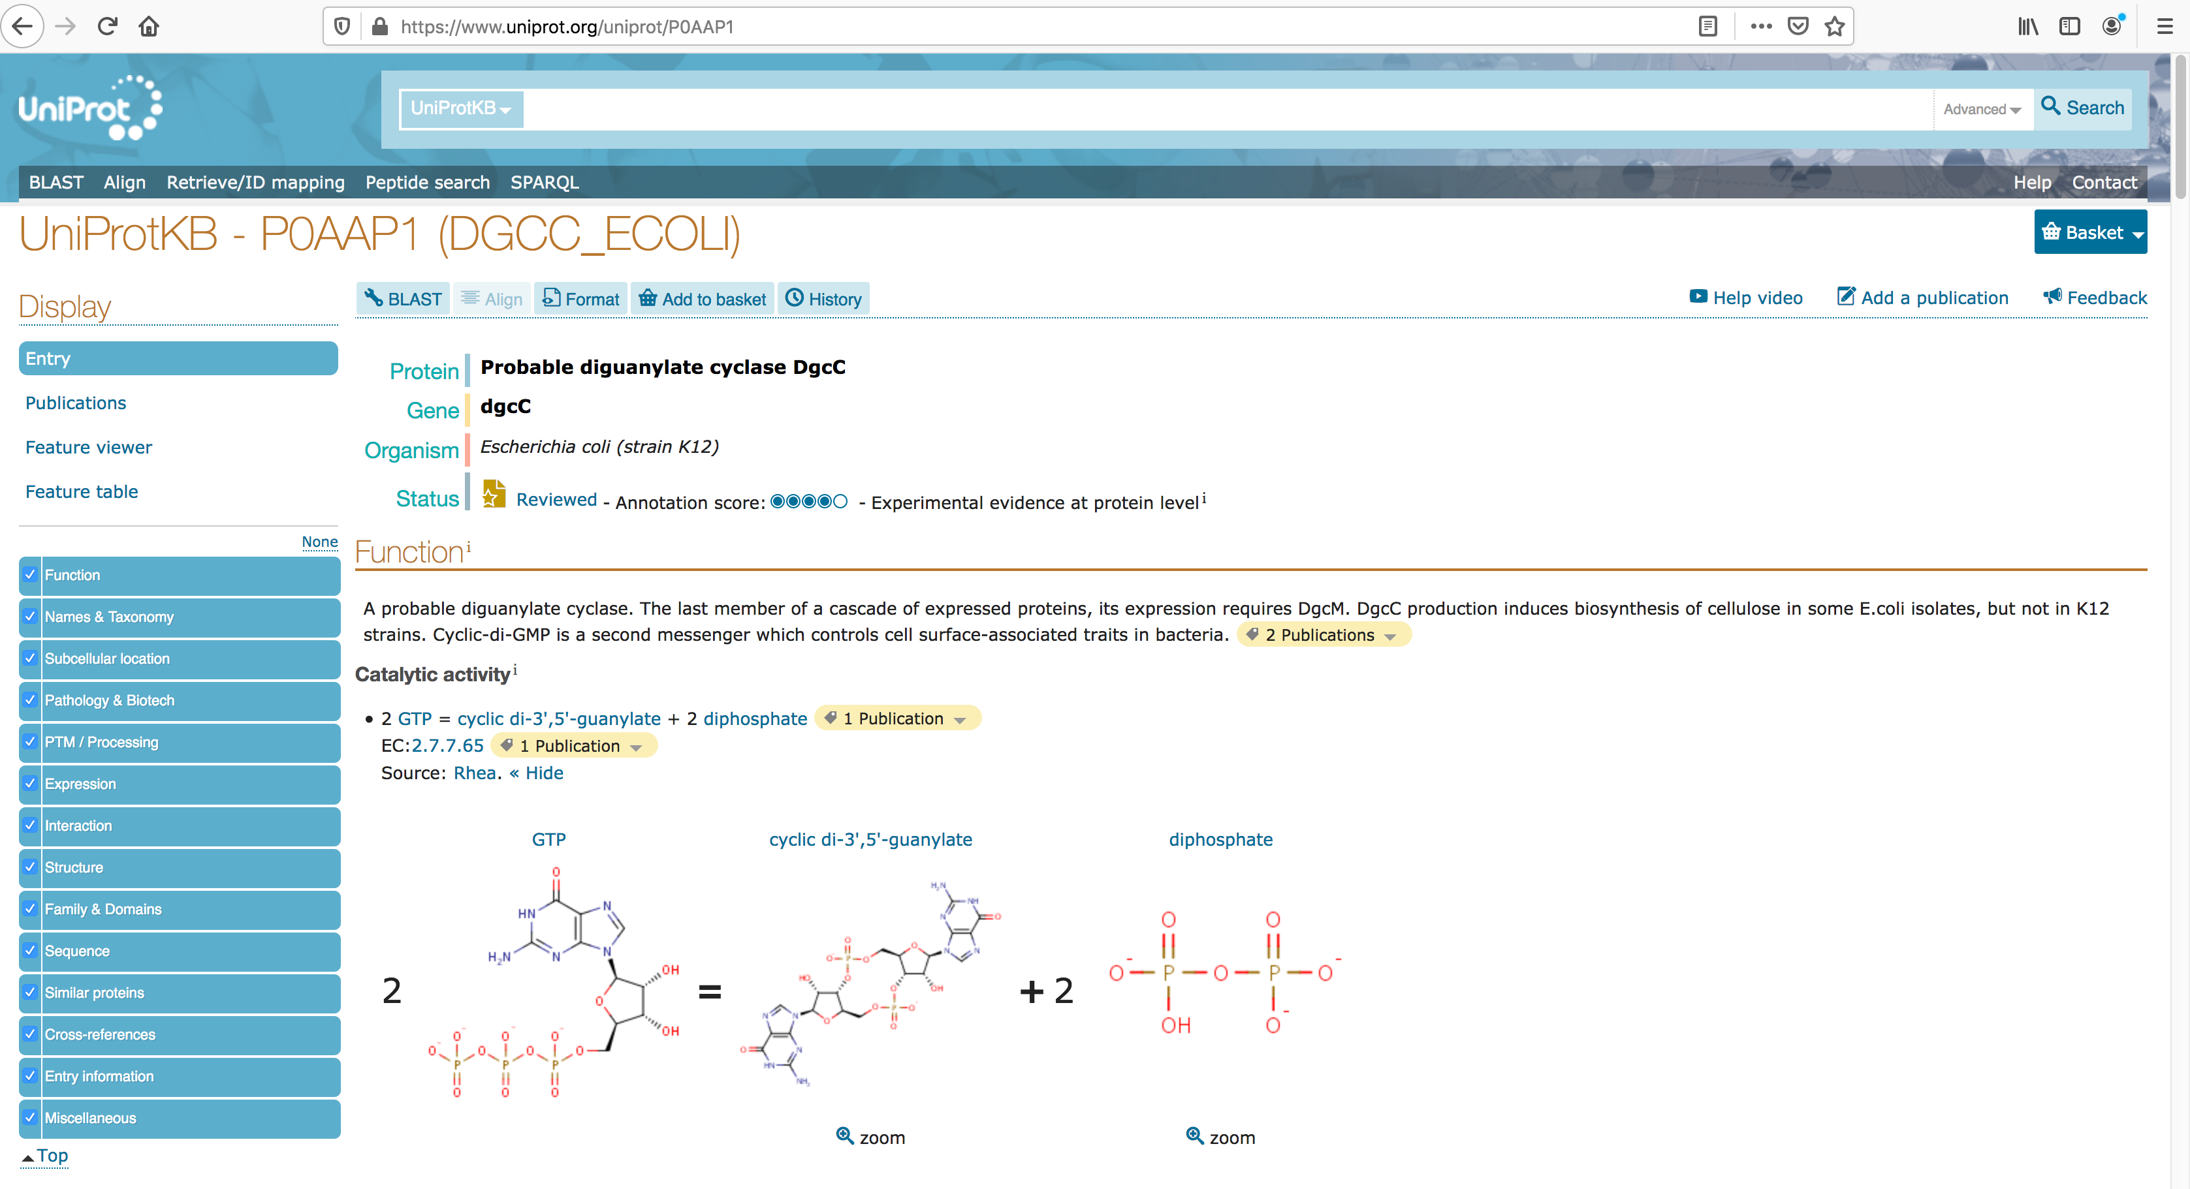
Sequence: UNIPROT(Swiss-Prot)
In a Swiss-prot entry we will find much more information than in an trembl one, specially related publications
1
2

Slide 24
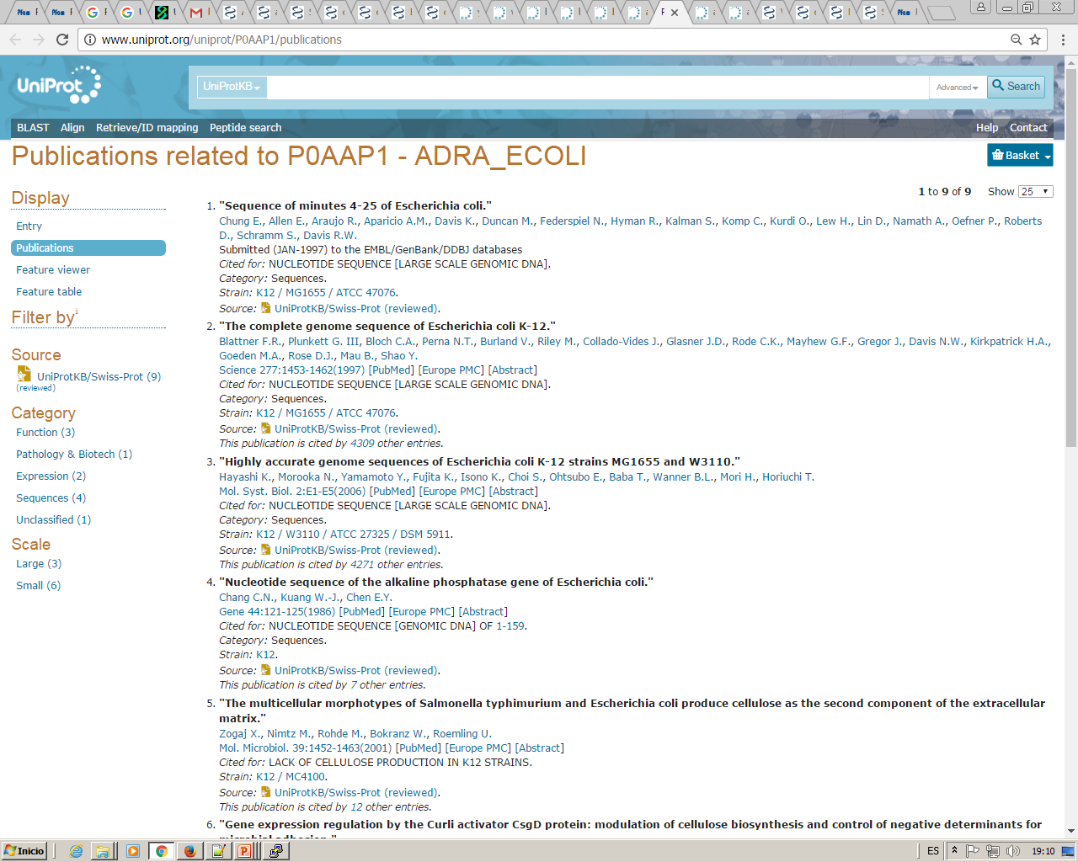
Sequence: UNIPROT(Swiss-Prot)

Slide 25
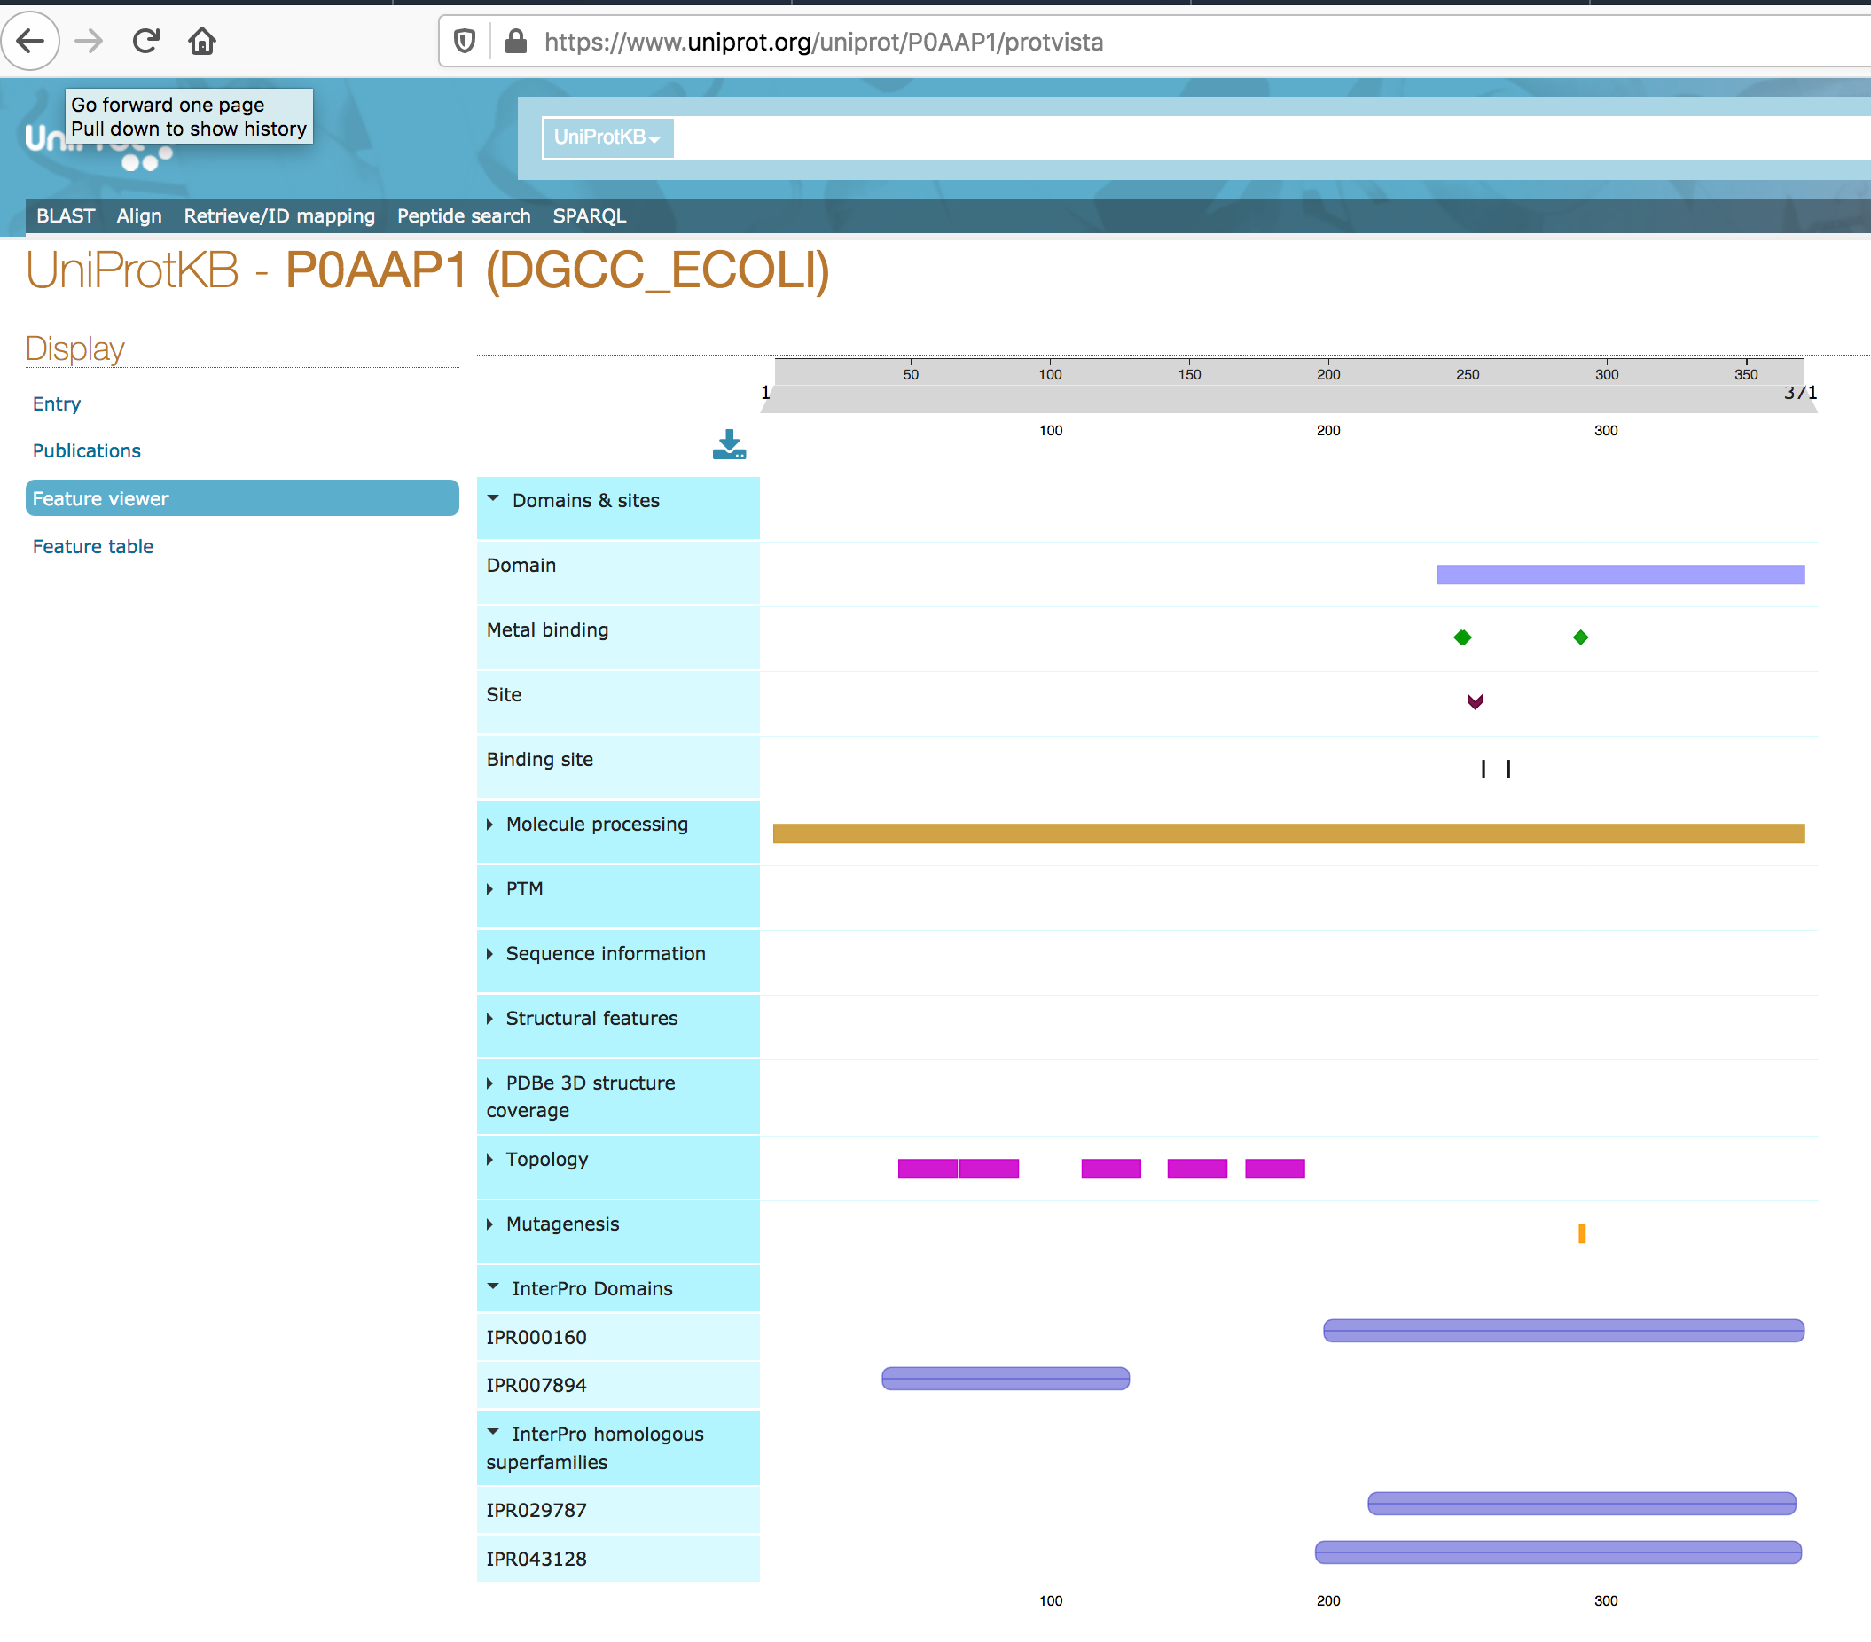
Sequence: UNIPROT(Swiss-Prot)

Slide 26
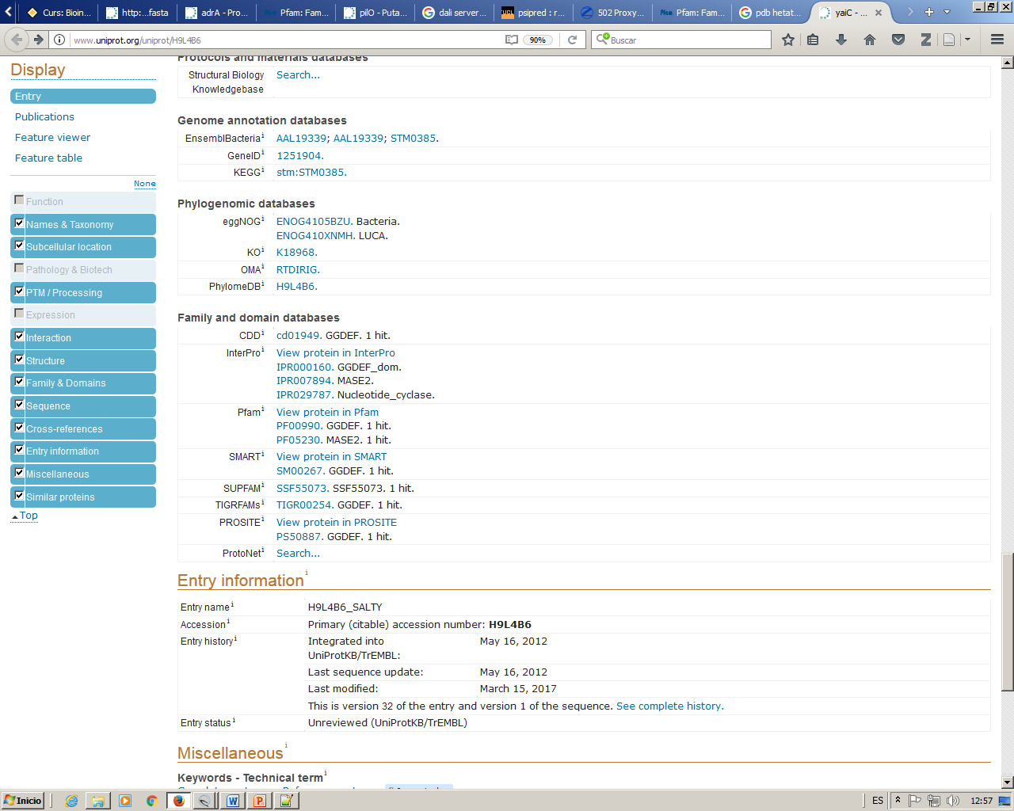
Sequence: from Uniprot to PFAM
http://www.uniprot.org/uniprot/H9L4B6
We can jump from uniprot to the pfam entry for this protein or directly to the pfam domains for those identified in our sequence
3
1
2

Slide 27
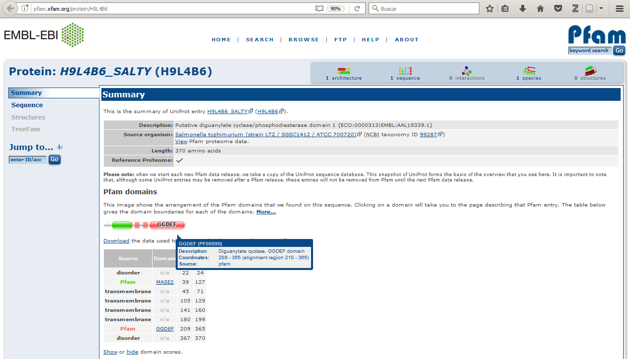
Sequence: PFAM
Annotated features and known Pfam domains in our selected sequence
1
2
3

Slide 28
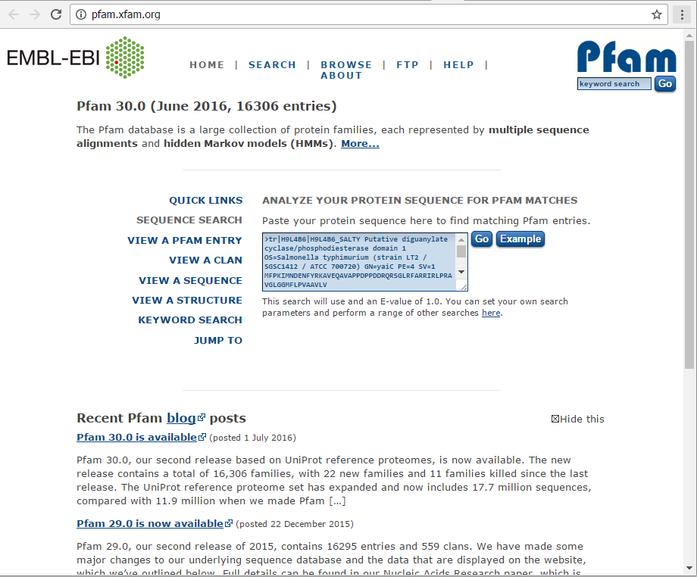
Sequence: PFAM
Database of protein domains families. They are based on manually curated alignments of known domains. These alignments are used in form of a HMM profile in a way that if a sequence aligns with a profile we could say that this sequence contains this domain.
They are SEQUENCE and functional domains, not structural domains.
1
2
http://www.uniprot.org/uniprot/H9L4B6.fasta

Slide 29
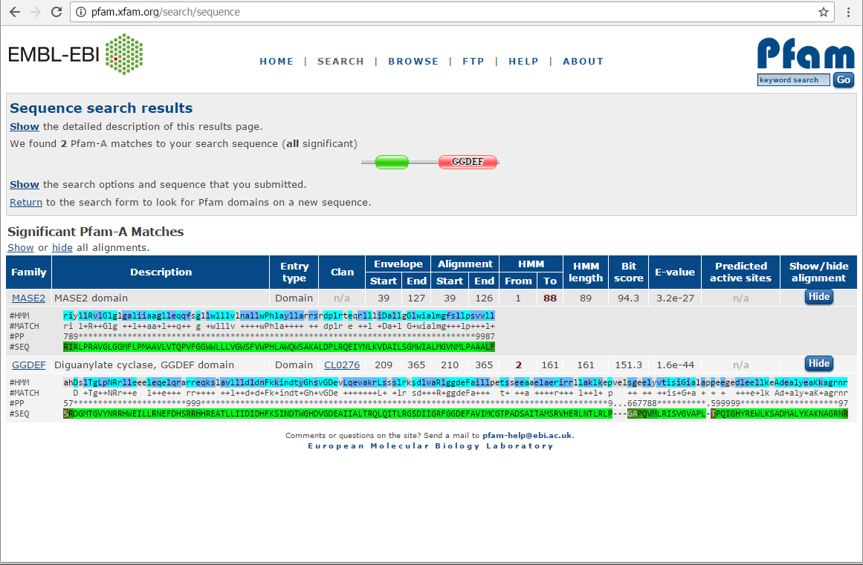
Sequence: PFAM
Positions of the HMM profile that align with our sequence
3
4
Size of the HMM profile that represents this domain family
1
2
Not all sequence is aligned, only those regions that align with the HMM profile representing each domain family (compare numbers here with those in the pfam entry for the protein which sequence we have aligned here).
If the #SEQ line contains lower case letters it means that they are not aligned with the HMM profile, so they are insertions in the sequence which are not considered part of the domain as it is defined by the HMM profile.

Slide 30
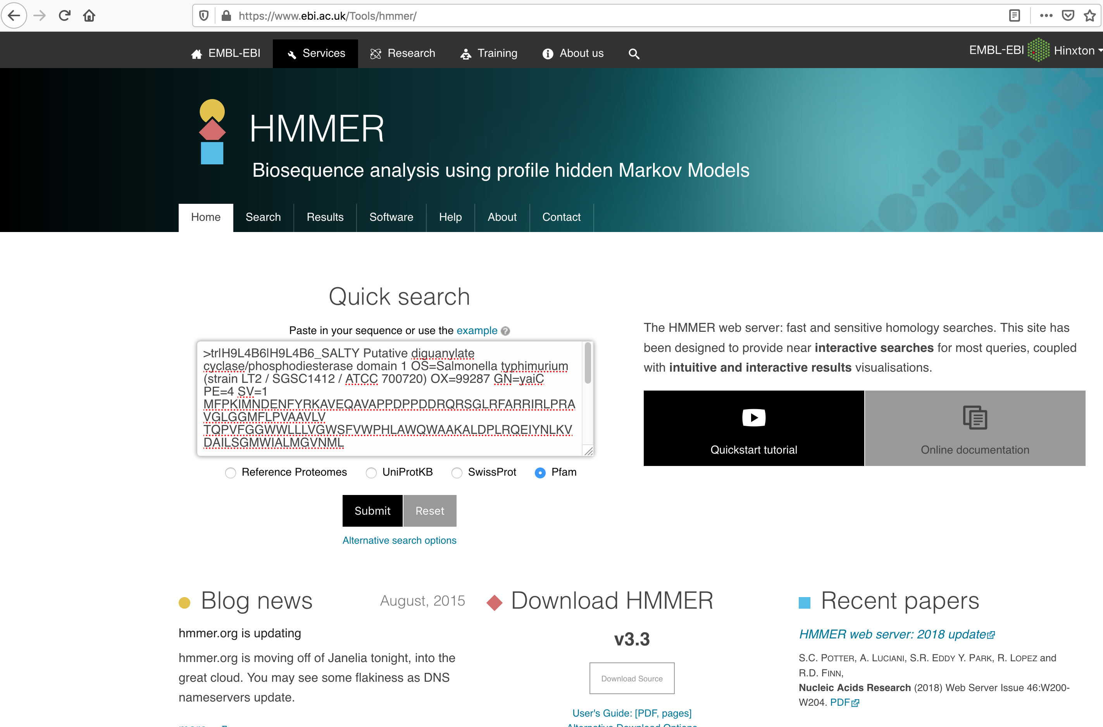
The same results can be accessed through hmmer embl-ebi: https://www.ebi.ac.uk/Tools/hmmer/
Sequence: PFAM
1
http://www.uniprot.org/uniprot/H9L4B6.fasta
2

Slide 31
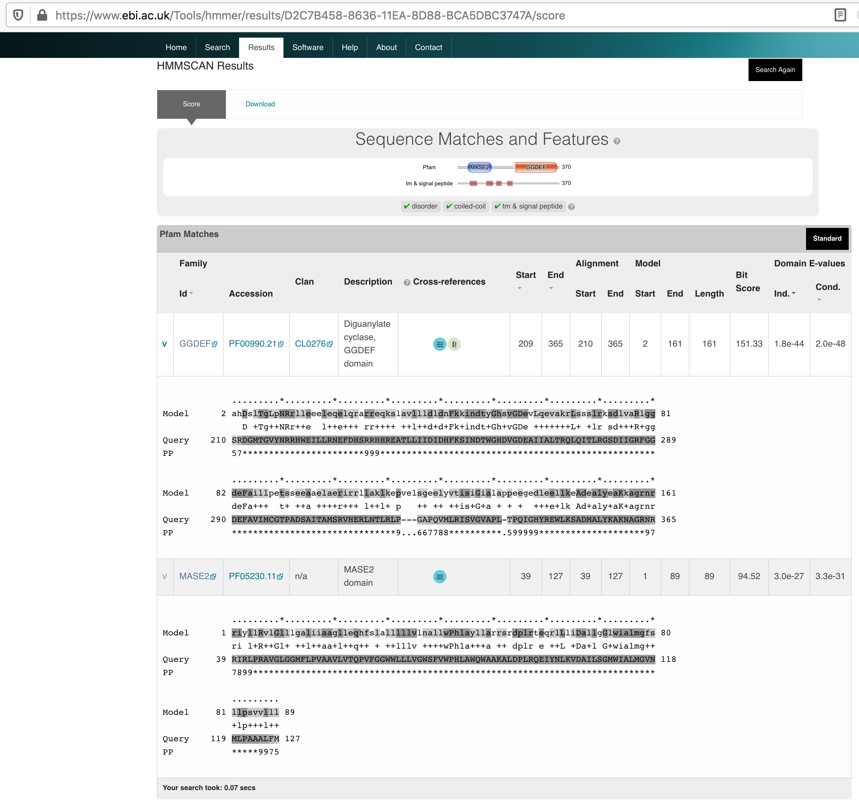
The same results can be accessed through hmmer embl-ebi: https://www.ebi.ac.uk/Tools/hmmer/
Sequence: PFAM
5
4
1
2
3

Slide 32
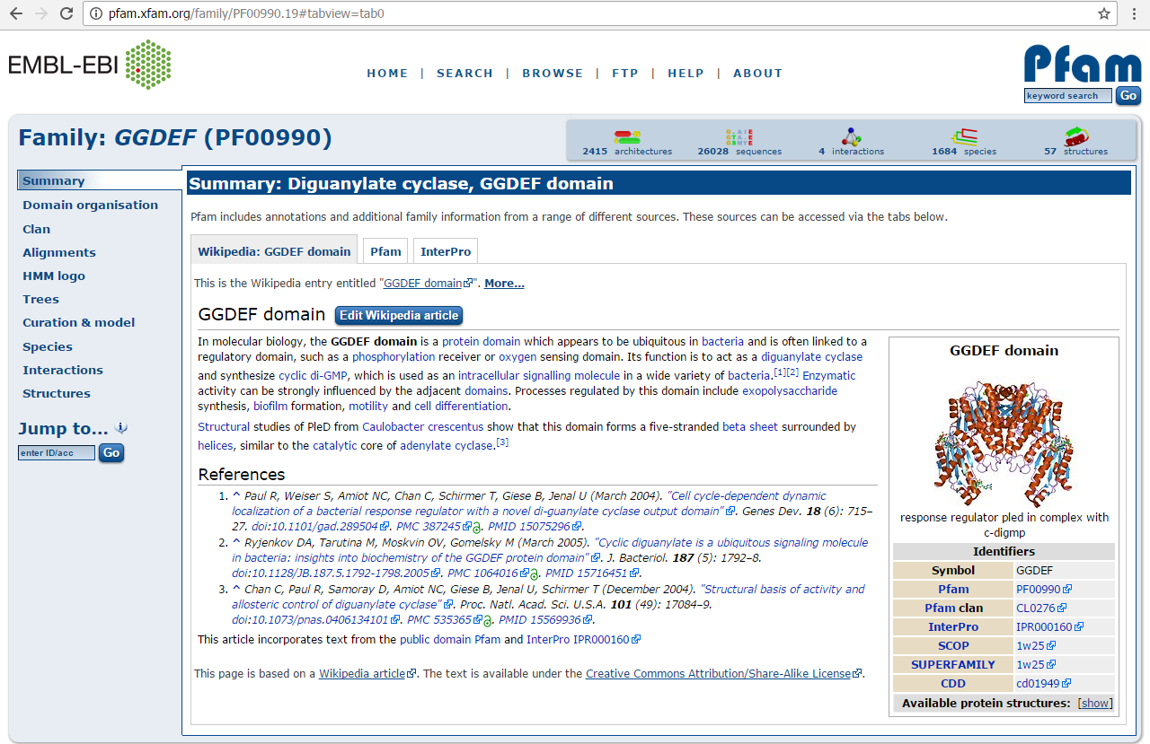
Sequence: PFAM
Wikipedia description of this family, curated by pfam people, not always available.
Pfam description of this family, less extended than Wikipedia, always available.
Identifier (ID)
Accession
Pfam

Slide 33
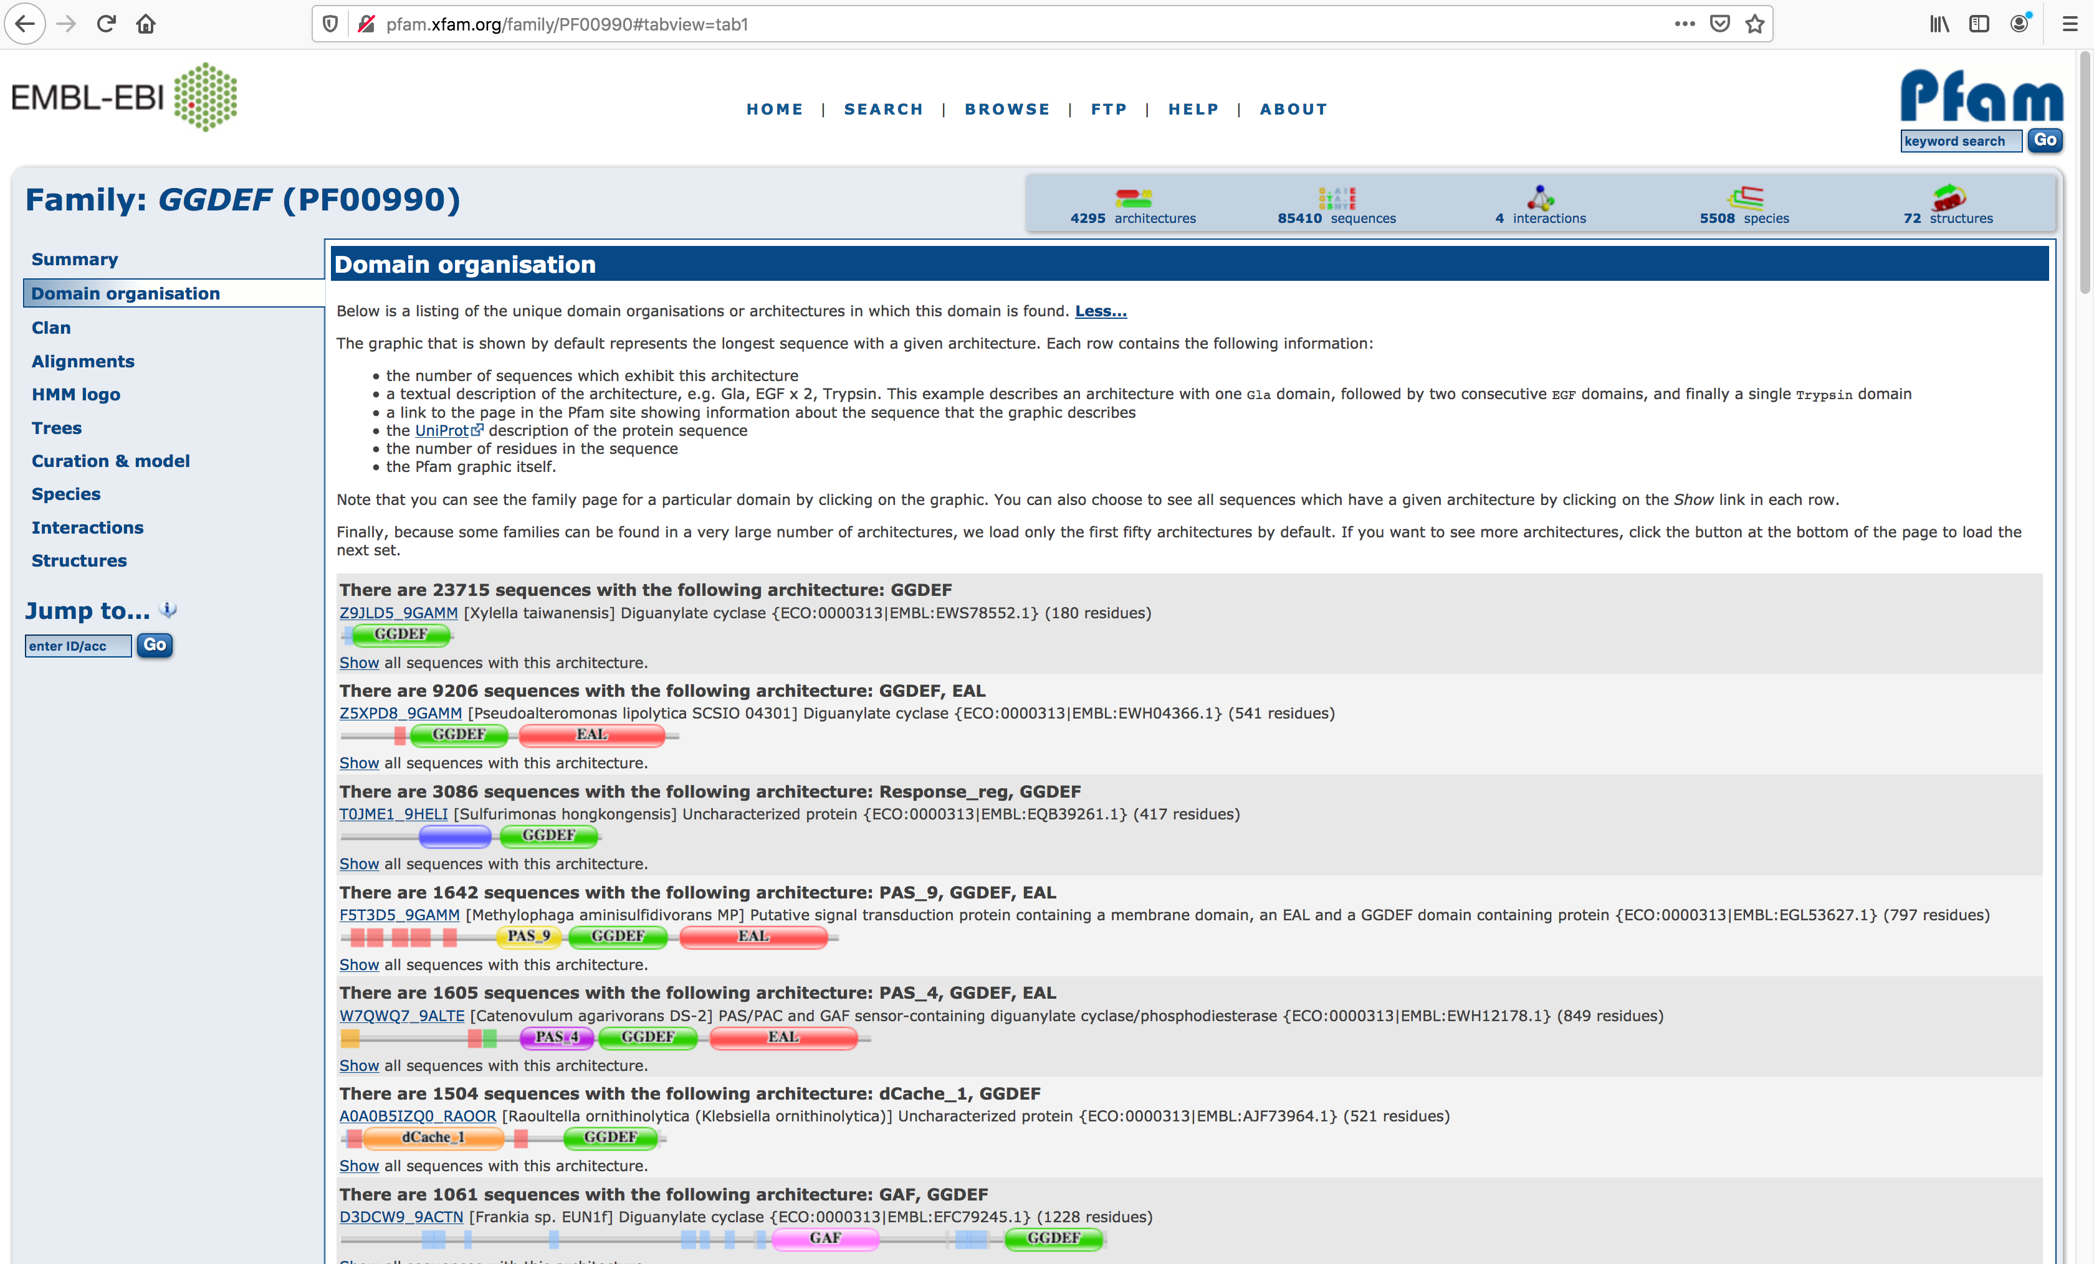
Sequence: PFAM
Read this to understand this page information

Slide 34
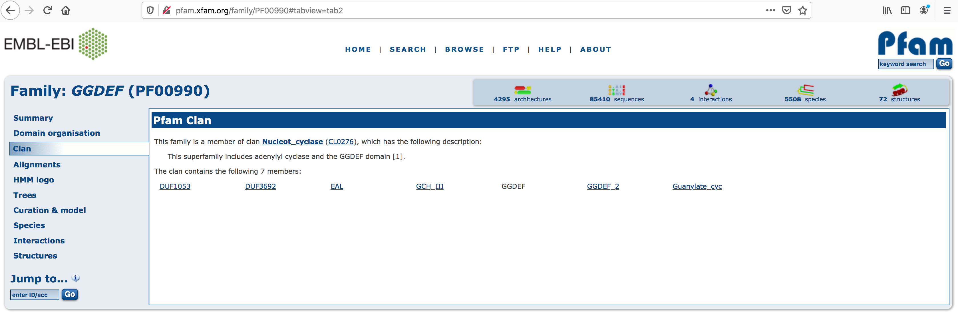
Sequence: PFAM
This family is similar to others and they are grouped in a “Clan”

Slide 35
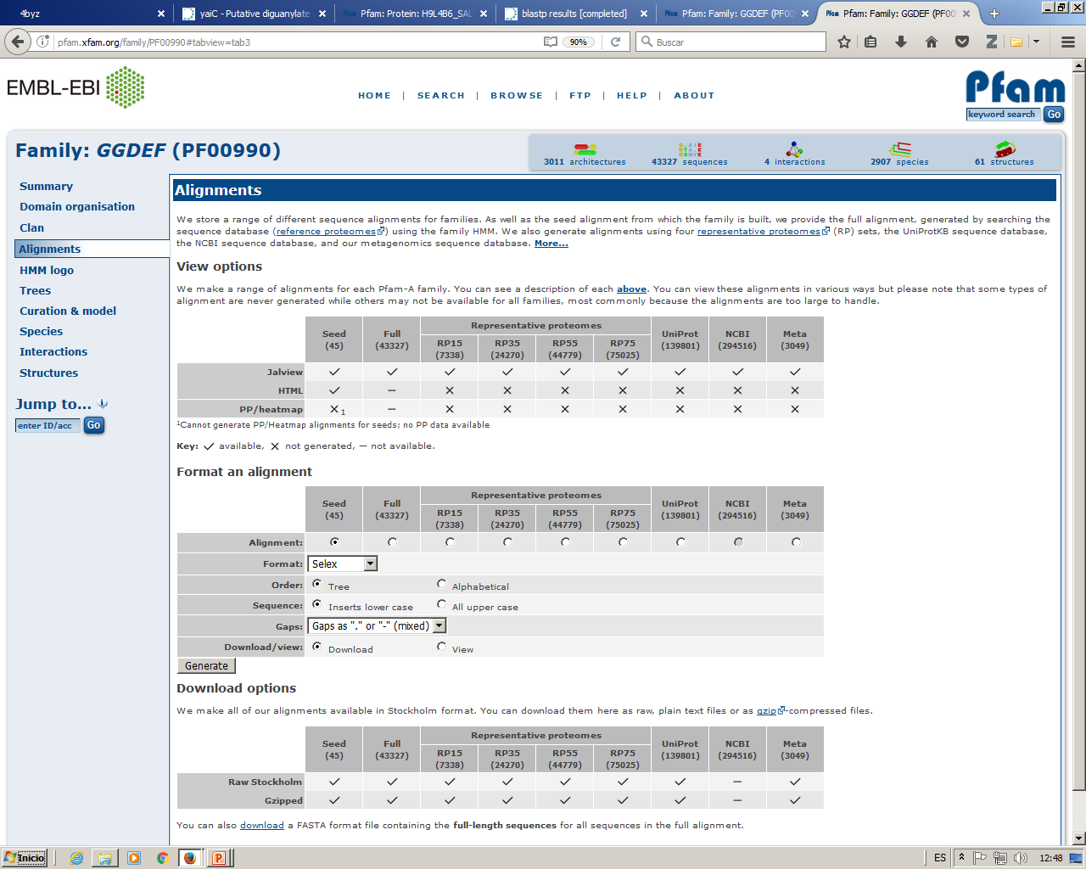
Sequence: PFAM
You can visualize or download many different alignments for proteins in this family:
Seed alignment is the one used to generate the HMM profile that defines the family
It is supposed to be manually curated and reviewed
Click and read
How many sequences Pfam knows of this domain in each different database (Does not mean this is the real, updated, number)

Slide 36
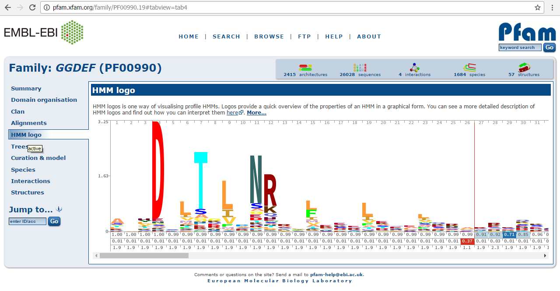
Sequence: PFAM
Using the “Logo” the conservation degree for each position in the domain can easily be seen:

Slide 37
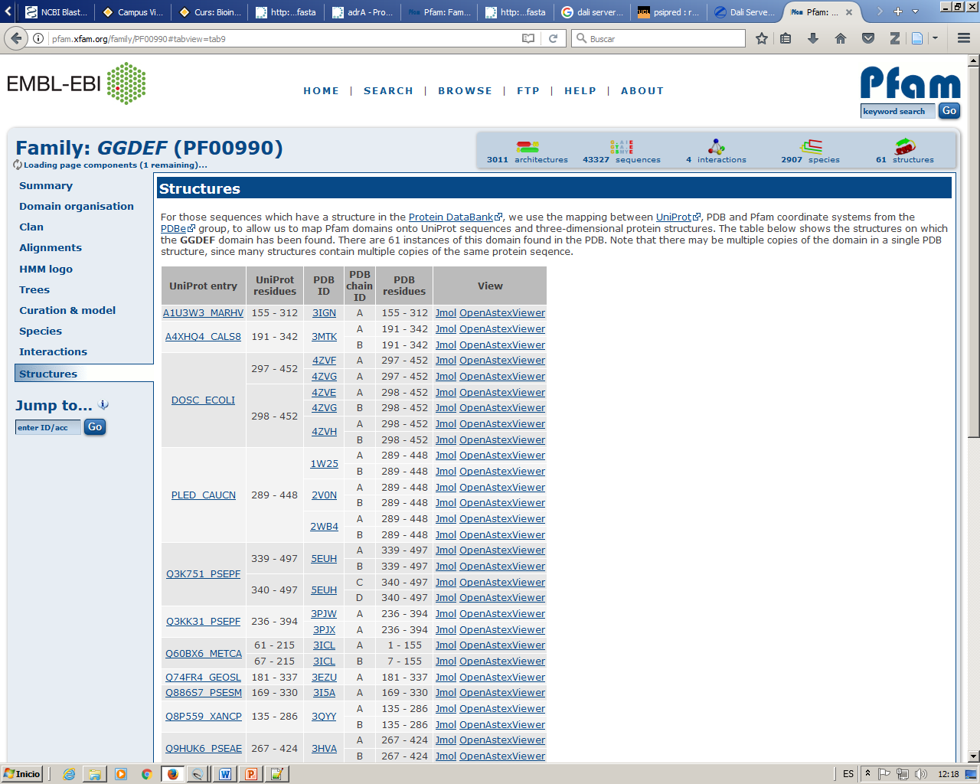
Sequence: PFAM
Here is the number.
Count them (in the web, not here) Understand to what this number refers to. Understand the different number of elements in each column (Uniprot entry, PDB ID, PDB chain ID)
All pdb structures known by pfam that contain a domain of this family.
Observe that several structures could be from the same protein (same uniprot code => same protein)
Do not trust “pdb residues” since these numbers sometimes differ from the PDB residue numeration.

Slide 38
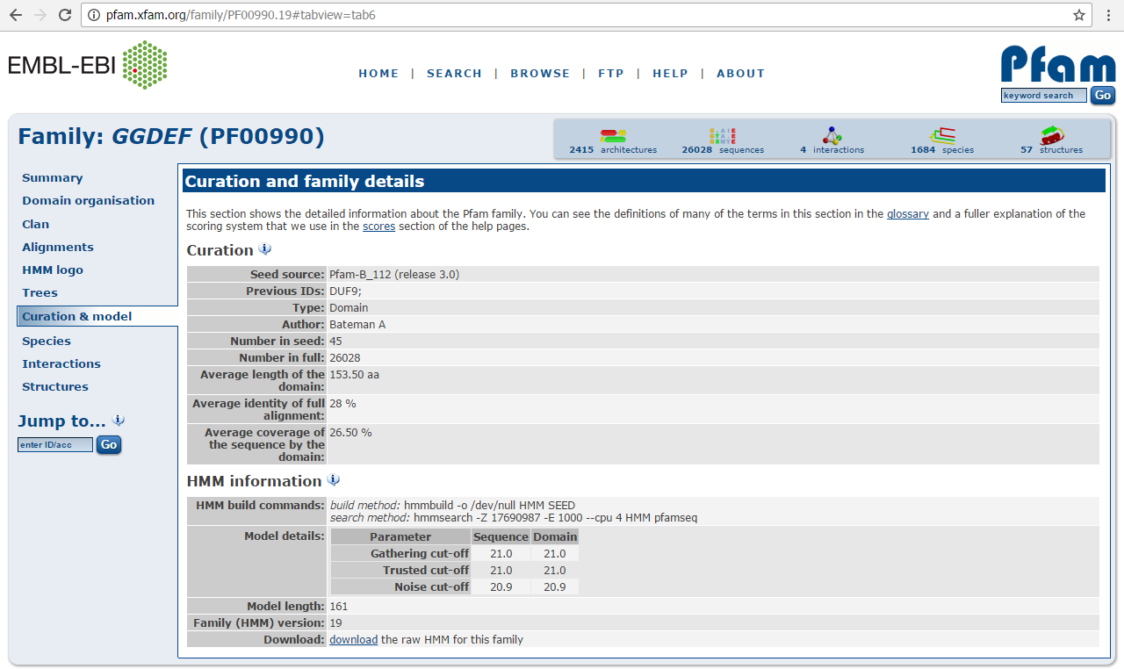
Sequence: PFAM
The HMM profile derived from the seed alignment, which defines this domain, can be downloaded. We can use it to create highly reliable multiple alignments because we are using a scoring system, for each position in the alignment, specially designed for this specific domain.
Once it has been downloaded open it with a text editor.
Observe the different positions in the profile and the scores (probabilities) for a “match” of each residue in the profile, for the insertion in the profile and for transitions from one state (match to match, match to insert, match to deletion, etc ) to another.

Slide 39
Sequence: Prediction tools
Based in the protein sequence and using different methods and algorithms we can predict several features about our protein which could be extremely helpful when trying to produce and / or purify a protein:
A good starting point: http://www.expasy.org/tools/
* Secondary structure, domains and disorder
- PSIpred
*Unstructured / Globular regions
- Iupred
- Disopred
* Aggregation regions
- aggrescan
*Surface accessibility
- NetSurfP
- SABLE
* Transmembrane helix
- TMHMM
* Lots of predictions in one tool
- PredictProtein
* Cellular location
- PsortB
We are going to make all this predictions for this protein:
http://www.uniprot.org/uniprot/Q63JW5.fasta
We know there are problems producing this protein in order to cristalize it. We expect to find a solution after running this predictions
Here we will predict ADRA_ECOLI Cellular location
http://www.uniprot.org/uniprot/P0AAP1.fasta

Slide 40
Sequence: PSIPRED
http://bioinf.cs.ucl.ac.uk/psipred_new/
Paste here the sequence from this protein:
http://www.uniprot.org/uniprot/Q63JW5.fasta
Your email here, not mine!

Slide 41
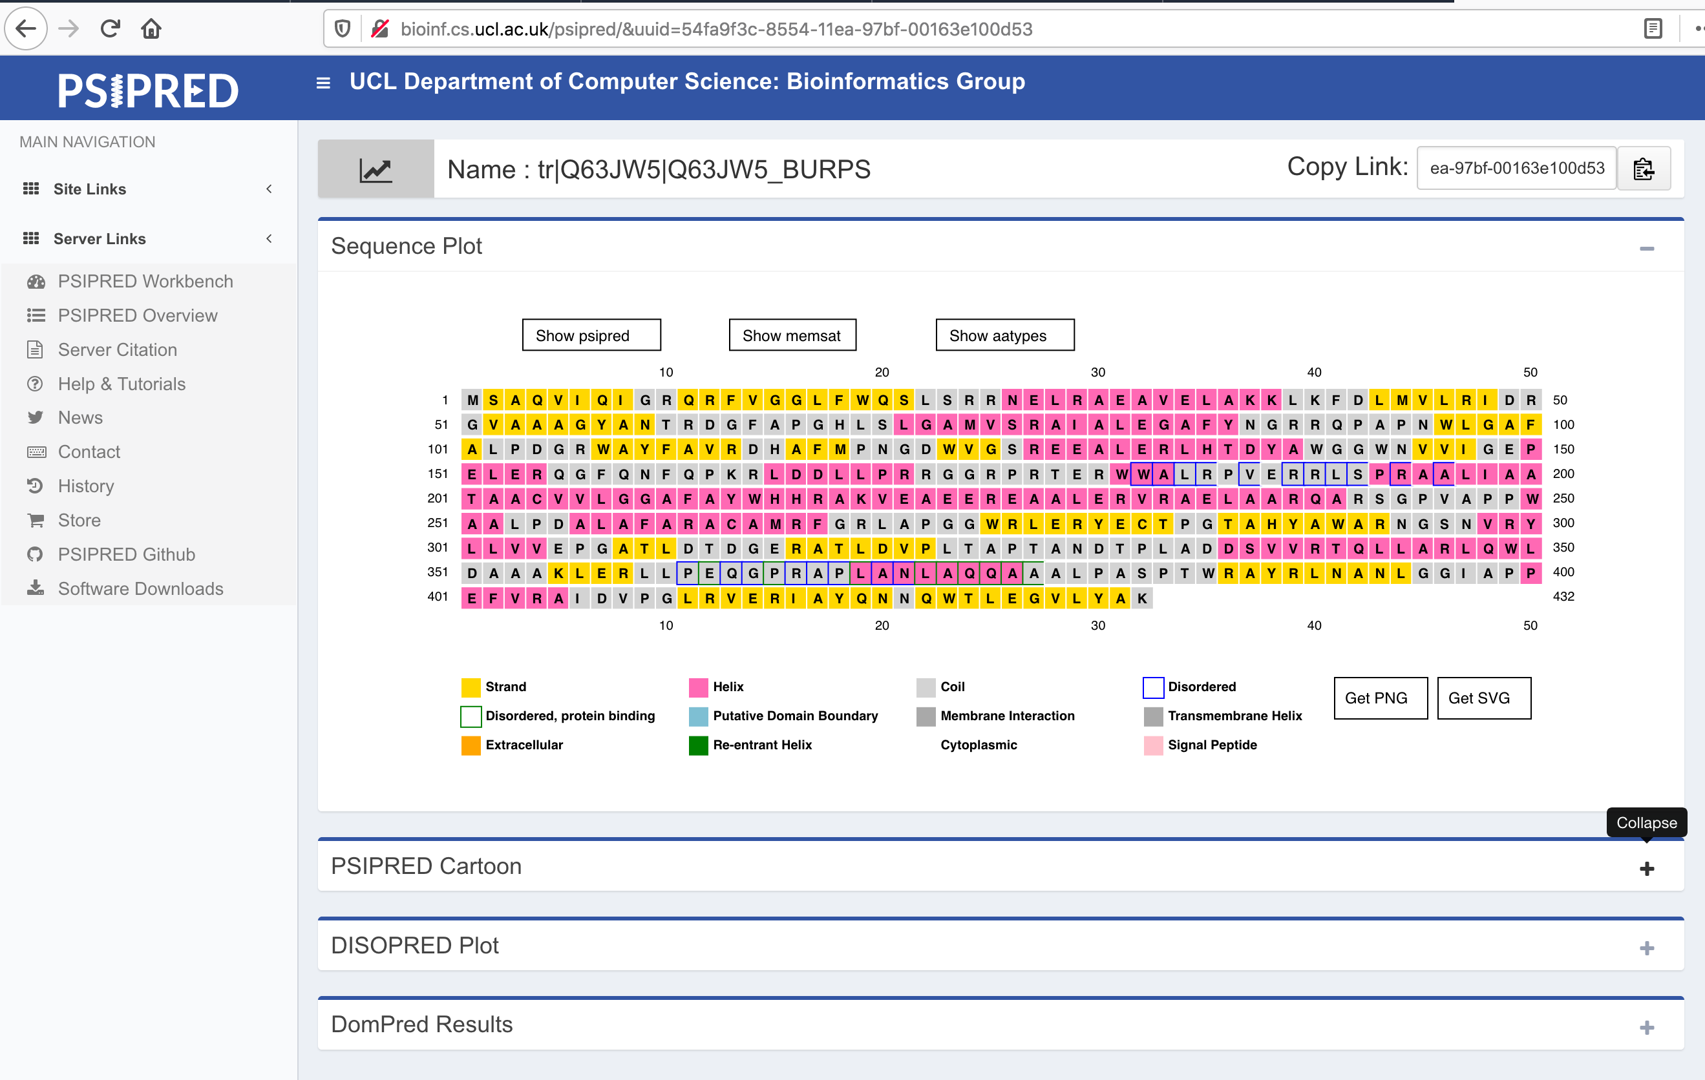
Psipred secondary structure predictions: Helix, Beta (strand) and loop (coil).
Dispopred disordered regions and disordered regions which could be involved in protein binding are also shown here
Sequence: PSIPRED

Slide 42
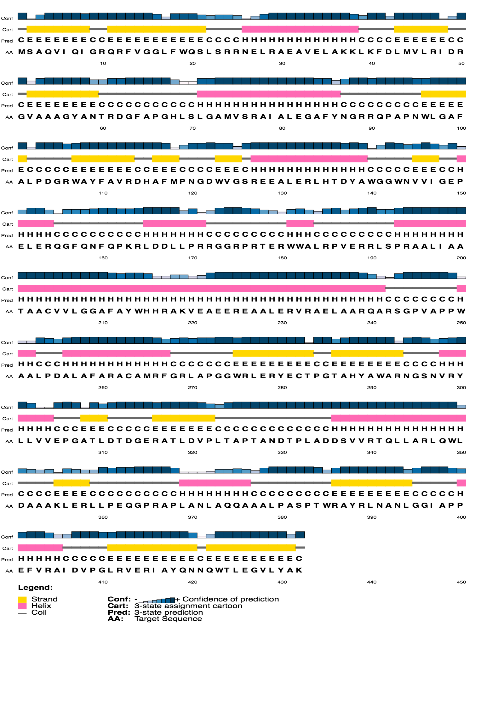
Sequence: PSIPRED
PSIPRED:
Predicted secondary structure for the input sequence Helix (H), Beta (E) and loop (C).

Slide 43
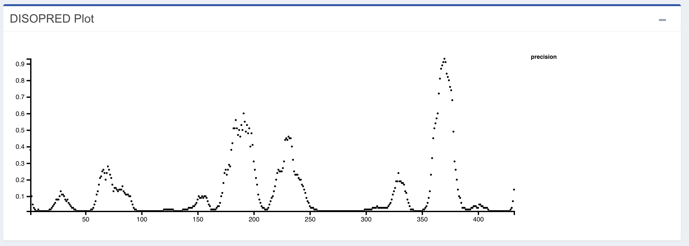
Sequence: PSIPRED
DISOPRED:
Predicted disordered regions (long regions with no secondary structure AKA unstructured)
These two peaks indicate that there is certain probability that this regions are disordered. There is a third, but less defined.

Slide 44
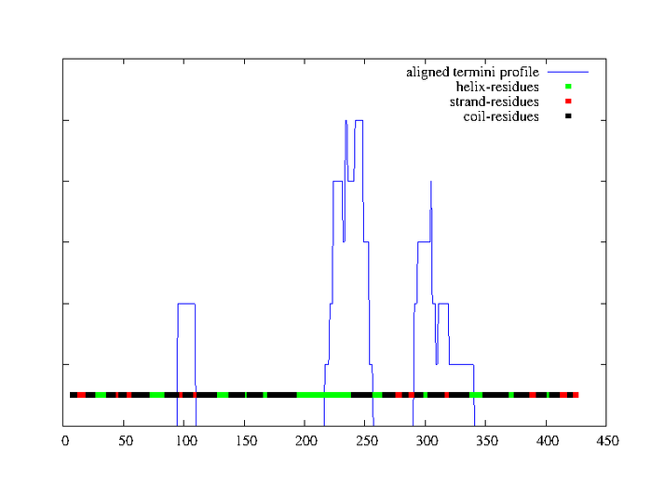
Sequence: PSIPRED
DOMPRED:
Domains are ancestral proteins that now are expressed together in a single chain.
The chart shows regions of our sequence that tend to align with C and N terminals of other sequences in the data base after a psi-blast search. (Those regions are found in the database as the end or the beginning of standalone proteins, so they are potential domain boundaries)

Slide 45
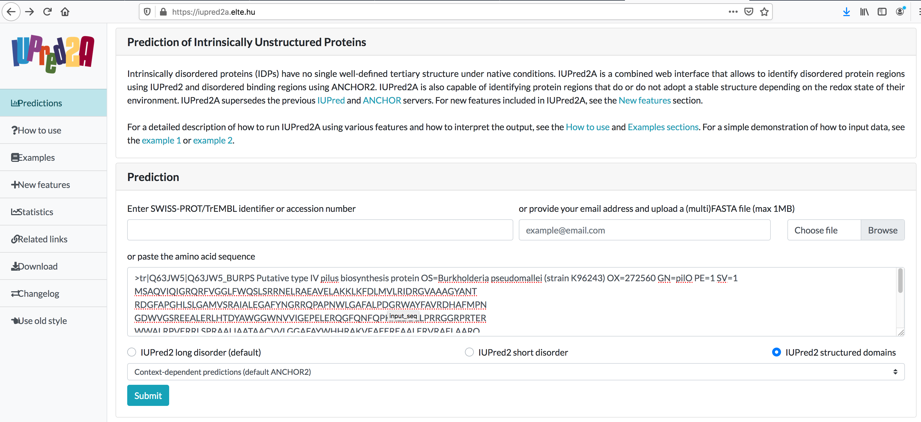
Sequence: IUPred
Unstructured (AKA disordered) regions
Domain boundaries tend to be disordered. In this case we use this option in order to make our predictions
Paste your sequence here

Slide 46
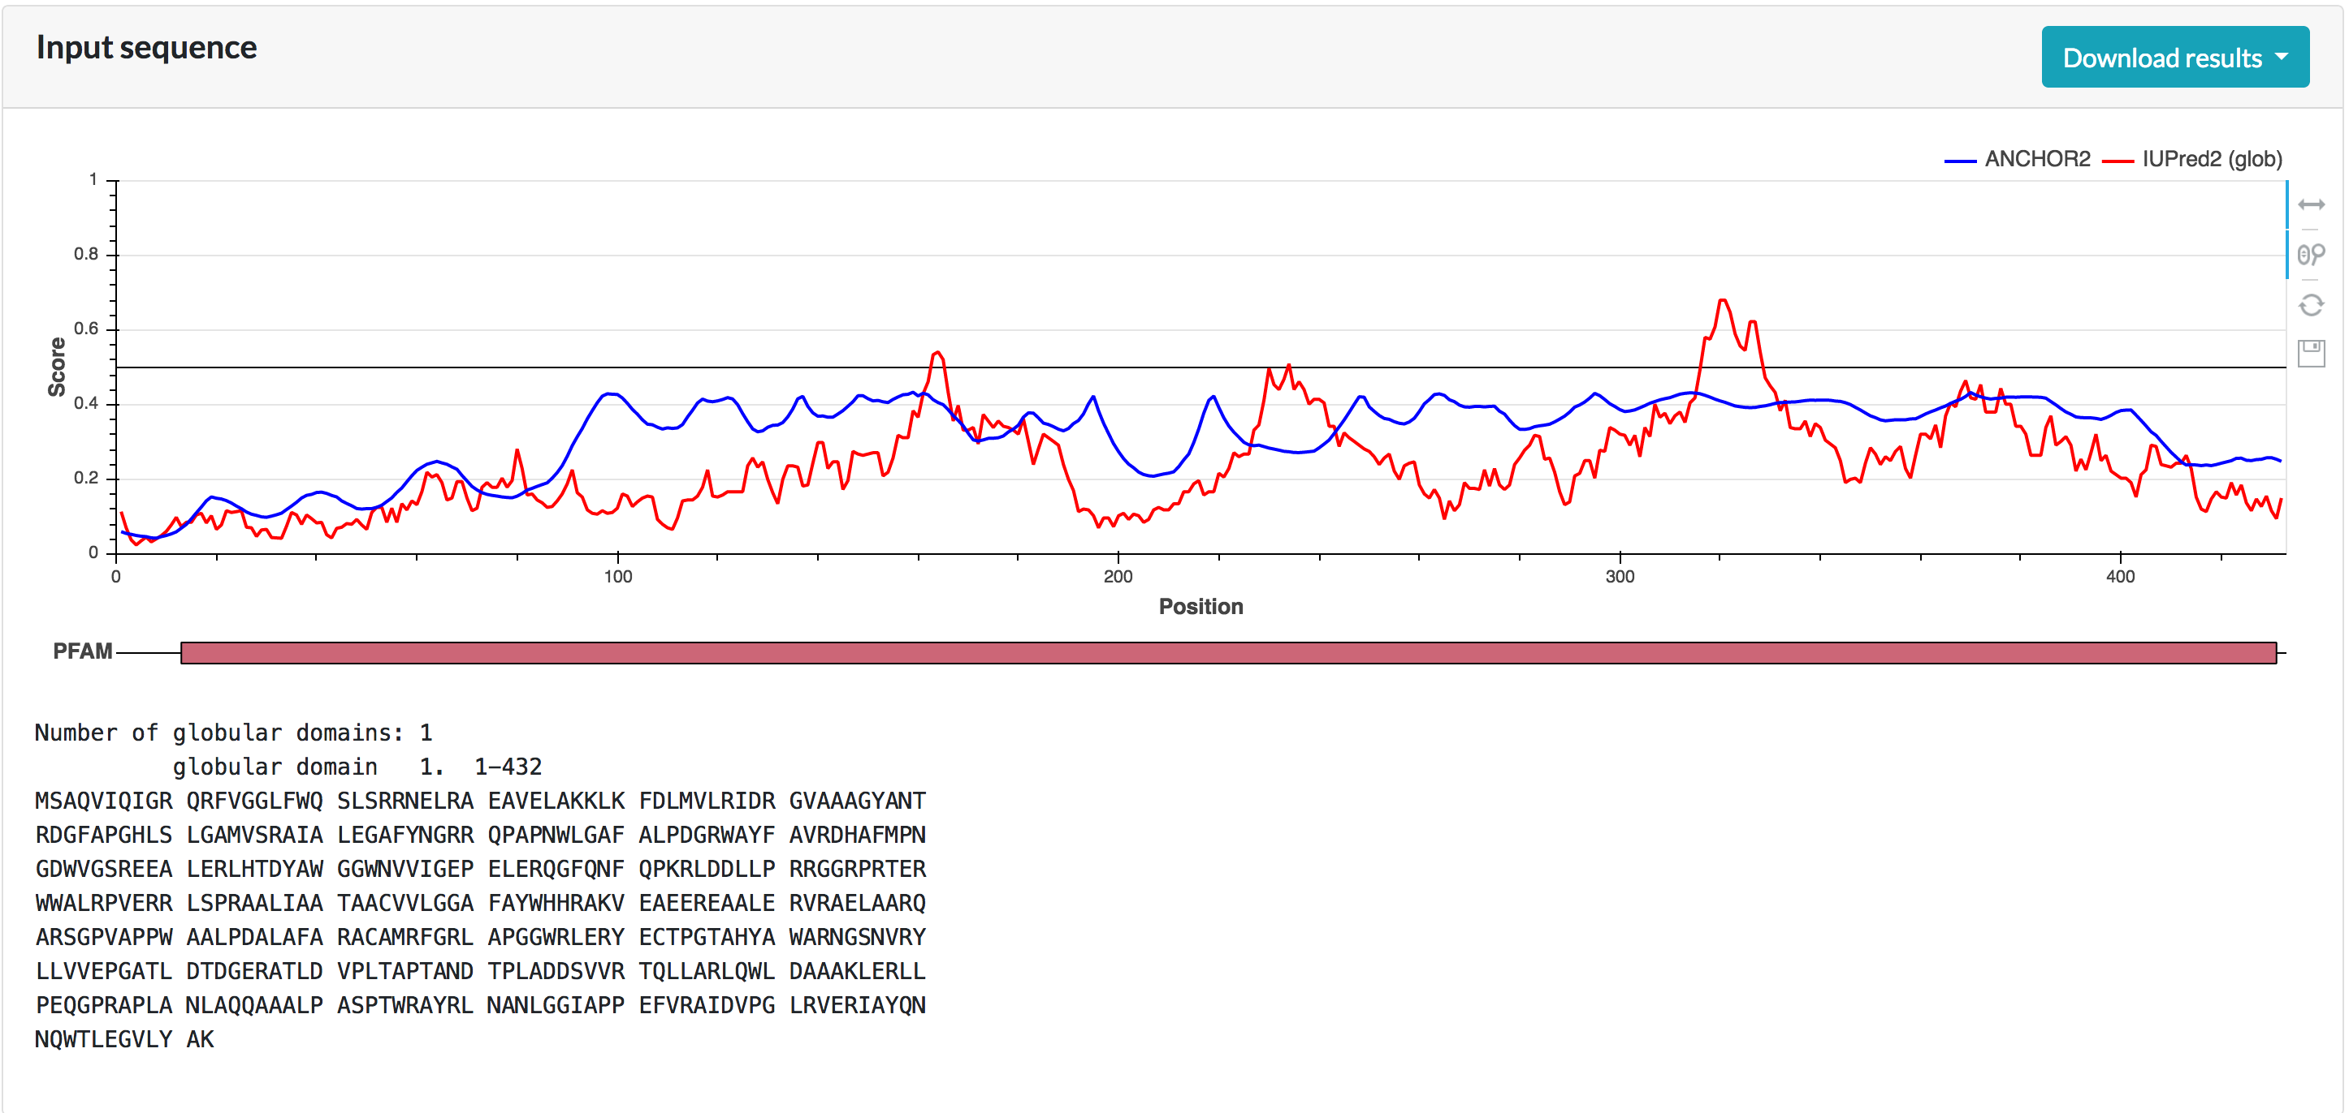
Sequence: IUPred
Unstructured (AKA disordered) regions
Low disorder region
(tendency)
High disorder region
(tendency)
Iupred does not predict a clear unustructured region or a clear domain

Slide 47
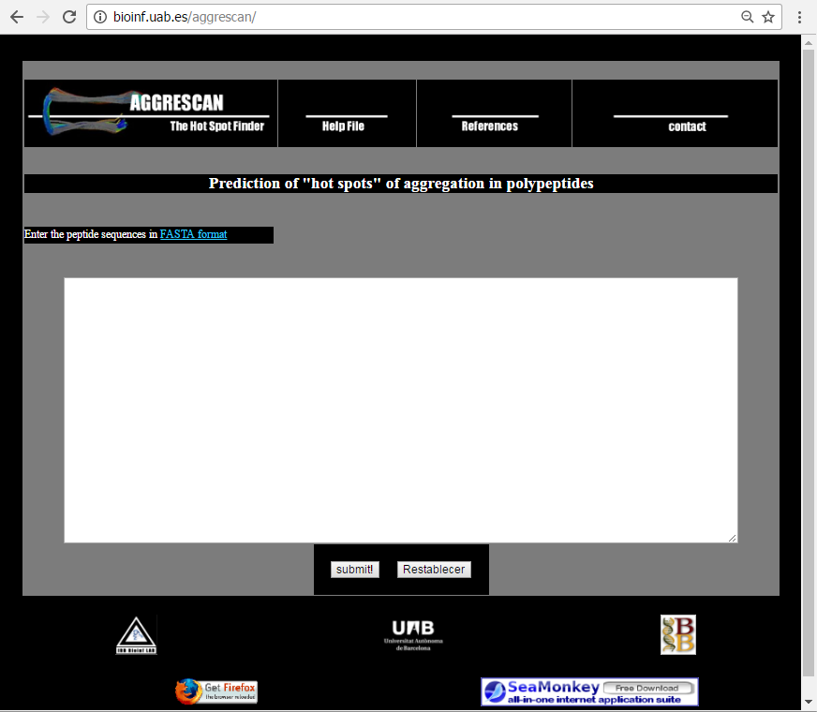
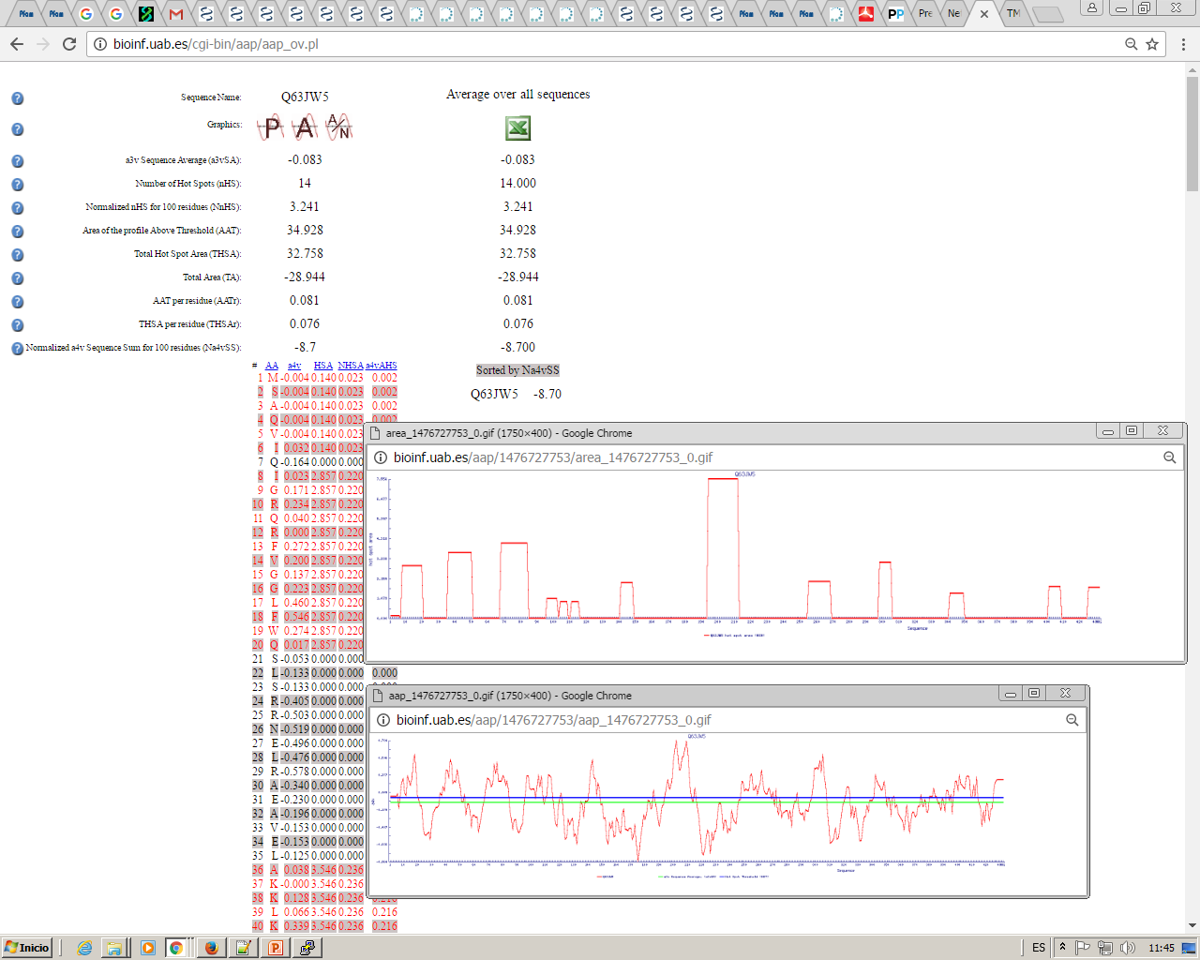
Sequence: Aggrescan
Aggregation Hot-Spots
Paste your sequence here
Aggrescan predicts a big aggregation hot-stpot
Aggrescan does not know if this region is surface exposed or not
(There is no problem with an aggregation hot spot which is not surface exposed)

Slide 48
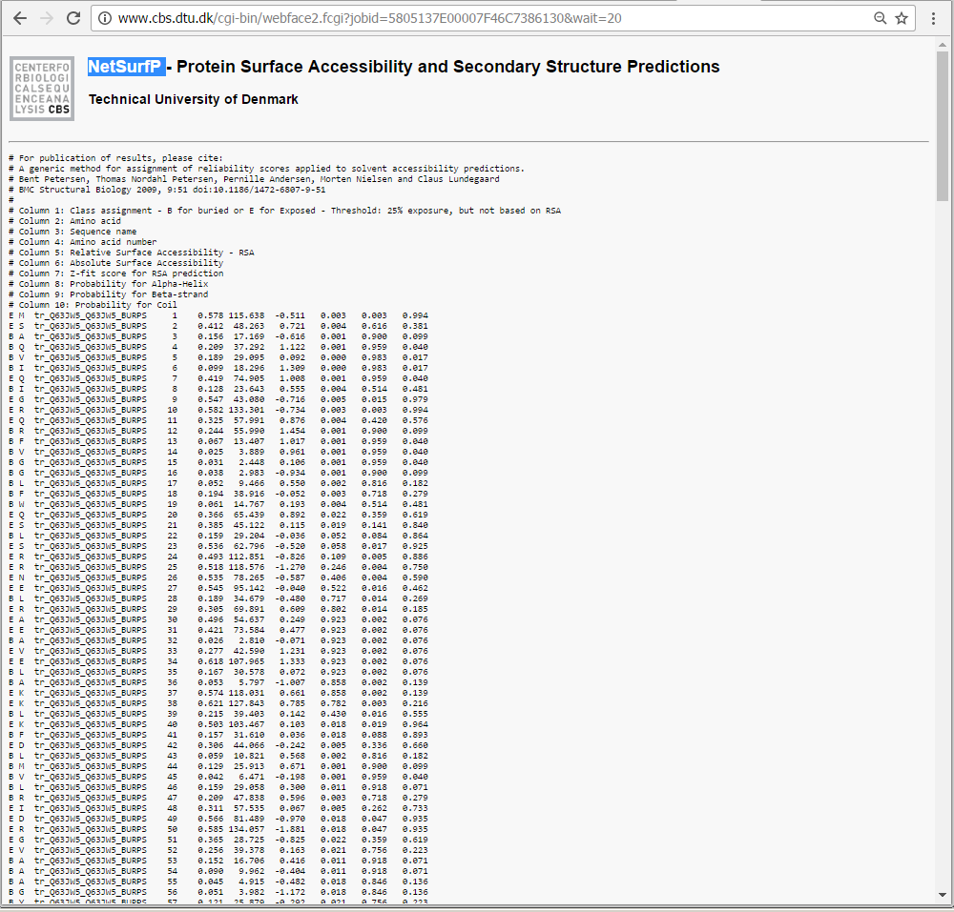
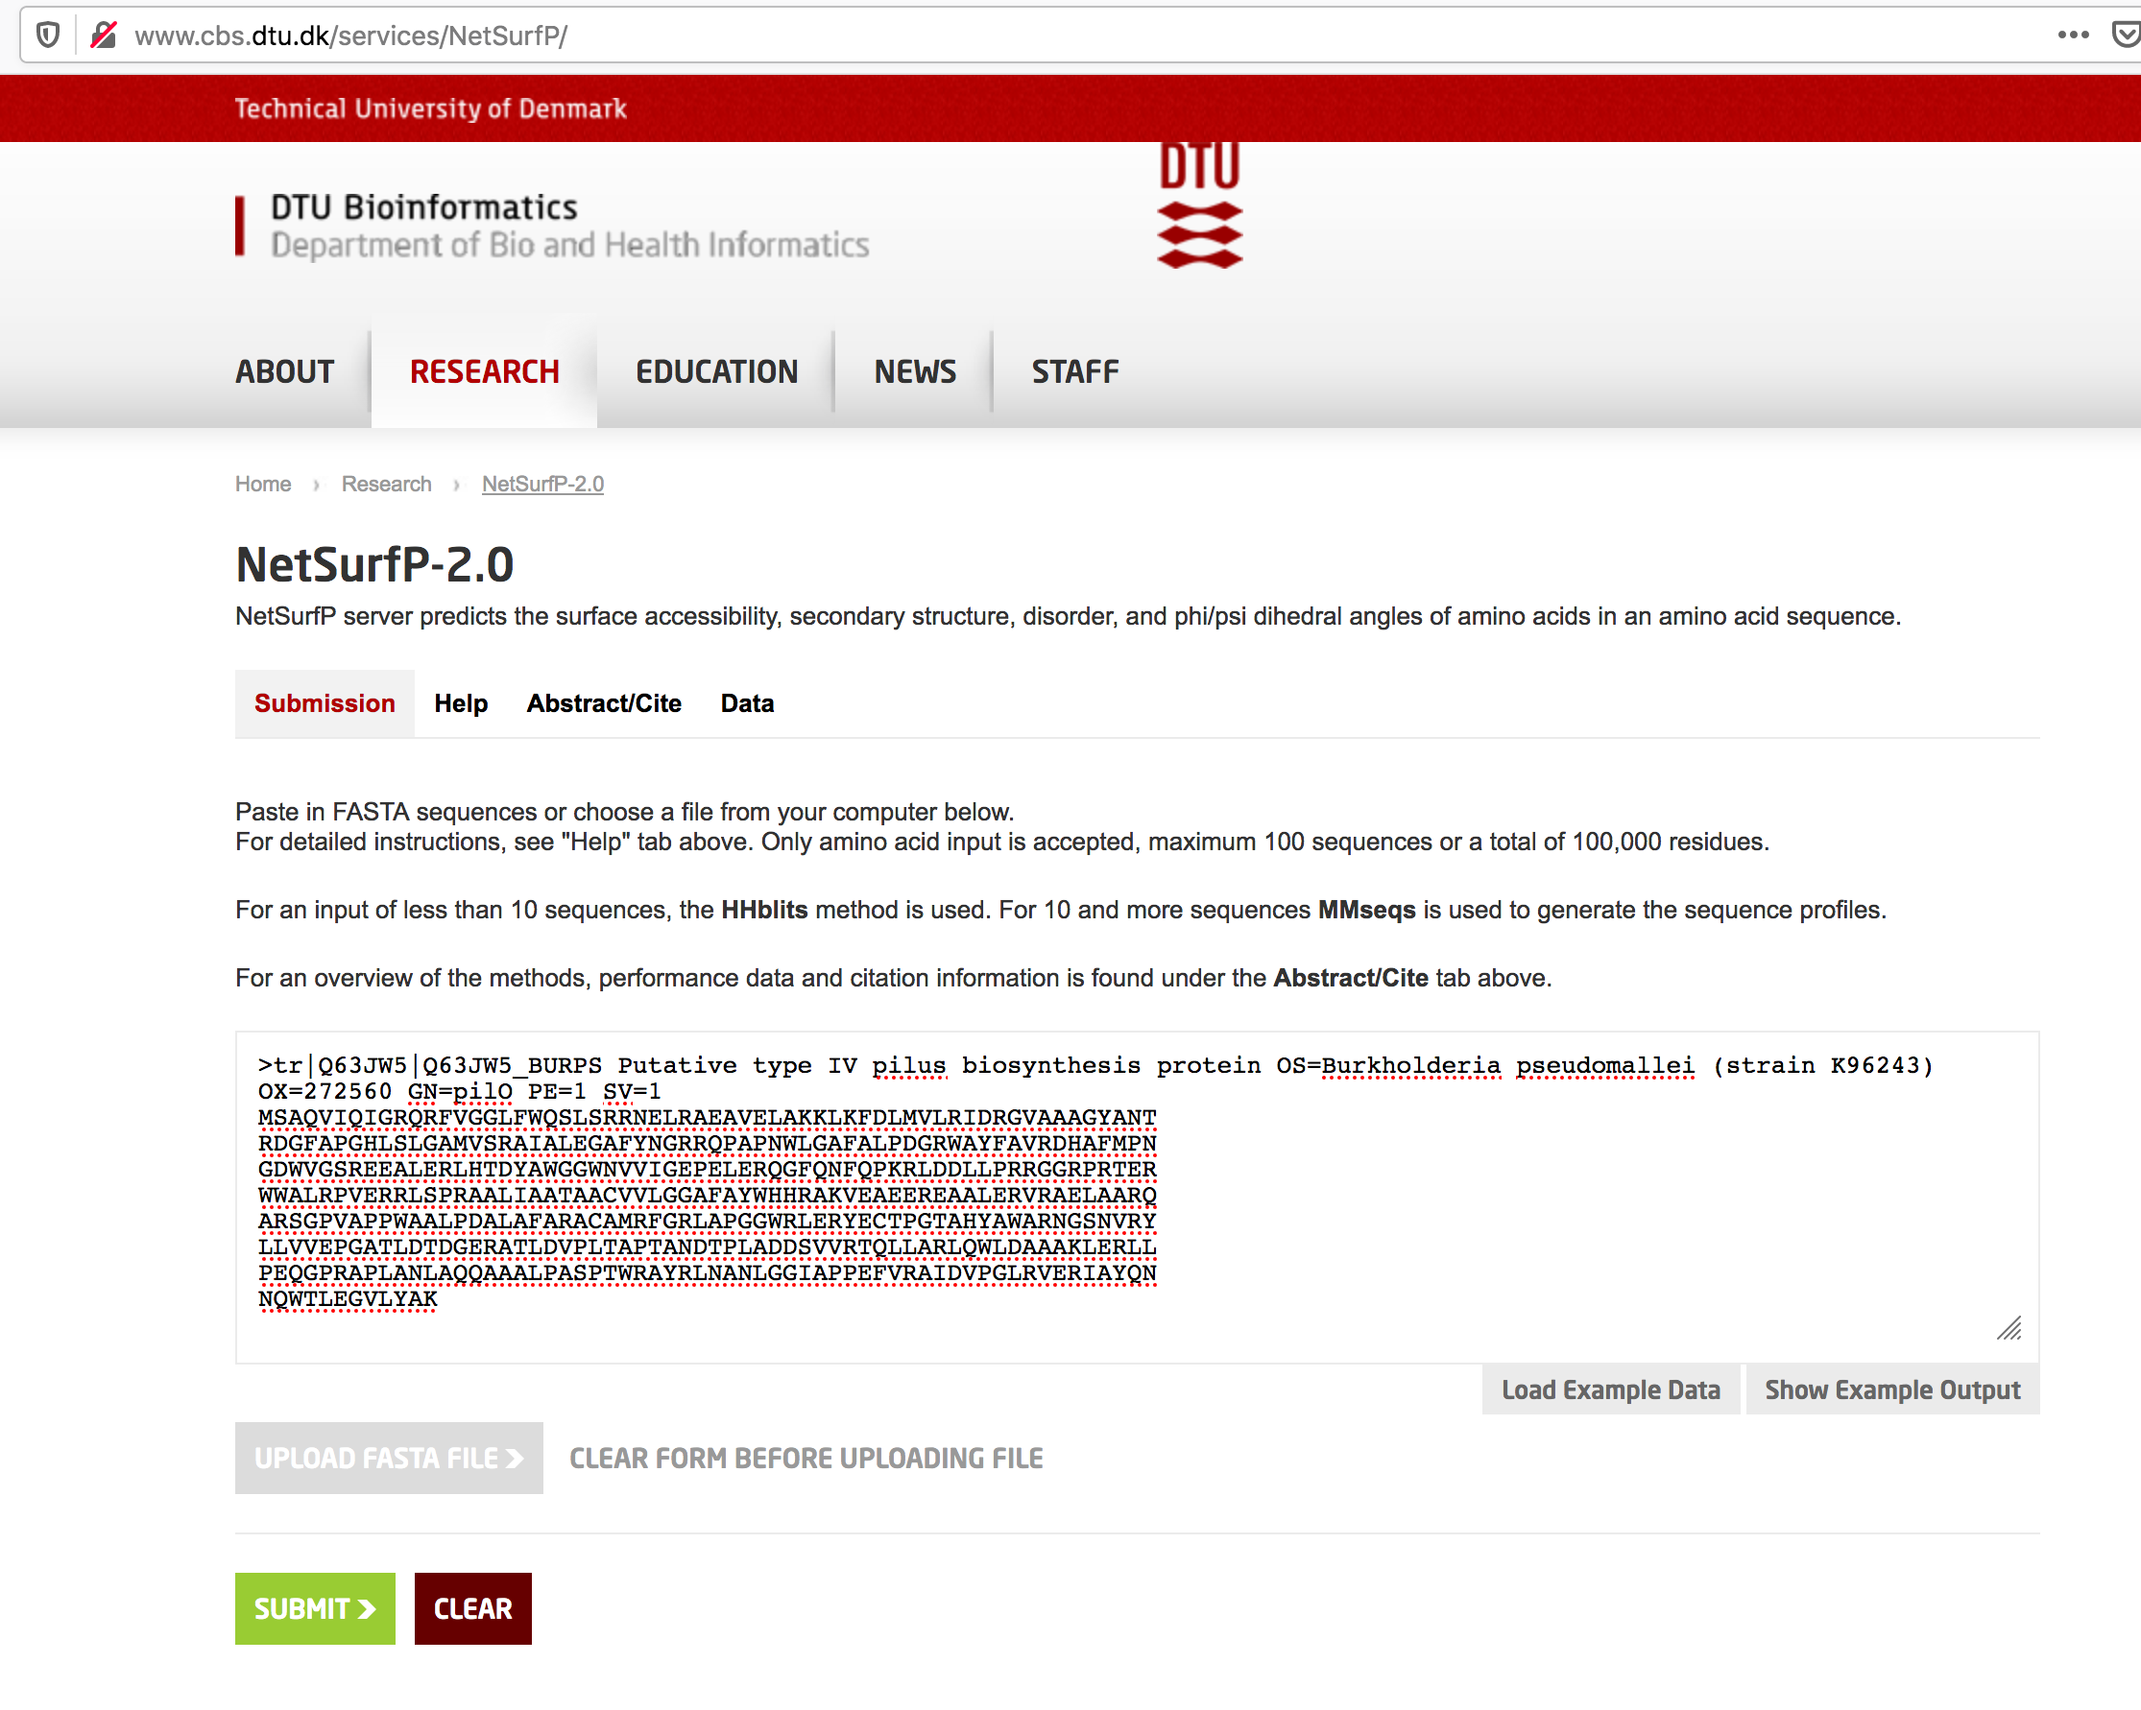
Sequence: NetSurfP
Surface Accessibility
Prediction of surface accessibility to see if aggregation regions are in the surface
Paste your sequence here

Slide 49
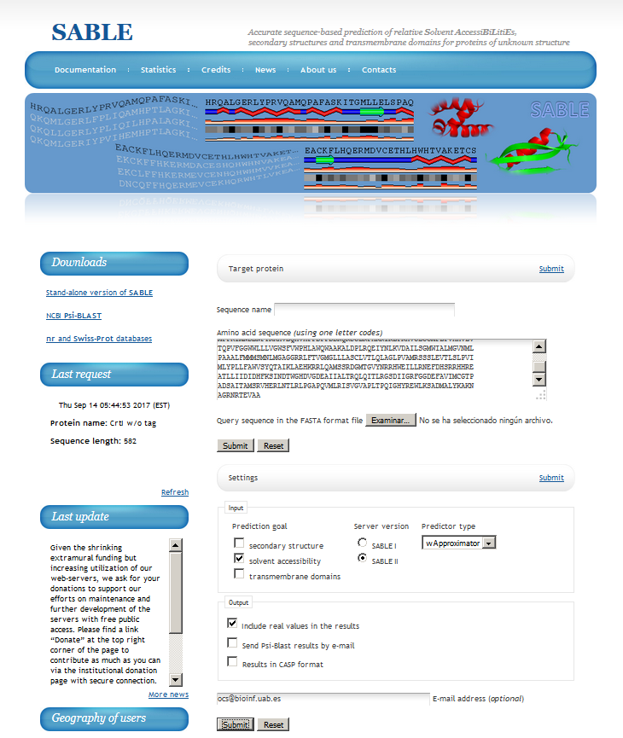
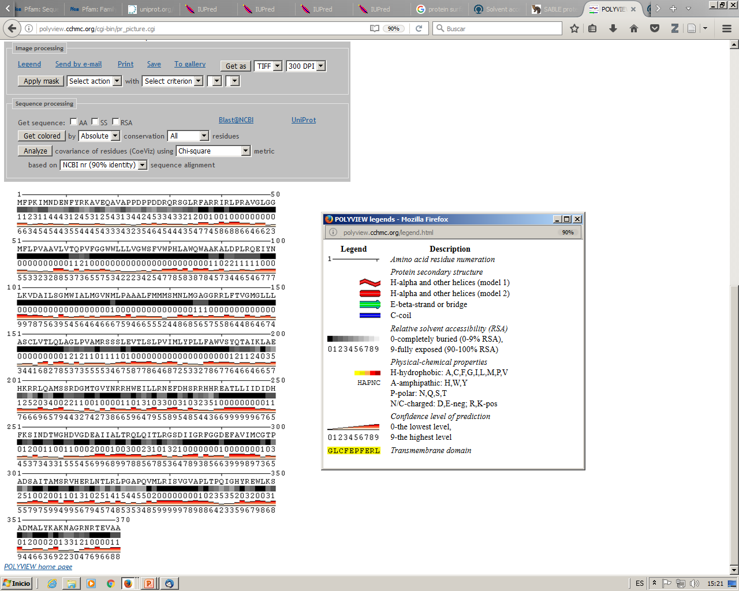
Sequence: SABLE
Surface Accessibility
http://sable.cchmc.org/
Prediction of surface accessibility to see if aggregation regions are in the surface
Paste your sequence here
Your email adress

Slide 50
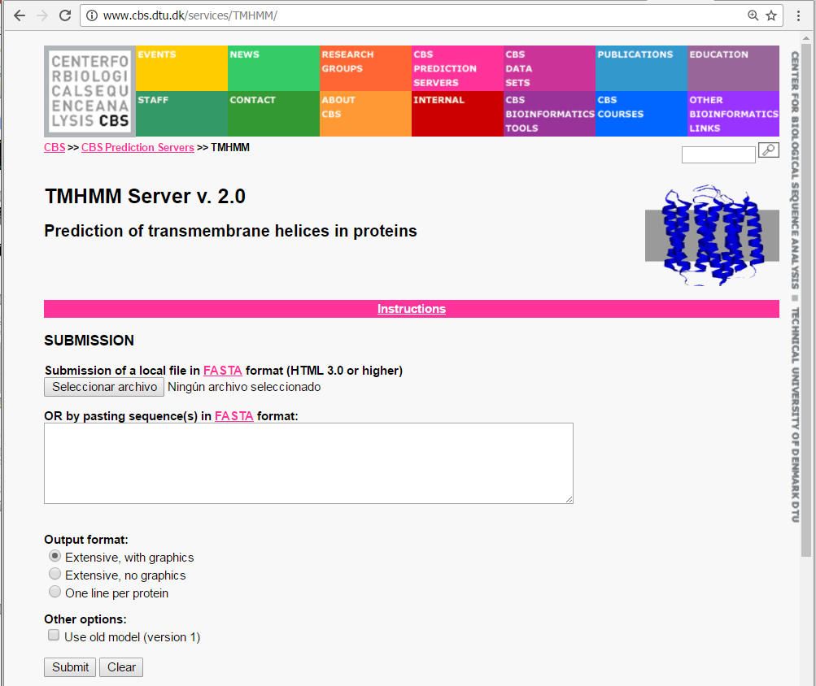
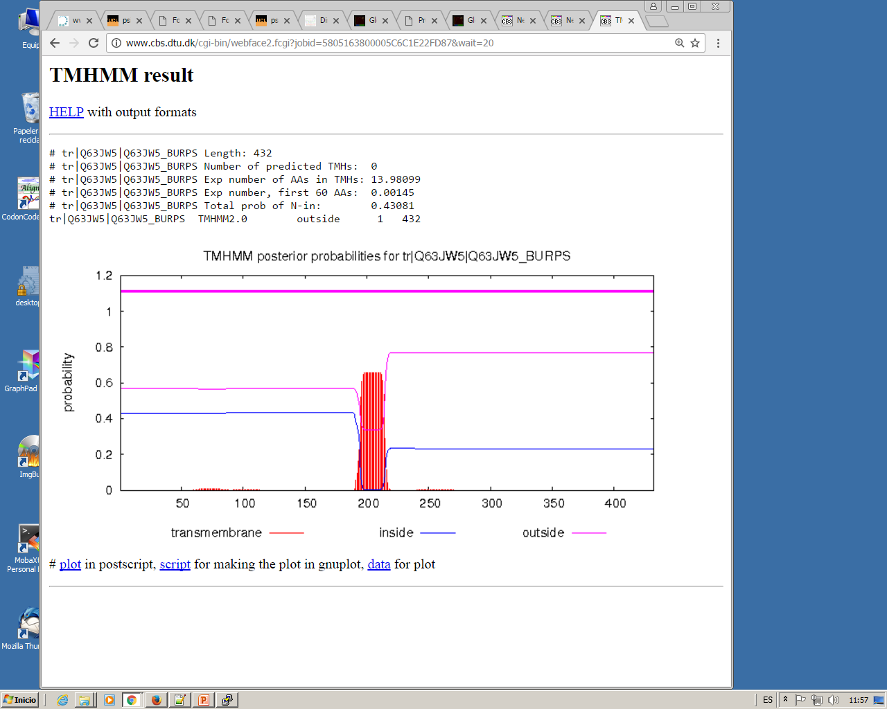
Sequence: TMHMM
Transmembrane helices (TMHs)
Paste your sequence here
TMHMM predicts 0 TMHs, but we can see a spike in the prediction numbers

Slide 51
Sequence: Prediction Sumary
We have added several predictions in the following exel:
http://bioinf.uab.es/ocs/PROTEINPRED/PilO2Bp_predictions.xlsx
Around residue 200 (approx.) Disopred predicts an unstructured region
Around residue 200 (approx.) IUpred predicts a transition of tendency from structured to unstructured.
Aggrescan also predicts a huge Hot-Spot in this region
NetSurfP and SABLE predict possible residues exposed in the same Hot-Spot region (although they are not very conclusive)
TMHMM shows a possible transmembrane in the same region (although it is not accepted)
Psipred shows a large Helix in this region and a predicted domain boundary
So with all this information what could we do?

Slide 52
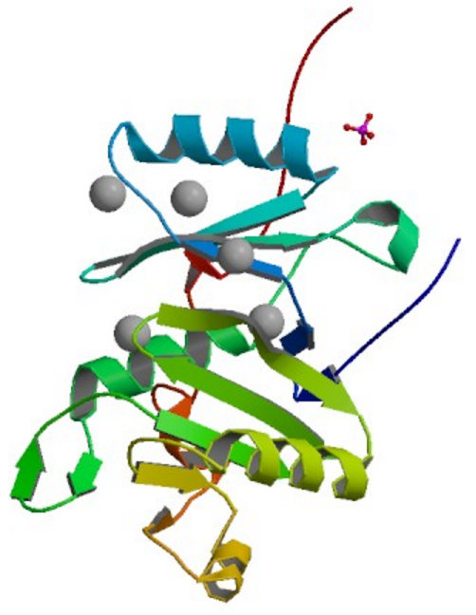
Sequence: Prediction Sumary
We can split the protein in two parts which we consider putative domains and express them independently:
Residues from 1 to 192 were produced and purified and its structure solved: PDB 4BYZ
We were not able to produce the other domain :(

Slide 53
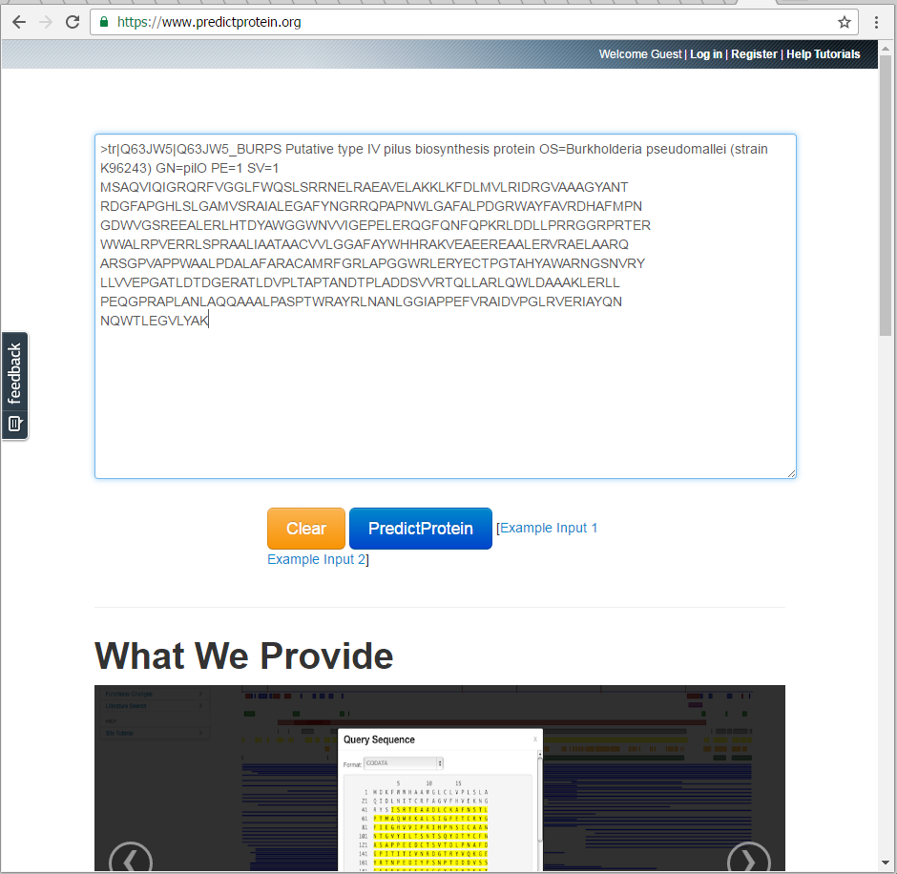
Sequence: PredictProtein
All in one
Integrates several predictors.
Data is presented graphically and together.
It is not free, but recently they provide an “open” version.

Slide 54
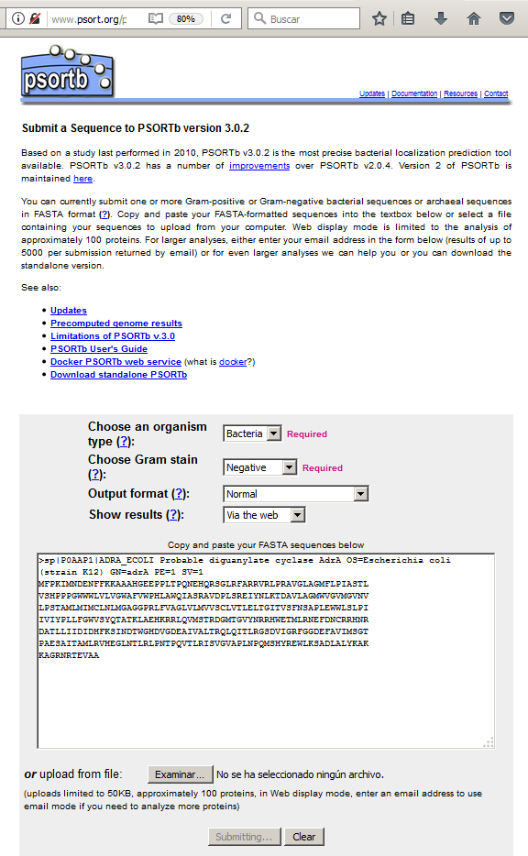
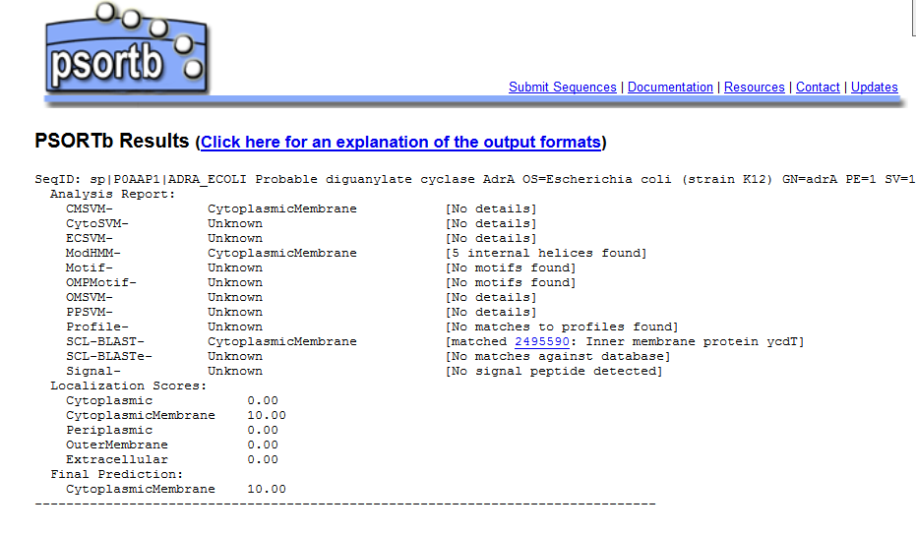
Sequence: PsortB
Cellular location prediction
Search by sequence:
ADRA_ECOLI
Predicted to be the cytoplasme membrane
Search by protein name:
ADRA_ECOLI

Slide 55
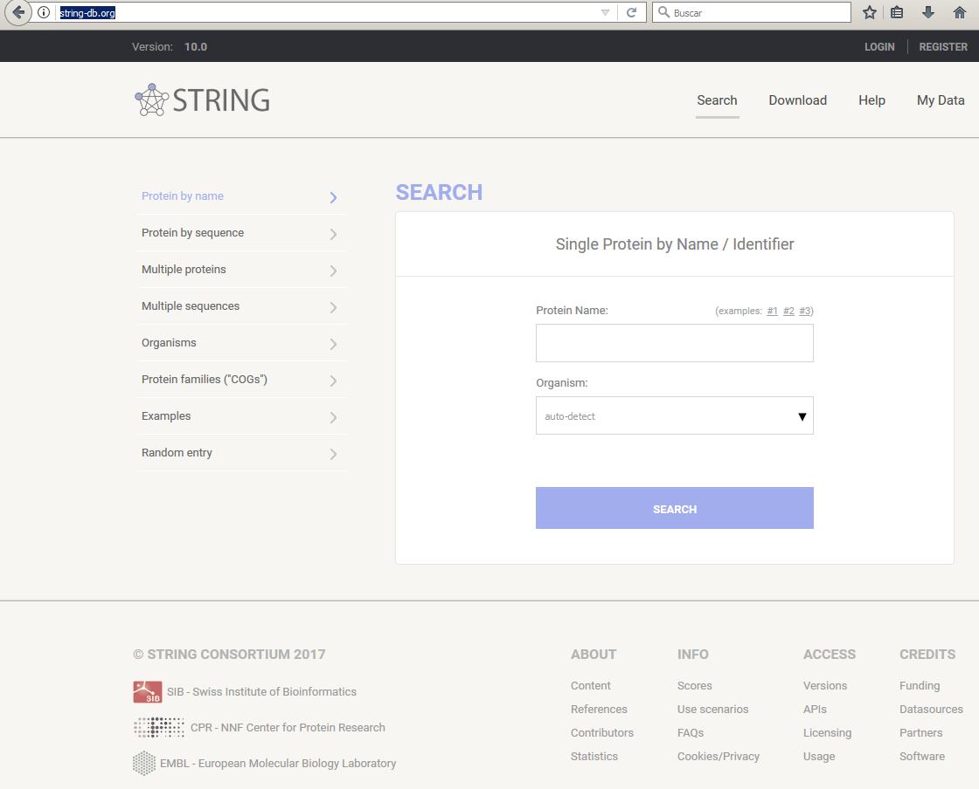
Sequence: STRING
Protein Interactions
http://string-db.org/
Search by protein name:
P0AAP1

Slide 56
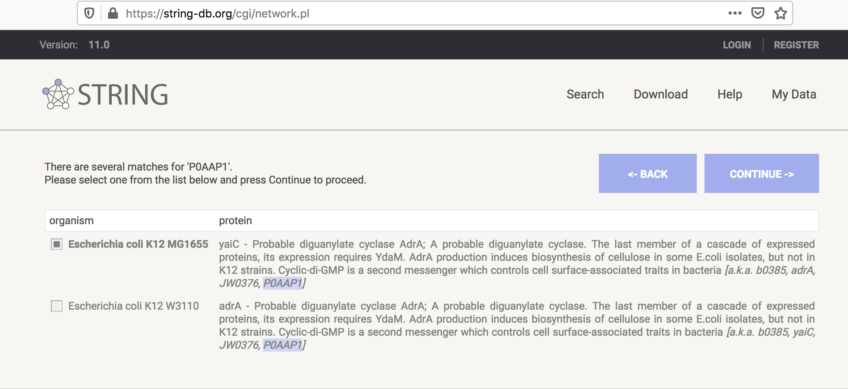
Sequence: STRING
Protein Interactions
2
1

Slide 57
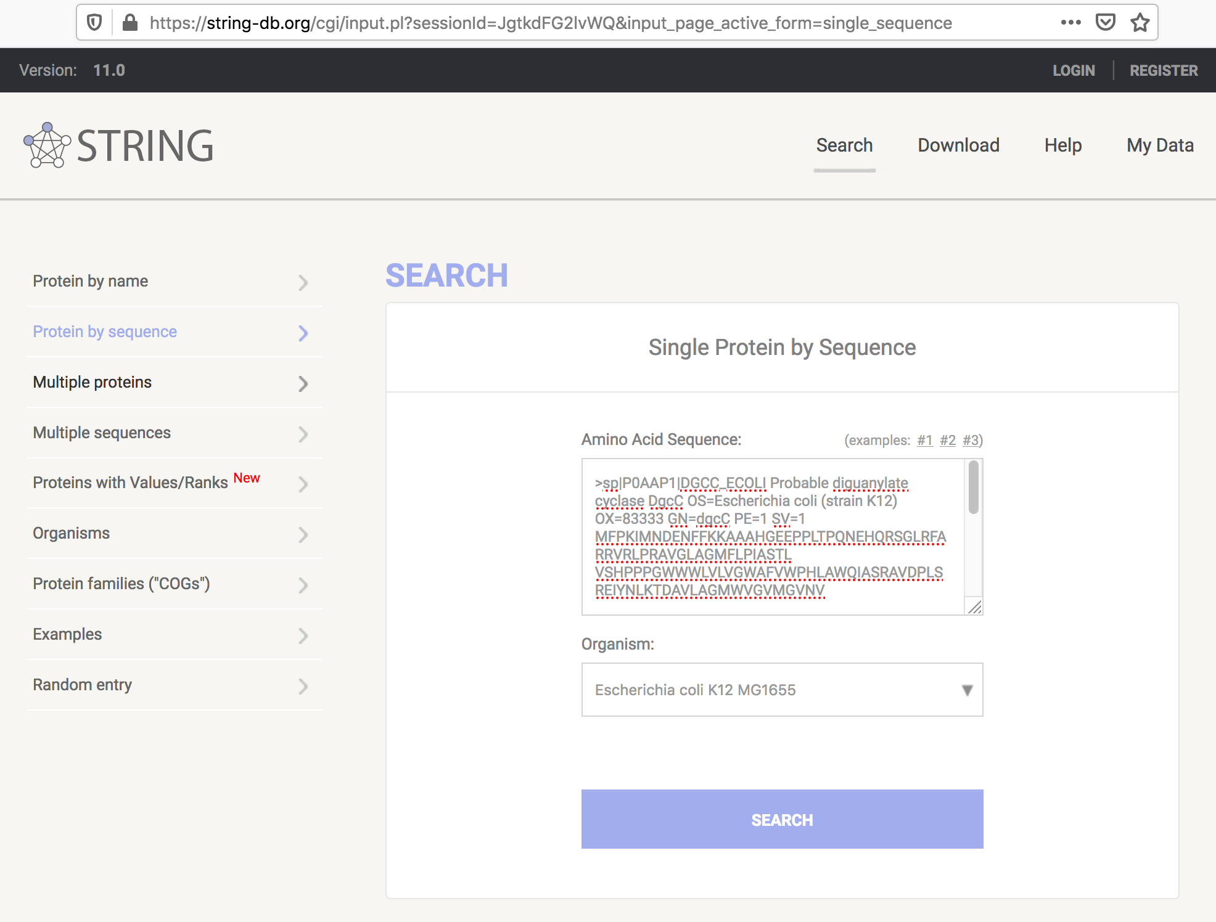
Sequence: STRING
Protein Interactions
Search by sequence
https://www.uniprot.org/uniprot/P0AAP1.fasta
Select organism

Slide 58
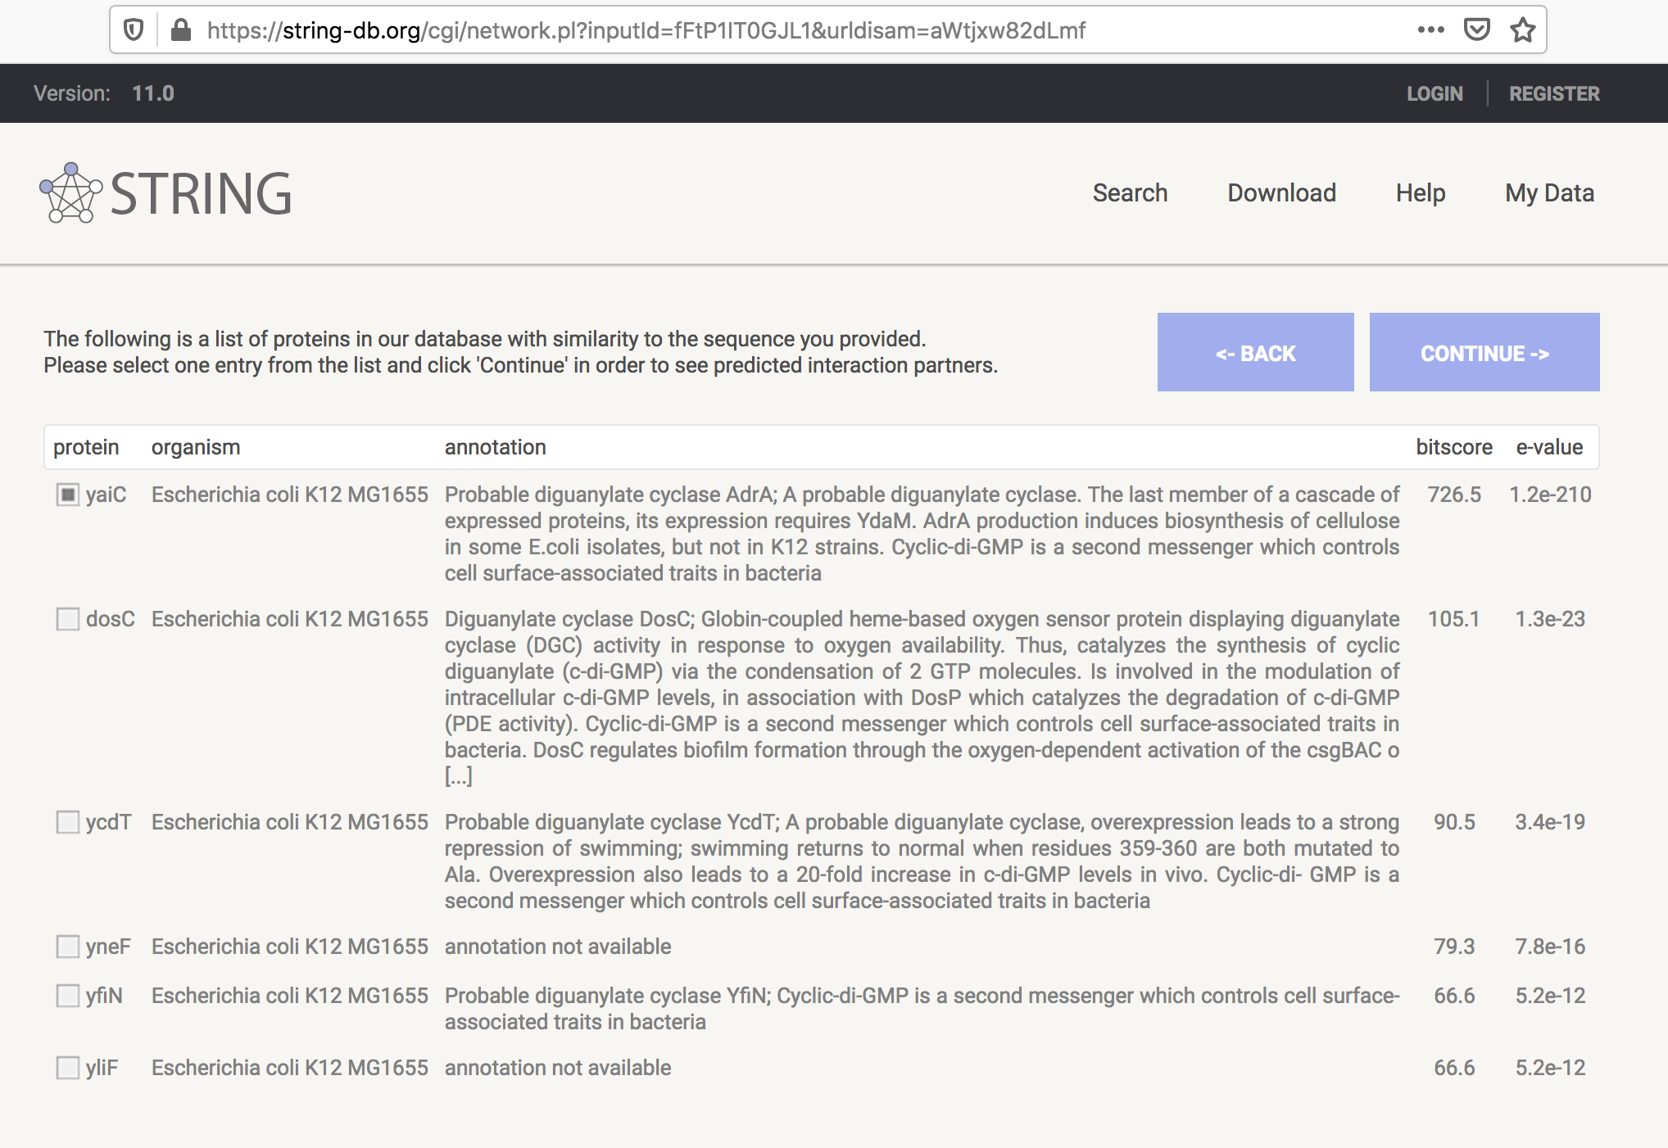
Sequence: STRING
Protein Interactions
2
1

Slide 59
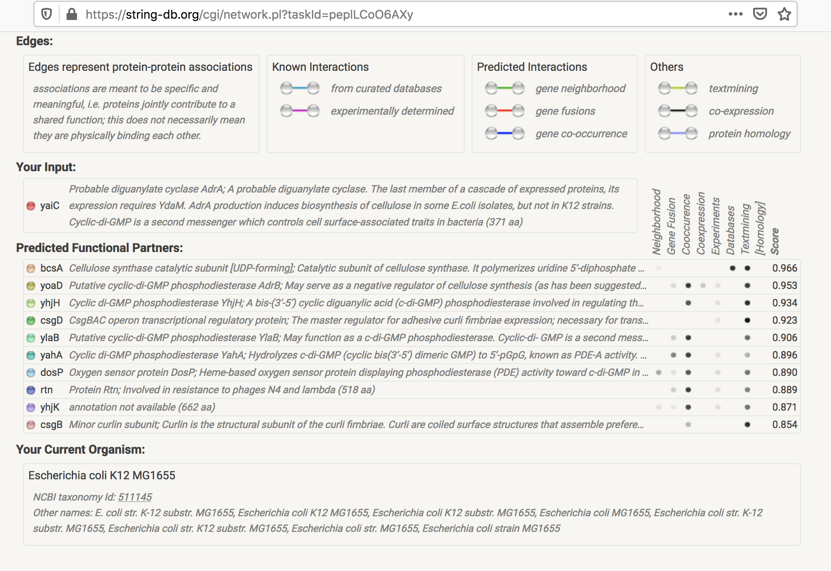
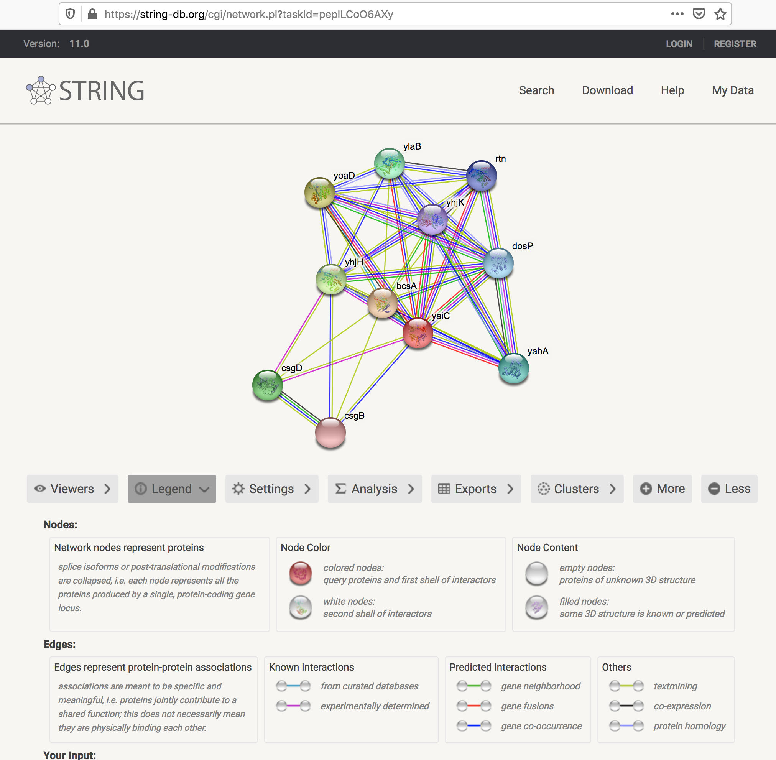
Sequence: STRING
Protein Interactions
Interaction network
https://string-db.org/cgi/network.pl?taskId=hiNQqD50R4f2
Source of the presented interaction. Not all sources are the same (predicted vs known)
colors in the axes
Dots in the table indicates how strong is the evidence
Compare a “Known source” (eg: Database) to other (eg: “Text mining”)

Slide 60
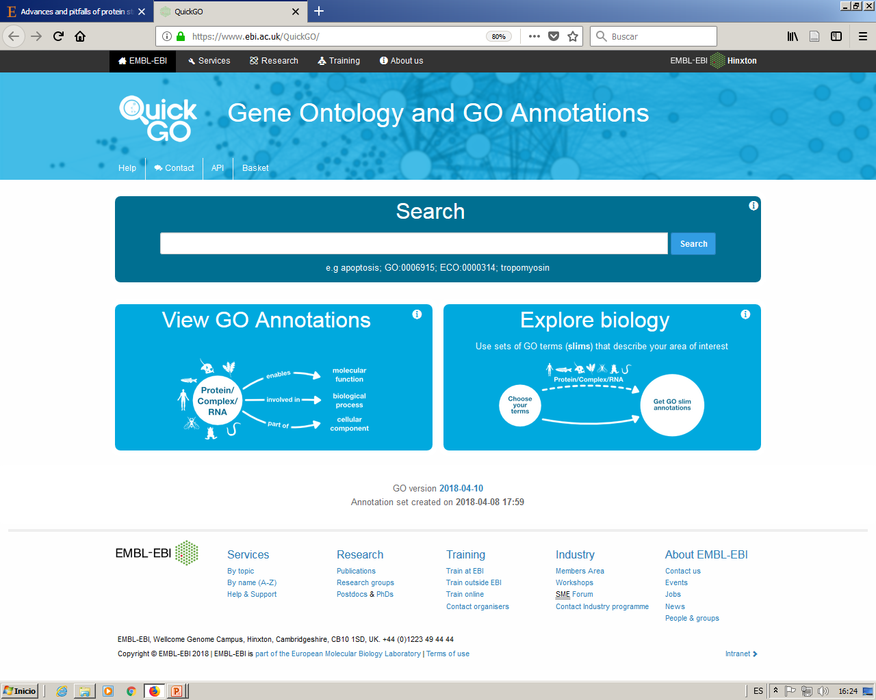
Sequence: GO
Gene Ontology
https://www.ebi.ac.uk/QuickGO/
GO is a controlled vocabulary describing three functional attributes of gene products: molecular function, biological process and cellular component. The terms within these three ontologies have unique identifiers and are organized as a directed acyclic graph (DAG), a hierarchical structure where each term can have one or many parent (less-specific) terms and zero, one or many child (more-specific) terms
antibiotic metabolic process

Slide 61
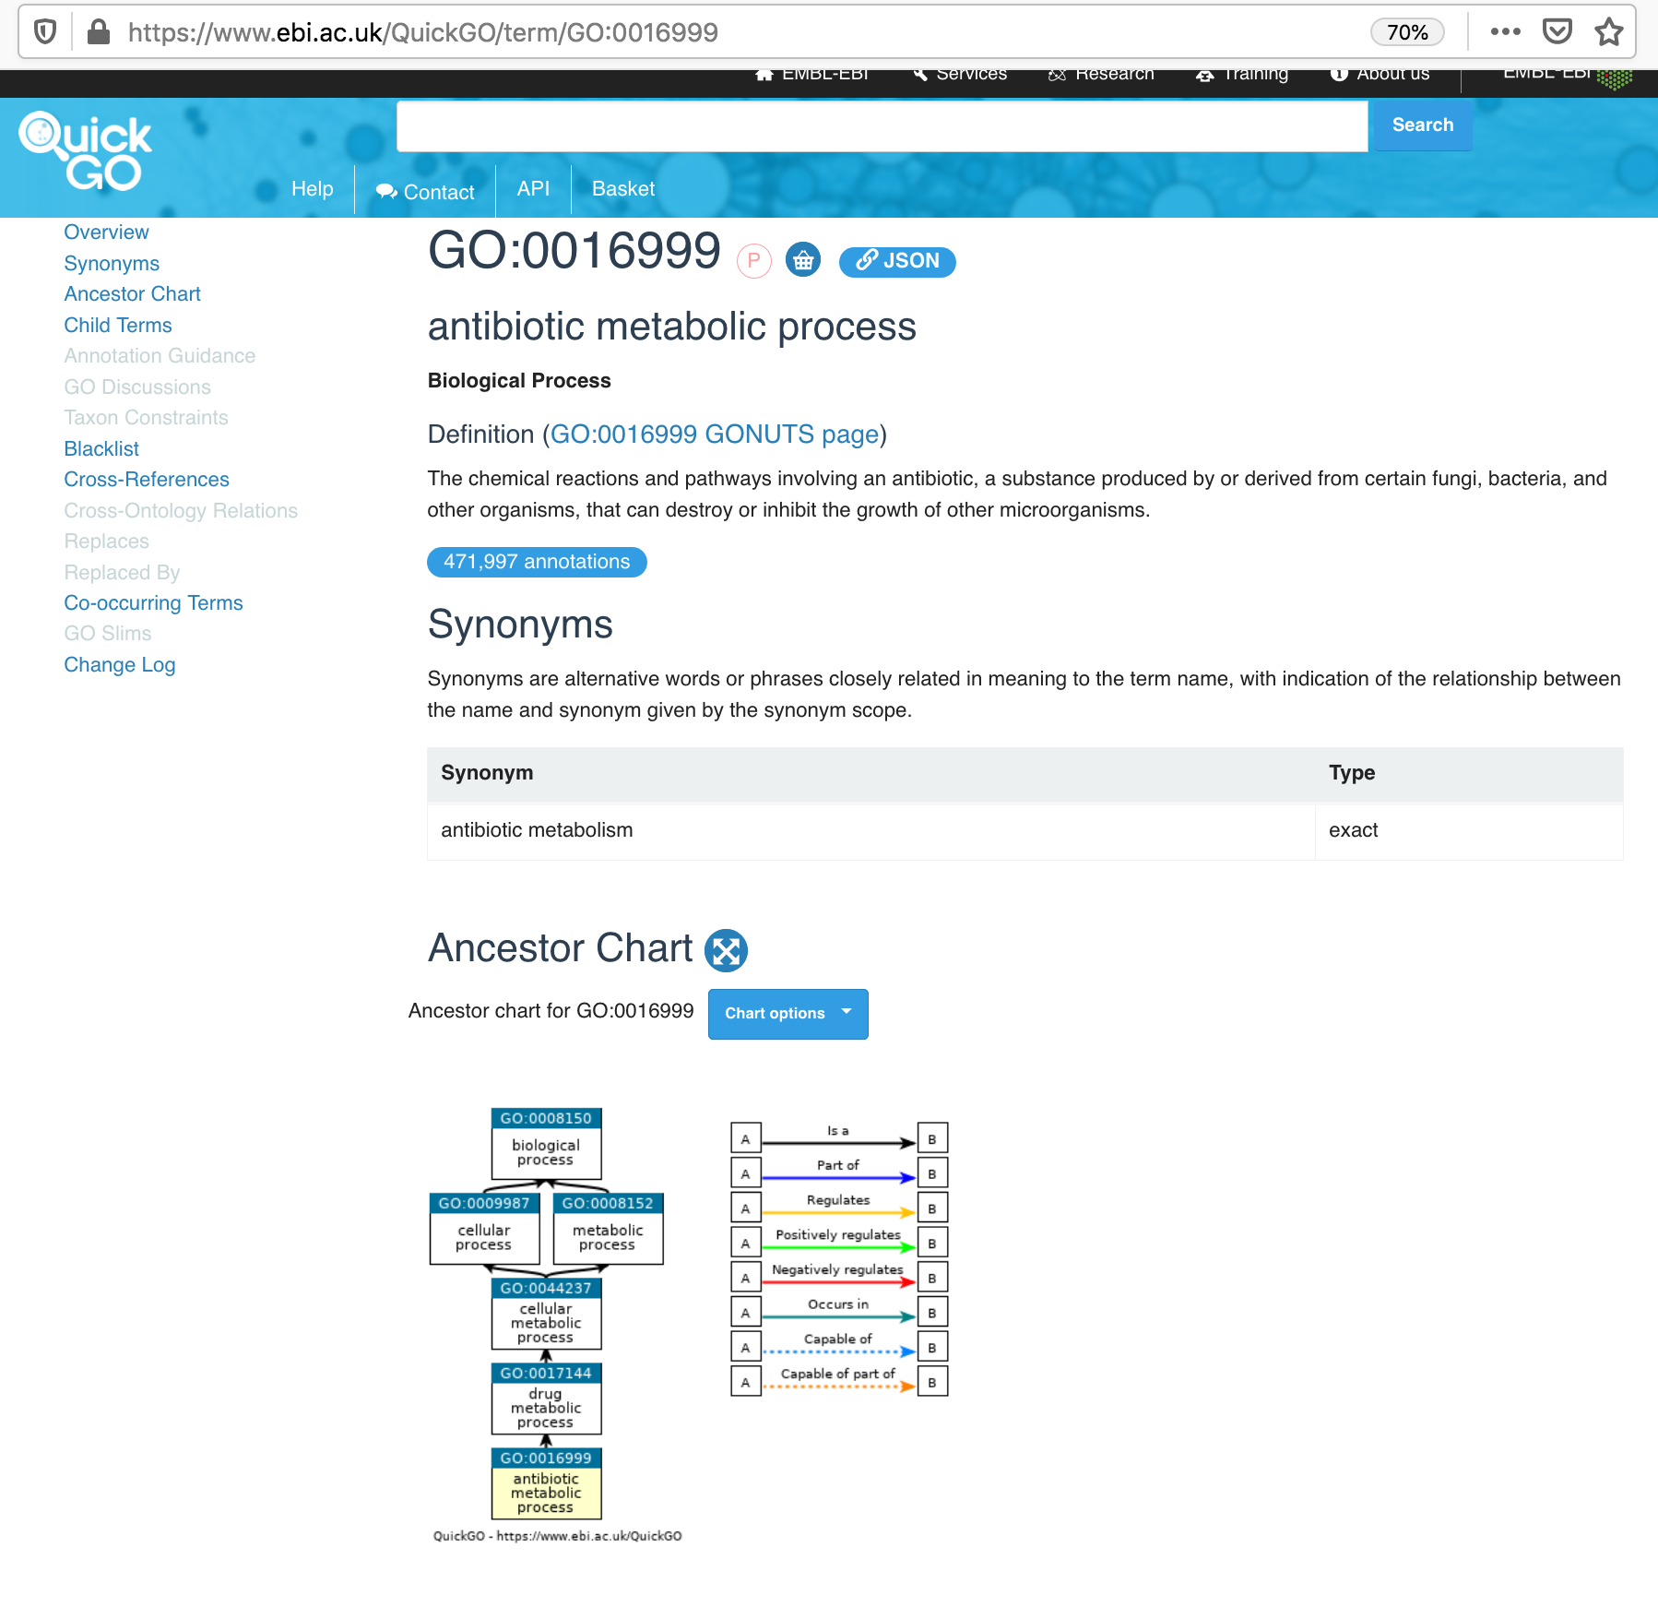
Sequence: GO
Gene Ontology
GO code
This term descends from those others, (its parents).
If a protein has this term (GO: 0016999 antibiotic metabolic process) will have all its ancestors too.

Slide 62
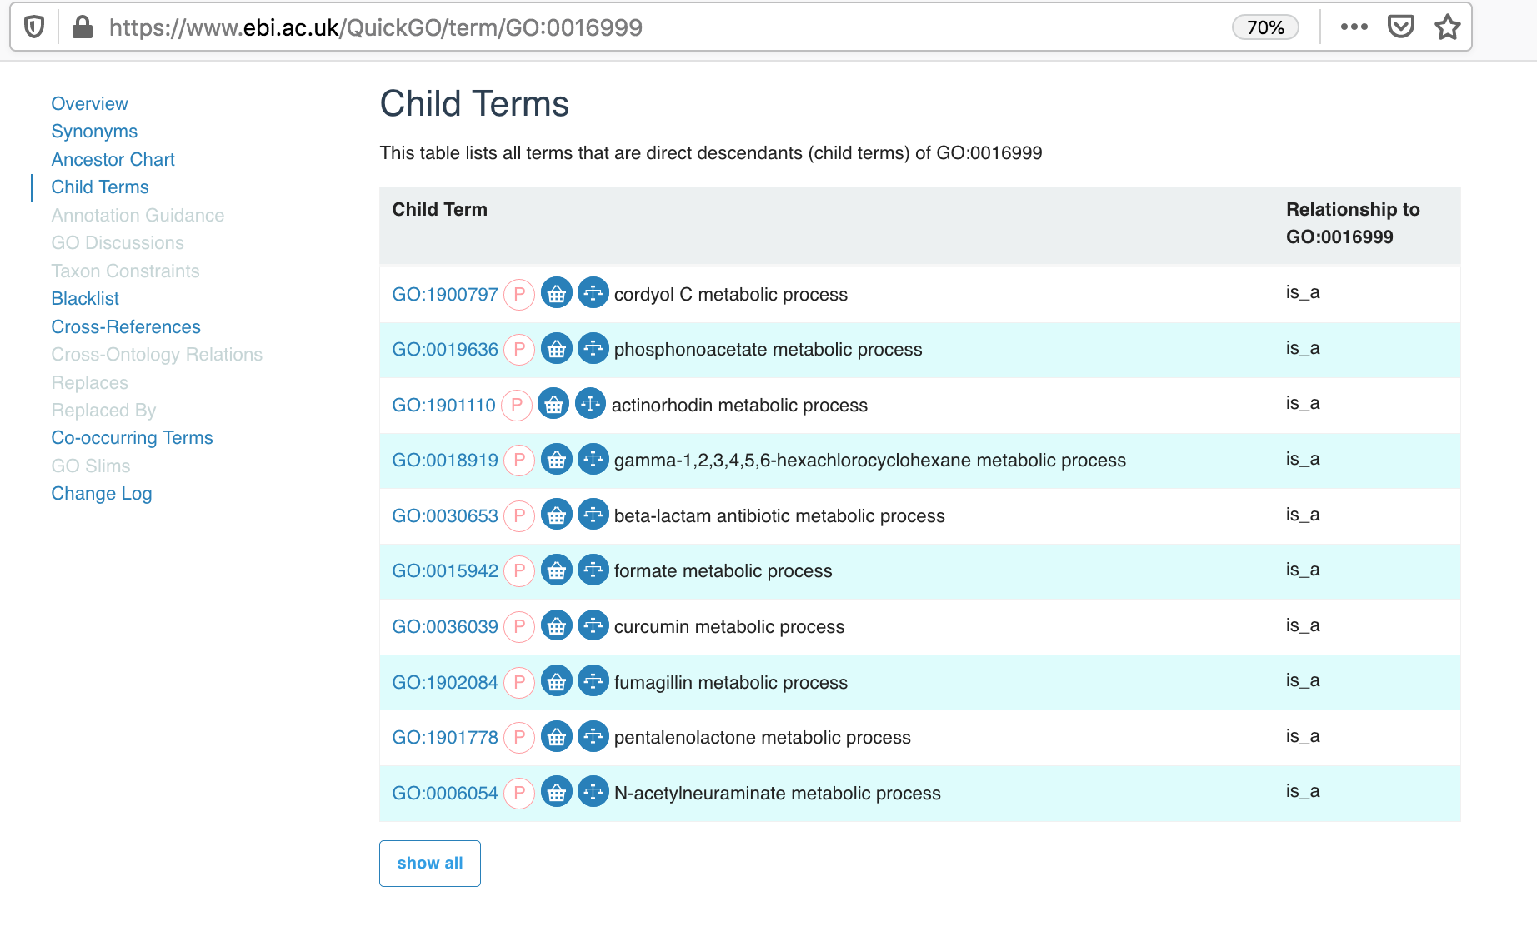
Sequence: GO
Gene Ontology
This term has many descends (its child).
If a protein has this term (GO: 0016999 antibiotic metabolic process) will not necessarily have any if its descendants.

Slide 63
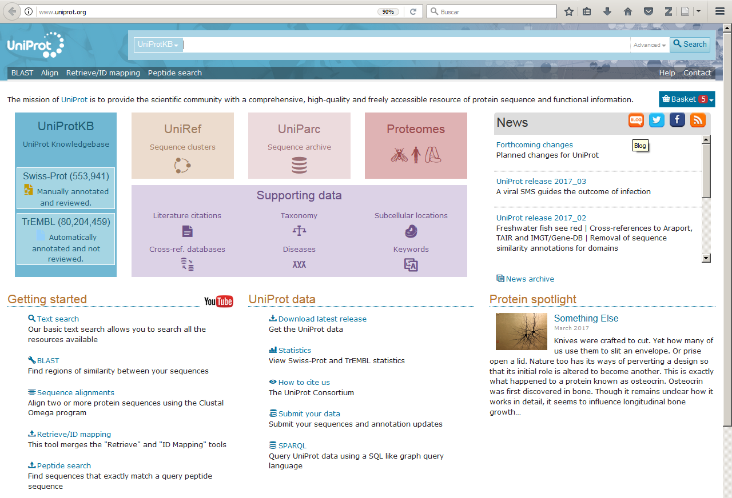
Sequence: GO & UP
Gene Ontology & Uniprot
Using Uniprot we can create complex searches with go terms.

Slide 64
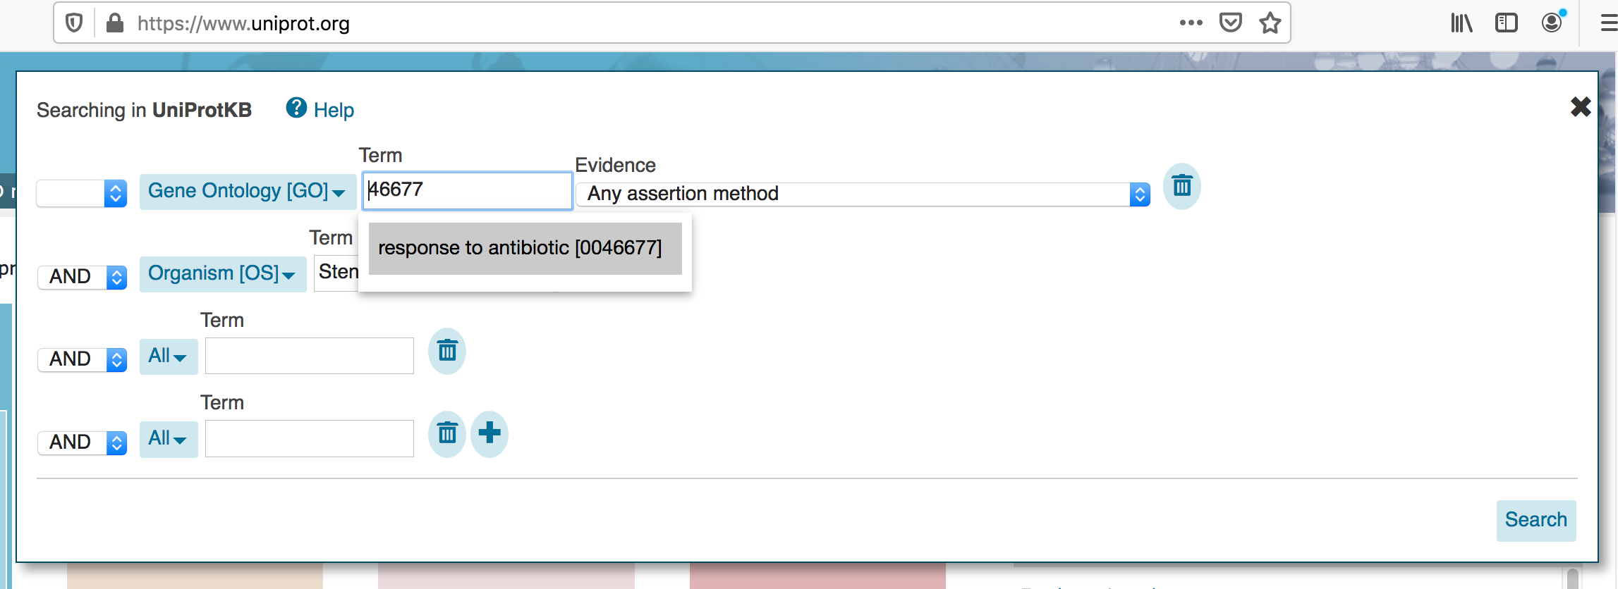
Sequence: GO
Gene Ontology
Using Uniprot we can create complex searches.
Example: all proteins annotated as involved in pathogenesis in Stenotrophomonas maltophilia
Where to search:GO
GO code
Organism: Stenotrophomonas maltophilia
Boolean condition
Where to search:
Organism

Slide 65
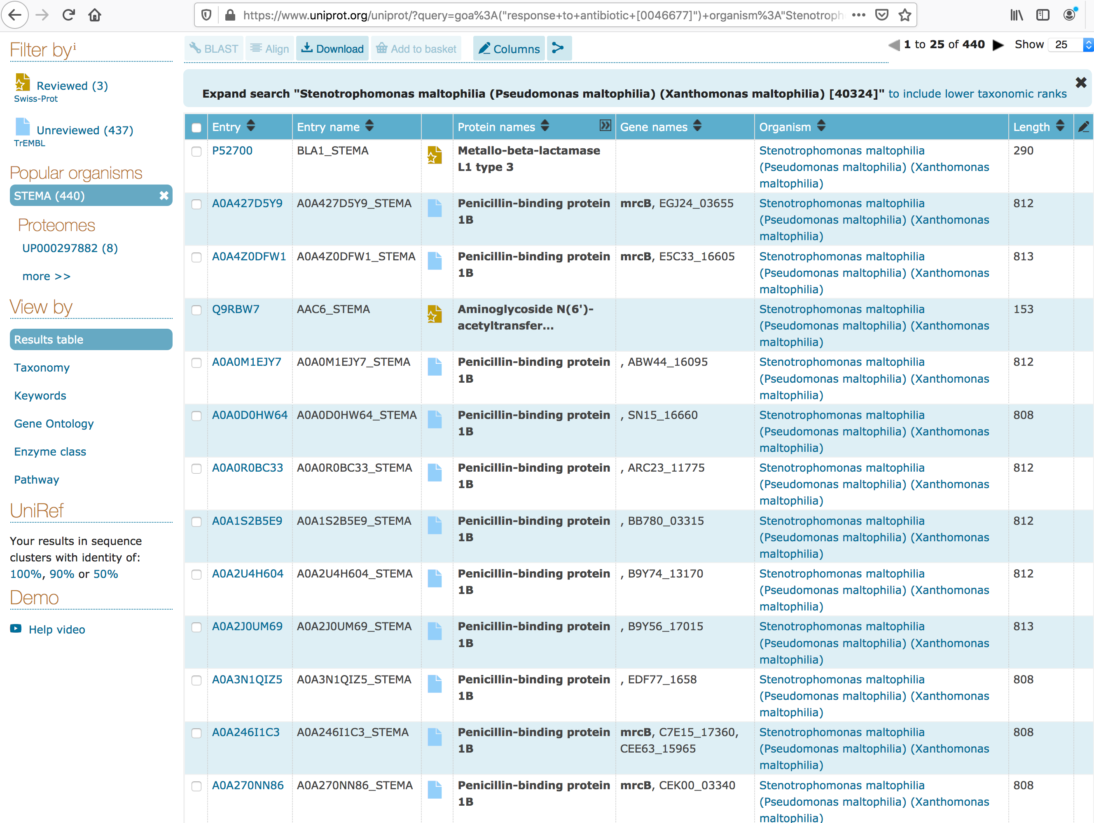
Sequence: GO & UP
Gene Ontology & Uniprot
There are probably redundant results
mrcB:
Same protein in different strains
UniRef:
Cluster of similar sequences (100, 90 or 50 % identical

Slide 66
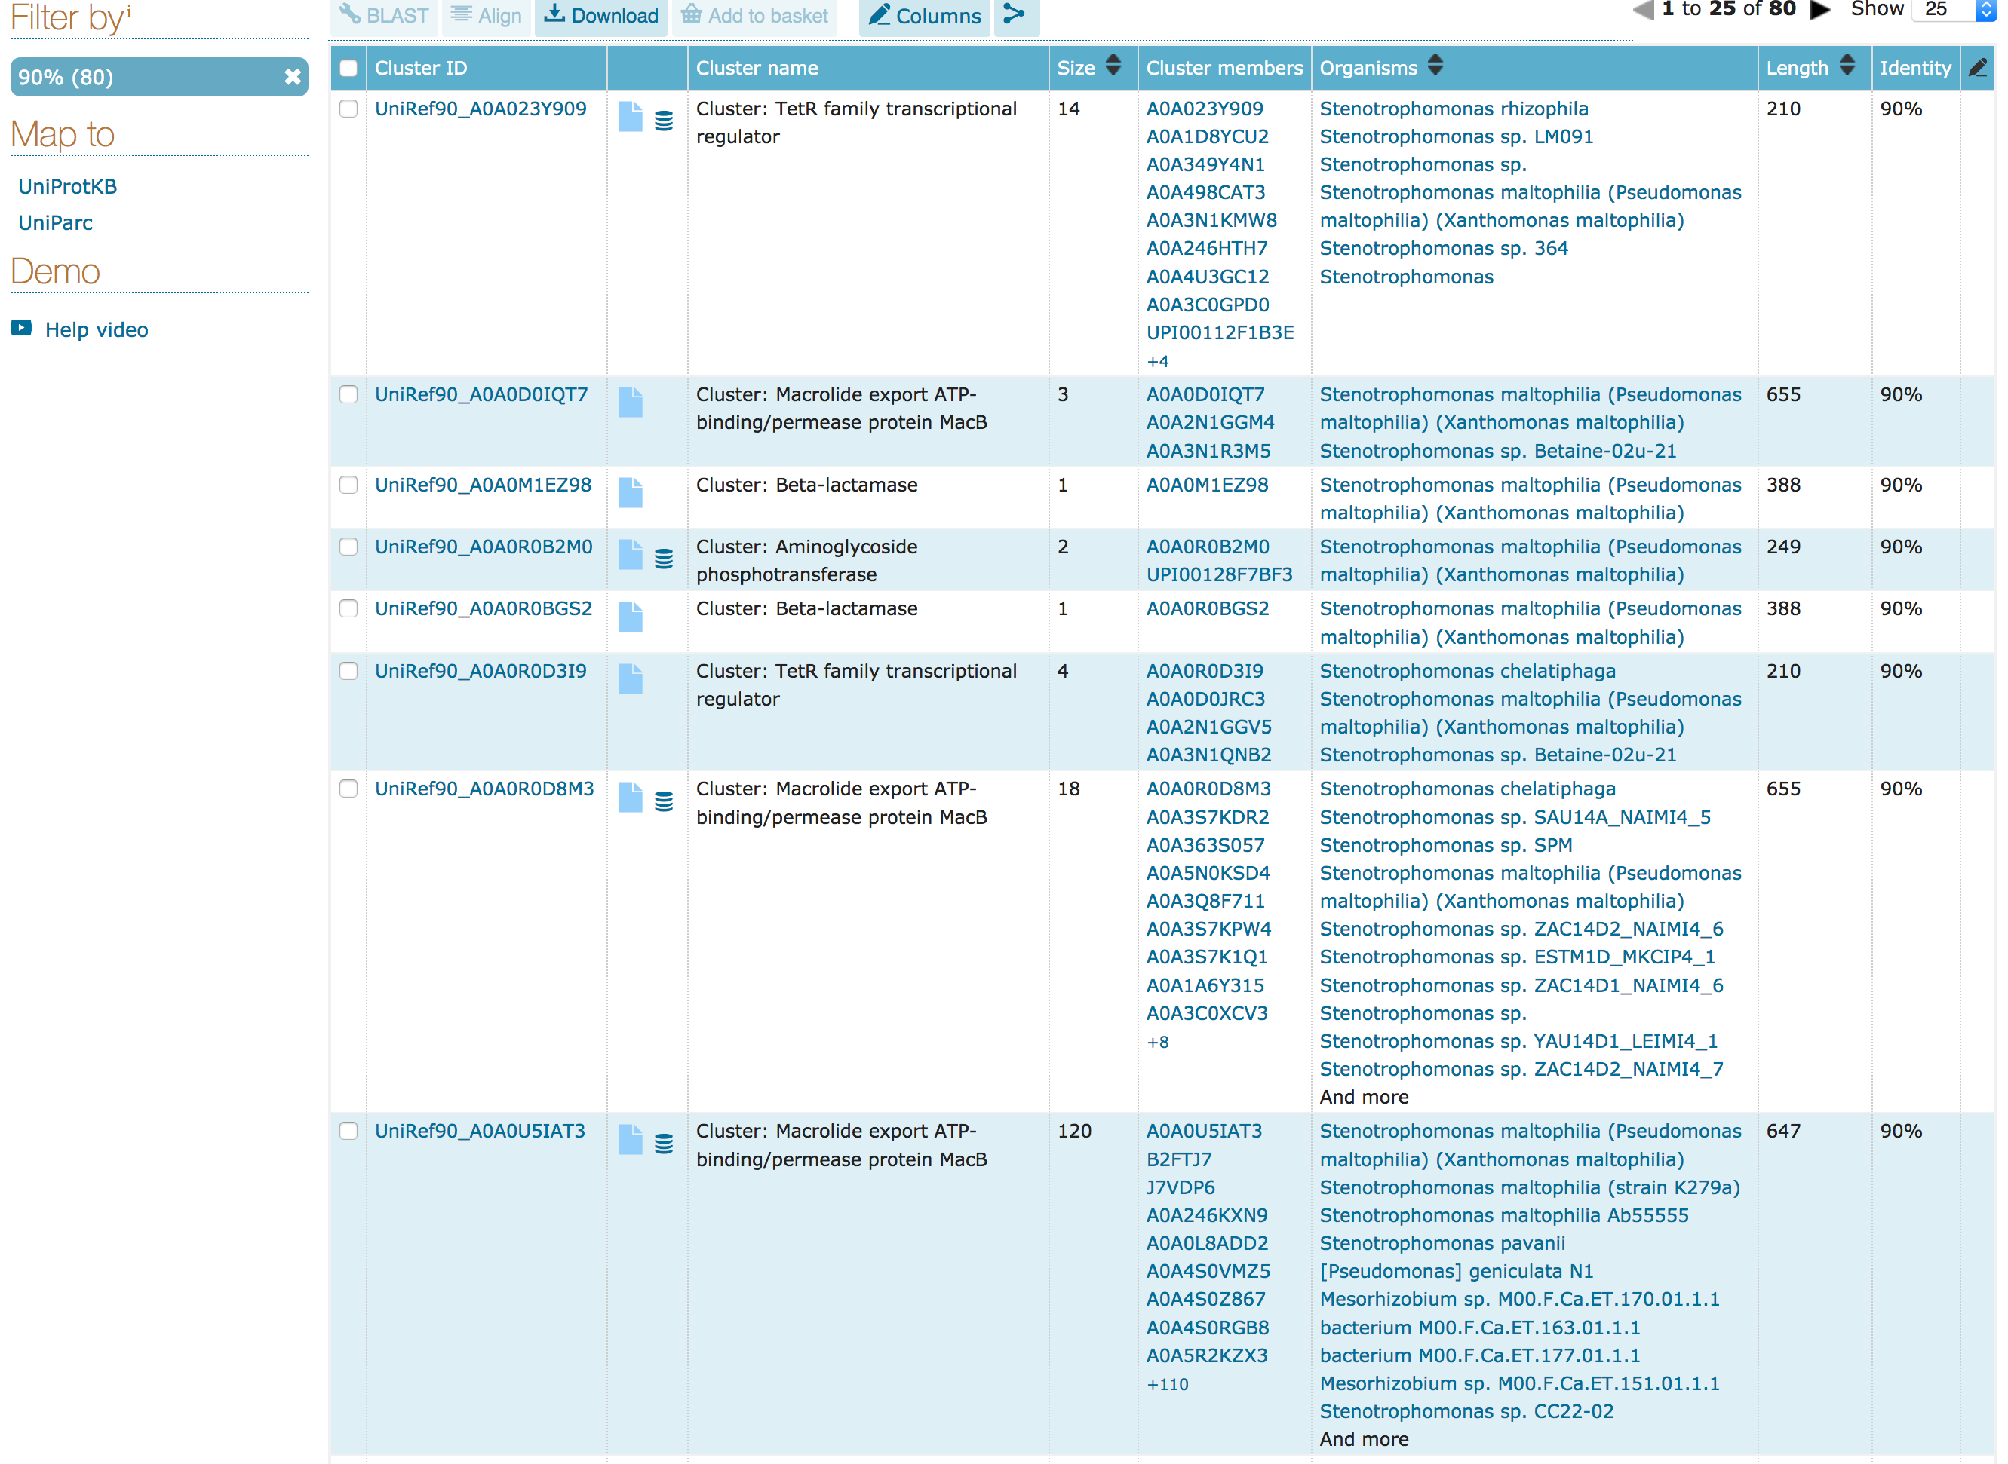
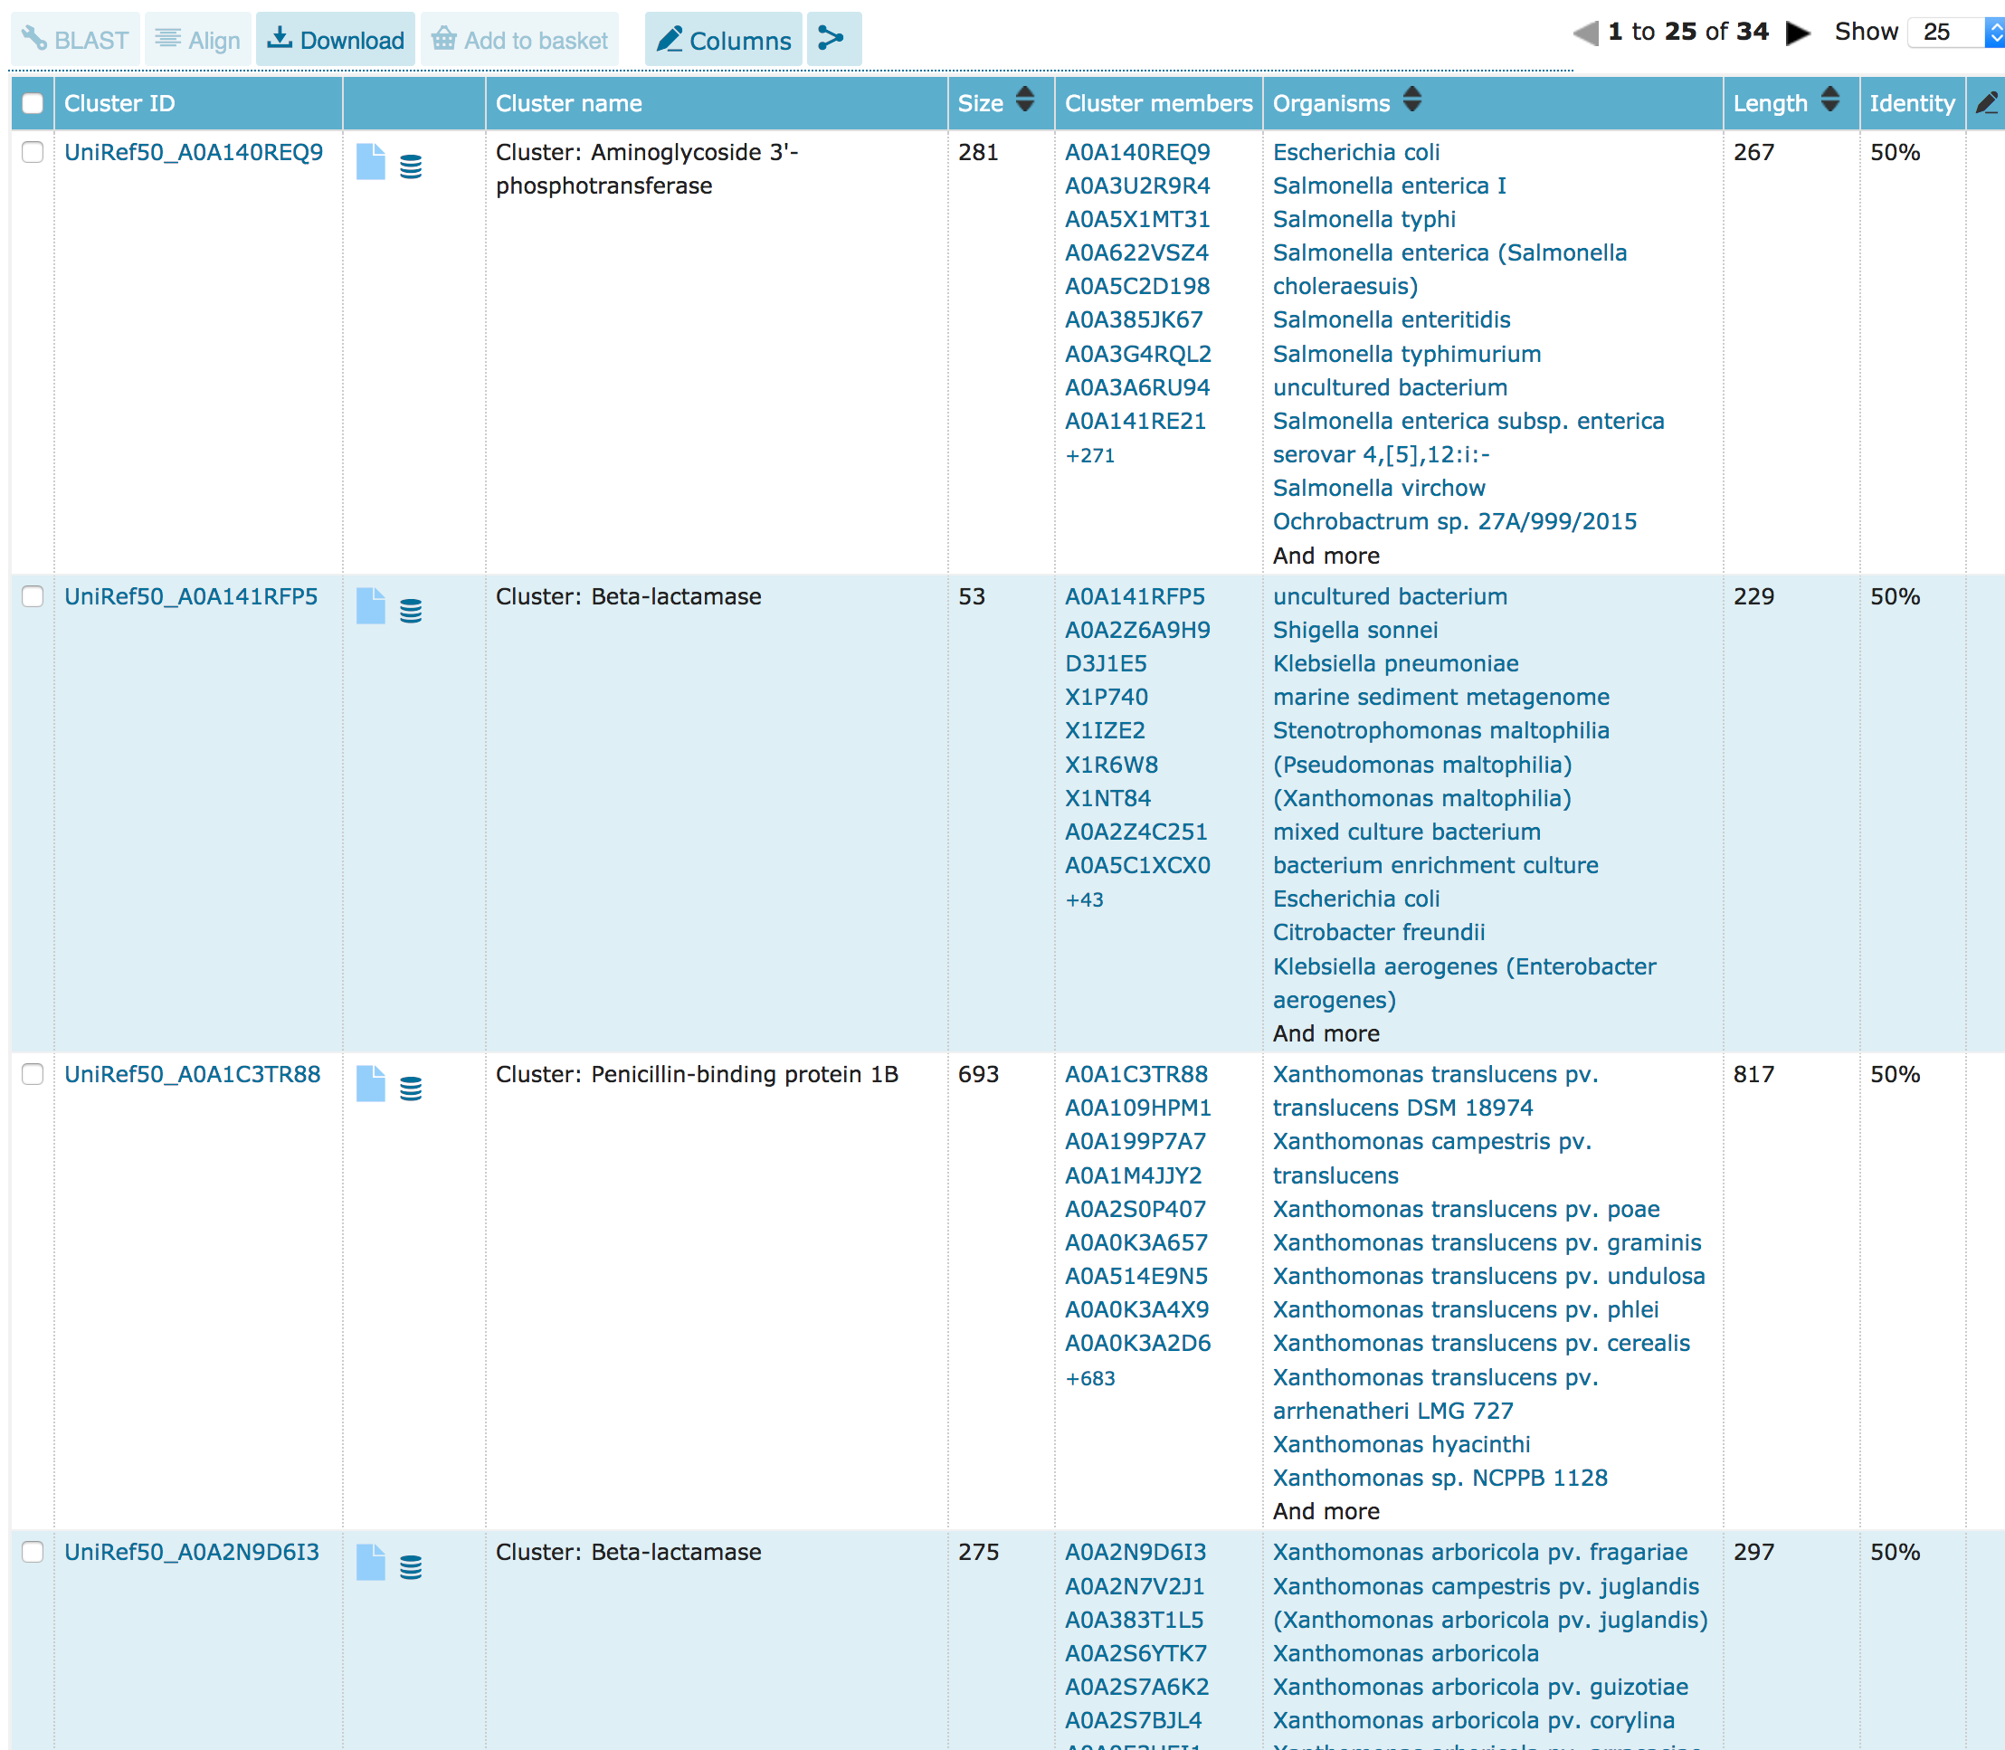
Sequence: GO & UP
Gene Ontology & Uniprot
The UniProt Reference Clusters (UniRef) provide clustered sets of sequences from the UniProt Knowledgebase (including isoforms) and selected UniParc records. This hides redundant sequences and obtains complete coverage of the sequence space at three resolutions:
UniRef100 combines identical sequences and sub-fragments with 11 or more residues from any organism into a single UniRef entry.
UniRef90 is built by clustering UniRef100 sequences such that each cluster is composed of sequences that have at least 90% sequence identity to, and 80% overlap with, the longest sequence (a.k.a. seed sequence).
UniRef50 is built by clustering UniRef90 seed sequences that have at least 50% sequence identity to, and 80% overlap with, the longest sequence in the cluster.
Uniref 90 Still redundancy
Uniref 50 Probably we have lost something

Slide 67
Bioinformatics tools for proteins
Sequence Based:
NCBI
UNIPROT
PFAM
prediction tools
Structure Based:
PDB
Dali server
MAESTROweb
Swiss-Model
Pymol

Slide 68
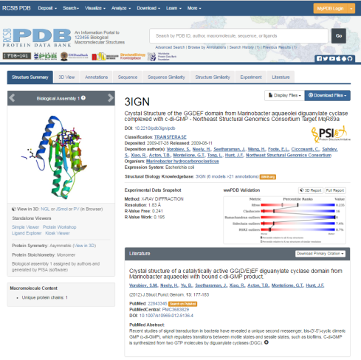


Structure: PDB
THE Database
PDB stores proteins (and DNA, lipids, small molecules …) with their structures solved. This means that we know the coordinates X,Y and Z of their atoms. So we can see their “shape” and KNOW which residues are buried, which are exposed, the distance between them, their interactions, etc.
Every structure deposited has a 4 digit code which starts with a number and then has 3 other characters which are normally letters. They currently have no meaning, although the first ones did (Ex 4CPA = CarboxyPeptidase A). Sometimes pdb codes are expressed with a 5 digit codes including the chain identifier ex: 4BYZ_A
Apart from the coordinates it also has information derived from them, from the state in which the protein was when preparing it for solving its structure or the experiment conditions when its structure was solved (catalytic, binding and allosteric sites, ligands, secondary structures, mutations, etc.)

Slide 69

Structure: PDB
THE Database
We will use 4BYZ structure as an example

Slide 70

Structure: PDB
Structure Summary
Expression system
Method used to solve the structure and, if by X-Ray diffraction, its resolution (any value below 3A is considered good resolution)
View the structure interactively (rotate, zoom, cartoons, surface, etc) and its electron density
Publications:
View this pubmed entry
Search PDB by this pubmed reference

Slide 71

Structure: PDB
Structure view
Translate, rotate, zoom …
Lines, backbone, cartoons, surface …
Color by chain, element …
Play with it

Slide 72

Structure: PDB
Structure Summary
All proteins (chains) present in this structure
(links to uniprot)
Different known and predicted features
Ligands present in this structure (their structure is also solved)

Slide 73


Structure: PDB
Protein Feature View
Protein: complete sequence
Several 3d structures of the same protein exists (in this case two: chain A of 4byz and chain A of 4bz0)
Some residues in 4bz0 could not be solved

Slide 74

Structure: PDB
Data in Uniprot
https://www.uniprot.org/uniprot/Q63JW5
Positions in the Uniprot sequence with the structure solved in the pdb file. (WARNING: this range can include internal AA which its structure could NOT be solved, so they will not have X,Y,Z coordinates for their atoms in the PDB file).
Which PDB should I use
(Europe, USA, Japan)
PDB codes for this protein
And method to solve the structure

Slide 75

Structure: PDB
Structure Summary
We download the structure in a text file with “pdb” format (the most standard, all software read this format)
We can download the structure as it was solved in the experiment (PDB format)
or
In the form it works in nature (Biological Assembly). There may be several structures here because sometimes the oligomerization state is not clear or the protein may work as a monomer but be solved as an oligomer or complex

Slide 76

Structure: PDB
Structure Sunmary
We have to take care when downloading the “FASTA” sequence, this is not necessarily the protein sequence nor the sequence with the X,Y,Z coordinates in the pdb file. This is the sequence that the experimentalist who solved the structure used.
It can contain mutations, be just a fragment or include tags used for purification that are not present in the real protein.
At the same time, perhaps not all atoms and/or residues could be resolved, so not all the aa in the sequence may have their structure solved

Slide 77
Structure: PDB
Fasta sequences
CLUSTAL O(1.2.0) multiple sequence alignment
Q63JW5_A MSAQVIQIGRQRFVGGLFWQSLSRRNELRAEAVELAKKLKFDLMVLRIDRGVAAAGYANT
4BZ0_A-RES msaQVIQIGRQRFVGGLFWQSLSRRNELRAEAVELAKKLKFDLMVLRIDRGVAAAGYANT
4BZ0_A-ATM ---QVIQIGRQRFVGGLFWQSLSRRNELRAEAVELAKKLKFDLMVLRIDRGVAAAGYANT
*********************************************************
Q63JW5_A RDGFAPGHLSLGAMVSRAIALEGAFYNGRRQPAPNWLGAFALPDGRWAYFAVRDHAFMPN
4BZ0_A-RES RDGFAPGHLSLGAMVSRAIALEGAFYNGRRQPAPNWLGAFALPDGRWAYFAVRDHAFMPN
4BZ0_A-ATM RDGFAPGHLSLGAMVSRAIALEGAFYNGRRQPAPNWLGAFALPDGRWAYFAVRDHAFMPN
************************************************************
Q63JW5_A GDWVGSREEALERLHTDYAWGGWNVVIGEPELERQGFQNFQPKRLDDLLPRRGGRPRTER
4BZ0_A-RES GDWVGSREEALERLHTDYAWGGWNVVIGEPELERQGFQNFQPKRLDDLLprrggrprTER
4BZ0_A-ATM GDWVGSREEALERLHTDYAWGGWNVVIGEPELERQGFQNFQPKRLDDLL--------TER
************************************************* ***
Q63JW5_A WWALRPVERRLSPRAALIAATAACVVLGGAFAYWHHRAKVEAEEREAALERVRAELAARQ
4BZ0_A-RES WWALRPVerrls------------------------------------------------
4BZ0_A-ATM WWALRPV-----------------------------------------------------
*******
Q63JW5_A ARSGPVAPPWAALPDALAFARACAMRFGRLAPGGWRLERYECTPGTAHYAWARNGSNVRY
4BZ0_A-RES ------------------------------------------------------------
4BZ0_A-ATM ------------------------------------------------------------
Q63JW5_A LLVVEPGATLDTDGERATLDVPLTAPTANDTPLADDSVVRTQLLARLQWLDAAAKLERLL
4BZ0_A-RES ------------------------------------------------------------
4BZ0_A-ATM ------------------------------------------------------------
Q63JW5_A PEQGPRAPLANLAQQAAALPASPTWRAYRLNANLGGIAPPEFVRAIDVPGLRVERIAYQN
4BZ0_A-RES ------------------------------------------------------------
4BZ0_A-ATM ------------------------------------------------------------
Q63JW5_A NQWTLEGVLYAK
4BZ0_A-RES ------------
4BZ0_A-ATM ------------
Here we see an alignment between the sequence of all atoms whose structure has been resolved (4BZ0_A-ATM) the sequence obtain when when downloading 4BZ0 in fasta format (4BZ0_A-RES) and the UNIPROT sequence of the protein whose structure has been solved with the code 4BZ0 chain A (Q63JW5)
Observe that there are gaps in the alignment, those residues do not have coordinates for their atoms in the PDB.

Slide 78

Structure: PDB
Structure Sunmary
What can be downloaded can also be displayed

Slide 79

Structure: PDB
PDB file
A PDB file starts with a long header that contains all information that can be visualized in the web page for this protein: https://www.rcsb.org/structure/4BYZ
Example fields:
TITLE: the name of the structure
COMPND: Which macromolecules are included in this structure.
SEQRES: Sequence of the protein that was used to produce crystals (the same that can be downloaded as fasta).
REMARK 800: Interaction sites with different molecules in the structure.

Slide 80
Structure: PDB
PDB file
https://files.rcsb.org/view/4BYZ.pdb
After the long header there are the XYZ coordinates for the atoms of the molecules present in the structure
with the following format:
(Lines with Atom coordinates begin with the tag ATOM or HETATM)
ATOM For standard Amino acids and Nucleotides.
HETATM for everything else
#---------------------------------------------------------------------------
#Field | Column | FORTRAN |
# No. | range | format | Description
#---------------------------------------------------------------------------
# 1. | 1 - 6 | A6 | Record ID (eg ATOM, HETATM)
# 2. | 7 - 11 | I5 | Atom serial number
# - | 12 - 12 | 1X | Blank
# 3. | 13 - 16 | A4 | Atom name (eg " CA " , " ND1")
# 4. | 17 - 17 | A1 | Alternative location code (if any)
# 5. | 18 - 20 | A3 | Standard 3-letter amino acid code for residue
# - | 21 - 21 | 1X | Blank
# 6. | 22 - 22 | A1 | Chain identifier code
# 7. | 23 - 26 | I4 | Residue sequence number
# 8. | 27 - 27 | A1 | Insertion code (if any)
# - | 28 - 30 | 3X | Blank
# 9. | 31 - 38 | F8.3 | Atom's x-coordinate
# 10. | 39 - 46 | F8.3 | Atom's y-coordinate
# 11. | 47 - 54 | F8.3 | Atom's z-coordinate
# 12. | 55 - 60 | F6.2 | Occupancy value for atom
# 13. | 61 - 66 | F6.2 | B-value (thermal factor)
# - | 67 - 67 | 1X | Blank
# 14. | 68 - 70 | I3 | Footnote number
#---------------------------------------------------------------------------
#
# 1 2 3 4 5 6
#12345678901234567890123456789012345678901234567890123456789012345678
#--------------------------------------------------------------------
#@<<<<<@>>>> @<<<@@<< @@>>>@ @>>>>>>>@>>>>>>>@>>>>>>>
#ATOM 1751 N GLY C 250 32.286 1.882 43.206 1.00 22.00
#ATOM 31 P POM 3 8.010 4.280 1.939
#ATOM 3000 SE MSE A 401 -1.600 -14.228 65.136 0.70 15.94 SE
This lines are not in the pdb file
They are here for you to view the column range (each character is a column) and if fields are left or right aligned
http://www.wwpdb.org/documentation/file-format
http://www.wwpdb.org/documentation/file-format-content/format33/v3.3.html

Slide 81

Structure: PDB
Annotations

Slide 82

Structure: PDB
Sequence
Here we can view the sequence for all chains and all features annotated in the pdb file

Slide 83

Structure: PDB
Sequence
Change the sequence displayed:
Sequence used by the experimentalist to solve this structure
Sequence in Uniprot for this protein
Mouse over a residue to see the residue and its number (numeration in PDB is not necessary the position in the sequence) this can be a cause for confusion
A section of the protein could have not been solved so you will not see structure here (so there would be no XYZ coordinates for its atoms)
1
2

Slide 84

Structure: PDB
Multiple Chains
Be careful! A pdb structure may contain multiple chains, which can be from the same or different proteins. In the following example we see that the 4CPA structure has 4 chains (A, B, I, J).
- A and B are from Carboxypeptidase A from Bos taurus (cow) UniprotID: P00730.
- I and J are from Metallocarboxypeptidase inhibitor from Solanum tuberosum (potato) UniprotID: P01075

Slide 85

Structure: PDB
Advanced Search
Like in most databases we can combine multiple searches using Boolean operators
1
2
3

Slide 86

Structure: PDB
Advanced Search
There are 17392 pdb entries with the word protease in any field. 146 with this ligand (ABA) . 2187 from HIV organism (well, it is a virus, but I believe we understand each other)
But only 12 which satisfy all criteria.
1
2
3
4
5
6
8
9
Add search criteria
7
10

Slide 87

Structure: PDB
Advanced Search
There are only 12 pdb entries with that protein and that ligand

Slide 88


Structure: PDB
Ligand Search
1
2
3
We can also search for pdb files by the ligands they can contain
1
2
Or by protein sequence (blast)
3

Slide 89

Structure: Operations
Pairwaise Structure superposition
1
2
We are going to perform an structural alignment of 4byz to 3vhj.
In this kind of “alignments” no sequence information is used, only structural information is used. The result is one structure over the other. This is why it is called “Superposition”
3
6
4
7
5
8

Slide 90
Structure: Operations
Pairwaise Structure superposition
1
2
3
6
4
7
5
8

Slide 91

Structure: Operations
Pairwaise Structure superposition
We can see that both structures are very similar (RMSD=2.90A) in spite of having a very low sequence identity (11.6%).
Like with resolution, any RMSD value below 3A is considered a good superposition.
Move and zoom the molecule (mouse: left button and wheel)

Slide 92

Structure: Operations
Pairwaise Structure superposition
- EQR: number of superposed residues
- Len1 & Len2 : Length of the superposed structures
- RMSD: Root Mean Square Deviation (average distance between superposed atoms)
This alignment is not based on the sequence but based on the structure

Slide 93
Structure: Operations
Pairwaise Structure superposition (ALTERNATIVE VERSION)
1
2
3

Slide 94

Structure: Operations
Pairwaise Structure superposition (ALTERNATIVE VERSION)

Slide 95

Structure: Operations
Pairwaise Structure superposition (ALTERNATIVE VERSION)
1
2
3
4

Slide 96

Structure: Operations
Pairwaise Structure superposition (ALTERNATIVE VERSION)
Move and zoom the molecule (mouse: left button and wheel)
1
- EQR: number of superposed residues
- Len1 & Len2 : Length of the superposed structures
- RMSD: Root Mean Square Deviation (average distance between superposed atoms)
This alignment is not based on the sequence but based on the structure

Slide 97


Structure: Operations
Pairwise Structure superposition
Proposed exercise:
Use EMBOSS water:
https://www.ebi.ac.uk/Tools/psa/emboss_water/
And blast2seq:
https://blast.ncbi.nlm.nih.gov/Blast.cgi?PAGE=Proteins&PROGRAM=blastp&BLAST_PROGRAMS=blastp&PAGE_TYPE=BlastSearch&BLAST_SPEC=blast2seq&DATABASE=n/a&QUERY=&SUBJECTS=
Compare the 2 sequence alignments obtained with the structural alignment.

Slide 98
Structure: Dali
Database Structure search
http://ekhidna2.biocenter.helsinki.fi/dali/
We can search against the whole pdb database using a structure, not a sequence, with
Dali server
This way we can find similar proteins that, using just a sequence search method, could not be found.
NO SEQUENCE INFORMATION IS USED HERE. Only structure (XYZ coordinates of some of some of the atoms common in all aminoacids)
Make sure you delete all the text, leaving only this: 4byzA
Your email here, not mine!

Slide 99

Structure: Operations
Database Structure search
Different sets of redundancy i the database:
PDB25: selection of pdb structures which are less than 25 % identical in its sequence
PDB50: selection of pdb structures which are less than 50 % identical in its sequence
PDB90: selection of pdb structures which are less than 90 % identical in its sequence

Slide 100

Structure: Operations
Database Structure search
http://ekhidna2.biocenter.helsinki.fi/barcosel/tmp//4byzAPILUS//4byzA.html

Slide 101
Structure: Operations
Database Structure search
Chain: pdb code of the structure in the database that is similar to our query (if our query is in the database the 1st will probably be our query)
http://ekhidna2.biocenter.helsinki.fi/barcosel/tmp//4byzAPILUS//4byzA.html
Z: Dali score, used to present sorted results, from most similar to less
RMSD: average distance between superposed atoms ( in general below 3 indicates that the structures are really similar)
lali: number of superposed residues (residues that form similar structures in both proteins)
nres: number residues in the pdb structure that matches our query
%id: % of sequence identity

Slide 102

Structure: Operations
Database Structure search
2
3
1

Slide 103

Structure: Operations
Database Structure search
We can visualize the sequence alignment and the structure superposition.
But both results are obtained using only structural data, not the sequence.

Slide 104


Homology modelling
Similar sequences => Similar Structures
This way we can transfer the ATOMs x,y,z coordinates from a sequence with a known structure (Template) to a similar sequence with an unknown structure (Target)

Slide 105
Homology modelling: aproaches
Automatic (click, click, click …)
Semiautomatic (search for templates, click: look and decide, click: look and decide, click: look and decide…)
Semimanual (search for templates, manually perform the alignments, send the alignments, click: look and decide, click: look and decide…)
Fully manual (search for templates, manually perform the alignments, run the models, evaluate, decide, superpose, etc. NO CLICKS HERE)
Swiss-Model
(and other web tools)
Modeller
(and other command line tools)

Slide 106
Homology modelling: Automatic
Click, Click, Click …
Paste a sequence
Build a model
Download and visualize the model

Slide 107
Homology modelling: Exercise 1
In this exercise and all the others we are going to model AdrA protein from Salmonella enterica, a protein involved in antibiotic resistance (http://journals.plos.org/plosone/article?id=10.1371/journal.pone.0144802)
Go to ncbi (https://www.ncbi.nlm.nih.gov/)database and download in fasta format the following code WP_039589453.1 (S. enterica AdrA ncbi code)
Open the downloaded file and copy the sequence to the clipboard
Go to Swiss-Model (https://swissmodel.expasy.org/) web page and press “Start Modelling”
Paste your sequence and press “Build Models”
When the build ends, look at the result page, identify the resulting model, observe it. Try to understand all given information. Download the results, decompress and view them locally.

Slide 108
Homology modelling: Semiautomatic
Click: look and decide …
Blast vs PDB
Paste sequence in Swiss-Model
Search templates
Select templates
Build Model
Compare different results from selected templates

Slide 109
Homology modelling: Exercise 2.0
Go to Swiss-Model web page and press “Start Modelling”, paste your sequence and press “Search for Templates”
In Paralel go to ncbi blast (protein), select database PDB, check “show results in new window” paste your AdrA sequence and press BLAST
When both programs end and present results, observe what has been found. Can we model the whole sequence? Which template(s) would you choose? Why?

Slide 110
Homology modelling: Exercise 2.1
Go to the Sequence Similarity tab and observe the different clusters (mouse over the circles). Would you say the structures differ?

Slide 111
Homology modelling: Exercise 2.2
Go back to the Templates tab and select 5llx.1.A (already selected) and 3ign.1.A (best blast match)
Go to the Sequence Similarity tab, on the right side there is a structure representation, press the “detach” button and turn the structure around (keep left mouse button pressed while moving the mouse). This is a superposition of both templates, observe the differences specially in loops.
What will this differences involve? How will they influence our models?

Slide 112
Homology modelling: Exercise 2.3
Go to the Alignment of Selected Templates tab and observe the alignments of both templates with your target sequence
Now press the “Build Models” button

Slide 113
Homology modelling: Exercise 2.4
From the left panel using the help buttons “?” try to understand the different data presented as results. Which model would you chose? Why?
From the right panel (after selecting both models) observe the differences, would you say one is better than the other?
3
Both highlighted
1
2

Slide 114
Homology modelling: Exercise 2.6
10. As a final step download the complete report, uncompress it and visualize it locally.

Slide 115
Homology modelling: Final thoughts 1
So… after all of this…
Which model, from which approach, would you choose as the best one?
Depends on what you want it for.
A nice picture (in a publication)
Try to understand the structure and function
Mutagenesis studies
Predict interactions with other proteins (without high detail)
Predict interactions with other proteins (with high detail)
Predict interactions with small molecules

Slide 116
Homology modelling: Final thoughts 2
Homology modeling ends up generating a X,Y,Z coordinate for each atom, like in a high resolution NMR or X-ray experimentally obtained structure, but …
How much should I believe about the predicted model?
(IMMO, but this numbers are fully illustrative)
99..85% identity
70..60% identity
50..40% identity

Slide 117
Structure: Visualize
Pymol
We can visualize and make several operations with structures using pymol software (and lots of others), pymol can be downloaded from here:
https://www.pymol.org/
We are going to visualize with Pymol the structure 4BYZ previously downloaded

Slide 118
Structure: Visualize
Pymol
Now we Display the sequence.
Use different mouse buttons to zoom, rotate and move the molecule.
Go to the right menu.
Click on every letter to discover the meaning (A,S,H,L,C)

Slide 119
Structure: Visualize
Pymol
Show-> as -> Cartoon
(all selected is presented as cartoons)

Slide 120
Structure: Visualize
Pymol
Drag the mouse while pressing left button over the sequence to select some residues.
Go to the new tab in the right menu called (sele)
Show-> lines
(all selected is presented as lines, but previous representation is still present)
Now go to
Action-> delete selection

Slide 121

Structure: Visualize
Pymol
We can easily draw a “nice” picture.
Action -> preset -> publication

Slide 122



Structure: Visualize
Pymol
We can use pymol to view the residues colored by their hydrophobicity, visualizing this way if there is a region in the surface that could be a problem when producing this protein. For that we need an external script, instructions for it are here:
http://www.protein.osaka-u.ac.jp/rcsfp/supracryst/suzuki/jpxtal/Katsutani/en/hydrophobicity.php
You can download the script here:
http://www.protein.osaka-u.ac.jp/rcsfp/supracryst/suzuki/jpxtal/Katsutani/color_h.py
http://bioinf.uab.es/ocs/PYMOL/color_h.py
Once it is loaded (file -> run) execute in the command prompt: color_h
And in the right menu: Show -> as -> surface

Slide 123




Structure: Visualize
Pymol: final exercice
Close pymol and open it again
Download this file and unzip it (not just open, unzip it!):
http://bioinf.uab.es/ocs/PYMOL/PYMOL_SCRIPT.zip
Edit the file called “m12.pms” with notepad, wordpad, notepad++ or any other text editor (DO NOT USE WORD!!!) and change the location of the files mod1.pdb and mod2.pdb for the location wherever you have download and unzip them.
Go to pymol, file -> run -> m12.pms
Unzoom over the visualized structures (right mouse)
Unselect mod1 and mod2 from the right panel
Now look back at the mod12.pms file and try to understand the script instructions

