Slide 1
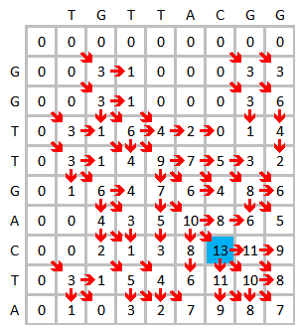
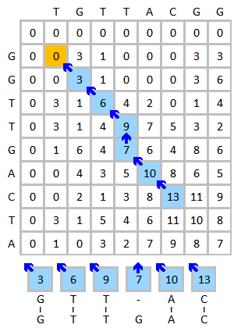
Alignments as a search tools:
Blast (algorithm)
Good alignments, but too slow to be used to search for similar sequences in a Data Base.
https://upload.wikimedia.org/wikipedia/commons/2/28/Smith-Waterman-Algorithm-Example-Step2.png
https://upload.wikimedia.org/wikipedia/commons/e/e6/Smith-Waterman-Algorithm-Example-Step3.png

Slide 2
NCBI BLAST:
Basic Local Alignment search tool
Heuristic method (sacrifices a bit of accuracy to gain a lot of speed)
IDEA: Two really similar sequences will have some small identical regions (k-words§), I can look for them and lengthen them, generating longer fragments (HSP *).
When I stretch, I can put together HSPs.
Those that do not join like this, I can try to put them together by aligning the fragments between 2 HSPs with "dynamic programming" as it allows to align more different sequences and also allows "gaps". If I can't put together the HSPs I will present them separately, always sorted from highest to lowest "score" (Always remember what the “L” of bLast means)
§ Default: K = 3 proteins, K = 11 nucleotides
* High Scoring Segment Pair
NOTE: Not the only one, but the most common, there are others, e.g. FASTA and BLAT
Notes:
2

Slide 3
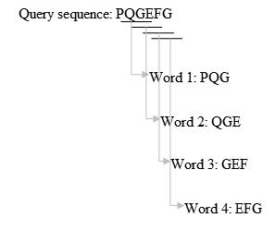
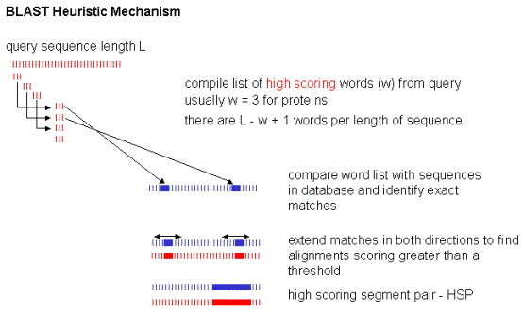
Generate the k-words list.
Warning: low-complexity regions (e.g.:PPCDPPPKDKKKKDDGPP) are not used to generate k-words.
Search for these words
Extend alignment
Stop the extension when the cumulative score drops from a given "threshold" (dropoff value)

Slide 4
Q
S

Slide 5
Q
c m e
= = =
S
c m e
9 5 5

Slide 6
Q
h l a c m e s t
= = =
S
k g s c m e i s
9 5 5
-1 -4 1 -1 1
=15

Slide 7
Q
h l a c m e s t
= = =
= = =
S
k g s c m e i s
9 5 5
-1 -4 1 -1 1
=15

Slide 8
Q
h l a c m e s t
= = =
= = =
S
k g s c m e i s
=20
9 5 5
-1 -4 1 -1 1
=15

Slide 9
HSP 1
HSP 2
Q
h l a c m e s t
= = =
= = =
S
k g s c m e i s
=20
9 5 5
-1 -4 1 -1 1
=15
This area does not alienate as well as the others. What will blast do?

Slide 10
HSP 1
HSP 2
Q
h l a c m e s t
= = =
= = =
S
k g s c m e i s
=20
9 5 5
-1 -4 1 -1 1
=15
This region does not alienate as well as the others, Blast will try to use a dynamic algorithm to align it.
If it can align it, it may be using gaps. If we find gaps in an alignment made with blast, it will always be in an region like this, a region located between two HSP (High scoring Segment Pair).
If it cannot align the sequences here, it will present the 2 fragments separately.

Slide 11
HSP 1
HSP 2
Q
h l a c m e s t
= = =
= = =
S
k g s c m e i s
=20
9 5 5
-1 -4 1 -1 1
=15
Q
HSP 2=20
The alignments are presented in order from highest to lowest "score". Not for the order in which they appear in the sequence
S
Q
h l a c m e s t
HSP 1=15
= = =
S
k g s c m e i s

Slide 12
HSP 1
HSP 2
Q
h l a c m e s t
= = =
= = =
S
k g s c m e i s
=20
9 5 5
-1 -4 1 -1 1
=15
What about the alignment of these regions? Where is it?

Slide 13
HSP 1
HSP 2
Q
h l a c m e s t
= = =
= = =
S
k g s c m e i s
=20
9 5 5
-1 -4 1 -1 1
=15
Blast cannot align these regions, so blast will not give us an alignment of them.
REMEMBER: BLAST is a local alignment program, not global, only aligns what it can and only returns results for what it has aligned.

Slide 14
This whole process will be done with my problem sequence ("query") against each and every one of the sequences in the database I'm using.
So, for each entry in the database (called "subject") I will have a result, which may contain one or more alignments. The latter is because there are regions that cannot be aligned and therefore only those that can be aligned are presented (as we have seen before). Or because the same fragment can be aligned in several positions of the same sequence.
>Q
E S T A S M A L A L T E S T I C M A L A M E N T
vs
>S
E S T E S M L E T
Alignment 1
Q E S T A S M A L A L T E S T I C M A L A M E N T
S E S T E S M - L E - T
Alignment 2
Q E S T A S M A L A L T E S T I C M A L A M E N T
S E S T E S M - L - - E - T

Slide 15
Score:
Value of the alignment score taking into account the replacement matrix (BLOSUM62, PAM250 or whatever).
Max Score : score of the alignment with the highest score.
Total Score – Total score for all aligned segments.
Query cover:
Which % of the sequence "query" (ours) is covered by alignment
E value:
Probability that the match has been given at random (false positives)
E=10 (We will find this "score" by chance 10 times for each search)
E=0.01 (We will find this "score" by chance 1 time for every 100 searches)
Ident:
The highest percentage of identical aligned amino acids of all alignments obtained by this "query-subject" pair. WARNING!!! is not the %identity of the two sequences, this number refers only to the aligned portion. Example: The sequence "query" is 100 AA and the "subject" is 200 AA, only one alignment has been generated and contains 10 AA aligned (10% of "query cover") with 99% identity. Are these two sequences 99% identical? NO!!!

Slide 16
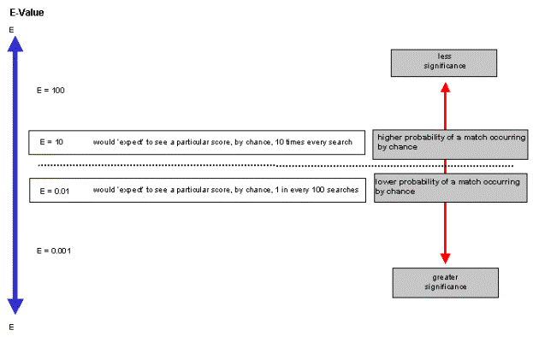
E value:
Probability that the match has been given at random (false positives)
E=10 (We will find this "score" by chance 10 times for each search)
E=0.01 (We will find this "score" by chance 1 time for every 100 searches)

Slide 17
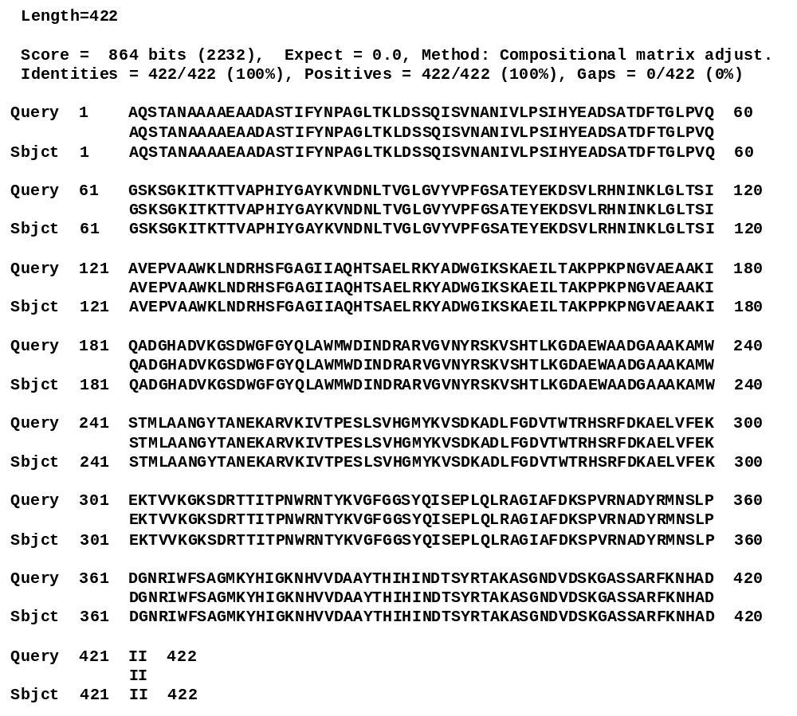
Equal Sequences: Perfect Positive

Slide 18
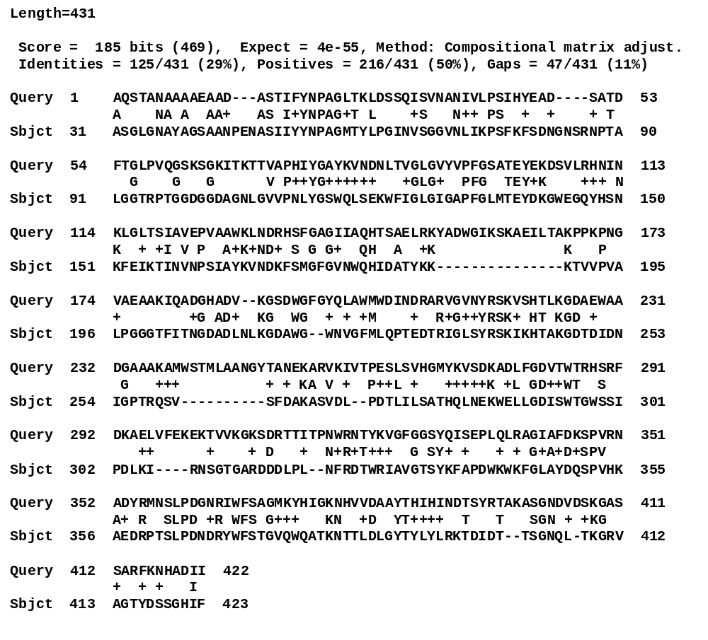
Similar Sequences: Real Positive

Slide 19
Different sequences: False positu
Score = 32.3 bits (72), Expect = 0.004, Method: Compositional matrix adjust.
Identities = 55/255 (22%), Positives = 96/255 (38%), Gaps = 22/255 (9%)
Query 1 AQSTANAAAAEAADASTIFYNPAGLTKLDSSQISVNANIVLPSIHYEADSATDFTGLPVQ 60
++ AA A A + NPA L+ + + ++ L ++ + D TG V
Sbjct 36 SRGLGGAATAVDVGAPGMMTNPATLSLIKEG---ASVHLGLDMVNTDIDVRNQATGEVVS 92
Query 61 GSKSGKITKTTVAPHIYGAYKVNDNLTVGLGVYVPFGSATEYEKDSVLRHNINKLG---- 116
+ VAP Y+ L +G+G + G TEY S L L
Sbjct 93 SNSHSHNRGPYVAPEAAFVYR-RGALALGVGAFAQGGLGTEYGNSSFLSRATGALESGLE 151
Query 117 ----LTSIAVEPVAAWKLNDRHSFGAGIIA--QHTSAELRKYADW------GIKSKAEIL 164
L +++ ++ +++R + G + A Q + EL AD ++ ++
Sbjct 152 NSSRLLVLSIPFAVSYAVDERLTIGGSLDAVWQGLNLELLLGADQVGSLIGSGRASGSLI 211
Query 165 TAKPPKPNGVAEAAKIQADGHADVKGSDWGFGYQLAWMWDINDRARVGVNYRSKVS-HTL 223
P+ + D + WGFG ++ + D +GV Y + S +
Sbjct 212 GVLAGLPDLRGAHFSLTRDQPLNSGVDAWGFGGRVGLTYKATDATLLGVAYTLEASMEDM 271
Query 224 KGDAEW-AADGAAAK 237
KG A A DGAA +
Sbjct 272 KGRATLTAVDGAAGQ 286

Slide 20
BLAST Basic programs
nucleotide blast Search a nucleotide database using a nucleotide query
protein blast Search protein database using a protein query
blastx Search protein database using a translated nucleotide query
tblastn Search translated nucleotide database using a protein query
tblastx Search translated nucleotide database using a translated nucleotide query

Slide 21
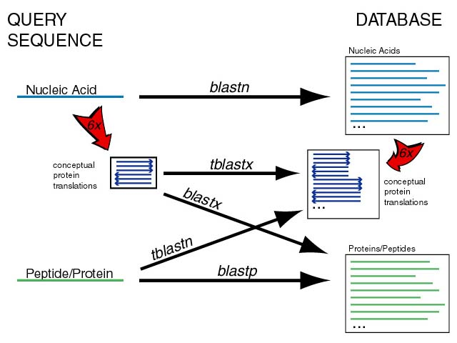
BLAST Basic programs

Slide 22
advanced protein searches with BLAST
* PSSM(Position-Specific Scoring Matrix):
- PSI-BLAST: Search remote homologous
- DELTA-BLAST: Search known domains
* Patterns
- PHI-BLAST: search for similar sequences sharing patterns

Slide 23
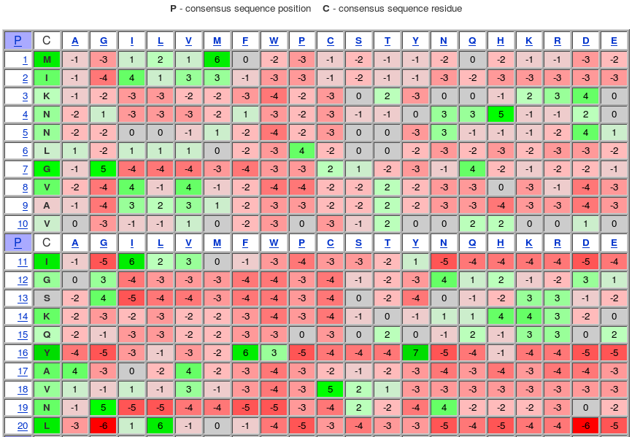
PSI-BLAST: Posicion Specific Iterated BLAST
http://www.ncbi.nlm.nih.gov/Class/Structure/pssm/pssm_viewer.cgi

Slide 24

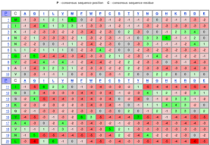
PSI-BLAST: Posicion Specific Iterated BLAST
>queryseq
XXXXXXXXXX
get alignments
queryseq xxxxxxxxxxxx
S1 xxxxxxxxxxxx
queryseq xxxxxxxxxxxx
S2 xxxxxxxxxxxx
…
queryseq xxxxxxxxxxxx
Sn xxxxxxxxxxxx
Build pssm
blastp
Blosum62
seqDB
>s1
xxxxxxxxxx
>s2
xxxxxxxxxx
…
>sn
xxxxxxxxxxx
>queryseq
XXXXXXXXXX
QUESTION:
When will I stop?
PSI-blast
PSSM
ANSWER:
When the results do not vary
or
I've gotten to where I wanted to be.
seqDB
>s1
xxxxxxxxxx
>s2
xxxxxxxxxx
…
>sn
xxxxxxxxxxx

Slide 25
Fast sequence search is used for:
Identification of species or taxonomic groups
Annotation of genes and genomes
Establishing phylogenetic relationships
Identification of protein function
Domain location
Gene mapping in genomes and chromosomes
Genome assembly (BLAST is too slow)
...

Slide 26
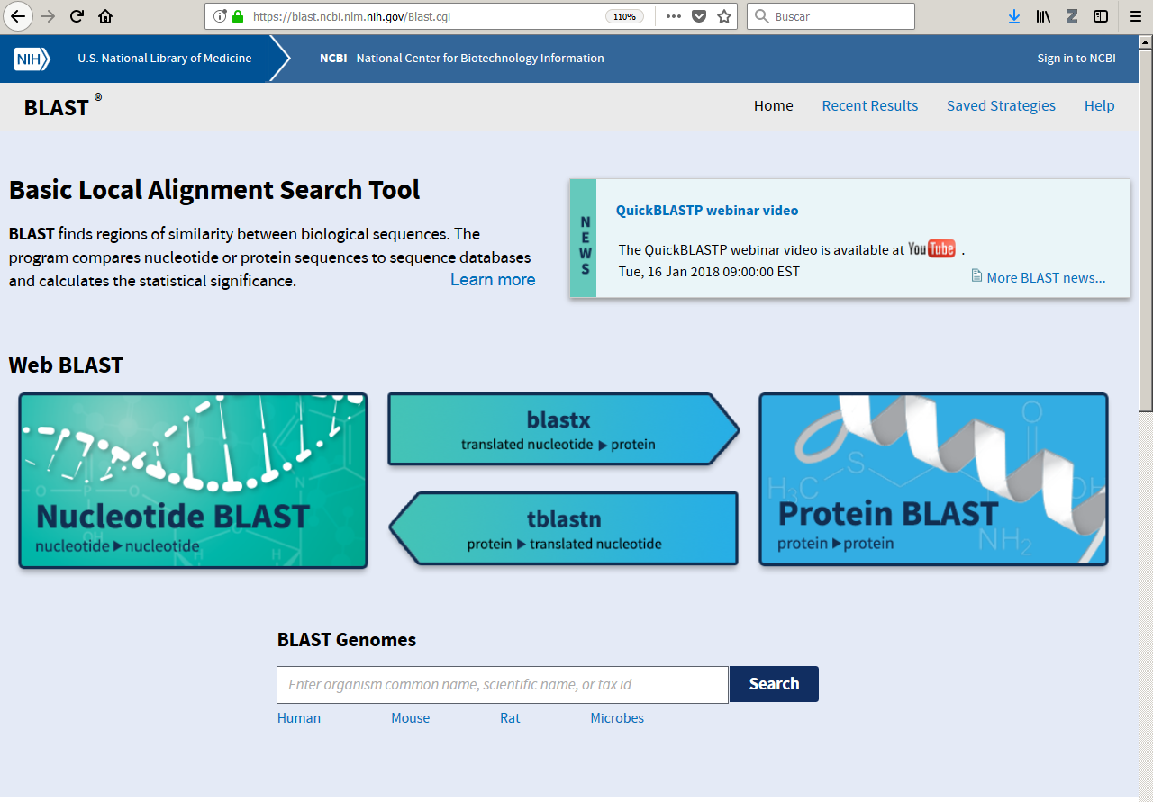

Slide 27
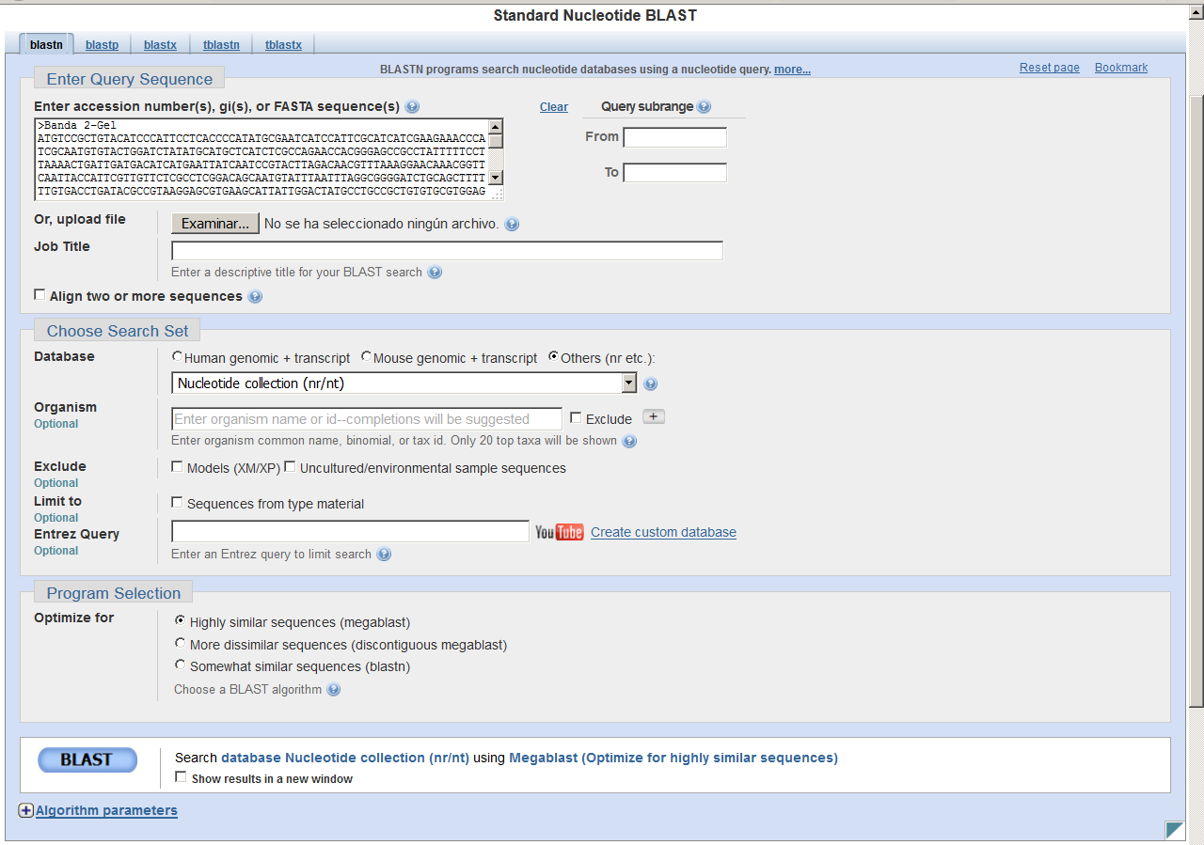

Slide 28
The "query" sequence in fasta format
Returns all modified values to defaults. We will always do it before we do any searches.
I'm not going to look for the whole sequence, my "query" will be just a range (from .. to)
In which database will I search for my "query" sequence?
In which organism or taxonomic domain should I search for it?
I want to add another taxonomic domain to search for
No, what I want is to look for it in all but this one
What modification of the algorithm do I want to use? (unless otherwise said, we will use blastn). This will affect the parameters of the algorithm.
Keep this window and show the result coming out in another window. We will always mark this "checkbox" (so we can always see again what we have done)

Slide 29
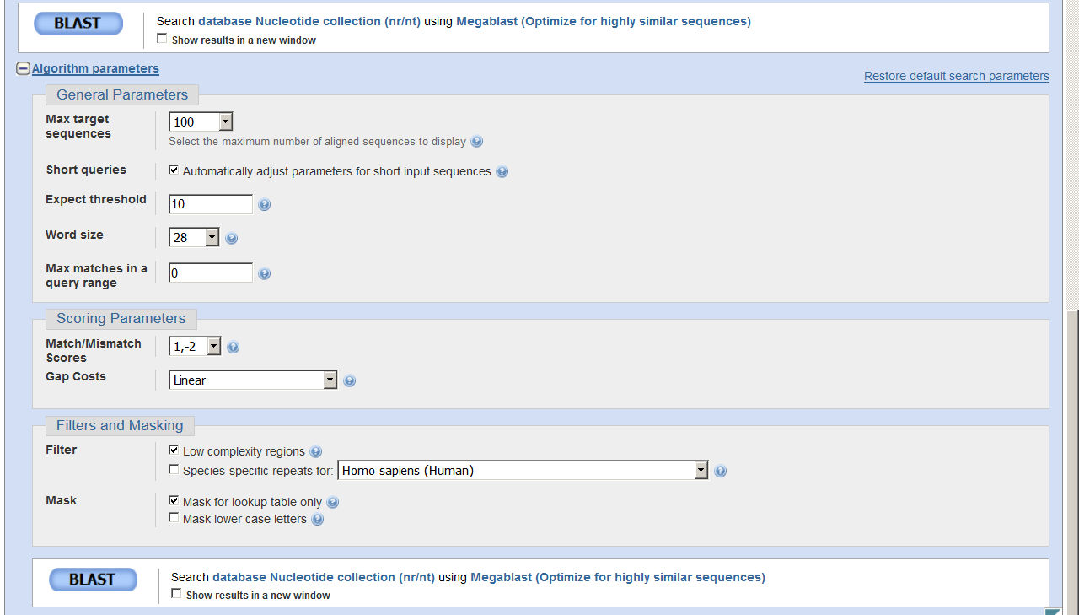
If I click here I will expand the configurable algorithm parameters
How many results (query-subject groups) will blast show?
Alignments with an "E value" below will not be reported
K-word Size (Slide 3)
How do I calculate the score?
With this option enabled low-complexity regions will be shown in lowercase inside alignment and will not be displayed at the ends.

Slide 30
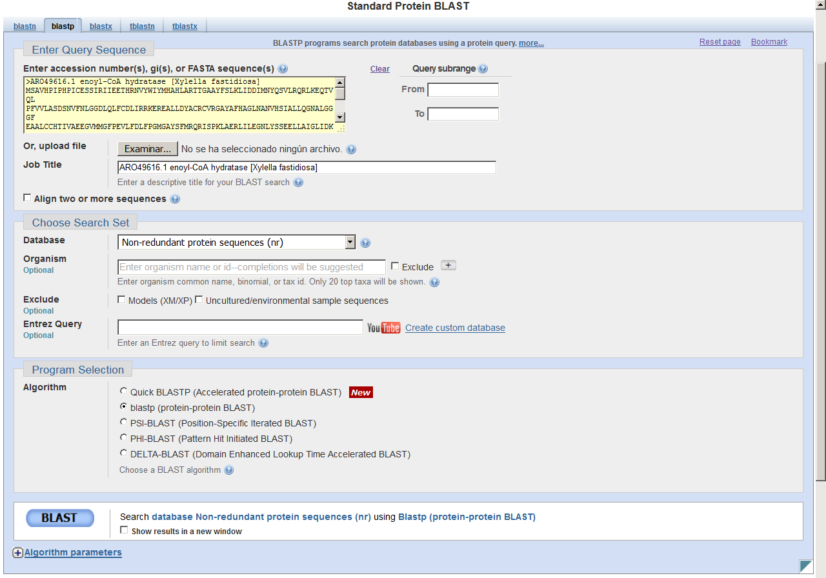
What modification of the algorithm do I want to use?
They are not simple modifications of the parameters of the algorithm, here each algorithm works slightly differently since it performs slightly different functions.
Modify the settings of the selected algorithm

Slide 31
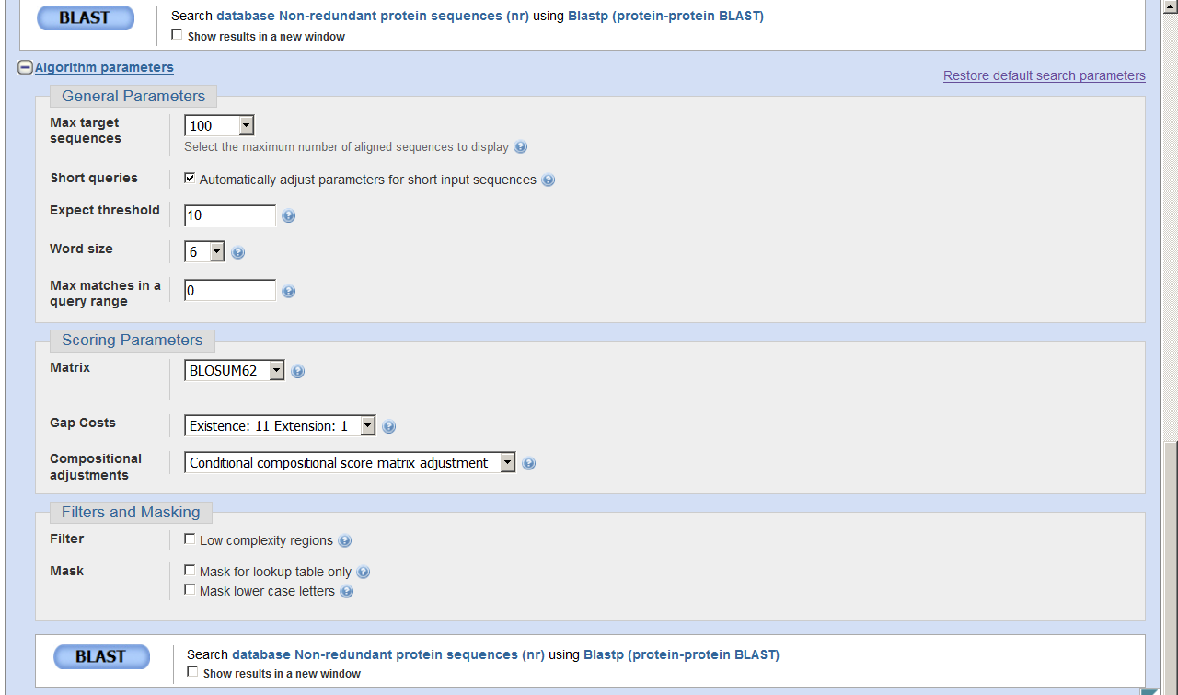
If I click here I will expand the configurable algorithm parameters
These parameters are the same as in the case of blastn, but the value of k-word varies
In blastp we use a scoring matrix!

Slide 32
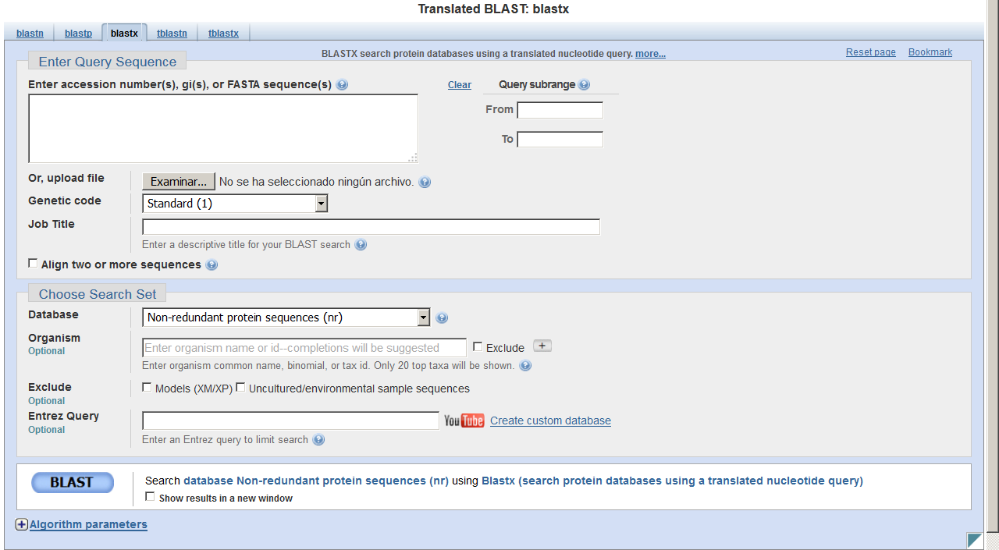
We are translating, therefore we need the right "dictionary", not all organisms have the same genetic code

Slide 33
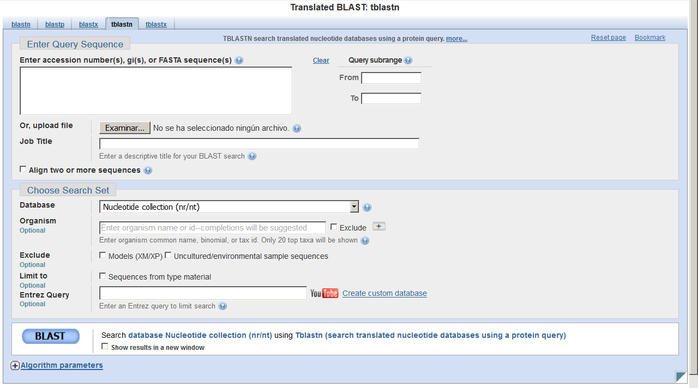

Slide 34
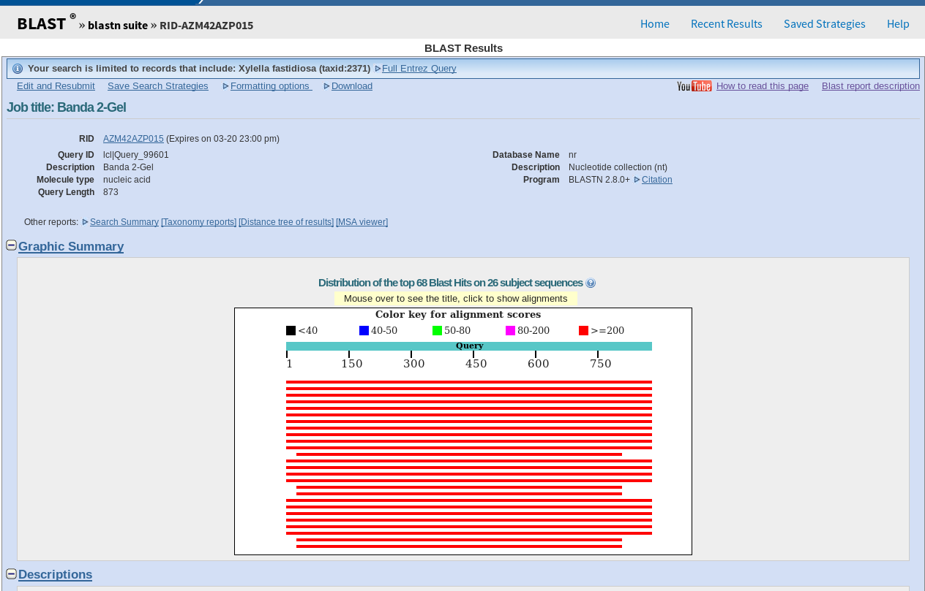
Quite self-explanatory names, try to see what these links do!
All blast output explained
RID: my search ID
Our search summary
Previous executions (perhaps I find completed here some that have been left hanging)
My query goes from tip to toe
The first thing I must always know about my blast search!!!
The "subject" that aligns with it can align in different positions and do so with different "score".(color)
If we click on them, they will take us to the couple "query – subject" result. Warning! Remember that if a "query-subject" couple has several possible alignments the first one that comes out is the one that has the highest score, which may not be what is represented here.
Simplification of the blast result

Slide 35
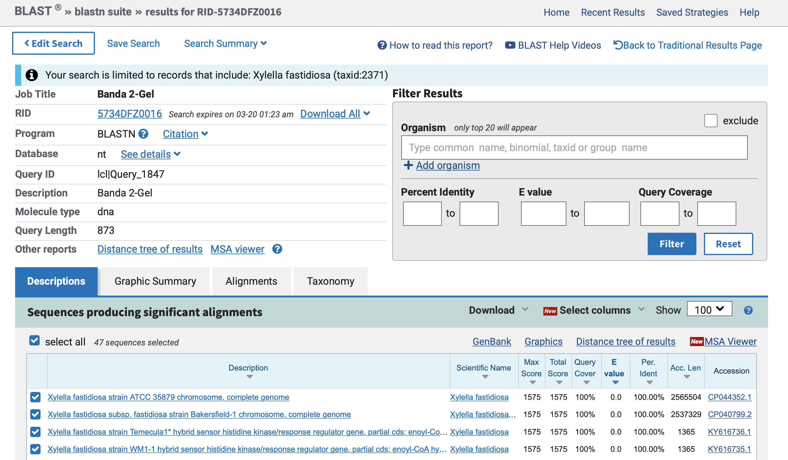
RID: my search ID.
We can save the link to this results page
Previous executions (perhaps I find completed here some that have been left hanging)
Quite self-explanatory names, try to see what these links do!
Our search summary
The first thing I must always know about my blast search!!!

Slide 36
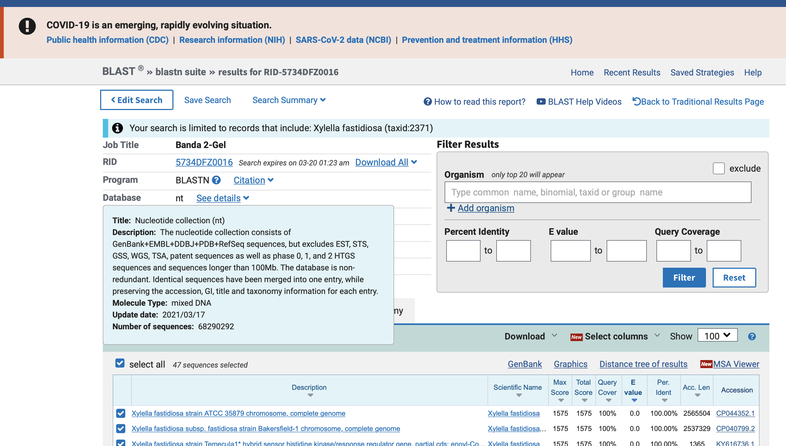

Detailed explanation of the database used

Slide 37
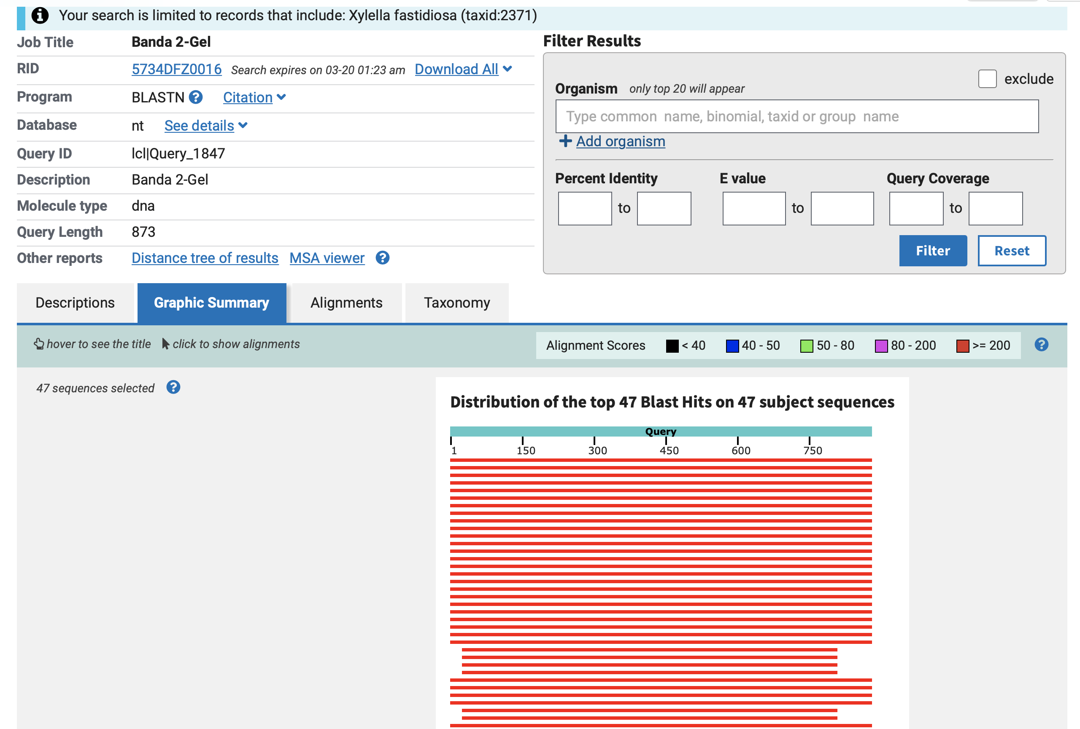
My query goes from tip to toe
The "subject" that aligns with it can align in different positions and do so with different "score".(color)
If we click on them, they will take us to the couple "query – subject" result. Warning! Remember that if a "query-subject" couple has several possible alignments the first one that comes out is the one that has the highest score, which may not be what is represented here.

Slide 38
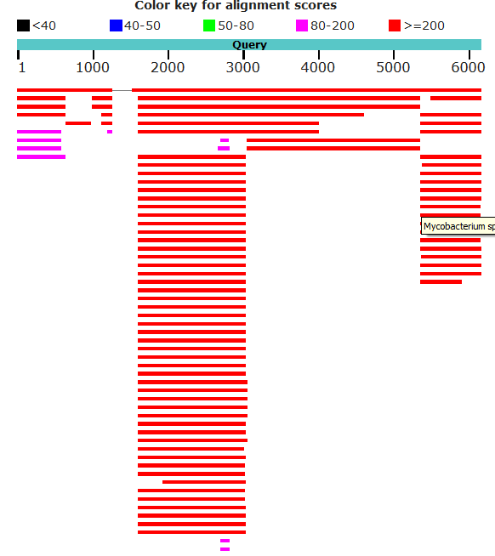
A continuous line indicates a single entry in the database, here we have a single couple query-subject. The "subject" aligns virtually the entire sequence except in the area with the thin grey line (marked with )

Slide 39
Non-continuous lines indicate different entries in the database, here we have 4 couples query-subject. They appear on the same line because they fit (none of them align in the same place as the others) no other reason.

Slide 40
Multiple different entries in the database align exactly in the same region of our "query" sequence. They are different "subjects", but with very similar sequence, so all of them are similar to our sequence region, so all of them align.

Slide 41
A continuous line indicates a single entry in the database, here we have a single couple query-subject. The "subject" aligns virtually the entire sequence except in the area with the thin grey line (marked with )
Non-continuous lines indicate different entries in the database, here we have 4 couples query-subject. They appear on the same line because they fit (none of them align in the same place as the others) no other reason.
Multiple different entries in the database align exactly in the same region of our "query" sequence. They are different "subjects", but with very similar sequence, so all of them are similar to our sequence region, so all of them align.

Slide 42
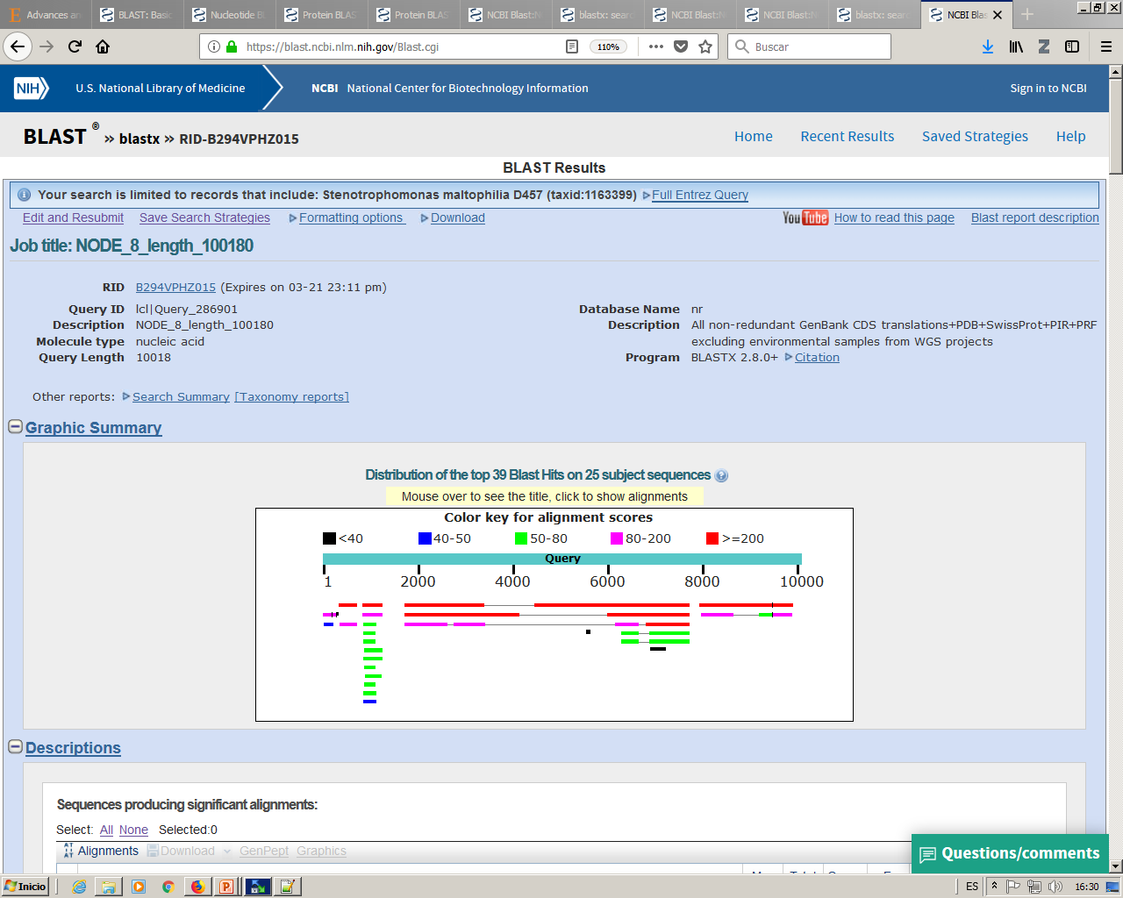

Slide 44
Two different entries (2 "query-subject" couples) but both have regions with similar sequences (both align in the same position of the "query") and regions with different sequences (only one of the two aligns with some "query" position)

Slide 45
>q
AAAACCBBBB
>s1
AAAABBBB
q AAAACCBBBB
S1 AAAA BBBB
>q
AAAABBAAAA
>s2
AAAA
q AAAABBAAAA
S2 AAAA
S2 AAAA
>q
AAAACCBBBB
>s3
AAAADDBBBB
q AAAACC--BBBB
S3 AAAA--DDBBBB

Slide 46
Quite self-explanatory names, try to see what these links do!
All blast output explained
RID: my search ID
Our search summary
Previous executions (perhaps I find completed here some that have been left hanging)
My query goes from tip to toe
The first thing I must always know about my blast search!!!
The "subject" that aligns with it can align in different positions and do so with different "score".(color)
If we click on them, they will take us to the couple "query – subject" result. Warning! Remember that if a "query-subject" couple has several possible alignments the first one that comes out is the one that has the highest score, which may not be what is represented here.
Simplification of the blast result

Slide 47
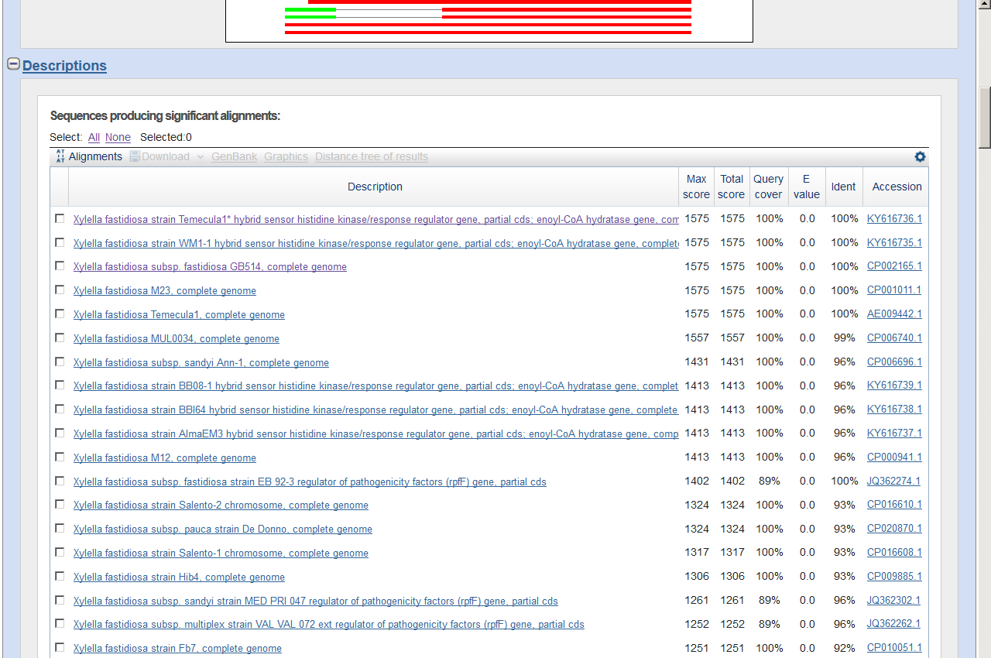
Link to this entry (the subject) within the database used to search
The 100 query-subject couples which have the best "Total score"
The "numbers"

Slide 48
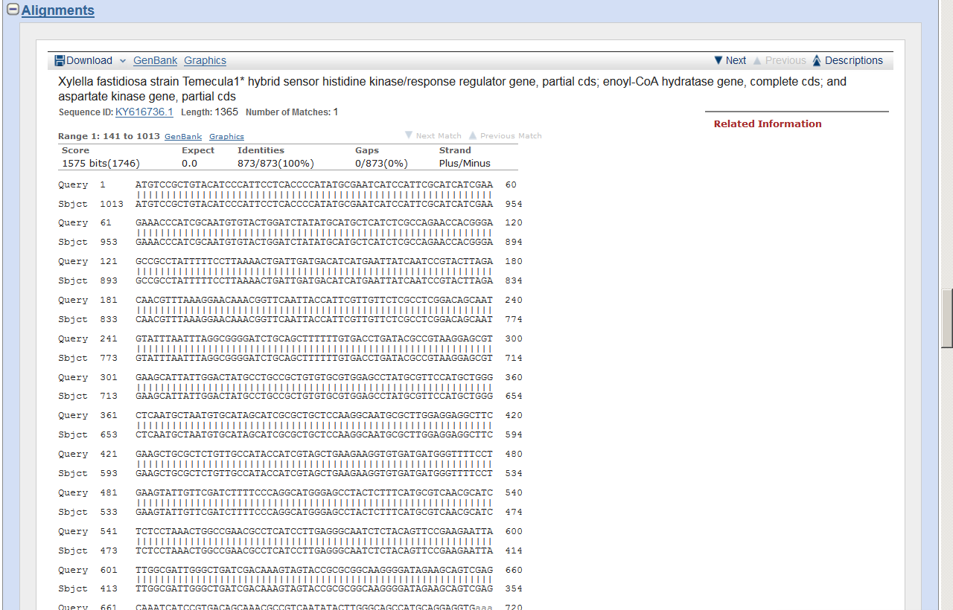
Link to this entry within the database used to search
Subject description
subject size
Number of different alignments that have been generated.
If there are more than one, we can go directly to the next ones.
The "numbers"
Visualize in genbank format (gbk, gb or gp) the subject region of this alignment, in this case, from nucleotide 141 to nucleotide 1013
The match is in the complementary strand (minus)

Slide 49
The most important thing!!!
The Alignment!!!
What we always have to look at!!!
We're aligning, aren't we?
Well, there's no point in us not looking at the alignment.
It would be like driving and not looking at the road.

Slide 50
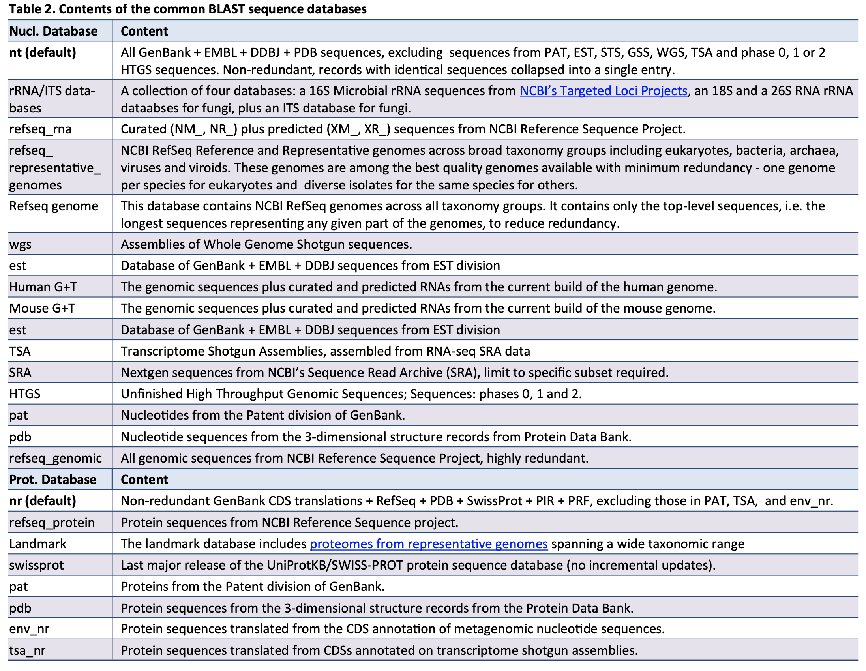
Apendix: Blast databases.
Here you will find a detailed description of "How to Blast" where this table is shown:
Note that the different databases are actually combinations of other databases that we already found combining although differently in the "Meta"- Database "nuccleotide" or "protein"

