Slide 1
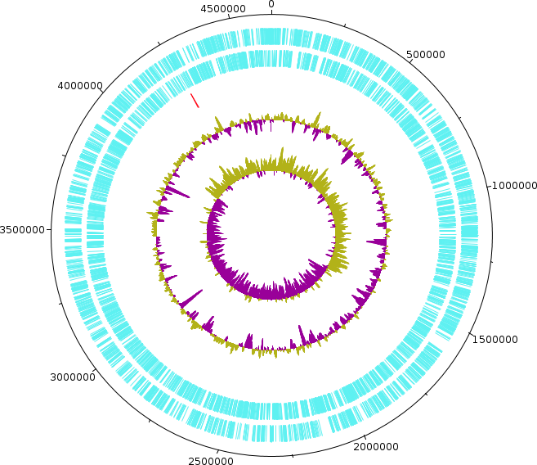
| E. coli CDS
| lexA – dinF operon

Slide 2
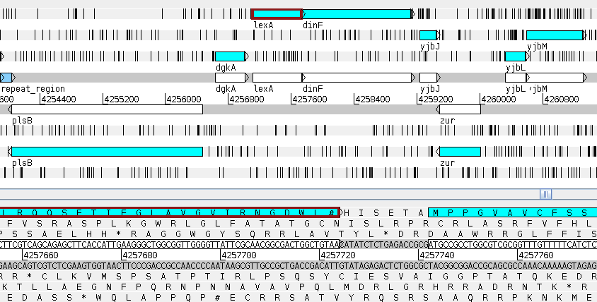

Slide 3
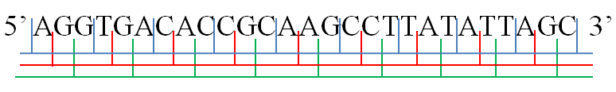
AGG·TGA·CAC·CGC·AAG·CCT·TAT·ATT·AGC
A·GGT·GAC·ACC·GCA·AGC·CTT·ATA·TTA·GC
AG·GTG·ACA·CCG·CAA·GCC·TTA·TAT·TAG·C

Slide 4
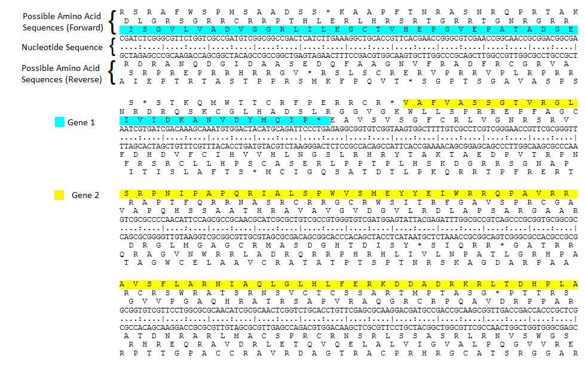
https://upload.wikimedia.org/wikipedia/commons/6/66/Open_reading_frame.jpg

Slide 5
1
2
3
-1
-2
-3
1
2
3
-1
-2
-3

Slide 6
1
2
3
-1
-2
-3
1
2
3
-1
-2
-3
Genes DO NOT OVERLAP!!!
Only one gene I a given set of coordinates (position in the genome, from AAAA to BBBB, expressed as AAAA..BBBB. Example: 4256700.. 4257800)

Slide 7
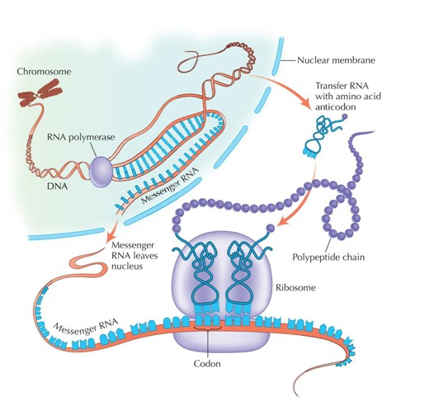
Continuous thread of DNA
Continuous thread of RNA
Continuous Protein Chain
Obtained from here: https://player.slideplayer.com/25/7962625/data/images/img0.jpg

Slide 8
>seq1 length: 42 bp
ATG AAA GCG TTA ACG CTT TCC AGC ACA GCC AGG CAA CAA GAG
Match Found: Seq_DB DNA length: 30 bp
Seq1 28 GCCAGGCAACAAGAG 42
|||||||||||||||
Seq_DB 16 GCCAGGCAACAAGAG 30
seq1 1 ATGAAAGCGTTAACG 15
|||||||||||||||
Seq_DB 1 ATGAAAGCGTTAACG 15
Our DNA has an insertion.
What is happening here?
seq1 1 ATGAAAGCGTTAACGCTTTCCAGCACAGCCAGGCAACAAGAG 42
||||||||||||||| |||||||||||||||
Seq_DB 1 ATGAAAGCGTTAACG------------GCCAGGCAACAAGAG 30

Slide 9
>seq1 length: 42 bp
ATG AAA GCG TTA ACG CTT TCC AGC ACA GCC AGG CAA CAA GAG
M K A L T L S S T A R Q Q E
>seq1 length: 42 bp
ATG AAA GCG TTA ACG CTT TCC AGC ACA GCC AGG CAA CAA GAG
Match Found: Seq_DB Protein length: 10 AA
seq1 28 GCCAGGCAACAAGAG 42
|||||||||||||||
Seq_DB 6 A R Q Q E 10
seq1 1 ATGAAAGCGTTAACG 15
|||||||||||||||
Seq_DB 1 M K A L T 5
Our DNA has an insertion.
So does our protein!
So, our protein is 14 AA long
What is the size of our protein?
seq1 1 ATGAAAGCGTTAACGCTTTCCAGCACAGCCAGGCAACAAGAG 42
||||||||||||||| |||||||||||||||
Seq_DB 1 M K A L T - - - - A R Q Q E 10

Slide 10
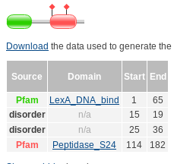
>sp|P0A7C2|LEXA_ECOLI LexA repressor OS=Escherichia coli (strain K12) GN=lexA PE=1 SV=1
MKALTARQQEVFDLIRDHISQTGMPPTRAEIAQRLGFRSPNAAEEHLKALARKGVIEIVS
GASRGIRLLQEEEEGLPLVGRVAAGEPLLAQQHIEGHYQVDPSLFKPNADFLLRVSGMSM
KDIGIMDGDLLAVHKTQDVRNGQVVVARIDDEVTVKRLKKQGNKVELLPENSEFKPIVVD
LRQQSFTIEGLAVGVIRNGDWL
Size: 202 AA

Slide 11
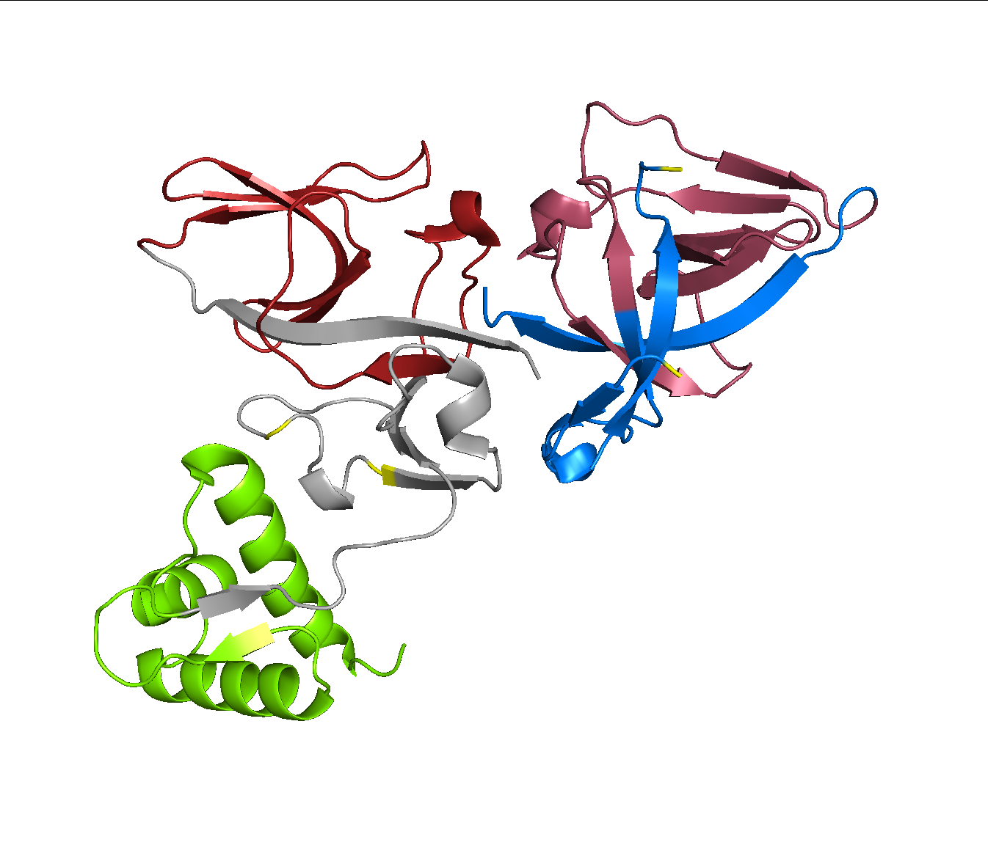

Slide 13
