Slide 2
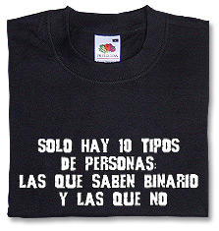

Slide 3
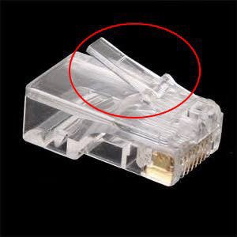
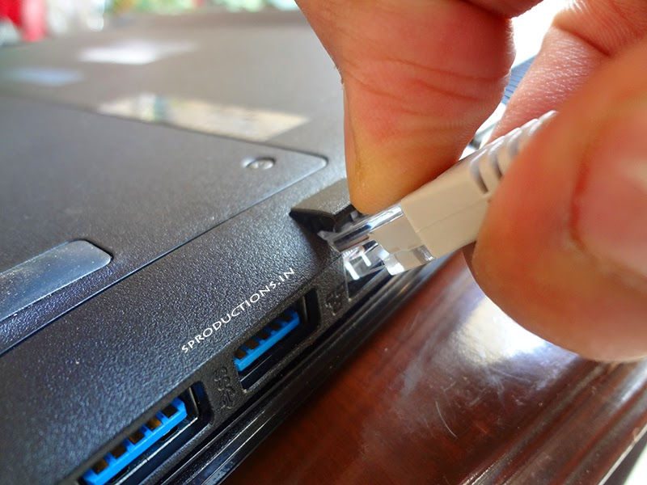
Disconnect your computer from the network
(unplug the connector and pull gently the network cable)

Slide 4
What is feeding the computer?
In other words:
What is the only "thing" that the computer receives from outside?
What other peace of technology we have in this room that receives the same "thing" and works based in the same principle?

Slide 5
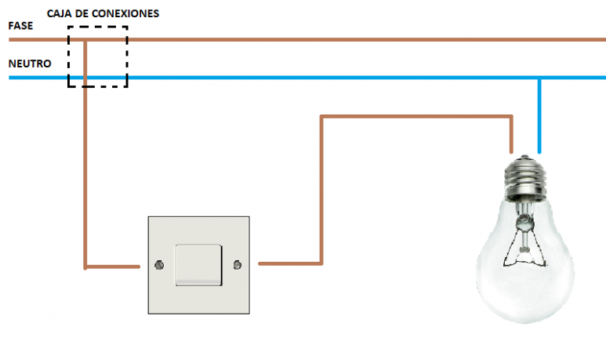

Slide 6
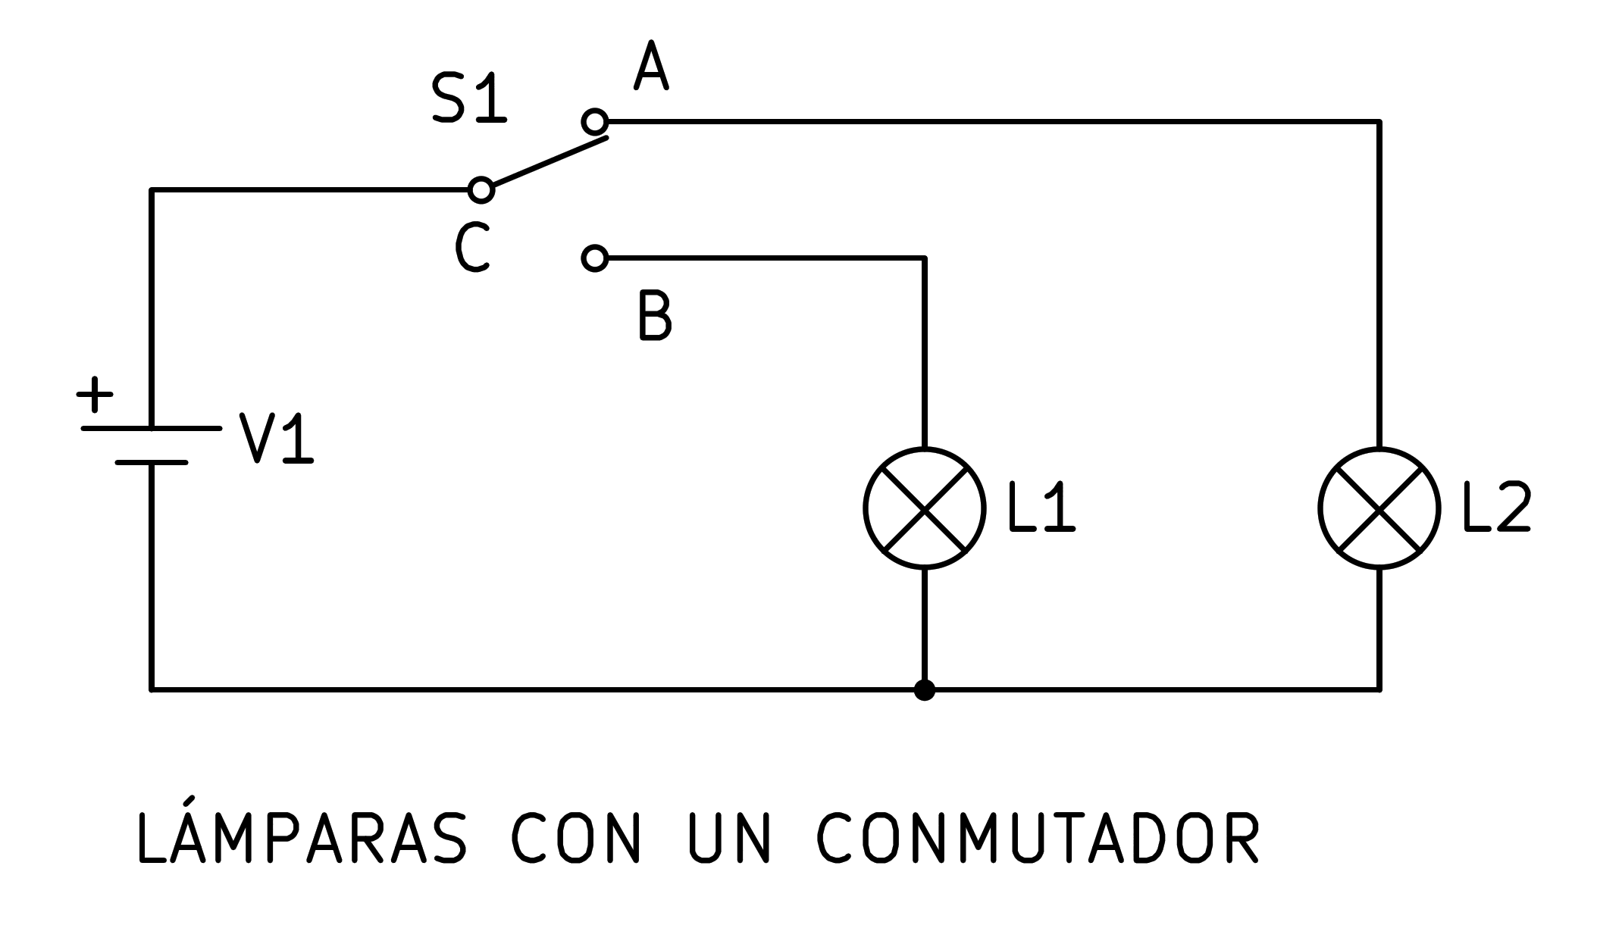
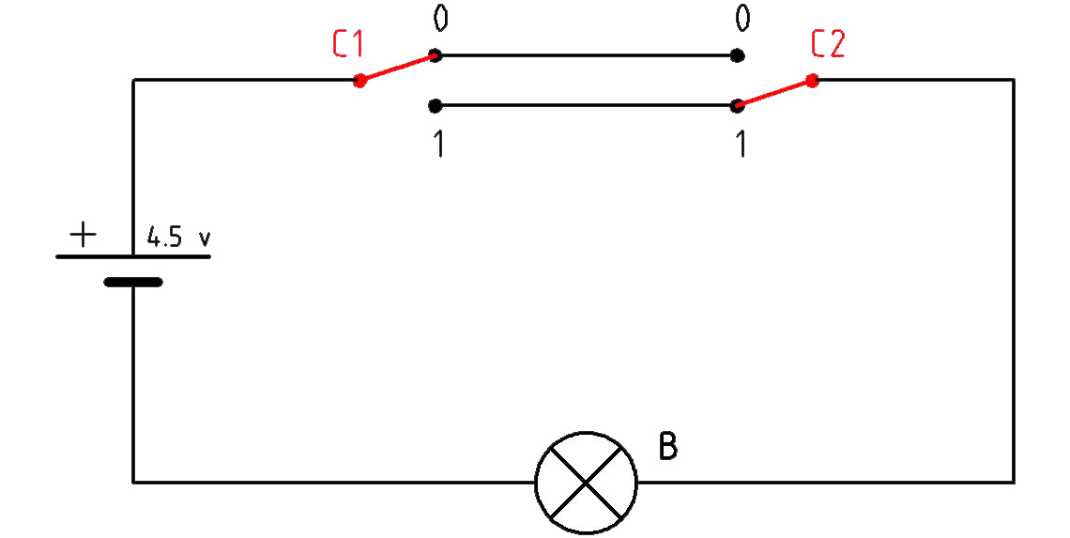

Slide 7
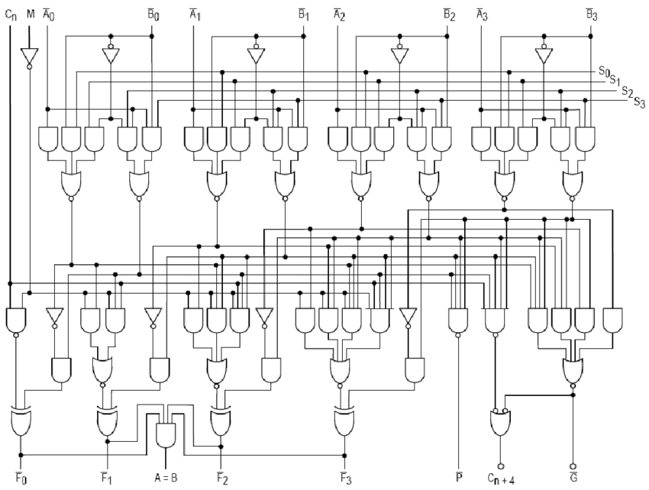

Slide 8
The basic unit of information in computing:
the "bit"
There is only two different bits:
0: There is no current
1: There is current
We can group the bits in groups of 8
and we call this :
a "byte"
The "byte" is the atomic (indivisible) unit of information in computing.

Slide 9
Since a byte is 8 groups of 2 different values we can have
2^8 = 256 possible combinations (please note X^Y = X^{Y})
We can assign a number to each of this combinations
Decimal Binary
0 00000000
1 00000001
2 00000010
3 00000011
4 00000100
5 00000101
6 00000110
7 00000111
8 00001000
9 00001001
10 00001010
…
255 ????????
Questions:
How many bytes do I need to store a
"0"?
;)
"1"?
"11"?
"255"?
"256"?

Slide 10
We can store 256 using two bytes:
256 00000001 0000000
257 00000001 0000001
How many byes do I need to store 65535?
65535 11111111 11111111

Slide 11
DEC | BIN | Symbol | Description
0 | 00000000 | NUL | Null character
1 | 00000001 | SOH | Start of Heading
2 | 00000010 | STX | Start of Text
3 | 00000011 | ETX | End of Text
4 | 00000100 | EOT | End of Transmission
5 | 00000101 | ENQ | Enquiry
6 | 00000110 | ACK | Acknowledge
7 | 00000111 | BEL | Bell, Alert
8 | 00001000 | BS | Backspace
9 | 00001001 | HT | Horizontal Tab
10 | 00001010 | LF | Line Feed
11 | 00001011 | VT | Vertical Tabulation
12 | 00001100 | FF | Form Feed
13 | 00001101 | CR | Carriage Return
14 | 00001110 | SO | Shift Out
15 | 00001111 | SI | Shift In
16 | 00010000 | DLE | Data Link Escape
17 | 00010001 | DC1 | Device Control One (XON)
18 | 00010010 | DC2 | Device Control Two
19 | 00010011 | DC3 | Device Control Three (XOFF)
20 | 00010100 | DC4 | Device Control Four
21 | 00010101 | NAK | Negative Acknowledge
22 | 00010110 | SYN | Synchronous Idle
23 | 00010111 | ETB | End of Transmission Block
24 | 00011000 | CAN | Cancel
25 | 00011001 | EM | End of medium
26 | 00011010 | SUB | Substitute
27 | 00011011 | ESC | Escape
28 | 00011100 | FS | File Separator
29 | 00011101 | GS | Group Separator
30 | 00011110 | RS | Record Separator
31 | 00011111 | US | Unit Separator
But what about letters?
And symbols like "!" or "*" or "?" ?
The answer: ASCI code:
check here if you are interested
https://www.ascii-code.com

Slide 12
DEC | BIN | Symbol | Description | DEC | BIN | Symbol | Description | DEC | BIN | Symbol | Description
32 | 00100000 | SP | Space | 64 | 01000000 | @ | At sign | 96 | 01100000 | ` | Grave accent
33 | 00100001 | ! | Exclamation mark | 65 | 01000001 | A | Uppercase A | 97 | 01100001 | a | Lowercase a
34 | 00100010 | " | Double quotes (or speech marks) | 66 | 01000010 | B | Uppercase B | 98 | 01100010 | b | Lowercase b
35 | 00100011 | # | Number sign | 67 | 01000011 | C | Uppercase C | 99 | 01100011 | c | Lowercase c
36 | 00100100 | $ | Dollar | 68 | 01000100 | D | Uppercase D | 100 | 01100100 | d | Lowercase d
37 | 00100101 | % | Per cent sign | 69 | 01000101 | E | Uppercase E | 101 | 01100101 | e | Lowercase e
38 | 00100110 | & | Ampersand | 70 | 01000110 | F | Uppercase F | 102 | 01100110 | f | Lowercase f
39 | 00100111 | ' | Single quote | 71 | 01000111 | G | Uppercase G | 103 | 01100111 | g | Lowercase g
40 | 00101000 | ( | Open parenthesis (or open bracket) | 72 | 01001000 | H | Uppercase H | 104 | 01101000 | h | Lowercase h
41 | 00101001 | ) | Close parenthesis (or close bracket) | 73 | 01001001 | I | Uppercase I | 105 | 01101001 | i | Lowercase i
42 | 00101010 | * | Asterisk | 74 | 01001010 | J | Uppercase J | 106 | 01101010 | j | Lowercase j
43 | 00101011 | + | Plus | 75 | 01001011 | K | Uppercase K | 107 | 01101011 | k | Lowercase k
44 | 00101100 | , | Comma | 76 | 01001100 | L | Uppercase L | 108 | 01101100 | l | Lowercase l
45 | 00101101 | - | Hyphen-minus | 77 | 01001101 | M | Uppercase M | 109 | 01101101 | m | Lowercase m
46 | 00101110 | . | Period, dot or full stop | 78 | 01001110 | N | Uppercase N | 110 | 01101110 | n | Lowercase n
47 | 00101111 | / | Slash or divide | 79 | 01001111 | O | Uppercase O | 111 | 01101111 | o | Lowercase o
48 | 00110000 | 0 | Zero | 80 | 01010000 | P | Uppercase P | 112 | 01110000 | p | Lowercase p
49 | 00110001 | 1 | One | 81 | 01010001 | Q | Uppercase Q | 113 | 01110001 | q | Lowercase q
50 | 00110010 | 2 | Two | 82 | 01010010 | R | Uppercase R | 114 | 01110010 | r | Lowercase r
51 | 00110011 | 3 | Three | 83 | 01010011 | S | Uppercase S | 115 | 01110011 | s | Lowercase s
52 | 00110100 | 4 | Four | 84 | 01010100 | T | Uppercase T | 116 | 01110100 | t | Lowercase t
53 | 00110101 | 5 | Five | 85 | 01010101 | U | Uppercase U | 117 | 01110101 | u | Lowercase u
54 | 00110110 | 6 | Six | 86 | 01010110 | V | Uppercase V | 118 | 01110110 | v | Lowercase v
55 | 00110111 | 7 | Seven | 87 | 01010111 | W | Uppercase W | 119 | 01110111 | w | Lowercase w
56 | 00111000 | 8 | Eight | 88 | 01011000 | X | Uppercase X | 120 | 01111000 | x | Lowercase x
57 | 00111001 | 9 | Nine | 89 | 01011001 | Y | Uppercase Y | 121 | 01111001 | y | Lowercase y
58 | 00111010 | : | Colon | 90 | 01011010 | Z | Uppercase Z | 122 | 01111010 | z | Lowercase z
59 | 00111011 | ; | Semicolon | 91 | 01011011 | [ | Opening bracket | 123 | 01111011 | { | Opening brace
60 | 00111100 | < | Less than (or open angled bracket) | 92 | 01011100 | \ | Backslash | 124 | 01111100 | | | Vertical bar
61 | 00111101 | = | Equals | 93 | 01011101 | ] | Closing bracket | 125 | 01111101 | } | Closing brace
62 | 00111110 | > | Greater than (or close angled bracket) | 94 | 01011110 | ^ | Caret - circumflex | 126 | 01111110 | ~ | Equivalency sign - tilde
63 | 00111111 | ? | Question mark | 95 | 01011111 | _ | Underscore | 127 | 01111111 | DEL | Delete

Slide 13
DEC | BIN | Symbol | Description | DEC | BIN | Symbol | Description | DEC | BIN | Symbol | Description | DEC | BIN | Symbol | Description
128 | 10000000 | € | Euro sign | 160 | 10100000 | NBSP | Non-breaking space | 192 | 11000000 | À | Latin capital letter A with grave | 224 | 11100000 | à | Latin small letter a with grave
129 | 10000001 |  | Unused | 161 | 10100001 | ¡ | Inverted exclamation mark | 193 | 11000001 | Á | Latin capital letter A with acute | 225 | 11100001 | á | Latin small letter a with acute
130 | 10000010 | ‚ | Single low-9 quotation mark | 162 | 10100010 | ¢ | Cent sign | 194 | 11000010 | Â | Latin capital letter A with circumflex | 226 | 11100010 | â | Latin small letter a with circumflex
131 | 10000011 | ƒ | Latin small letter f with hook | 163 | 10100011 | £ | Pound sign | 195 | 11000011 | Ã | Latin capital letter A with tilde | 227 | 11100011 | ã | Latin small letter a with tilde
132 | 10000100 | „ | Double low-9 quotation mark | 164 | 10100100 | ¤ | Currency sign | 196 | 11000100 | Ä | Latin capital letter A with diaeresis | 228 | 11100100 | ä | Latin small letter a with diaeresis
133 | 10000101 | … | Horizontal ellipsis | 165 | 10100101 | ¥ | Yen sign | 197 | 11000101 | Å | Latin capital letter A with ring above | 229 | 11100101 | å | Latin small letter a with ring above
134 | 10000110 | † | Dagger | 166 | 10100110 | ¦ | Pipe, broken vertical bar | 198 | 11000110 | Æ | Latin capital letter AE | 230 | 11100110 | æ | Latin small letter ae
135 | 10000111 | ‡ | Double dagger | 167 | 10100111 | § | Section sign | 199 | 11000111 | Ç | Latin capital letter C with cedilla | 231 | 11100111 | ç | Latin small letter c with cedilla
136 | 10001000 | ˆ | Modifier letter circumflex accent | 168 | 10101000 | ¨ | Spacing diaeresis - umlaut | 200 | 11001000 | È | Latin capital letter E with grave | 232 | 11101000 | è | Latin small letter e with grave
137 | 10001001 | ‰ | Per mille sign | 169 | 10101001 | © | Copyright sign | 201 | 11001001 | É | Latin capital letter E with acute | 233 | 11101001 | é | Latin small letter e with acute
138 | 10001010 | Š | Latin capital letter S with caron | 170 | 10101010 | ª | Feminine ordinal indicator | 202 | 11001010 | Ê | Latin capital letter E with circumflex | 234 | 11101010 | ê | Latin small letter e with circumflex
139 | 10001011 | ‹ | Single left-pointing angle quotation | 171 | 10101011 | « | Left double angle quotes | 203 | 11001011 | Ë | Latin capital letter E with diaeresis | 235 | 11101011 | ë | Latin small letter e with diaeresis
140 | 10001100 | Œ | Latin capital ligature OE | 172 | 10101100 | ¬ | Negation | 204 | 11001100 | Ì | Latin capital letter I with grave | 236 | 11101100 | ì | Latin small letter i with grave
141 | 10001101 |  | Unused | 173 | 10101101 | ­SHY | Soft hyphen | 205 | 11001101 | Í | Latin capital letter I with acute | 237 | 11101101 | í | Latin small letter i with acute
142 | 10001110 | Ž | Latin capital letter Z with caron | 174 | 10101110 | ® | Registered trade mark sign | 206 | 11001110 | Î | Latin capital letter I with circumflex | 238 | 11101110 | î | Latin small letter i with circumflex
143 | 10001111 |  | Unused | 175 | 10101111 | ¯ | Spacing macron - overline | 207 | 11001111 | Ï | Latin capital letter I with diaeresis | 239 | 11101111 | ï | Latin small letter i with diaeresis
144 | 10010000 |  | Unused | 176 | 10110000 | ° | Degree sign | 208 | 11010000 | Ð | Latin capital letter ETH | 240 | 11110000 | ð | Latin small letter eth
145 | 10010001 | ‘ | Left single quotation mark | 177 | 10110001 | ± | Plus-or-minus sign | 209 | 11010001 | Ñ | Latin capital letter N with tilde | 241 | 11110001 | ñ | Latin small letter n with tilde
146 | 10010010 | ’ | Right single quotation mark | 178 | 10110010 | ² | Superscript two - squared | 210 | 11010010 | Ò | Latin capital letter O with grave | 242 | 11110010 | ò | Latin small letter o with grave
147 | 10010011 | “ | Left double quotation mark | 179 | 10110011 | ³ | Superscript three - cubed | 211 | 11010011 | Ó | Latin capital letter O with acute | 243 | 11110011 | ó | Latin small letter o with acute
148 | 10010100 | ” | Right double quotation mark | 180 | 10110100 | ´ | Acute accent - spacing acute | 212 | 11010100 | Ô | Latin capital letter O with circumflex | 244 | 11110100 | ô | Latin small letter o with circumflex
149 | 10010101 | • | Bullet | 181 | 10110101 | µ | Micro sign | 213 | 11010101 | Õ | Latin capital letter O with tilde | 245 | 11110101 | õ | Latin small letter o with tilde
150 | 10010110 | – | En dash | 182 | 10110110 | ¶ | Pilcrow sign - paragraph sign | 214 | 11010110 | Ö | Latin capital letter O with diaeresis | 246 | 11110110 | ö | Latin small letter o with diaeresis
151 | 10010111 | — | Em dash | 183 | 10110111 | · | Middle dot - Georgian comma | 215 | 11010111 | × | Multiplication sign | 247 | 11110111 | ÷ | Division sign
152 | 10011000 | ˜ | Small tilde | 184 | 10111000 | ¸ | Spacing cedilla | 216 | 11011000 | Ø | Latin capital letter O with slash | 248 | 11111000 | ø | Latin small letter o with slash
153 | 10011001 | ™ | Trade mark sign | 185 | 10111001 | ¹ | Superscript one | 217 | 11011001 | Ù | Latin capital letter U with grave | 249 | 11111001 | ù | Latin small letter u with grave
154 | 10011010 | š | Latin small letter S with caron | 186 | 10111010 | º | Masculine ordinal indicator | 218 | 11011010 | Ú | Latin capital letter U with acute | 250 | 11111010 | ú | Latin small letter u with acute
155 | 10011011 | › | Single right-pointing angle quotation mark | 187 | 10111011 | » | Right double angle quotes | 219 | 11011011 | Û | Latin capital letter U with circumflex | 251 | 11111011 | û | Latin small letter u with circumflex
156 | 10011100 | œ | Latin small ligature oe | 188 | 10111100 | ¼ | Fraction one quarter | 220 | 11011100 | Ü | Latin capital letter U with diaeresis | 252 | 11111100 | ü | Latin small letter u with diaeresis
157 | 10011101 |  | Unused | 189 | 10111101 | ½ | Fraction one half | 221 | 11011101 | Ý | Latin capital letter Y with acute | 253 | 11111101 | ý | Latin small letter y with acute
158 | 10011110 | ž | Latin small letter z with caron | 190 | 10111110 | ¾ | Fraction three quarters | 222 | 11011110 | Þ | Latin capital letter THORN | 254 | 11111110 | þ | Latin small letter thorn
159 | 10011111 | Ÿ | Latin capital letter Y with diaeresis | 191 | 10111111 | ¿ | Inverted question mark | 223 | 11011111 | ß | Latin small letter sharp s - ess-zed | 255 | 11111111 | ÿ | Latin small letter y with diaeresis

Slide 14
There are many variations of ASCII code:
- ISO-8859-1 (or the modification ISO-8859-15) (the most used one)
- Windows-1252 (the one I showed you before)
- ISO-8859-2 for Eastern European languages using the Latin script
- ISO-8859-5 for languages using the Cyrillic script
- … (many more)
Later a new encoding system, called Unicode, was introduced. It can encode all languages' characters. There are three Unicode encodings:
- UTF8 : uses 8 bits like ASCII, so it is compatible, the first 128 characters are equal
(please go and check it). Nowadays almost all texts are encoded using UTF8
- UTF16: uses 16 bits
- UTF32: uses 32 bits

Slide 15
Questions:
In ASCII code
How many bytes do I need to store:
"A"?
"1"?
"AB"?
"11"?
"256"?

Slide 16
This way, in a computer, data is stored in bytes (or groups of bytes).
Depending on the data we want to store, bytes will be read grouped in different numbers and interpreted differently.
So, when a computer reads data, its "type" must be specified. Here some examples:
name of the type | bytes | interpreting the bits
char | 1 | ascii or utf8 characters
int32 (aka int) | 4 | integer numbers from -2 147 483 648 to 2 147 483 647
fp32 (aka float) | 4 | decimal numbers from 1.175494351 E -38 to 3.402823466 E +38 (positive or negative)
fp64 (aka double) | 8 | decimal numbers from 2.2250738585072014 E -308 to 1.7976931348623158 E +308 (- or +)
many more …
Computer programmers can define their own types to be used for specific functions

Slide 17
This way, in a computer we find storage units (AKA Units or Volumes or disks or partitions or…) which store the data we use in a "none volatile" way so when we turn off the power, the data remains.
Examples of storage units are: The Hard Disk, USB pendrive, DVD, Network drives, etc.
We organize the data inside these storage units, storing it in files, so the bytes that compound our data are stored in those files.
These files are organized in directories (AKA folders)
These folders are organized hierarchically in the directory tree

Slide 18
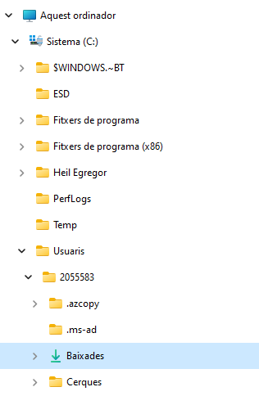
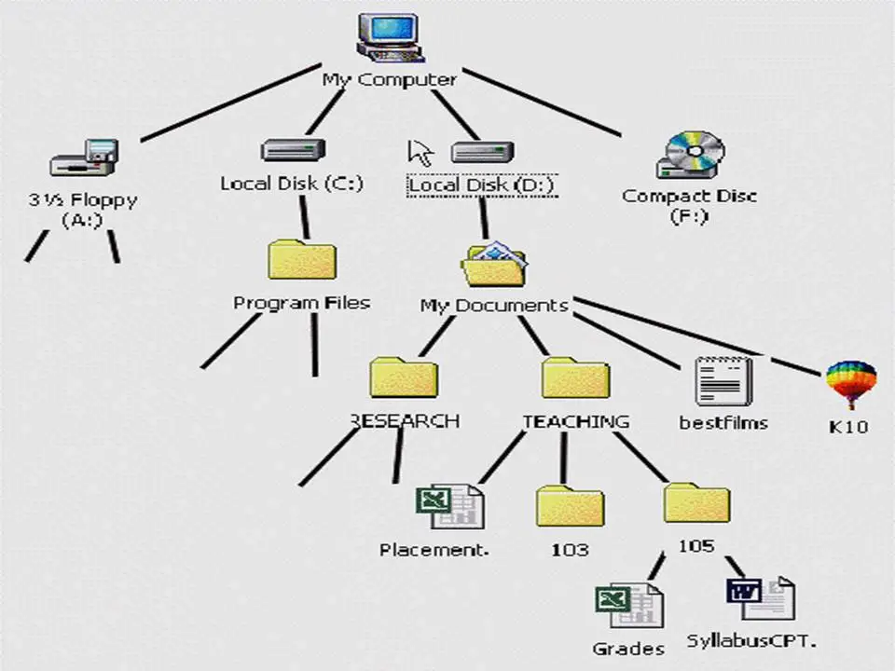
In Microsoft Windows:
Each storage unit receives a letter followed by ":" as a name.
It is mounted at the beginning of the directory tree.

Slide 19
Please follow the exercise 1 in you practice script (and everything before)
Objectives:
- Visualize file extensions in windows
- Move along the directory tree
- Discover how a "path" inside the directory tree can be expressed as a single line and how to use it
- Discover how windows "tries" to help translating some directory names
- Discover the "notepad.exe" program

Slide 20
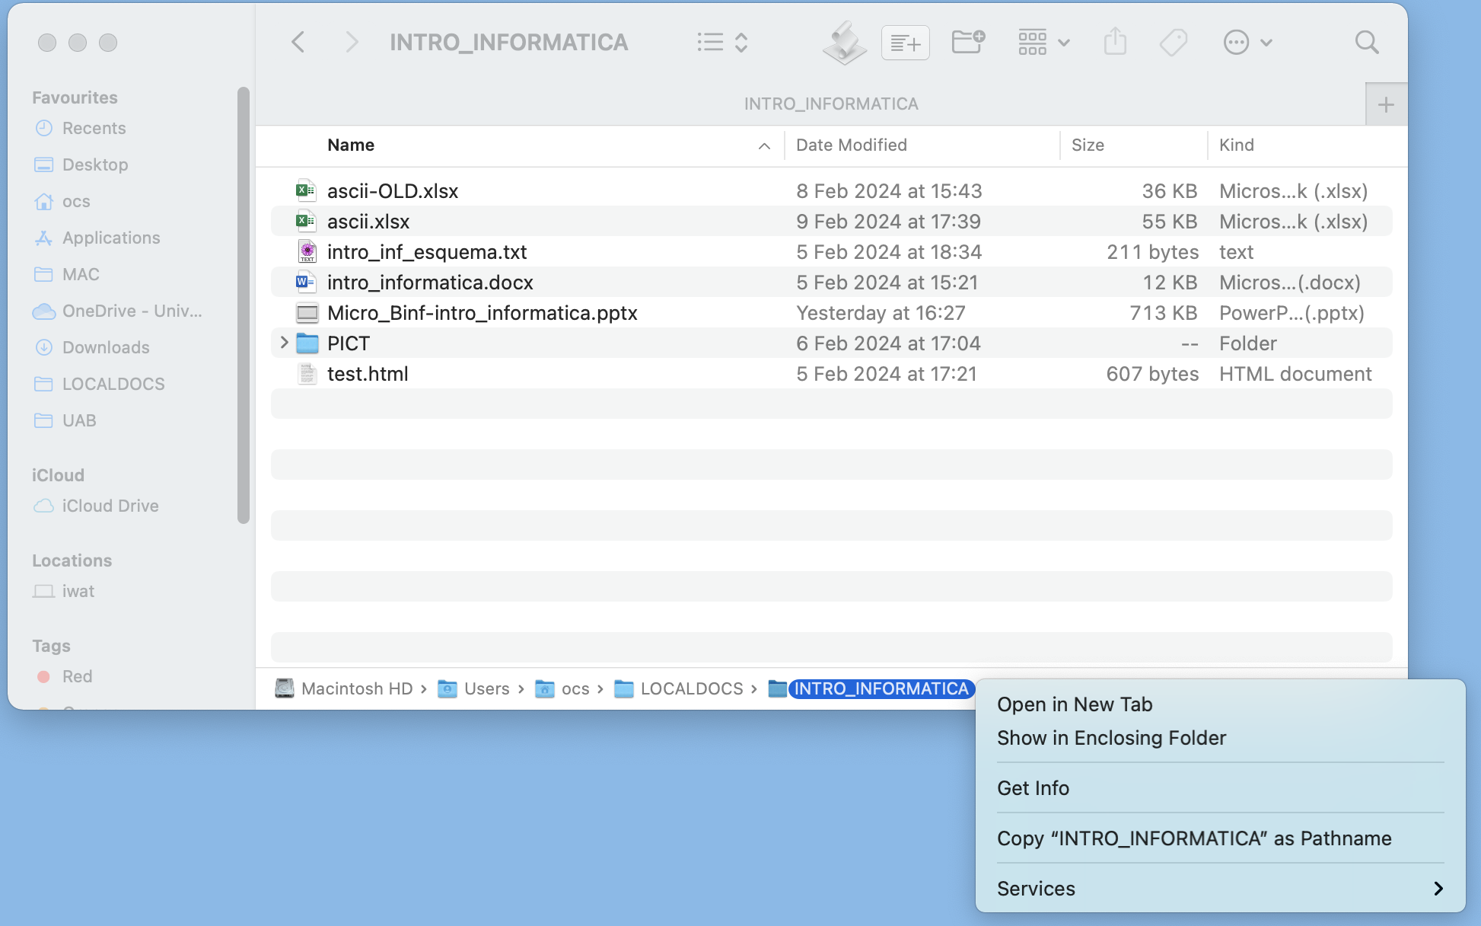

In MacOSX:
Each storage Unit receives a given name. The one that contains the MacOSX has the internal name of "/" and Becomes the start of the directory tree.
Any other storage unit you mount will be found as a folder inside this one:
/Volumes
This is what you would get:
/Users/ocs/LOCALDOCS/INTRO_INFORMATICA

Slide 21
These files, from the computer point of view are all the same
But, from the User perspective (us, humans), there are two types of files:
1 - Those that only contain bytes that must be interpreted as "chars" (single bytes) so when read by the computer and presented to the user, the user will only see characters from the ASCII code (or UTF8). They receive the name of text files (AKA txt files or flat files or …). The programs (AKA applications or apps or software) that work with them are called Text editors
2- Binary files: each byte (or group of bytes) will be interpreted according to its type (char, int, float…) specified by the file or by the program reading it.

Slide 22
Please follow the exercise 2 in you practice script
Objectives:
- Discover the word URL
- How to download a file in a web site
- Discover what a text file (AKA txt file, flat file, …) is
- notepad.exe is a very basic text editor
- Discover that MS Word is not a text editor and docx files are not text files

Slide 23
A text file (AKA txt file, flat file, …) contains only "simple" characters defined in a simple encoding system and easily visualized by a human. They do not contain any visualization format (e.g: font types, page sizes, margins, pictures, etc).
However, using those simple characters, we can define internal formats inside those text files that can be interpreted by a program (AKA: application, app, software …) specially created to interpret them and, at the same, since this is a txt file, humans can read this format and also interpret it.
E.g: web browsers interpret "labels" inside txt files in order to present the colors, fonts, and any other form of formatted text we see in the the web sites we visit

Slide 24
Please follow the exercise 3 in you practice script
Objectives:
- Discover some parts of a URL and its meaning
- Discover how to move along a web site directory tree
- Discover how txt files can have internal formats which can be interpreted by both humans and computers
- Discover that web pages are txt files interpreted by a browser according to an internal format based on labels
- Discover that the extension part of a file does not define the type of this file
- Discover how windows only uses the extension (not the type of the file) to decide what program to use to open a file

Slide 25
Regarding binary files, the simplest way to classify them would be in three different types:
- Compressed files
- Self-executable files
- Data files

Slide 26
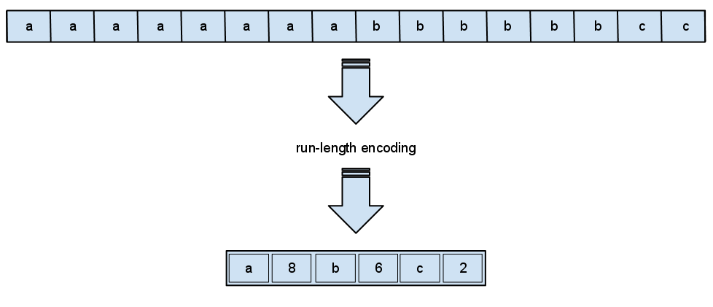
Regarding binary files, the simplest way to classify them would be in three different types:
- Compressed files: They are files created when applying a method (in this case AKA: an algorithm) to a file, groups of files or groups of folders and files. Compression algorithms can transform groups of bytes to a single byte or to a smaller group of them
There are many compression algorithms: zip, rar, 7z…
I don't want to make it complicated, so I'm not going to talk about "tar" or "gz" or "tar.gz (AKA: tgz)"
Example of how a compression algorithm works:
Run Length Encoding

Slide 27
Thanks to compression programs (AKA: applications, apps, software…) we can join multiple files and folders in a single file.
Advantages:
- It is easier and faster to "transport" (download, upload, copy, move…) than a complex branch of the directory tree
- It usually takes less disk space than the sum of the space used by the files and folders it contains (here the word "compression")
Disadvantages:
- Its contents must be extracted in order to be used.
Note on this: Sometimes (very few) this is not necessary, but if you want to avoid problems, always decompress them.

Slide 28
Please follow the exercise 4 in you practice script
Objectives:
- Discover the most used compressed file: zip
- Decompress (AKA: extract) a compressed file
- Discover what can be contained inside
- Discover the differences between a compressed file and a folder (AKA: directory)

Slide 29
Regarding binary files, the simplest way to classify them would be in three different types:
- Self-executable files: AKA: programs, applications, apps. They are binary files that contain instructions which can be interpreted by the computer.
They do not require the presence of any other program to interpret those instructions.
Sometimes they require other files which contain other data needed (or not) for them to work.

Slide 30
Sometimes some of their instructions can be located in other files called libraries (in windows ".dll" files, in linux ".so" files)
Sometimes those libraries do not come with the program.
Sometimes those libraries are already in the computer, they were placed there when MS Windows, MacOSX or Linux was installed.
Sometimes those libraries neither are provided with the system nor with the program. They require to be installed independently.
The main purpose of designing programs like this is that the same library can be reused by multiple programs.
This way, developers do not need to write instructions that have already been written.
And they do not need to provide files that are already there or can be obtained elsewhere.

Slide 31
In MS Windows when the program is very complex and requires lots of libraries and data files it needs to be installed.
Lots of times the installation process is nothing more than uncompressing lots of files and folders inside a directory.
Most of the time any can be selected, but for convenience, in order to keep all the programs (AKA: applications, apps…) together we choose a standard one e.g: "C:\Program Files"
In MacOSX the executable and all its libraries come compressed in a single file that we call "app". Except with very few exceptions we do not install "apps" we just move them to the "/Applications" folder

Slide 32
When we double click a file, we execute a program.
If this file is a binary executable, it is executed and it will proceed with the default instructions.
if this file is a data file and the system knows the extension in the file name and knows which program is in charge to open the files with this extension, this program will be executed and it will proceed with the instructions programed to be followed when this type of file is given as input

Slide 33
Please follow the exercise 5 in you practice script
Objectives:
- Identify programs (AKA: executables, applications, app…)
- Execute programs that do not require installation
- Discover how programs can require extra files which change how they work or that are essencial
- Discover where are programs installed by default and how to find their executables
- Discover what happens when we "doble click" a file
- Discover how the extension is just a given name
- Discover how executables read and interpret files depending on their extensions, not the type of files they are

Slide 34
END of the 1st part
Let's go for the second
Let's apply some of this to the bioinformatics

Slide 35
As you 've seen in the html example, you can format data made only of text characters, so stored inside text files (AKA txt files, flat files …).
You give this data an internal format using different conventions (in the case of html it was "<labels>".
As you can imagine this is widely use in informatics: configurations, data required by software, user profiles, etc.
Biological data is mostly text (Sequences of genes and proteins, Atoms forming a protein, source organisms from where these come from, etc.)
Text files (AKA txt, flat…) are perfect for store biological data, they can be read easily both by humans and computers.
This way, several formats for store biological data have been created.

Slide 36
The most used and known format is called "Fasta". It is designed for storing sequence data. It can be nucleotides or peptides. One or many different entries in the same file
An entry starts with a ">" and a description of what it is IN THE SAME LINE. This line can also have an internal format; each DB has its own
>L02362.1 Escherichia coli repressor protein (lexA) gene 3' end; DNA-damage-inducible protein (dinF) gene, complete cds
GGGTTATTCGCAACGGCGACTGGCTGTAACATATCTCTGAGACCGCGATGCCGCCTGGCGTCGCGGTTTG TTTTTCATCTCTCTTCATCAGGCTTGTCTGCATGGCATTCCTCACTTCATCTGATAAAGCACTCTGGCAT CTCGCCTTACCCATGATTTTCTCCAATATCACCGTTCCGTTGCTGGGACTGGTCGATACGGCGGTAATTG GTCATCTTGATAGCCCGGTTTATTTGGGCGGCGTGGCGGTTGGTGCAACGGCGACCAGCTTTCTCTTTAT GCTGTTGCTGTTTTTACGCATGAGCACCACCGGGCTGACTGCGCAGGCTTATGGTGCCAAAAATCCTCAG GCATTAGCCCGTACGCTGGTGCAACCGTTGCTGTTGGCGTTGGGGGCTGGGGCGTTAATTGCGCTGCTGC GTACGCCGATTATCGATCTGGCGCTGCATATTGTTGGCGGTAGTGAGGCAGTCCTGGAACAGGCGCGGCG CTTTCTTGAAATCCGCTGGTTAAGCGCACCGGCGTCGCTGGCGAATCTGGTATTACTCGGTTGGTTACTC GGCGTGCAATATGCCCGTGCGCCAGTAATTTTGTTAGTGGTCGGCAATATCCTCAACATTGTGCTGGATG TCTGGCTGGTGATGGGGCTGCATATGAACGTGCAGGGCGCGGCGCTGGCGACGGTTATTGCGGAATATGC AACATTGCTGATTGGTCTGCTAATGGTGCGTAAAATCCTCAAACTACGCGGAATTTCCGGCGAAATGCTG AAAACTGCCTGGCGAGGAAACTTCCGTCGCTTGCTGGCGCTTAACCGCGATATCATGCTGCGTTCGCTGT TGTTGCAACTCTGTTTCGGCGCGATCACCGTACTTGGCGCGCGACTGGGGAGTGACATTATCGCTGTTAA CGCGGTTCTGATGACGCTACTCACCTTTACCGCCTATGCGCTGGATGGTTTTGCCTACGCGGTTGAAGCG CACTCCGGTCAGGCATACGGTGCGCGCGACGGTAGCCAGTTGCTGGATGTCTGGCGGGCAGCGTGCCGCC AGTCGGGGATCGTAGCGTTACTGTTTTCGGTGGTTTATTTGCTGGCTGGGGAACACATCATTGCGTTACT GACGTCGTTAACCCAGATTCAGCAGCTGGCTGACCGCTATCTTATCTGGCAGGTGATTTTGCCGGTGGTT GGCGTCTGGTGTTATCTGCTGGACGGCATGTTTATAGGCGCAACGCGTGCCACCGAAATGCGTAACAGTA TGGCGGTGGCCGCCGCAGGTTTTGCGCTGACGCTCCTTACGCTGCCGTGGCTGGGTAATCATGCTTTGTG GCTGGCATTAACCGTCTTTCTGGCGTTGCGCGGGCTTTCTCTGGCGGCTATCTGGCGGCGTCACTGGCGC AATGGTACCTGGTTTGCCGCAACGTGACGGTTAAAAATTCTGAATAAATAATCCTAAGCCAAATTGCTGA CTACACTTAATCTCACGTTCAGAAGAAAAGTGAACGTACTCTCATTCACAACCTAACGATGAGGTCTTGA TTATGAATAAAGATGAAGCCGGCGGTAACTGGAAACAGTTTAAAGGTAAAGTGAAAGAGCAATGGGGCAA ACTGACCGATGATGATATGACGATCATTGAAGGTAAACGTGATCAACTGGTCGGTAAAATCCAGGAACGT TATGGTTATCAGAAAGATCAGGCAGAAAAAGAGGTCGTGGATTGGGAAACCCGCAATGAATATCGCTGGT AATTAATCCCTCCTGCCCGACGTGTACAAGGATGTACGCCCTCTTAACGCGGTTTCTTTTTCACCTGCAC AGAGTGATCATGCTGGCACTGTTCAGGATGACGACACGCTTCCACTTCTACACATGCCGCACAGAGCCCA TGTGCTTCAATCACATTATGCCGCAGGGCAAACCCCATTTTTGCCGCCAGCGTATGCATAATGTCTTCCA CGCCTTCTGCACACTCTTCTTTCACTGCGCCGCAGCGATCGCAAATAAACATGGCTGACGTATGGGTGGG CTGATCGAACAGATGACAGAGCACATAACTGTTGGTGGATTCCACCTTATGCACAAAACCTTGCTCAAGC AGAAAATCCAGCGCGCGATAAACCGTTGGCGGCTTGGCTTGCGGTTCAGCTTCGCGCAGTAAATCAAGCA GATCATAAGCGCTGATAGCGCCATCCTGCAG
Below, in one or multiple lines, the sequence. Only IUPAC characters and white characters are allowed (NO NUMBERS!!!)

Slide 37
Here data about the same gene
in "gbff" (AKA genbank, gb or gbk) format.
This is a single file. Here it is presented split in two parts for convenience.
LOCUS ECOLEXDIN 2201 bp DNA linear BCT 28-MAY-1993
DEFINITION Escherichia coli repressor protein (lexA) gene 3' end;
DNA-damage-inducible protein (dinF) gene, complete cds.
ACCESSION L02362
VERSION L02362.1
KEYWORDS DNA-damage-inducible protein; dinF gene; lexA gene; repressor
protein.
SOURCE Escherichia coli
ORGANISM Escherichia coli
Bacteria; Pseudomonadota; Gammaproteobacteria; Enterobacterales;
Enterobacteriaceae; Escherichia.
REFERENCE 1 (sites)
AUTHORS Horii,T., Ogawa,T. and Ogawa,H.
TITLE Nucleotide sequence of the lexA gene of E. coli
JOURNAL Cell 23 (3), 689-697 (1981)
PUBMED 7013987
REFERENCE 2 (sites)
AUTHORS Markham,B.E., Little,J.W. and Mount,D.W.
TITLE Nucleotide sequence of the lexA gene of Escherichia coli K-12
JOURNAL Nucleic Acids Res. 9 (16), 4149-4161 (1981)
PUBMED 6272195
REFERENCE 3 (sites)
AUTHORS Krueger,J.H., Elledge,S.J. and Walker,G.C.
TITLE Isolation and characterization of Tn5 insertion mutations in the
lexA gene of Escherichia coli
JOURNAL J. Bacteriol. 153 (3), 1368-1378 (1983)
PUBMED 6298183
REFERENCE 4 (bases 1 to 2201)
AUTHORS Lilley,P.E. and Dixon,N.E.
TITLE E. coli dinF gene
JOURNAL Unpublished
FEATURES Location/Qualifiers
source 1..2201
/organism="Escherichia coli"
/mol_type="genomic DNA"
/strain="K-12"
/db_xref="taxon:562"
gene 1..29
/gene="lexA"
CDS <1..29
/gene="lexA"
/citation=[1]
/citation=[2]
/codon_start=3
/transl_table=11
/product="repressor protein"
/protein_id="AAA24068.1"
/translation="VIRNGDWL"
gene 48..1427
/gene="dinF"
CDS 48..1427
/gene="dinF"
/citation=[3]
/codon_start=1
/transl_table=11
/product="DNA-damage-inducible protein"
/protein_id="AAA24069.1"
/translation="MPPGVAVCFSSLFIRLVCMAFLTSSDKALWHLALPMIFSNITVP
LLGLVDTAVIGHLDSPVYLGGVAVGATATSFLFMLLLFLRMSTTGLTAQAYGAKNPQA
LARTLVQPLLLALGAGALIALLRTPIIDLALHIVGGSEAVLEQARRFLEIRWLSAPAS
LANLVLLGWLLGVQYARAPVILLVVGNILNIVLDVWLVMGLHMNVQGAALATVIAEYA
TLLIGLLMVRKILKLRGISGEMLKTAWRGNFRRLLALNRDIMLRSLLLQLCFGAITVL
GARLGSDIIAVNAVLMTLLTFTAYALDGFAYAVEAHSGQAYGARDGSQLLDVWRAACR
QSGIVALLFSVVYLLAGEHIIALLTSLTQIQQLADRYLIWQVILPVVGVWCYLLDGMF
IGATRATEMRNSMAVAAAGFALTLLTLPWLGNHALWLALTVFLALRGLSLAAIWRRHW
RNGTWFAAT"
ORIGIN
1 gggttattcg caacggcgac tggctgtaac atatctctga gaccgcgatg ccgcctggcg
61 tcgcggtttg tttttcatct ctcttcatca ggcttgtctg catggcattc ctcacttcat
121 ctgataaagc actctggcat ctcgccttac ccatgatttt ctccaatatc accgttccgt
181 tgctgggact ggtcgatacg gcggtaattg gtcatcttga tagcccggtt tatttgggcg
241 gcgtggcggt tggtgcaacg gcgaccagct ttctctttat gctgttgctg tttttacgca
301 tgagcaccac cgggctgact gcgcaggctt atggtgccaa aaatcctcag gcattagccc
361 gtacgctggt gcaaccgttg ctgttggcgt tgggggctgg ggcgttaatt gcgctgctgc
421 gtacgccgat tatcgatctg gcgctgcata ttgttggcgg tagtgaggca gtcctggaac
481 aggcgcggcg ctttcttgaa atccgctggt taagcgcacc ggcgtcgctg gcgaatctgg
541 tattactcgg ttggttactc ggcgtgcaat atgcccgtgc gccagtaatt ttgttagtgg
601 tcggcaatat cctcaacatt gtgctggatg tctggctggt gatggggctg catatgaacg
661 tgcagggcgc ggcgctggcg acggttattg cggaatatgc aacattgctg attggtctgc
721 taatggtgcg taaaatcctc aaactacgcg gaatttccgg cgaaatgctg aaaactgcct
781 ggcgaggaaa cttccgtcgc ttgctggcgc ttaaccgcga tatcatgctg cgttcgctgt
841 tgttgcaact ctgtttcggc gcgatcaccg tacttggcgc gcgactgggg agtgacatta
901 tcgctgttaa cgcggttctg atgacgctac tcacctttac cgcctatgcg ctggatggtt
961 ttgcctacgc ggttgaagcg cactccggtc aggcatacgg tgcgcgcgac ggtagccagt
1021 tgctggatgt ctggcgggca gcgtgccgcc agtcggggat cgtagcgtta ctgttttcgg
1081 tggtttattt gctggctggg gaacacatca ttgcgttact gacgtcgtta acccagattc
1141 agcagctggc tgaccgctat cttatctggc aggtgatttt gccggtggtt ggcgtctggt
1201 gttatctgct ggacggcatg tttataggcg caacgcgtgc caccgaaatg cgtaacagta
1261 tggcggtggc cgccgcaggt tttgcgctga cgctccttac gctgccgtgg ctgggtaatc
1321 atgctttgtg gctggcatta accgtctttc tggcgttgcg cgggctttct ctggcggcta
1381 tctggcggcg tcactggcgc aatggtacct ggtttgccgc aacgtgacgg ttaaaaattc
1441 tgaataaata atcctaagcc aaattgctga ctacacttaa tctcacgttc agaagaaaag
1501 tgaacgtact ctcattcaca acctaacgat gaggtcttga ttatgaataa agatgaagcc
1561 ggcggtaact ggaaacagtt taaaggtaaa gtgaaagagc aatggggcaa actgaccgat
1621 gatgatatga cgatcattga aggtaaacgt gatcaactgg tcggtaaaat ccaggaacgt
1681 tatggttatc agaaagatca ggcagaaaaa gaggtcgtgg attgggaaac ccgcaatgaa
1741 tatcgctggt aattaatccc tcctgcccga cgtgtacaag gatgtacgcc ctcttaacgc
1801 ggtttctttt tcacctgcac agagtgatca tgctggcact gttcaggatg acgacacgct
1861 tccacttcta cacatgccgc acagagccca tgtgcttcaa tcacattatg ccgcagggca
1921 aaccccattt ttgccgccag cgtatgcata atgtcttcca cgccttctgc acactcttct
1981 ttcactgcgc cgcagcgatc gcaaataaac atggctgacg tatgggtggg ctgatcgaac
2041 agatgacaga gcacataact gttggtggat tccaccttat gcacaaaacc ttgctcaagc
2101 agaaaatcca gcgcgcgata aaccgttggc ggcttggctt gcggttcagc ttcgcgcagt
2161 aaatcaagca gatcataagc gctgatagcg ccatcctgca g
//

Slide 38
Please follow the exercise 6 in you practice script
Objectives:
- Apply some of the concepts introduced in this class when working with biological data
- Discover the "Sequence Manipulation Suite"
- Work with txt files containing sequences in format fasta AKA: fasta files
- Extract regions form sequences
- Translate DNA sequences to peptide sequences

Slide 40
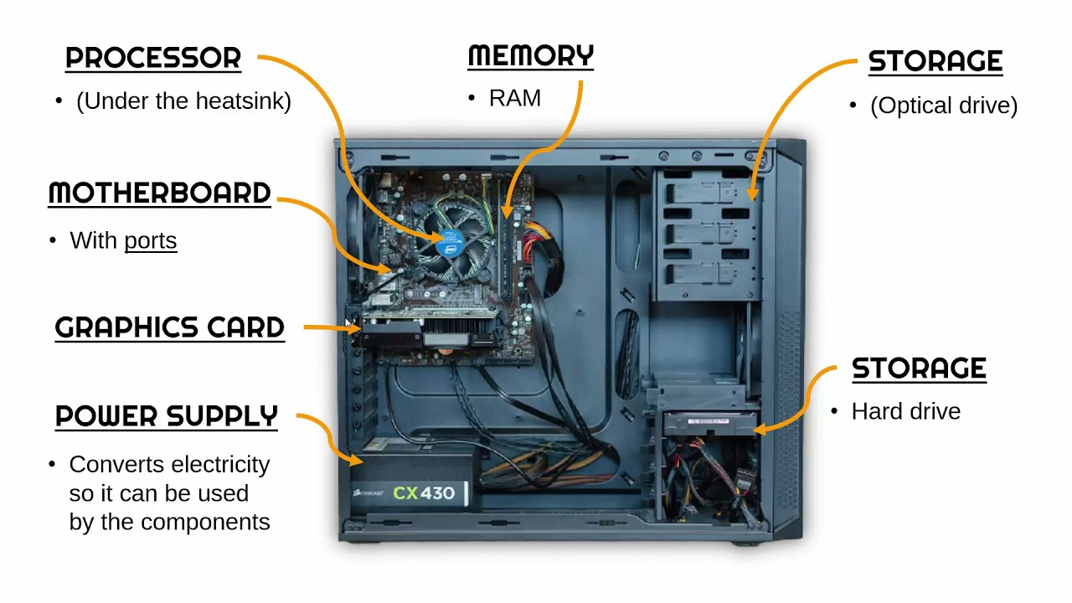
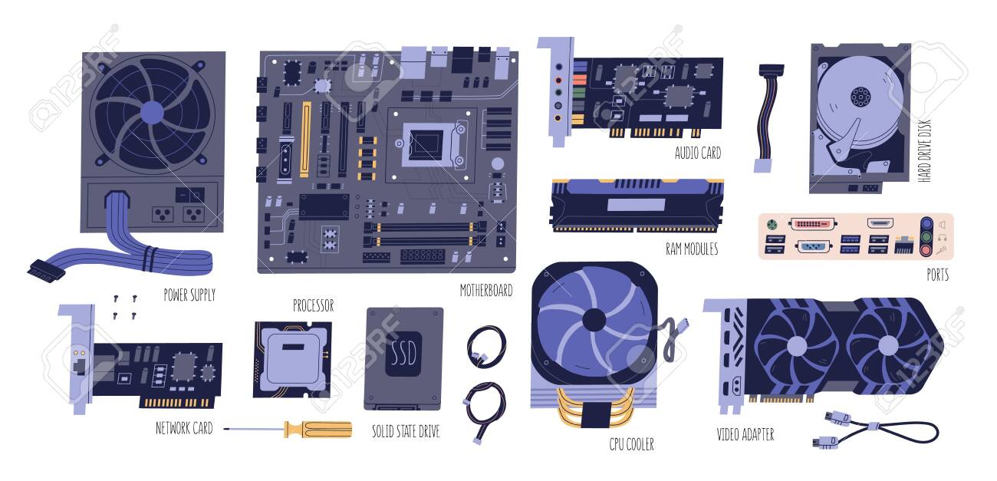
CPU (Central Processor Unit) the one that will process all the data and perform all the instructions we command. (e.g.: Intel i7, AMD Ryzen, Qualcomm Snapdragon, Samsung Exynos …)
Storage unit: Data is stored here. It is nonvolatile (it remains without power). It is slow, data cannot be used as it is here. (e.g.: Hard disk drives, USB pen drives, flash cards, SSD, NVME, DVD …)
RAM Memory: Data is placed here to be used by the CPU. It is faster than Storage but it is volatile. (it is gone when there is no power)
Graphics card (AKA: Video Adapter or GPU or …): Special type of Processor designed specifically to process data with the purpose to be presented in a computer monitor. (e.g.: Nvidia RTX 4090, AMD Radeon, …)
Other kinds of cards: They contain other types of dedicated processors designed for specific tasks. (e.g. Network cards, Audio cards, AI accelerators, etc)

