Slide 1
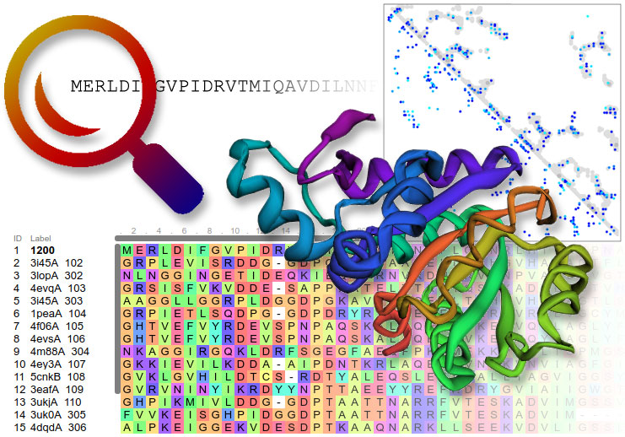
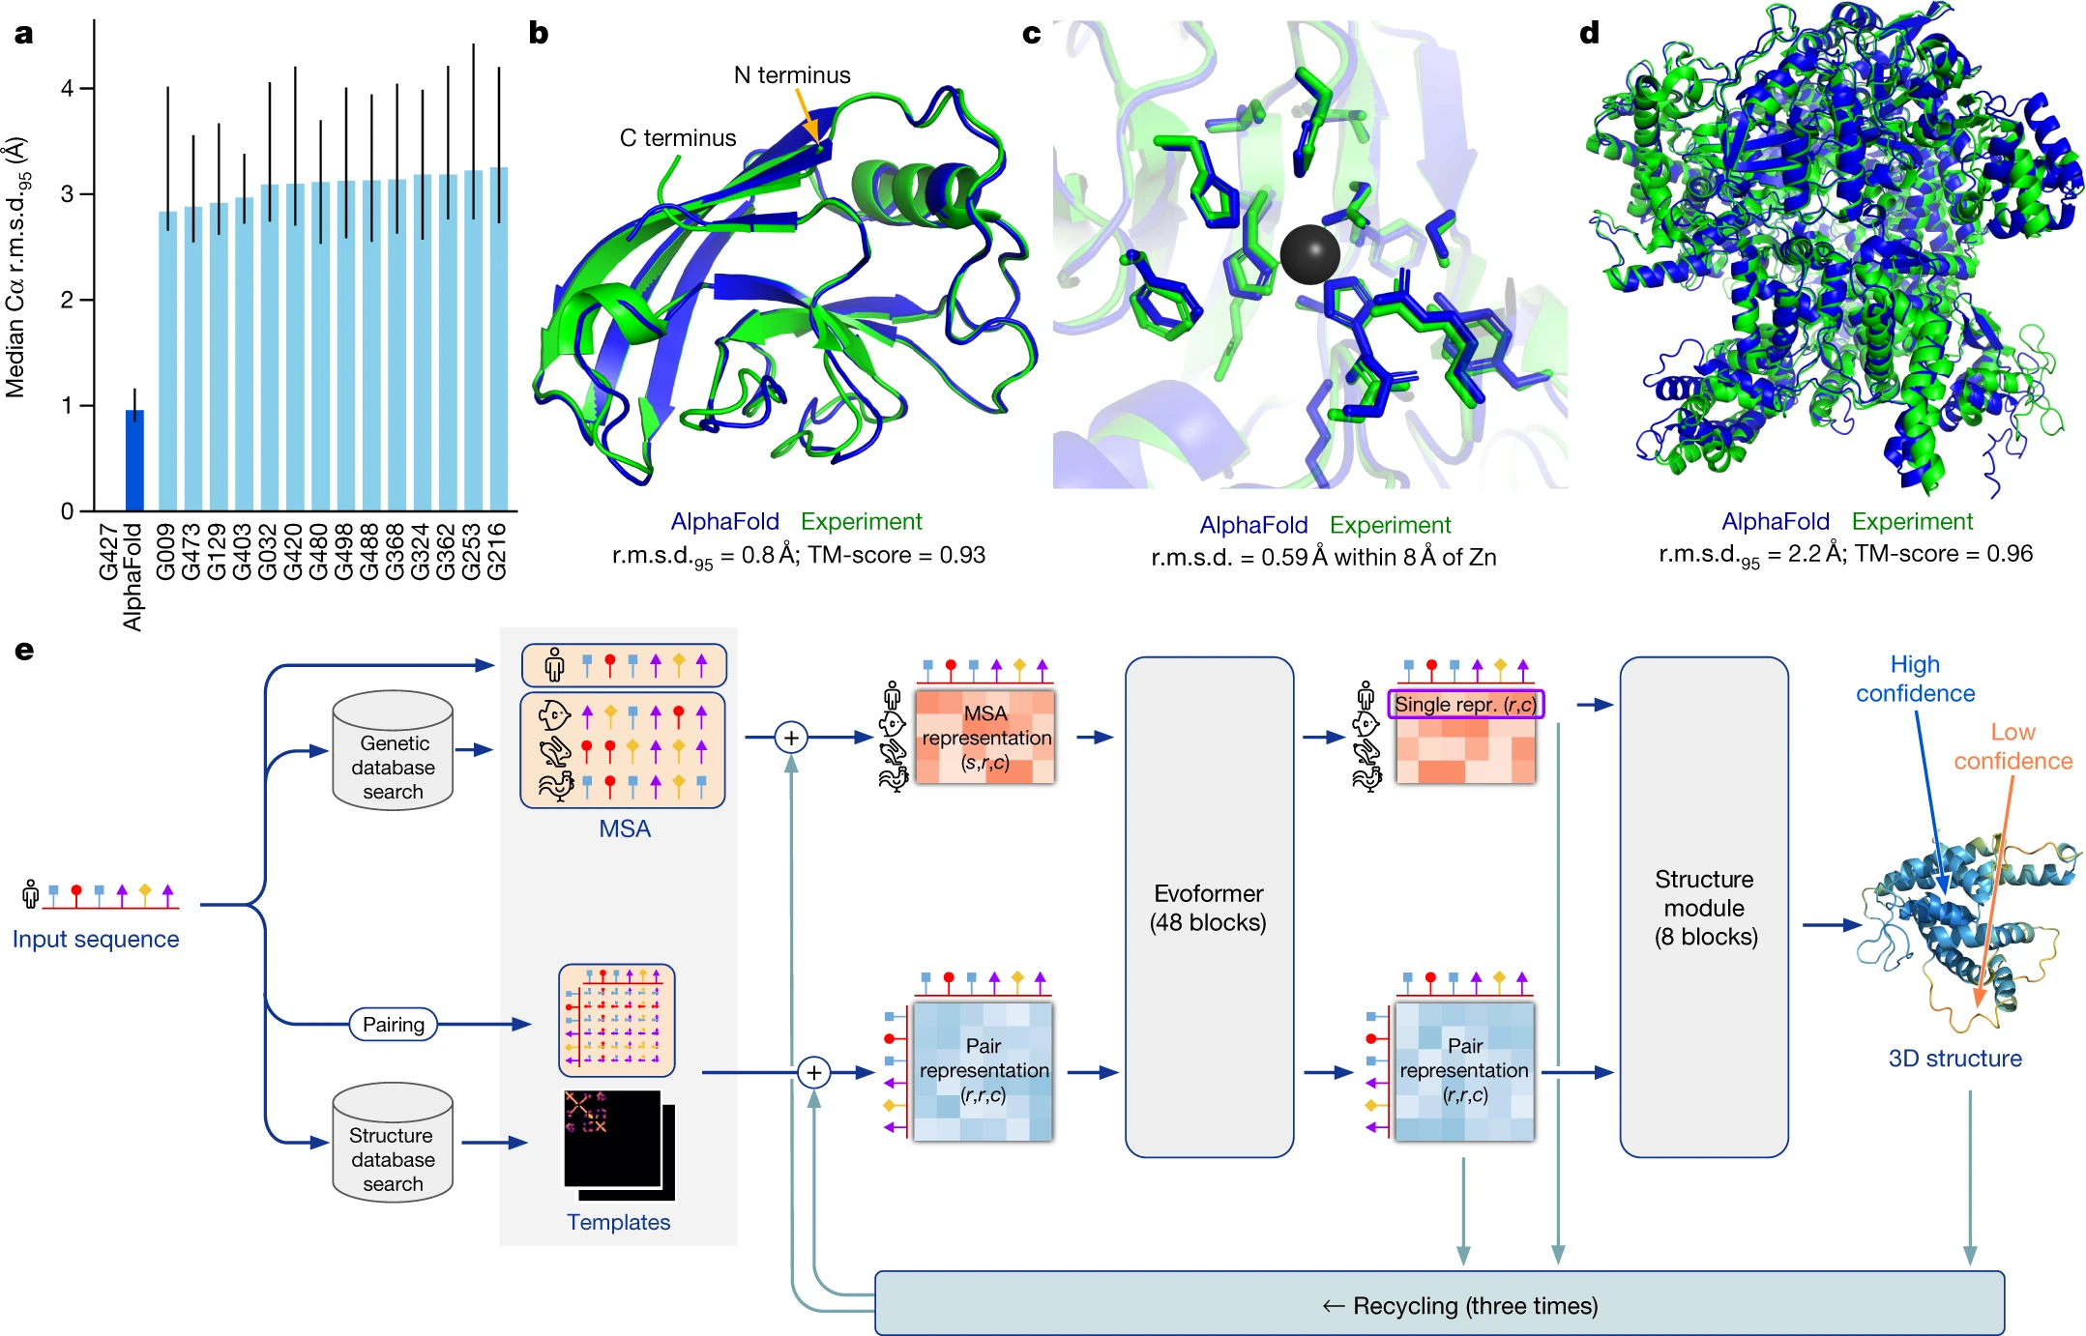
Nobel Prize in Chemistry 2024: A.I. in protein structure.
Rosetta
AlphaFold
Notes:
Canviar per una imatge més parlant

Slide 2
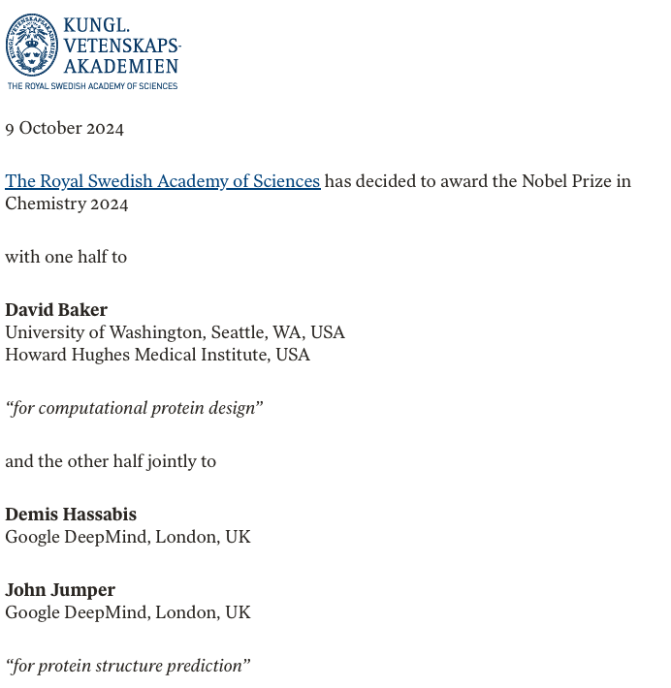
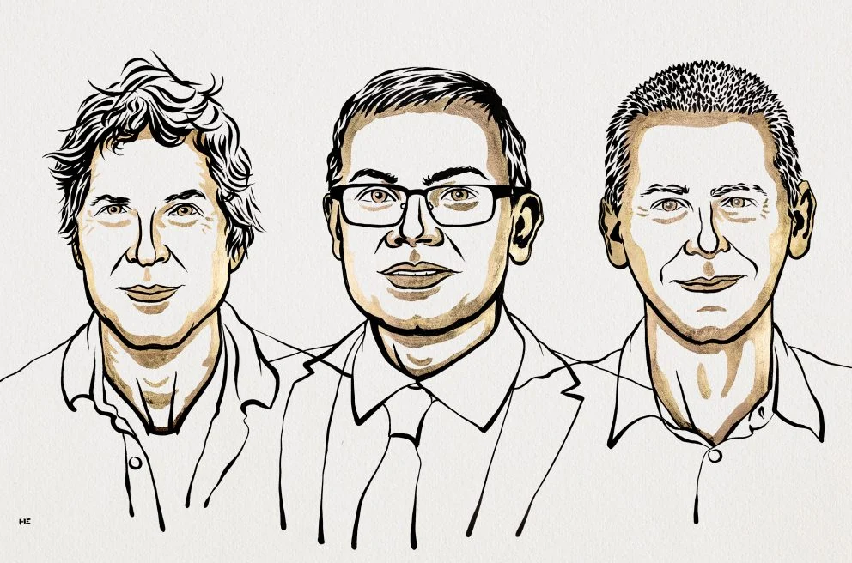
The announcement
D. Baker
D. Hassabis
J. Jumper
Notes:
Canviar les imatges

Slide 3
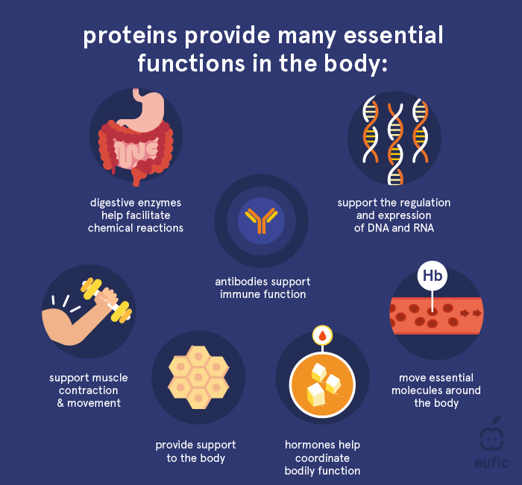
Nobel prize in chemistry on proteins?
“The diversity of life testifies to proteins’ amazing capacity as chemical tools. They control and drive all the chemi­cal reactions that together are the basis of life. Proteins also function as hormones, signal substances, antibodies and the building blocks of different tissues.
…..
….
Life could not exist without proteins. That we can now predict protein structures and design our own proteins confers the greatest benefit to humankind.”
https://www.eufic.org/en/whats-in-food/article/what-are-proteins-and-what-is-their-function-in-the-body
Predicting protein structures from sequence allows to:
Understand life’s molecular machinery
De novo design of proteins for new functions
https://www.nobelprize.org/prizes/chemistry/2024/press-release/

Slide 4
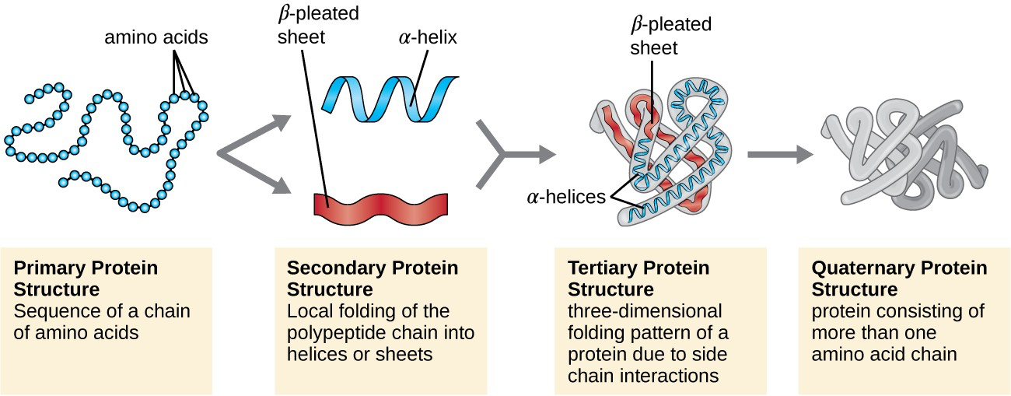
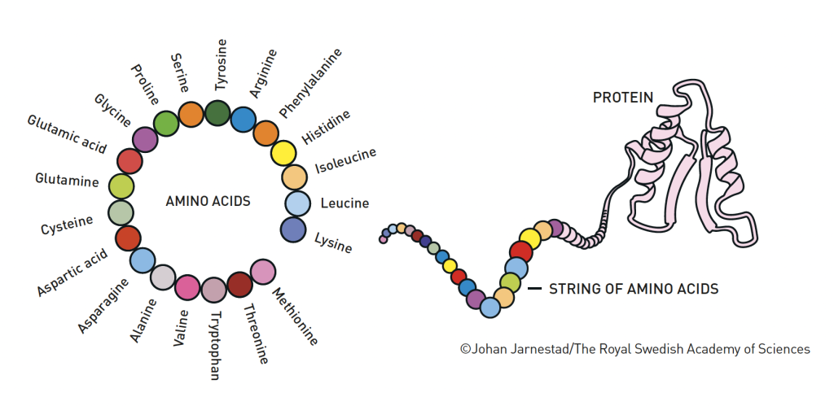
The structure levels in proteins
The starting raw material: 20 amino acids
The structure
<-> The function
Oxygen transport
Metabolism
Signaling
….
The sequence
MVLSPADKTNVKAAWGKVGAHAGEYGAEALERMFLSFPTTKTYFPHFDLSHGSAQVKGHGKKVADALTNAVAHVDDMPNALSALSDLHAHKLRVDPVNFKLLSHCLLVTLAAHLPAEFTPAVHASLDKFLASVSTVLTSKYR

Slide 5
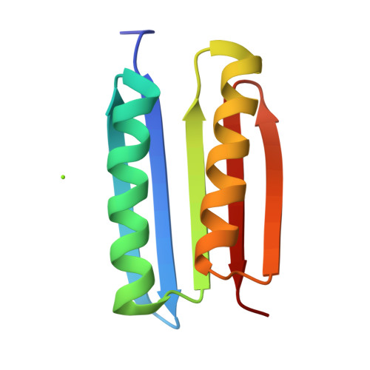
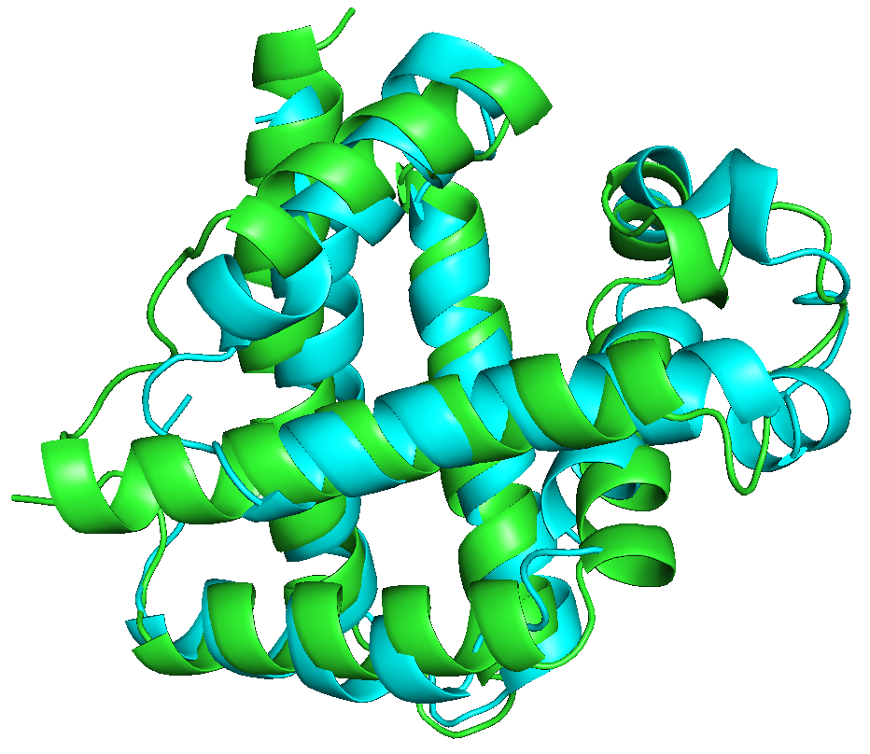
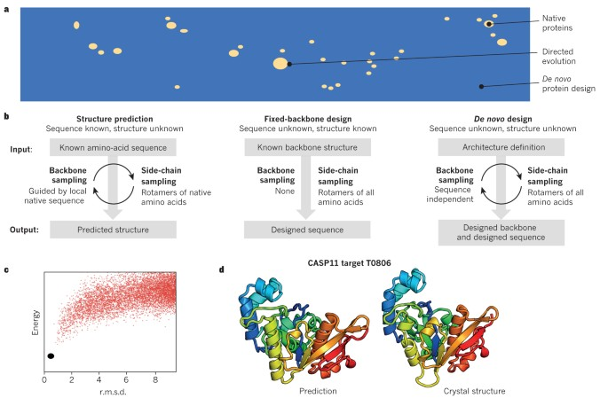
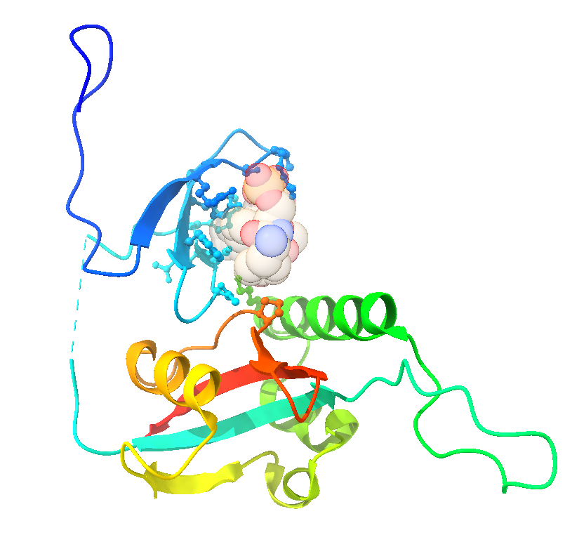
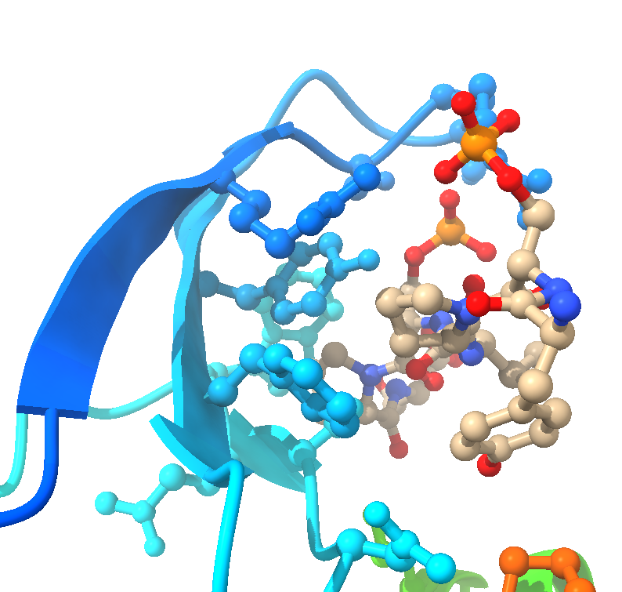
What can we do with structural knowledge?
Compare structures of proteins
Create new folds absent form nature
Directed evolution
Protein Engineering
nanomaterials
Full protein space versus Nature
Molecular evolution
Function discovery
Understand the interaction of proteins with partners
Create de novo enzymes
BioCatalysis
Green Chemistry
…
Drug design
Biosensors
Vaccines
Notes:
50%50

Slide 6
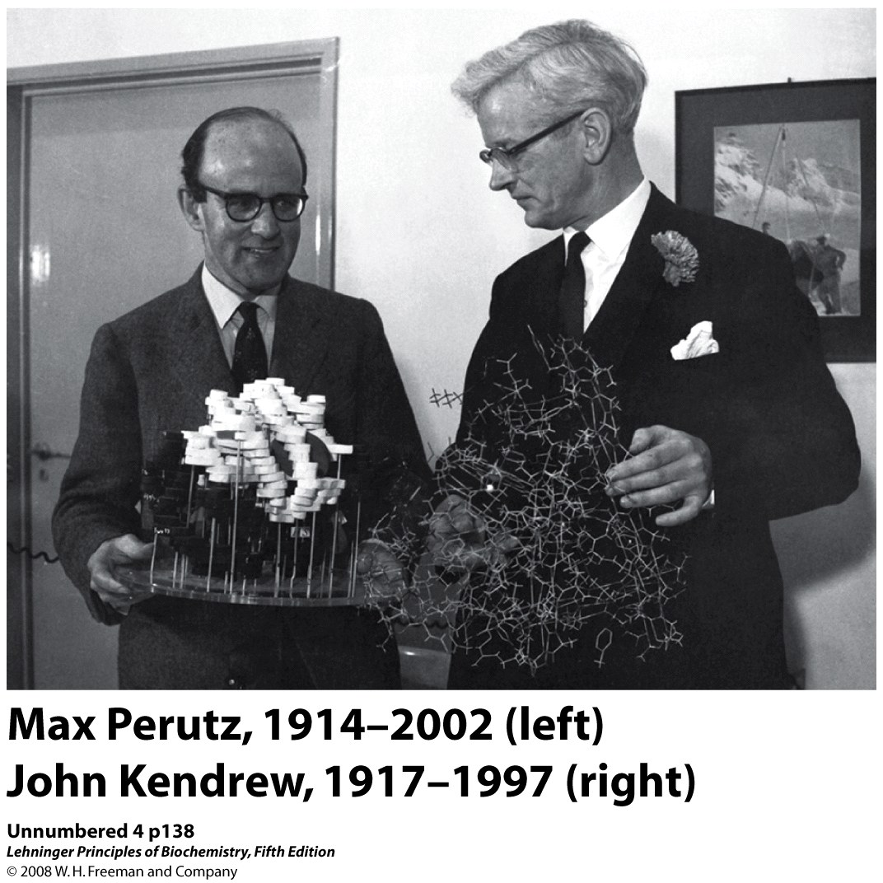
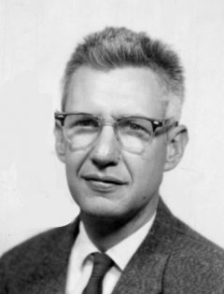
The results of a long-standing scientific effort
1957-1959: first atomic model of a protein
1962: First Nobel prize for solving a protein structure using crystallography and X-ray diffraction
1972: Levinthal paradox
Structure – function ?
Cyrus Levinthal, 1922-1990
“If I have seen further, it is by standing on the shoulders of giants.”
Sir Isaac Newton

Slide 7
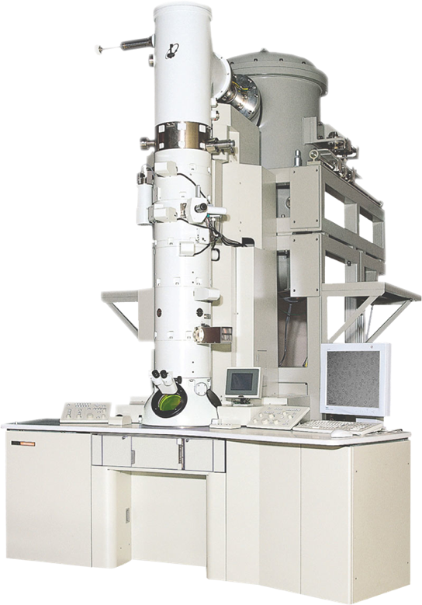
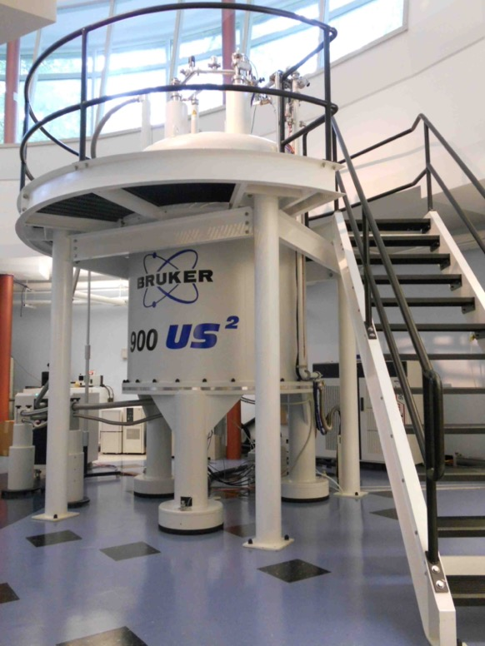
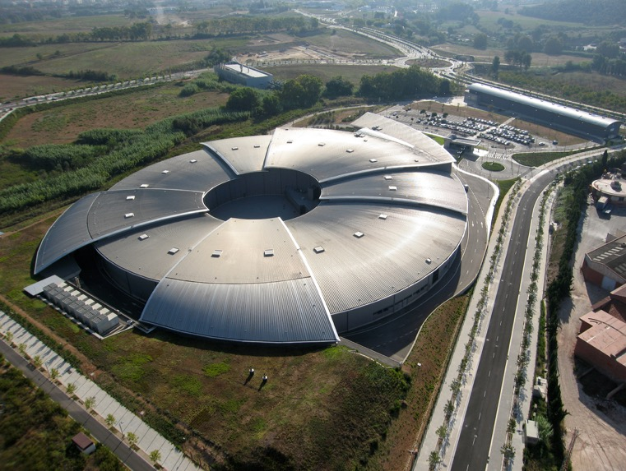
How to solve protein structures experimentally ?
https://www.utep.edu/science/chemistry/_files/images/facilities/cryo%20em%20microscope.png
https://structbio.vanderbilt.edu/nmr/facility/Renovation_2010_11/900_2012_2_small.jpg

Slide 8
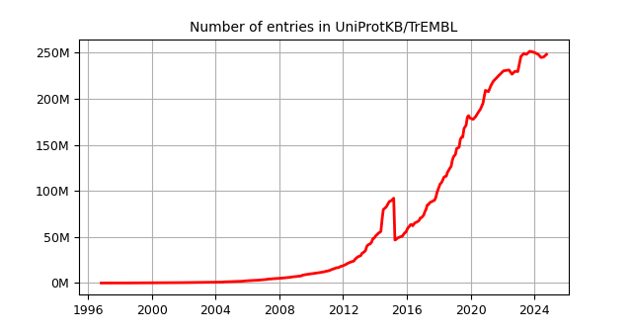
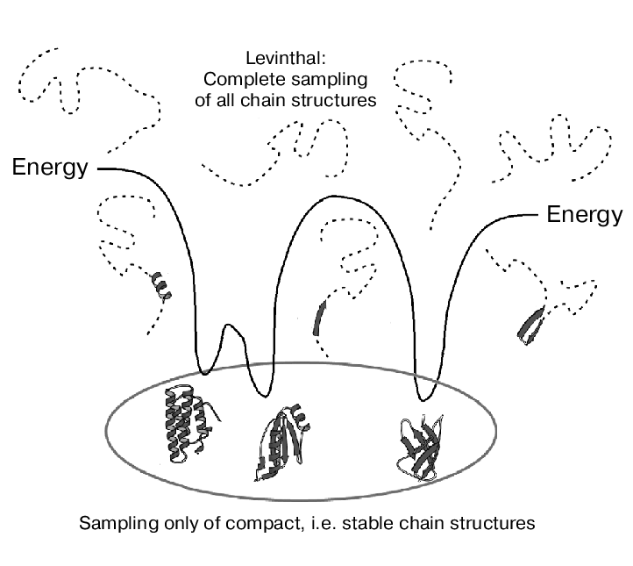
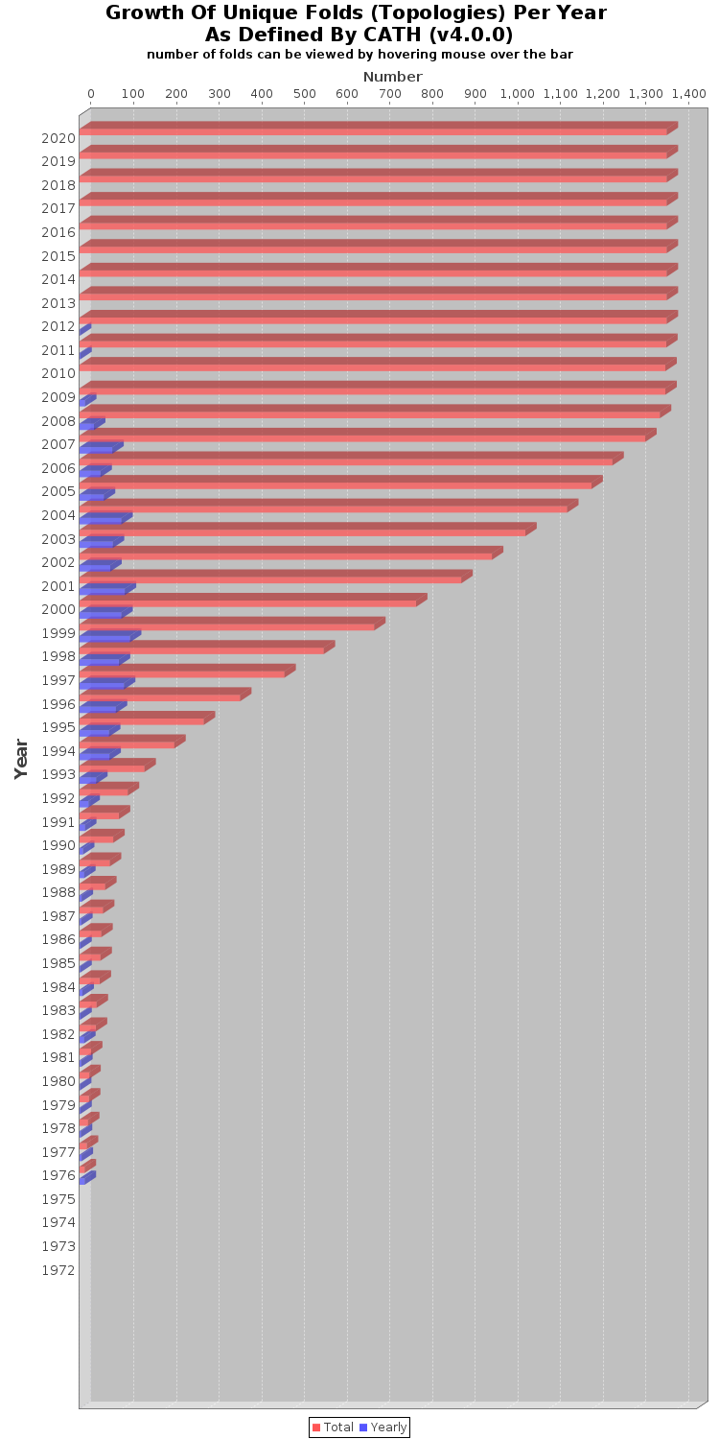
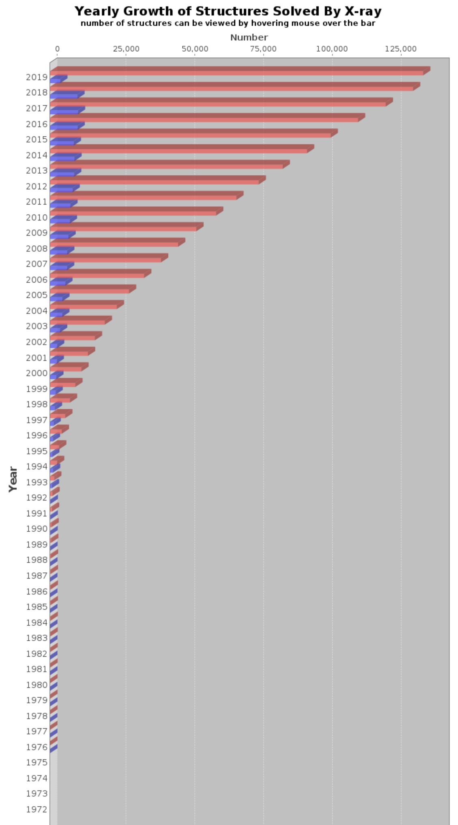
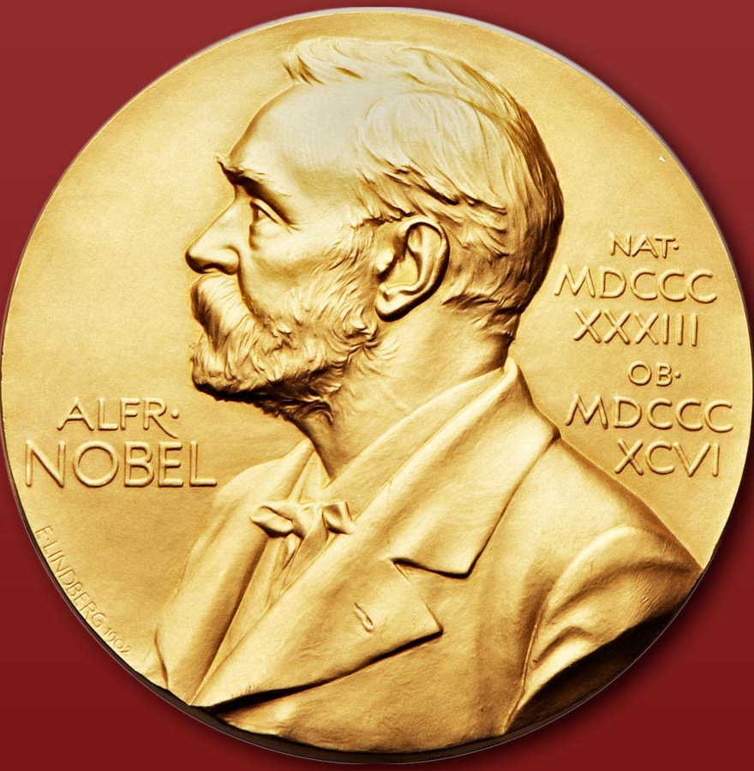
The number seqs vs numbers of structures vs number of folds
Problem Levinthal Folding
2024: 250 million sequences
Can’t be solved with pure physical models!
Computation ?
Last 10 years: almost no new fold identified
Only 0,1% of the protein structure of the known genome has been experimentally solved
2019 :1400 folds
Sufficient data to train AI and other statistical models to predict protein structures!
Computation !
2024: 228 227 structures.
Notes:
50/50

Slide 9
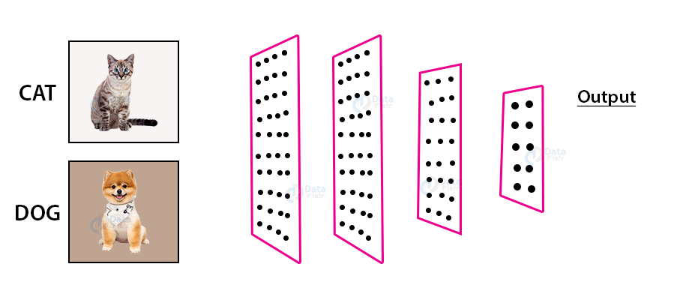
IA

Slide 10
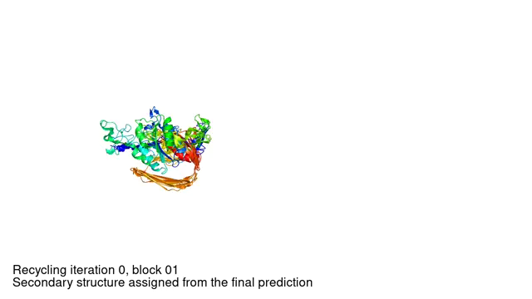
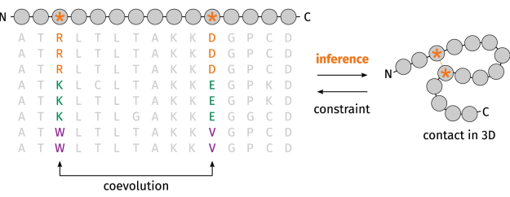
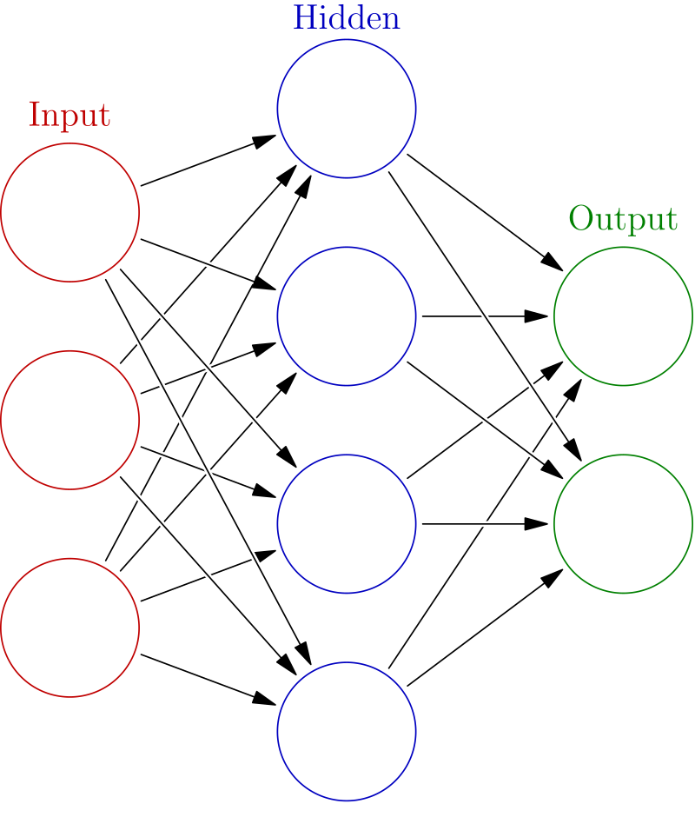
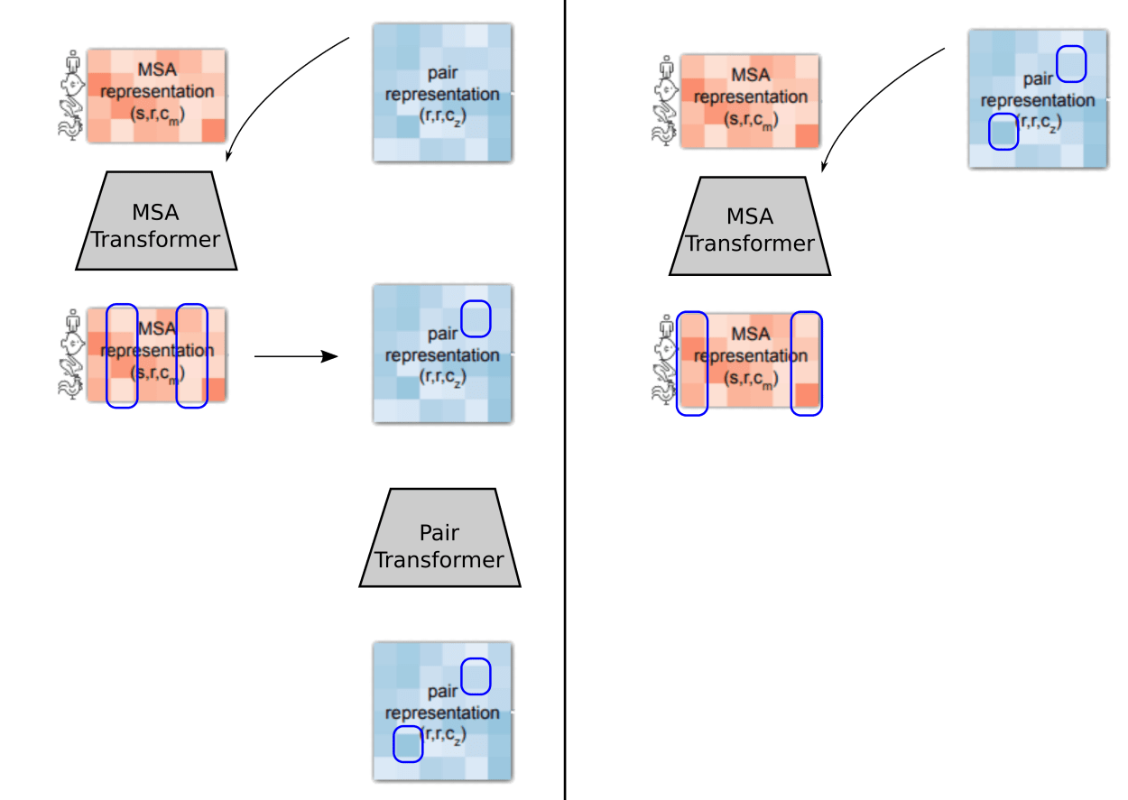
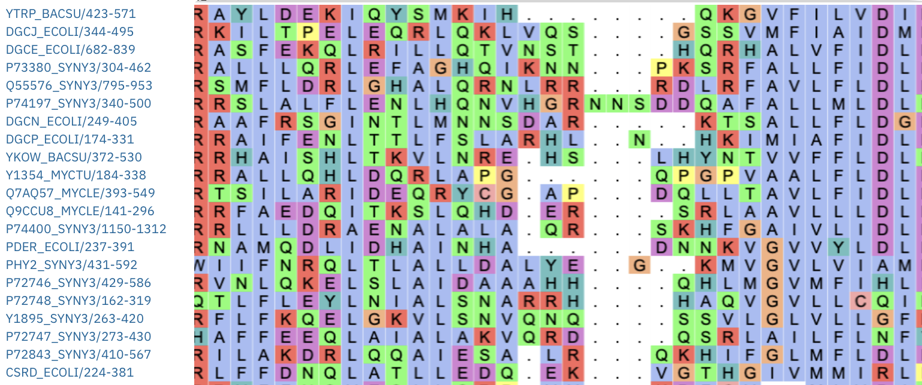
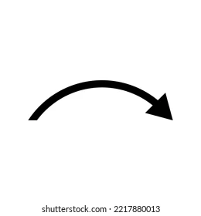
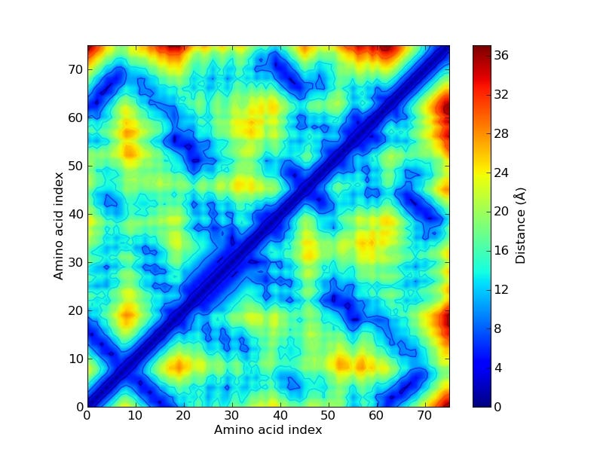
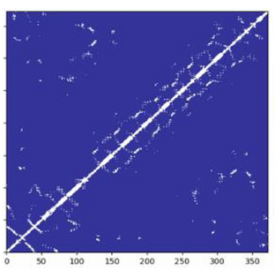
IA
Multiple Seq. Alignment
Generated contact map
Templates contact map
48 x 3

Slide 11
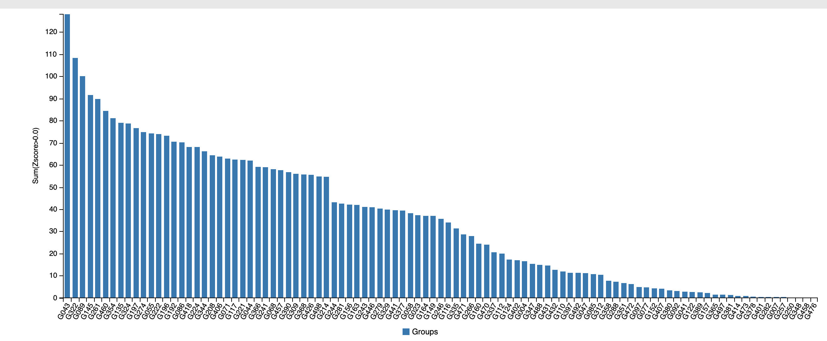
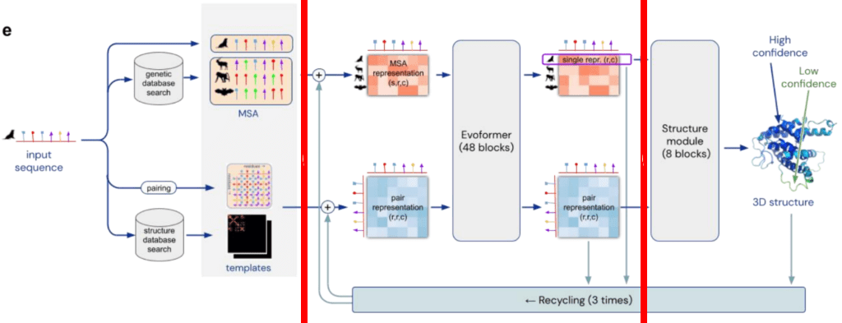
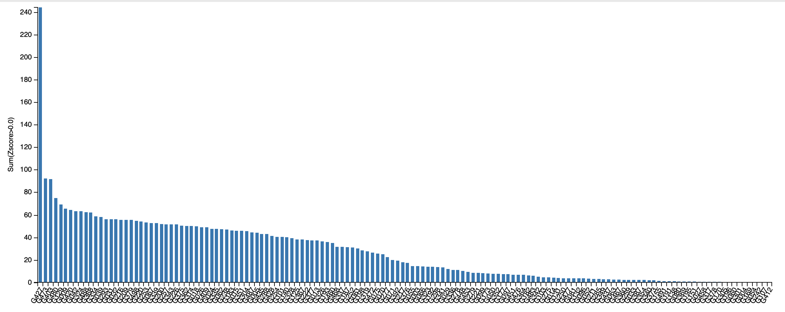
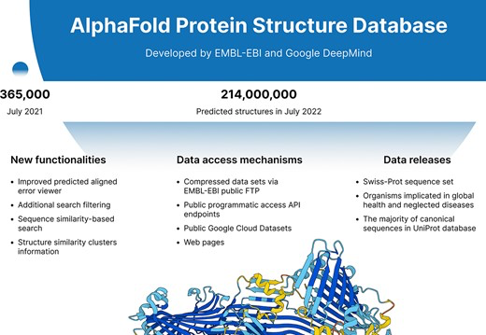
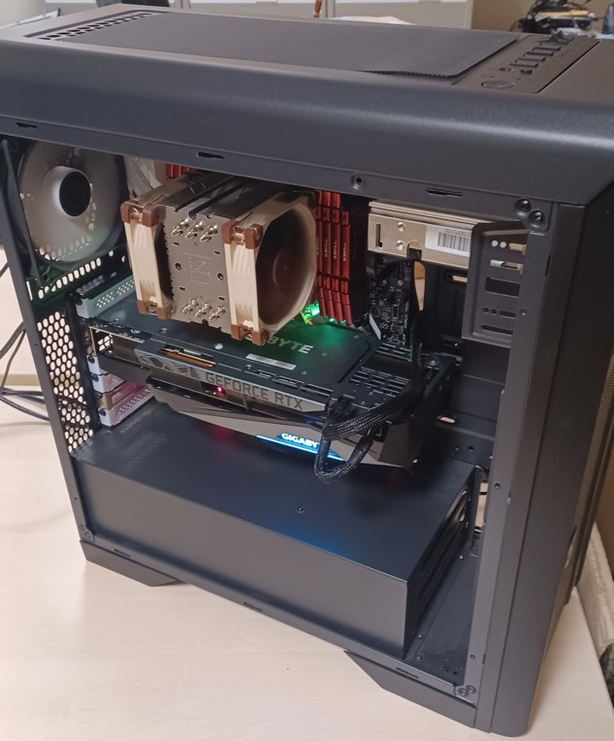
High Accuracy in protein structure predictions: AlphaFold
CASP (Critical Assessment of Structure Prediction)
Many software for prediction structure proteins but αFold:
  Accuracy as proved since 2018 in CASP tournament
  Practical (from desktop computers to HPC set ups)
  Massive outputs: αFold predictions available for ”almost” the entire known genome (more than 2M predicted structures)
Only starting point structures!
CASP13 (2018)
Biannual “tournament” for the assessment of computational approaches for structure prediction
CASP14 (2020)

Slide 12
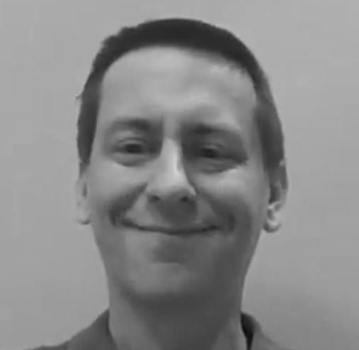
John M. Jumper
Protein structure
1985: Little Rock, Arkansas, U.S.
2007: B.Sc. In Physics and Mathematics (Van der Bild)
2010: M. Sc. Condensed Matter Physics (Cambridge)
2012: M. Sc. Theoretical Chemistry (Chicago)
2017: PhD thesis: New Methods Using Rigorous Machine Learning for Coarse-Grained Protein Folding and Dynamics (University of Chicago).
Joins Google Deep Mind
2018: Member of the team that won CASP13 with AlphaFold v1
2020: Author of AlphaFold v1 paper (3r)
Leader of the team that won CASP14 (AlphaFold v2)
2021: AlphaFold v2 Nature paper (1st, cC) & source code release
Highly accurate protein structure prediction for the human proteome (cC) (pTM score)
2022: AlphaFold Protein Structure Database (cC) (PAE)
AlphaFold-Multimer (cC)
NOW: Google Deep Mind director

Slide 13
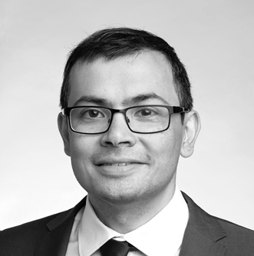

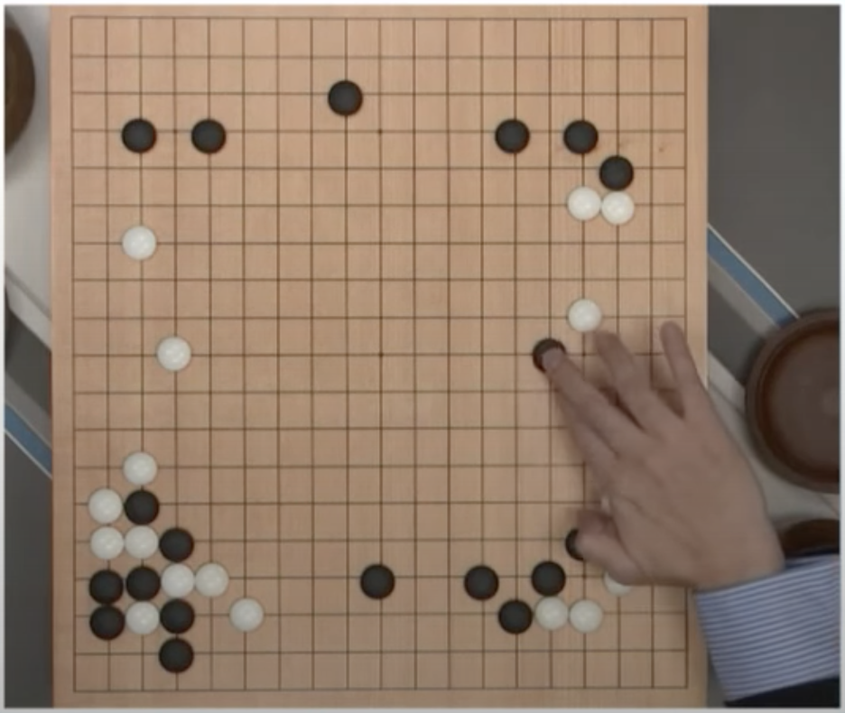
Sir Demis Hassabis
Protein structure
1976: London, UK(Chess child prodigy)
1990s: Videogame designer at high school age & Founds a Videogame company after College
1997: B.Sc. Computer Science Tripos (Cambridge)
2009: PhD in cognitive neuroscience from University College London (UCL) in 2009 (2007 in the top 10 Breakthrough of the Year for neuroscience research on imagination by the Science Magazine)
2010: Founds DeepMind in 2010, and after that, the sky is the limit
2013: Creates DQN algorithm, which gave birth to the Deep Reinforcement Learning
2016: AlphaGo (in top 10 Breakthrough of the Year )
2020: AlphaFold v1 (in top 10 Breakthrough of the Year )
2021: AlphaFold v2 (Top Breakthrough of the Year )
Notes:
Pays his college degree (and the Porsche) from the earnings of videogame sales

Slide 14
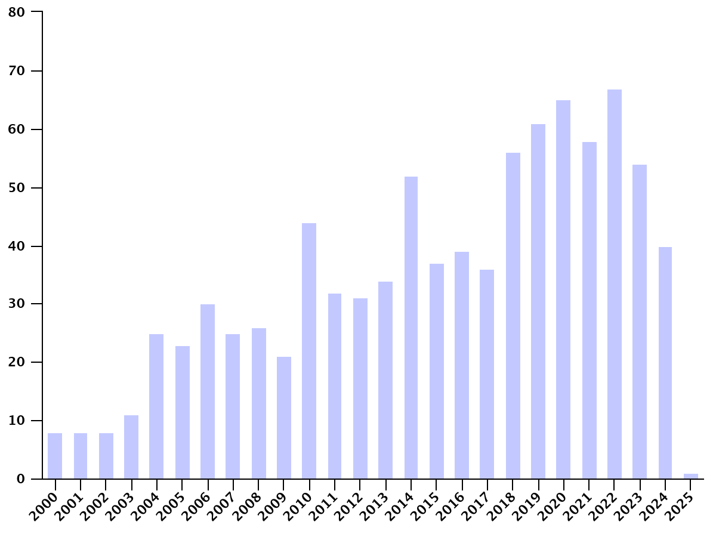
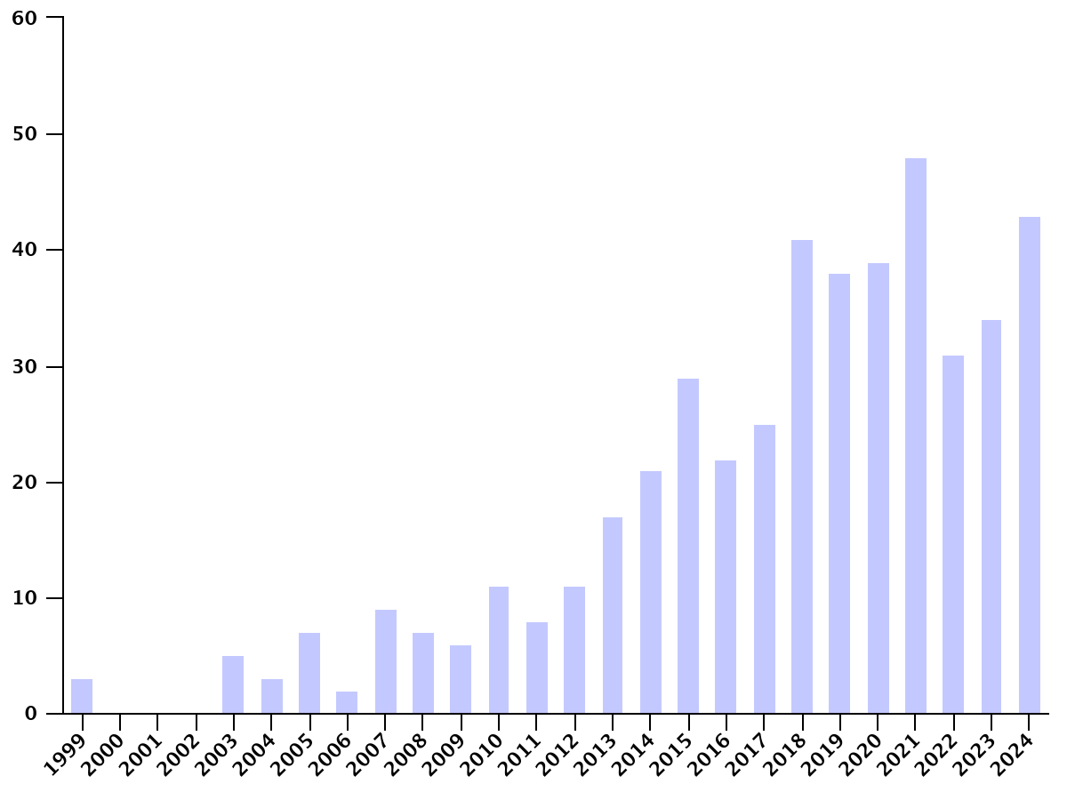
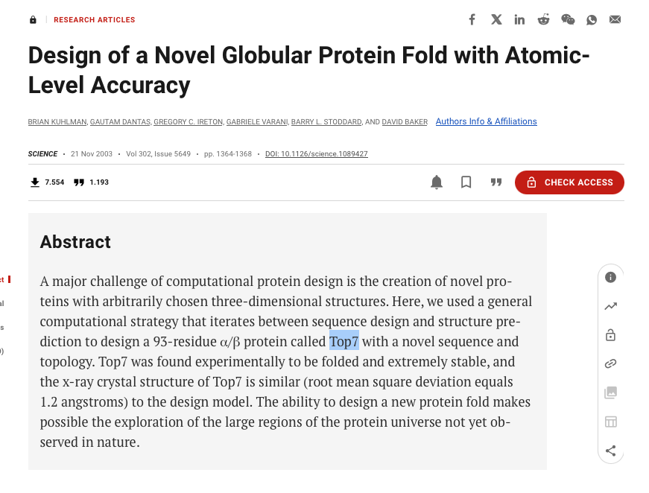
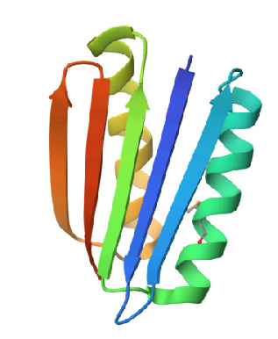
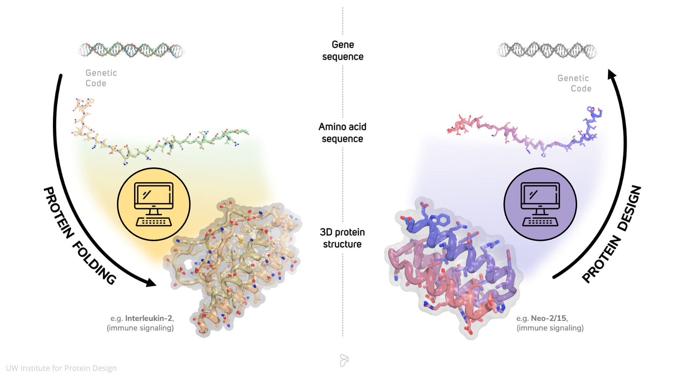
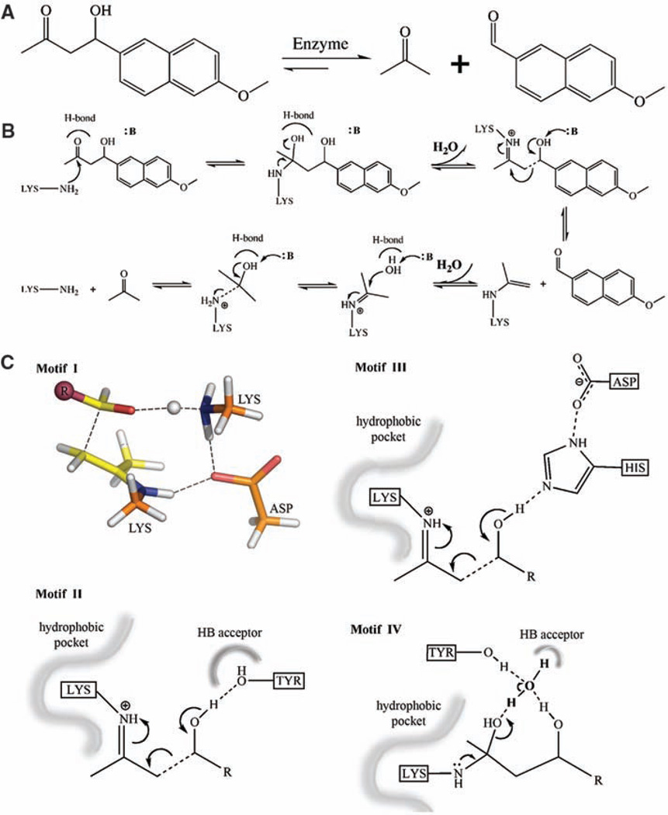
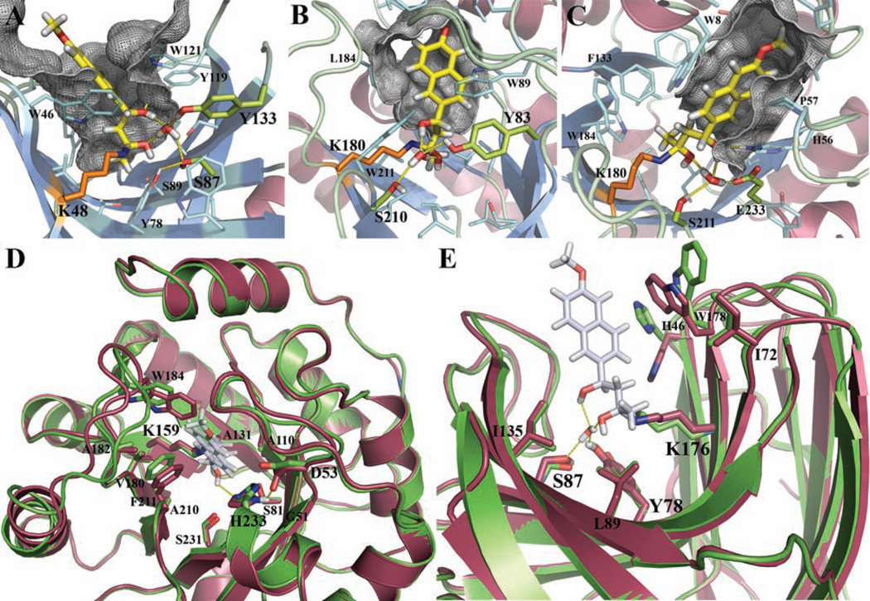
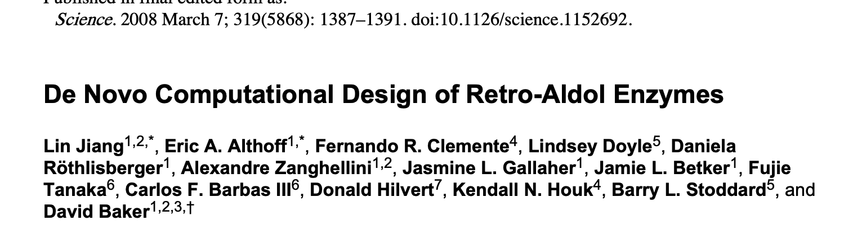
Protein (and enzyme) design
In protein engineering, de novo = hot topic for the last 30 years.
  De novo functions
  Recognition
  Catalysis
  Etc.
Baker’s lab pioneered the field:
  2003: Computer design of a novel globular enzyme with a new folding profile
  2008: First de novo enzyme published in Science.
  Publications non-natural proteins, left,
  and de novo metalloenzymes, right.
2003
2008
  From function to structure to gene

Slide 15
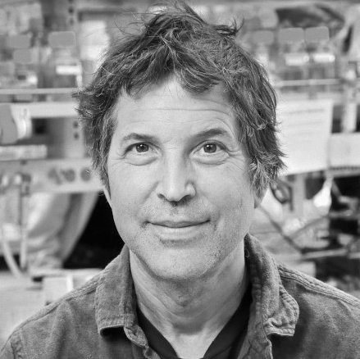
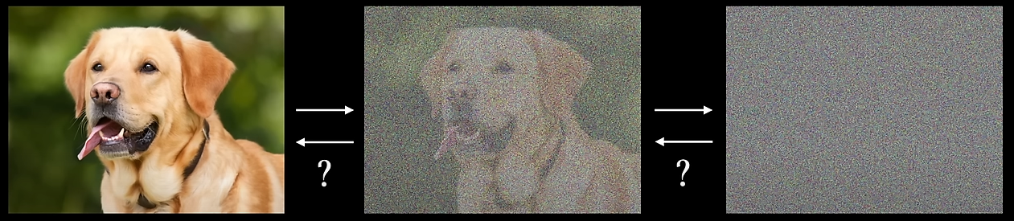
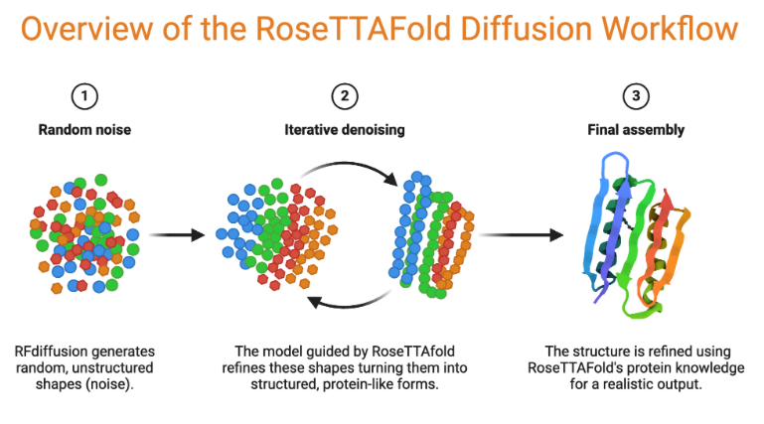

D. Baker (University of Washington)
1962: Seattle, USA
1984: B.Sc. In Art with Major in Biology (Harvard)
1989: Ph.D. in BioChemistry (Berkeley)
2005: Rosetta@Home shared resources worldwide to solve protein folding problem
2008: FoldIt video game ”folding” software using hyperclusterisation of home
2002: Rosetta ab initio
2005: Rosetta 2.0
2009: Rosetta 3.0
2021: RosettaFold
2022: ProteinNMM
2023: RFdiffusion
2024: A dozen of biotechnological companies creates, 600 articles cientifics, one of the 100 most influential persons in Health (Time)
Moved from physical models…
To AI..

Slide 16

Advances & limitations
A major step forwards!
Any researcher involved in structural biology (chemists, biochemists, biophysicists, etc.) can rapidly access suitable accuracy structures in a matter of seconds to hours and perform a search on them.
Tools for identifying protein sequences coding for new-to-nature proteins are now accessible and leading the way in biotechnologies and biomedicine
Does not solve everything:
  Levinthal’s problem is still unsolved
  Still substantial limitation for intrinsically disordered proteins (prions, amyloids, peptides..)
  Still need physical models (molecular modeling) for accurate mechanism

