Slide 1
Computer: The Tool in
Bioinformatics
Bio
Informatics

Slide 2
Why this class?
Some basic computer knowledge must be acquired in order to use computers in science:
Operative Systems (OS): what they are and their differences
Understanding the directory tree
Understanding the different kinds of files
Working with the command line
Understanding processes and programs
Unix / Linux has become the most used OS in protein crystallography and bioinformatics
Different Graphic User Interface (Windows)
Very powerful command line interface tools

Slide 3
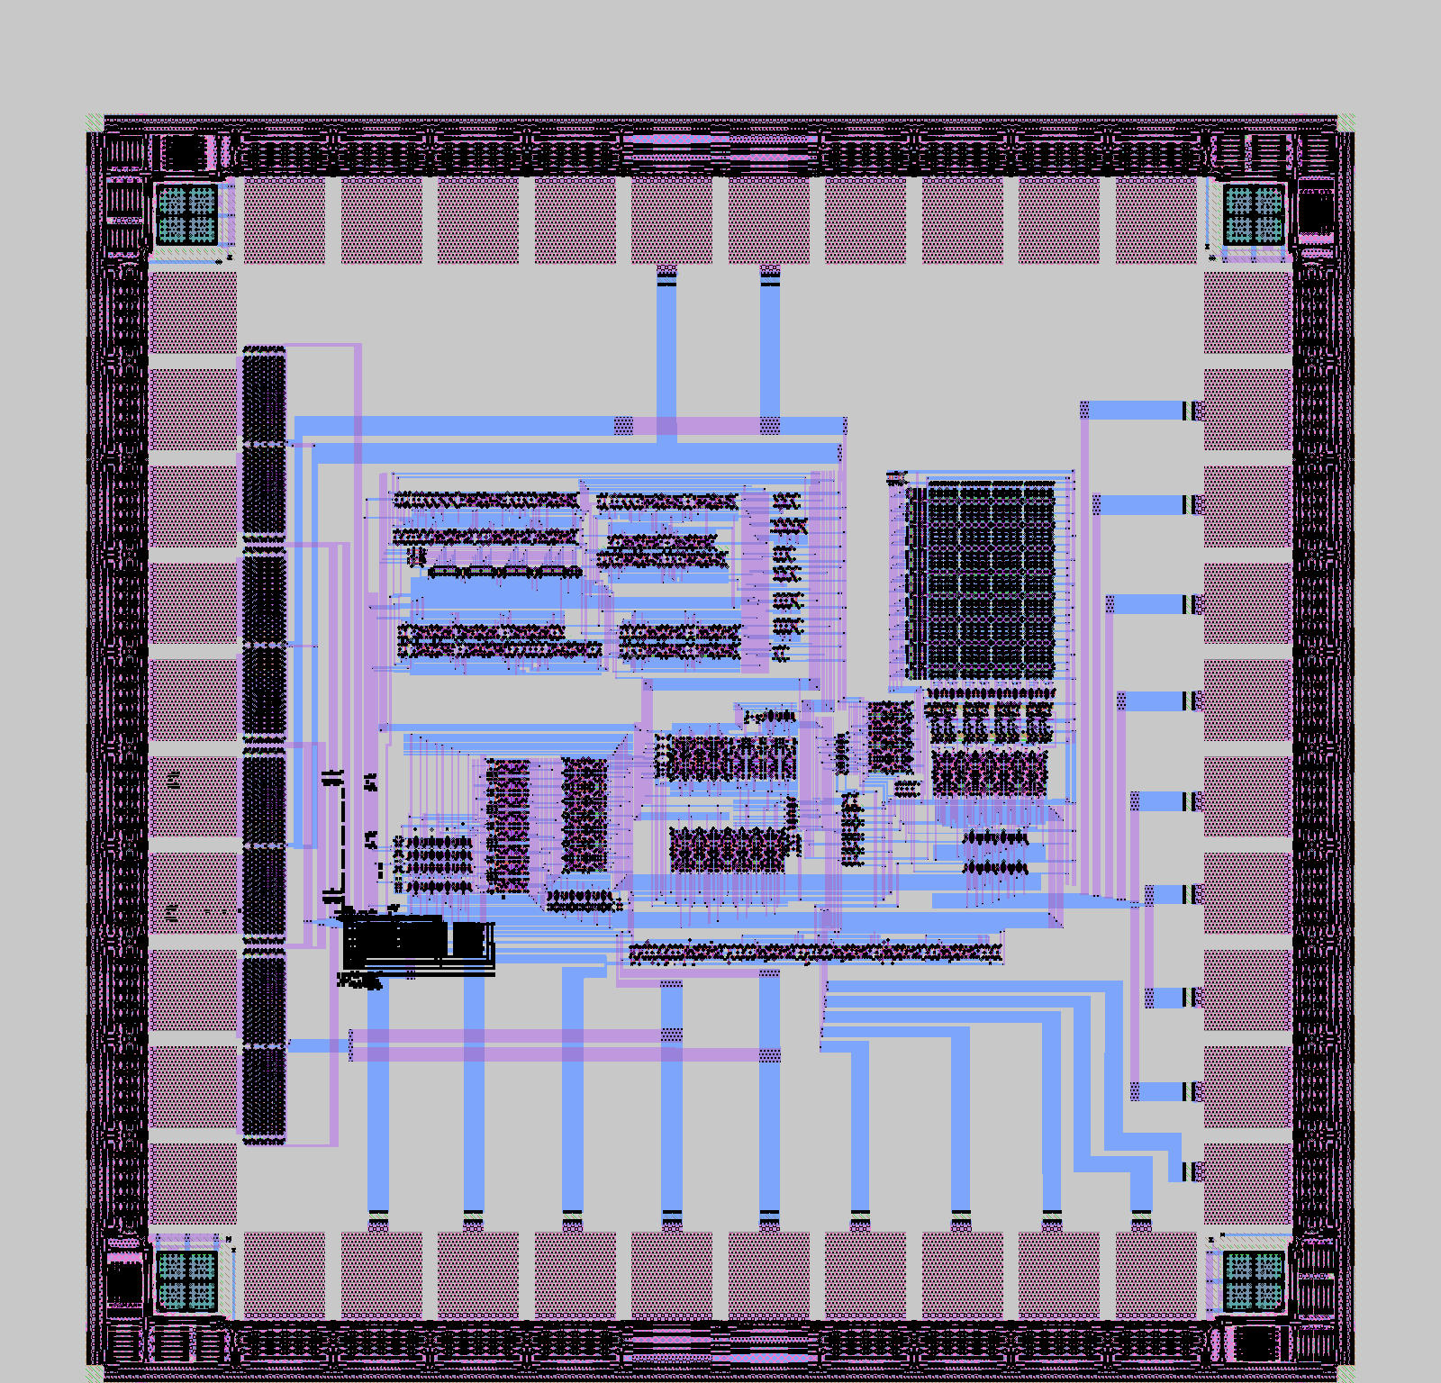
Processor (AKA: C.P.U.): computer’s brain
Electron Current
(there is or there is not)
Binary code
  0
  1
  01001110 ......... Byte (b)
  (1000 = 10^3)*Byte....... Kilobyte (Kb)
  (1024 = 2^10)*Byte....... Kibibyte (KiB)
  (1000 = 10^3)*Kb ........ Megabyte (Mb)
  (1024 = 2^10)*KiB........ Mebibyte (MiB)
  (1000 = 10^3)*Mb ........ Gigabyte (Gb)
  (1024 = 2^10)*MiB........ Gibibyte (GiB)
  (1000 = 10^3)*Gb ........ Terabyte (Tb)
  (1024 = 2^10)*GiB........ Tebibyte (TiB)
................. Bit
Architecture: x86 (AKA: i386), x86_64, IA64, PPC, SGI MIPS, SUN-SPARC, ARM , RISCV...

Slide 4
Processor (AKA: C.P.U.): computer’s brain
multiprocessor
A processor can only execute one instruction at a time.
If multiple process are running at the same time the processor has to stop one task to do the other. If both process have the same priority will follow something like this:
1st - process 1 instruction 1
2nd - process 2 instruction 1
3rd - process 1 instruction 2
4th - process 2 instruction 2
…
As you can deduce, this makes your process take double time to complete.
You can have multiple physical processors in the same computer. But currently, all processors contain multiple processors inside them (AKA: cores).
This way you can execute multiple tasks simultaneously without having to share its time between them.
Some processors contain multiple logical units which appear as different processors to the OS, but they are not. Depending on the task using them can make your task faster (In general: memory intensive, low number of calculations) or slower (In general high number of calculations low memory movements). But this is highly dependent on the program, the task, and lots of factors, the only way to know it is to test it.
Execute:
cat /proc/cpuinfo|less
look at:
processor : ?
physical id : ?
core id : ?
How many logical cores your computer have?
How many physical processors your computer have?
How many cores your computer have?
Execute:
top
press "1"
How many CPUs your operative system sees and is able to use?
How many is using?

Slide 5
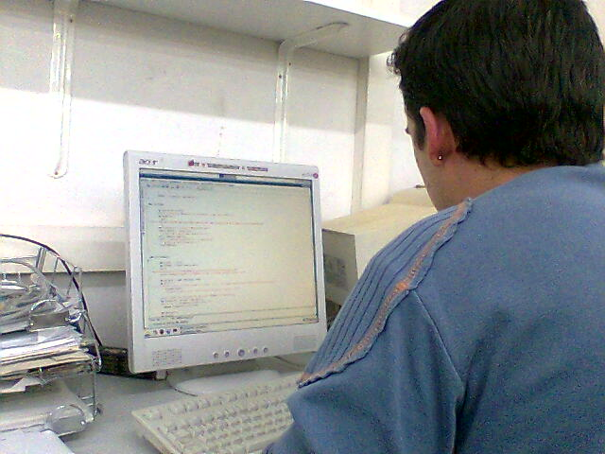
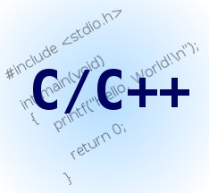





Why processor understands me?
Programmer: Writes software with users in mind (or not)
main()
{
printf “Hello world!!” ;
}
Compiler: translates programmer's language to computer’s language (0 and 1) generating binary programs executable by the processor
"R" = "01010010"
Operative System: allows interaction with the processor in a unified and easy way
"R" = "01010010"

Slide 6
Operative System, What is it and why we need it
An Operative System is a group of programs or software, devoted to allow interaction between users and computer, it manages its resources in an easy and efficient way. It starts to work when computer boots and mages hardware form lowest levels.
Device access
Input/Output (I/O)
Directory tree / File System
Process priority
Users

Slide 7
Operative System : some parts (private ones)
Kernel: The OS itself, it’s the one who decide what to do, how to do it and when to do it, it controls devices and peripherals at the lowest hardware level. (linux, NT Kernel, XNU,)
Windows : C:\WINDOWS\system32\ntoskrnl.exe
Linux: /boot/vmlinuz-*
Filesystem: Keeps hierarchy, easy access and consistency of stored data in the different physical or virtual devices (eg: fat32, ntfs, APFS, ext4, xfs, zfs, nfs, …)
-shell(s): programs that provide the interface between the user and the operating system. Shells may be text-based, such as bash or zsh (in both MacOS and linux) or graphical, such as the Windows Shell or the macOS Finder.
Various tools : group of programs that allow users and / or administrators interact with the OS

Slide 8


















Operative System: shapes, kinds and colors
UNIX
Linux
Windows
VMS
Macintosh
Symbian

Slide 9
Plataforms
Execuable
Binaries
Architecture O.S.
Sources
x86
Windows
2
1
SGI-MIPS
GNU/Linux
5
1
SPARC
MacOSX
2
1
1
PPC
IRIX
1
1
ARM
Solaris-SunOS
2
1
(Free/Open)BSD
4
1

Slide 10
32 bits
Operative
System
Working in 32 bits mode
32 bits
AthlonXP
Pentium4
AthlonMP
Xeon
32 bits
Compiled
Aplication
64 bits
Operative
System
CoreDuo
Not Working !
32 bits
Operative
System
64 bits
Athlon64
Corei?
64 bits
Compiled
Aplication
Epyc
Corei7
64 bits
Operative
System
Ryzen
Xeon
Working in 64 bits mode

Slide 11





According to function:
Types of Files
- Data files binaryfile.doc textfile.txt
They contain data that will be read by a program in order to use them
TextEdit
- Executables winword.exe
notepad.exe
They contain instructions that the Operative System understands and can send to the processor in order to be executed.
How data is stored in them:
- Text Files: textfile.txt
They contain only text, so can not be executed without the help of an external interpret
- Binary Files binaryfile.doc winword
They contain binary data, they can contain instructions understandable by the processor, so they can be executed without any external requirement (of course they still need the Operative system)

Slide 12
In a computer we find storage units (AKA Units or Volumes or disks or partitions or…) which store the data (the files) we use in a "none volatile" way, so when we turn off the power, the data remains.
Examples of storage units are: The Hard Disk, USB pendrive, DVD, Network drives, etc.
We organize the data inside these storage units, storing it in files, so the bytes that compound our data are stored in those files.
These files are organized in directories (AKA folders)
These folders are organized hierarchically in the directory tree

Slide 13
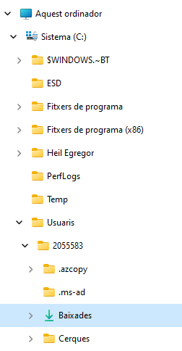
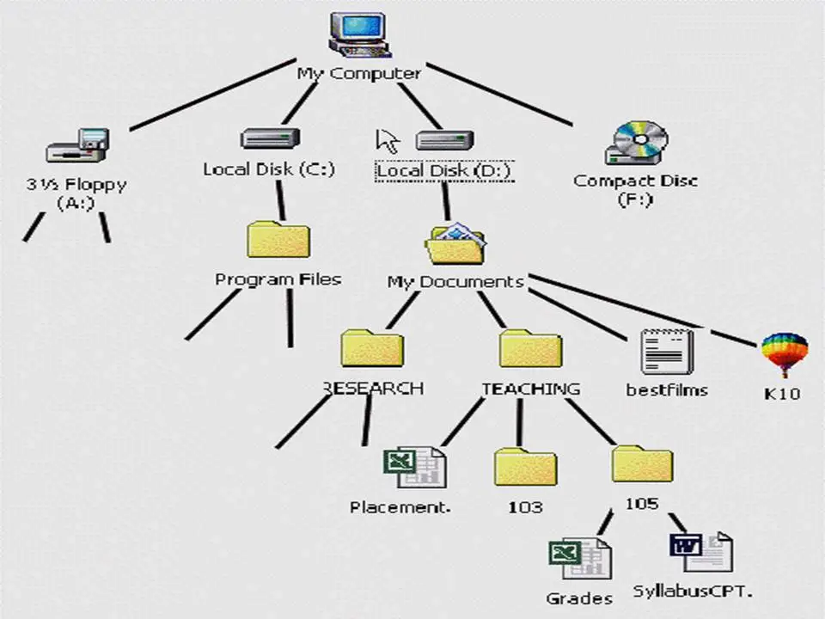
In Microsoft Windows:
Each storage unit receives a letter followed by ":" as a name.
It is mounted at the beginning of the directory tree.

Slide 14
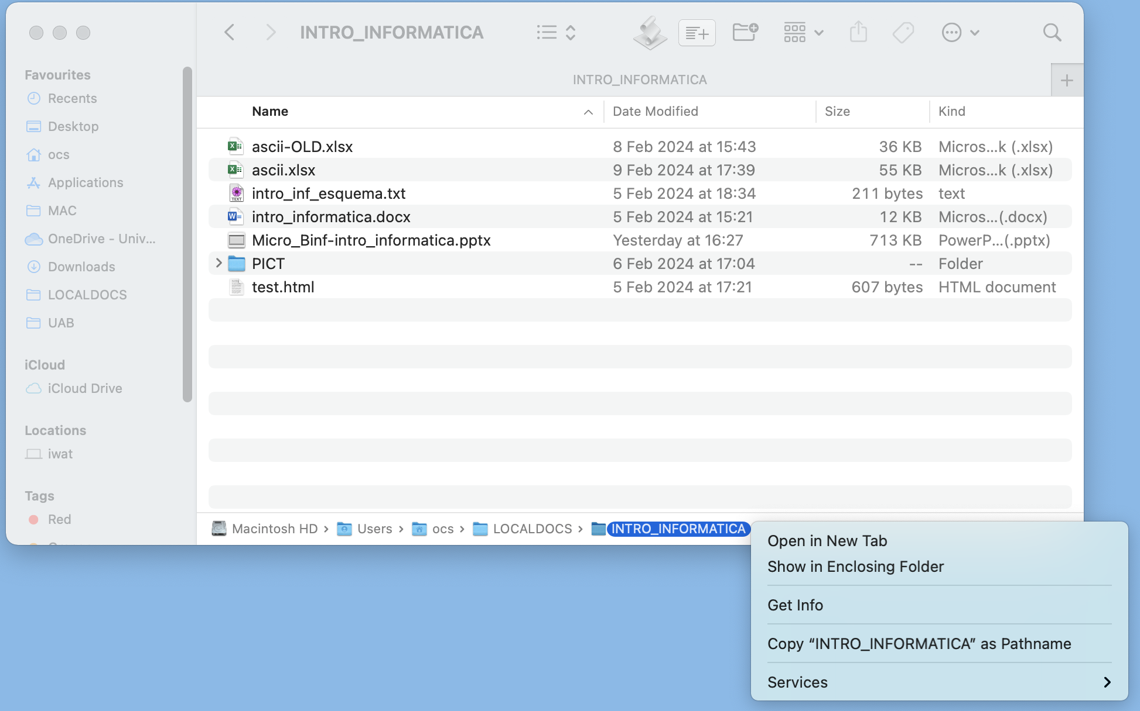

In MacOS:
Each storage Unit receives a given name. The one that contains the MacOS has the internal name of "/" and Becomes the start of the directory tree.
Any other storage unit you mount will be found as a folder inside this one:
/Volumes
This is what you would get:
/Users/ocs/LOCALDOCS/INTRO_INFORMATICA

Slide 15
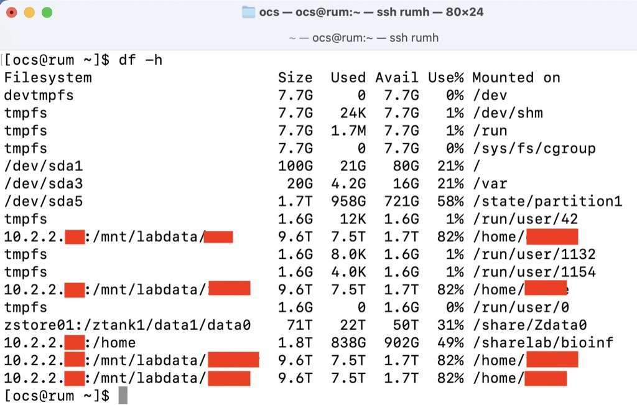
In Linux:
The directory tree starts with the "root" "/" where a storage unit containing most of the necessary files to make the operative system work is mounted. Other storage units could be mounted in any folder of the directory tree. (execute "df -h" to see them).

Slide 16
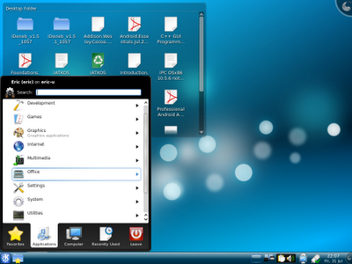
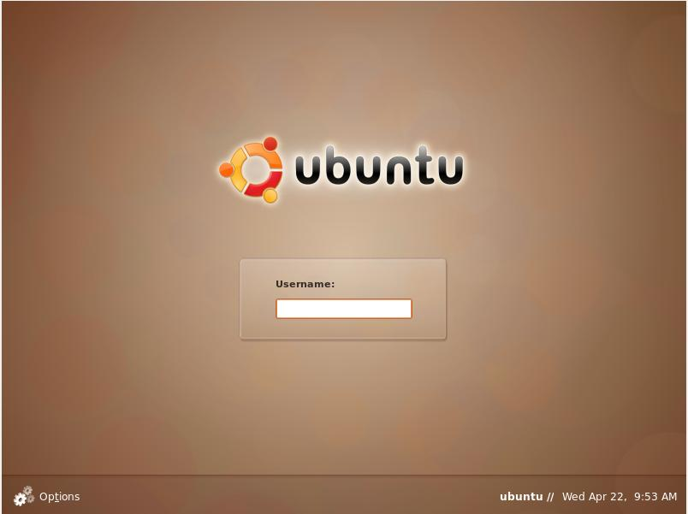
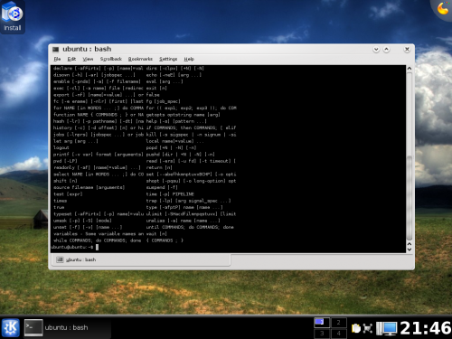
Forget about Windows, Linux from now on!
- Different Operative system, so requires different executables, but with the right application same data files can be read (mp3s, avi videos, MSOffice documents, images, etc).
- Different Graphic User interface.
- Multi user Operative system, so requires user identification
- Very powerful command line interface with very useful tools

Slide 17
Operative System: why Linux?
- Stability (more than windows)
- Multitask & Multiuser (Real Multitask and real multiuser)
- Application distribution (Same source code can be compiled on all UNIX systems)
- Libraries and compilers come installed whit the OS (Compilation process is the same for all UNIX like platforms)
- Command line Tools (All UNIX have the same ones, but not necessarily working the same way)
- Graphic Library (GL) (Historical reasons, nowadays all OS have OpenGL, but at the beginning only SGI-IRIX had them. Do you remember Terminator 2? )

Slide 18
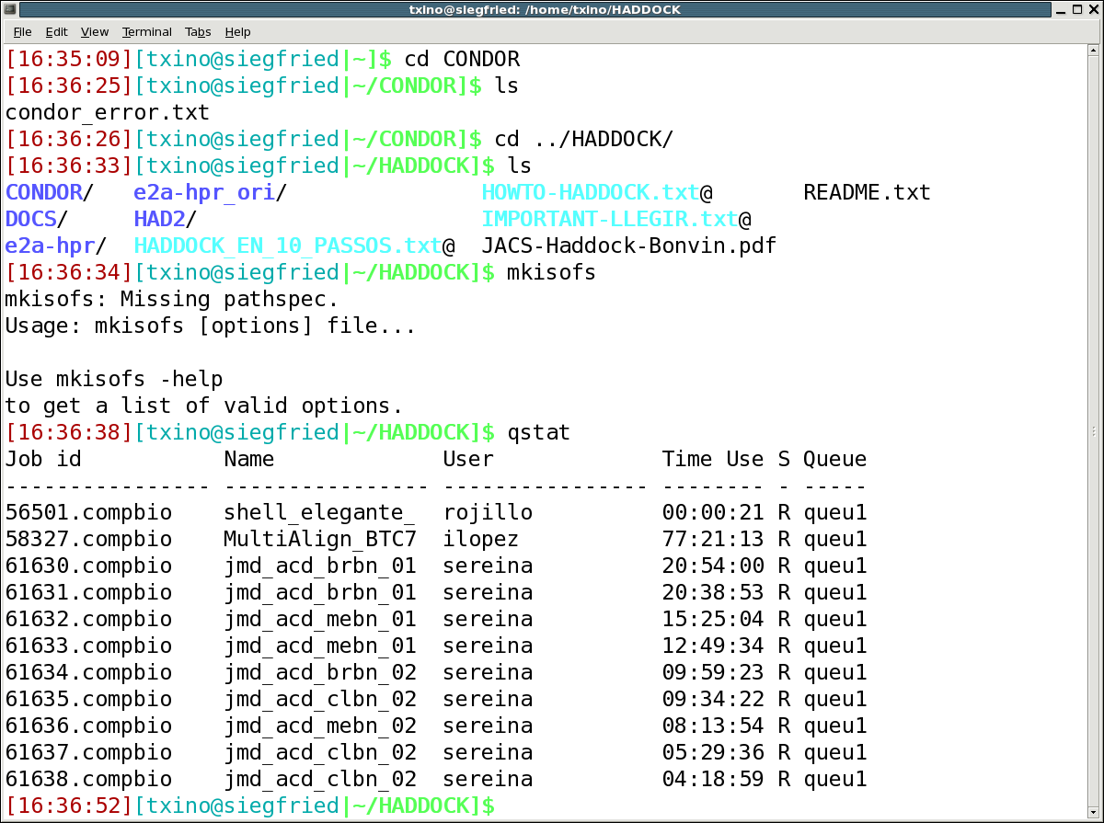
The Shell: The command line
Fundamental part in a operative system in charge of execute commands. It often has characteristics such as: process control, input / output redirection, and a programming language to write scripts.
Fast data access
Fast command execution (when you know them)
Multiple command combined execution
Tasks automation (Scripts)
Fast and easy remote work and administration with a little bandwidth consume
bash: GNU Bourne Again Shell, default linux shell, based on the old shell known as "sh".
tcsh: shell with similar syntaxes to C programming language, based on the old "csh"
zsh: An extended Bourne shell with many improvements over bash, currently default in macOS.
]$ command [agrument1] [argument2] ... [argN]

Slide 19
Exercise 0: execute a command
SPACE separates the arguments
[alumno@localhost ~]$ ls -l
promt (user@hostname)
command / program
argument1 argument2 argument3
[alumno@localhost ~]$ cp -r /usr/local/clustalw-2.0.10/ .
SPACE separates the arguments
[alumno@localhost ~]$ rm -rf clustalw-2.0.10/
[alumno@localhost ~]$ ls -l –a
[alumno@localhost ~]$ ls –la
[alumno@localhost ~]$ less .bashrc

Slide 20
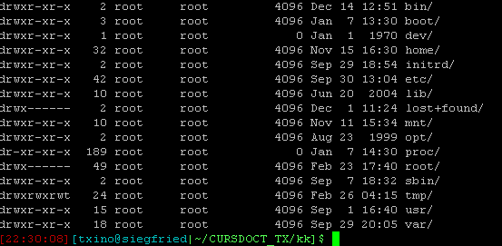

Directory tree and the filesystem I
ls –l /
ls –la
ls –la /home/$USER
cd .
pwd
cd ..
pwd
/
home/
pwd
$USER
./
(root)
/
../
/home
cd $USER
ls –la .
/home/$USER
relative path: ls –l ../
absolute path: ls –l /home

Slide 21
Directory tree and the filesystem II
/bin System executables
/boot kernel and its modules, needed in order to boot up
/dev Device acces
/home User data
/etc config files
/lib /lib64 System libraries
/mnt /media Other disks (USBs, DVDs, network units …)
/root Administrator files (do not touch)
/sbin admin executables
/tmp temporary files
/usr Not system programs, libraries, documentation, etc, installed by the OS package manager.
/opt y /usr/local Not system programs, libraries, documentation, etc which are not provided with the OS.
/var Varied stuff (received emails, web pages, “logs”, etc)

Slide 22
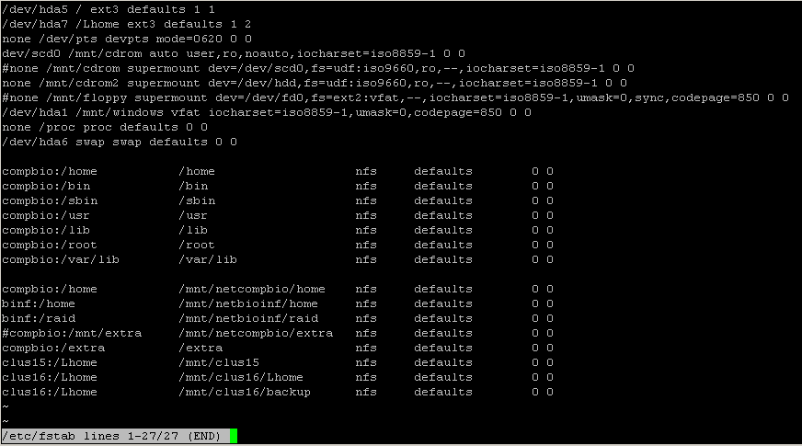
Directory tree and the filesystem III:
Mount points
less /etc/fstab
mount
df
There is only one root, different devices are mounted in directories inside a unique tree

Slide 23
Directory tree and the filesystem IV :
Permissions
ls –l /
owner
Owner group
kind
Owner user
group
The others
Only owner and administrator can change permissions from a file or directory

Slide 24
Environment Variables
Some hidden values that OS has, so it can access certain data in a fast way.
- Command “set” o “printenv”: (do not scare) they show us which environment variables are defined in a system.
echo $PATH Where are the executable programs
echo $HOME Our main working directory
echo $LD_LIBRARY_PATH Where the user defined function libraries are
.bashrc / .cshrc / .tcshrc: where users define their own environment variables and other stuff that shells need. IMPORTANT: this file is only loaded when you start a shell, so for any changes to take efect you need to start a new one (execute bash or zsh, exit and open a new terminal, etc)
less .bashrc
.bash_history: where all commands executed by the users in a bash shell are stored
less .bash_history
source : exports environment variables defined in a text file to the present shell.

Slide 25
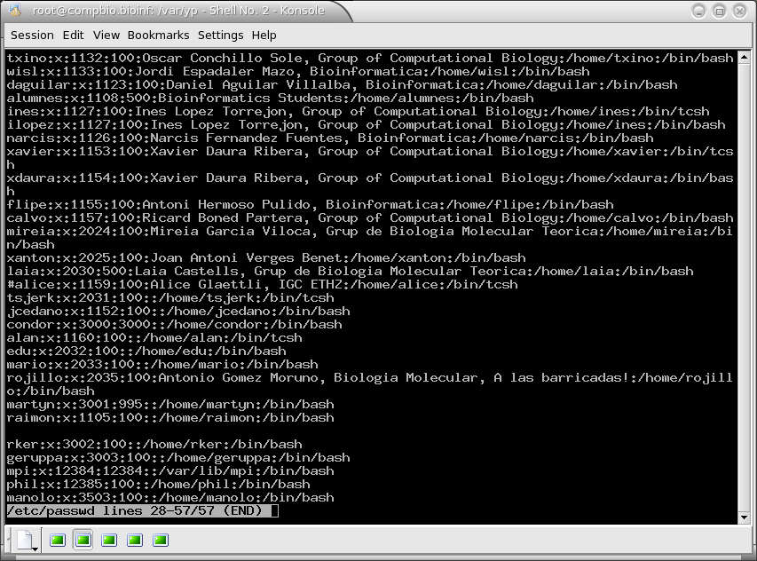
Users
less /etc/passwd
Every user has a unique identification number (UID)
If two users have the same UID they are the same user
Every user belongs ot one or more groups
Users in a same group have more privileges between them than with others
NEVER WORK WITH THE USER root!!!

Slide 26
Basic Commands
man /info: information about commands
cd: change directory
ls: lists files or directories
ls [directory/file name] metacharacters (*,?) can be used
  -l long
  -a all
  -R recursive
  -S sort by size
  -t sort by date
  -r revert order
  -h human readable sizes
cp: copy files or directories
cp [origin] [destination]
  -i interactive
  -R/r recursive
  -d keeps lincs
  -p keeps permisions
rm: erase files
  -i interactive
  -r recursive (and directories)
  -f force
mkdir/ rmdir: create/erase directories
mv: move files and directories
mv [origin] [destination]

Slide 27
Basic Commands II
chmod: change permisions
chmod [options] [new permision] [file/directory]
-R recursive
chmod u + r [file/directory]
g - w
o x
a
pwd: tells the current working directory
ln –s: create a symbolic link
ln –s [origin] [destination] (take care with the absolute / relative path)
ln –s /usr/local/clustalw2 (if destination is "." it can be ignored for a single file)
less clustalw_help
export / setenv: creates o changes and environment variables and turns it exportable to new shells generated by the current one.
bash: export CST=“/usr/local/clustalw2”
csh: setenv CST “/usr/local/clustalw2”
echo: writes a text or variable value
echo “/usr/local/clustalw2” ; echo $CST

Slide 28
Exercise 1: working with directories
Execute this commands in a terminal
#cd without arguments is equivalent to cd $HOME
cd
#wget is a command to download files from web or ftp servers
wget http://bioinf.uab.es/ocs/INTRO_LINUX/linux_CLI_exercises.tgz
#tar zxvf decompresses a gziped tar file (usually .tgz or .tar.gz)
tar zxvf linux_CLI_exercises.tgz
#less is a text file reader
less ~/LINUX_CLI_EXERCISES/exercise_1.txt
Now execute the commands that you find in the opened file.
I strongly suggest that you read the whole file (comments included) before starting to execute anything
You should be able to move through the directory tree
And understand the difference of a relative path and an absolute one

Slide 29
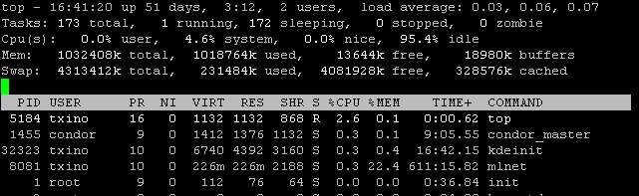

process commands I
We call process to any program currently on execution
top: shows in which tasks the processor is working on in real time
-p [process ID] only this process
options: M sorts by memory usage
N by name
P by CPU usage
1 shows different processors usage
ps: shows all process IN THE CURRENT SHELL
-e all process
-f more information about those process
-u [user] process belonging to a user
owner process ID process parent ID

Slide 30
process commands II
kill: sends a signal to a process (by default TERM)
kill [options] [PID]
-9 KILL signal
& Modifier: executes a process in “background”
[executable] [options and arguments] &
Ctrl c: kills a program
Ctrl z: pauses (stop) a program
bg: sends a paused program to “background”
fg: returns a program from “background” to “foreground”
nohup: immunizes a program against close signals (eg: exit)
xkill: kills a graphical program

Slide 31
execution related commands
bash / csh / sh: opens a new shell inside the current one, exportable environment variables are propagated to the son
bash %text file with commands%
csh
sh
bash –c "%command1%;%command2%"
creates a new bash shell, execute commands and exits
bash –x "%text file with commands%"
creates a new bash shell, execute the commands in the script showing each command (sort of a debugger)
alias: defines a new alias or shows the meaning of one of them or shows all available aliases
alias [existing alias]
alias [new alias]=[meaning] (in bash)
alias [new alias] [meaning] (in csh o tcsh)
which: where is an executable that is in PATH or defined by an alias which [program]
This commands are executed by a new shell which closes itself when the last command ends

Slide 32
Exercise 2: execute a process, identify it, monitor it and kill it
Follow the instructions in the file "~/LINUX_CLI_EXERCISES/exercise_2.txt"
Watch how clustalw2_sleep has not run because the directory was not in the PATH
Watch how the bash process is the father of the clustalw2_sleep process
Check how a running process prevents shell functionality

Slide 33
Command Lines: User commands
passwd: changes your password
who / w : who is connected to this computer?
whoami: who am I? (better use id)
su: changes the user but keeping the current environment
-l does not keep the current environment, loads the new user one and starts from the new user home directory
id: who are you and to which group do you belong

Slide 34
File commands I
file [filename] : tells what kind of a file it is
more / less: shows the content of a text file
less:
-N shows line numbers
+[num] starts with this line number
options: g beginning of the file
G end of the file
SPACE go forward one screen
b go backward one screen
/ search forward
? Search backward
n repeats search
N repeats search in reverse sense
cat [file1] … [file n] : sends the file(s) contents to the standard output (the current terminal by default)

Slide 35
File commands II
grep: shows lines in files which content a “pattern”
grep [options] [pattern] [file(s) name(s)]
-l shows only file name for those that match
-v shows lines that do not match
rgrep: recursive grep
-r really recursive!
find: search for files not only by name
find [directory] -name [name] -print
find [dir] -name [name] -exec [command, use {} as a substitute for file name] \;
wc: counts how many bytes, lines and words are in a file
-l only counts lines

Slide 36
File commands III
vi (thanks to José A. Parra Merino)
vi / vim: the TEXT EDITOR, it has lots of options and allows us to automate lots of tasks (if you know how to use it, which is not easy).
When we are executing vi we can be working in 3 different modes:
command mode : default one, here keys are not used to write anything , they have different functions.
writing mode: here they write
ex mode: to save, exit, configure, etc.

Slide 37
File commands III
vi: command mode
Ways to move in the document
w
  Moves forward a word.
W
  Moves forward a word, but only separated by spaces.
b
  Moves backwards a word.
B
  Moves backwards a word, but only separated by spaces.
$
  Goes to the end of current line.
^
  Goes to the beginning of current line.
nG
  Goes to the n line.
G
  Goes to the last line.
Editing commands
d
  Deletes: dd deletes a whole line, ndd deletes n lines, d$ and D deletes until the end of the line, 3dw deletes 3 words. When a text is deleted it is also copied to the buffer so later can be pasted with p.
x
  Deletes just a character.
y
  Copies selected text to the buffer (so it can be pasted).
p
  Pastes the text from the buffer.
ZZ
  Saves the document and exits the editor.

Slide 38
File commands III
vi: command mode
To go to the typing mode there are different commands, the ESC key exits this mode returning to the command one. These are some writing and inserting commands:
i
  Goes to typing mode in the same position where the cursor is.
I
  Goes to typing mode at the beginning of the current line.
a
  Goes to typing mode in the next character.
A
  Goes to typing mode at the end of current line.
o
  Creates a new line below the current one and inserts text on it.
O
  Creates a new line over the current one and inserts text on .

Slide 39
File commands III
vi: Ex mode
To access this mode we press : followed by any Ex command. Ex commands process the text line by line doing their corresponding changes. There are some Ex commands that do not affect the text, they are used to alter vi behavior and configuration or to perform specific tasks:
:%s/pattern1/pattern2/g:substitutes pattern1 by pattern2 in the whole document.
:r file
  Inserts the file contens in the document.
:r !command
  Inserts the stdout of this command in the document.
:syntax on / off
  Activates or deactivates syntax highlighting.
:w
  Saves the document.
:wq
  Saves the document and exits the editor.
:q!
  Exits without saving.
:set nu / nonu
  Activates or deactivates line numbers.

Slide 40
File commands IV
user friendly editors
emacs: another editor, but more “user friendly”
Graphical mode Editors: nedit, gedit, xemacs, kwrite, kate, gvim, ...

Slide 41
File commands V
Compress/Uncompress
bzip2 / bunzip2: compress / uncompress a “bzip2” compressed file (.bz2)
gunzip / gzip: (un)compress a “.gz” or “.Z” file
tar: join some files in only one
v verbose
c create a new file
x extract
t lists the contents
z working with gz compressed tar files
j working with bz2 compressed tar files
f %filepath" use this file to extract or compress
tar zcvf %directory.tgz% %directory% adds all files from “directory” to a “gz” compressed tar file called directory.tgz
tar zxvf %filepath.tgz% extracts all files from filepath.tgz to the current directory
zip /unzip : compress / uncompress a zip file

Slide 42
Exercise 3: vi or nano or whatever you like
Modify the $HOME/.bashrc file, add the WORK directory to the PATH and create some alias for mv, cp, rm and ls –ltr
(take care with COPY PASTE!)
vim ~/.bashrc
#add next lines to the recently open file
export PATH=$HOME/PRACT_SO/WORK/:$PATH
alias mv='mv –i'
alias cp='cp –i'
alias rm='rm –i'
alias t='ls –ltr'
This Environment variables are still unknown for the shell, we need to load them with the command source.
source ~/.bashrc
BUT I strongly advise against it, it is better that you start from scratch.
execute:
exit
or
bash
Check that now clustalw2_sleep can be executed from any directory.
Check that now t is a command that produces the same result as ls -ltr

Slide 43
Standards (input/output)
stdin: standard input, keyboard usually.
stdout standard output, the screen usually.
stderr standard error, the screen usually.

Slide 44
Standards (input/output)
Redirection: pipes I
| : redirects stdout from a program to the stdin from another
> : redirects stdout from a program to a new file, if that one exists it is destroyed.
>> : redirects stdout from a program to a file, adding that to the end of it. If that one does not exist it is created.
< : redirects the contents of a file to the stdin of another.
2>&1 : redirects stderr to the stdout.
xargs: redirects stdin to a command arguments
\ls |xargs –ti du –s {}

Slide 45
Exercise 4: Pipes & Standards
Follow the instructions in the file "~/ LINUX_CLI_EXERCISES /exercise_4.txt"
If we want to execute a program that require interactive input in a non interactive way (for example from another program) this would be the way.
How many steps do you think we need to compare 1 by 1 all sequences against the Ecoli one? (here I have 5 files, but they could be thousands!)
\ls *fst|grep -v Eco|xargs -ti bash -c "cat Eco.fst {} >clusin.inp;~/LINUX_CLI_EXERCISES/clustalw2 -ALIGN -OUTFILE={}+ecoli.aln -INFILE=clusin.inp"

Slide 46
Network commands
ping : check if a computer is connected (if its firewall allows it)
ping [ip / computer’s name]
/sbin/ifconfig: shows all network devices and their IP address.
ip a s (the same, more modern approach, the standard today).
nmcli (the same, more user friendly).
hostname: shows our computer’s name.
-f full name
-A all names
ssh: opens a shell from a remote computer in our computer. The connection with it is encrypted.
ssh [user]@[ip/computer’s name]
wget: ftp and http client file downloader.
wget “http://ftp.ebi.ac.uk/pub/software/clustalw2/2.0.10/clustalw-2.0.10-src.tar.gz”
-i [file] download all address in this file
lynx: Text web browser (very used at the www beginnings)

Slide 47
Exercise 5: the Script
One of the main advantages of the command line are the scripts, we can type different commands in a text file, give it execution permissions an execute it, the command interpreter will execute all of them one by one:
cd
ls PRACT_SO/
tar zcvf PRACT_SO.tgz PRACT_SO/
rm -rf PRACT_SO
less LINUX_CLI_EXERCISES/script_all.sh
# LINUX_CLI_EXERCISES/script_all.sh
That script allows us to execute everything that we’ve done in class with only one command.
After executing it, navigate through the directories and observe that all the files have been created as they were.
Now concatenate the exercise_?.txt files and modify the resulting file to create your own script_all.sh .
INFO: you can view the execution line by line using:
bash –x %your_script%
WARNING: text files in windows are not equal in UNIX. Investigate about the following comand: dos2unix

Slide 48
Compiling I
Computer’s language is very complicated for a human being (01000001 = A) so in order to create a new program we use programming languages (Fortran, C, java, python, etc).
To “translate” this programs to a language that a computer understands we have two methods:
Interpret: “translation” is done line by line. The computer must have the interpreter installed to execute your program. In this case, the program that it is executed is the interpreter, your program (in this case AKA: script) is a data file which is read by the interpreter which acts according to it. In a similar way as Microsoft Word reads a "*.docx" file and acts according to it (eg: python).
Compile: we translate the whole program at the same time, once compiled it is not necessary that the executing computer has the interpreter, but if the program uses shared libraries, they are going to be needed (eg: C or Fortran).
Almost all languages have a compiler (or interpreter) for each O.S., so the same source code can be interpreted or compiled in different O.S. and/or architectures without any changes (if we wrote it right).

Slide 49
Compiling II
When we download a source code (what a programmer has written), generally, the compilation and installation process is done in three steps:
(But first we will ALWAYS read the README or INSTALL or any other documentation file)
cmake %several options here%
or
./configure
Both ways check that our computer has the compiler and all necessary libraries. Some user depending options will be specified at this moment. This process generates the “Makefile” file that contains all the compiler options and the location of all needed libraries.
--help shows all possible options
--prefix=[install directory], /usr/local by default.
make: the true compilation process, all compiler options are read from the “Makefile”.
-j %number of simultaneous jobs to run%
make install: compiled program is installed in the directory specified when “configure” was executed.

Slide 50
Exercise 6: compile and install an application
Download clustalw2 source code (maybe it has already been done)
cd
cd PRACT_SO/
mkdir PROGRAMS
cd PROGRAMS/
wget "http://ftp.ebi.ac.uk/pub/software/clustalw2/2.0.10/clustalw-2.0.10-src.tar.gz"
tar zxvf clustalw-2.0.10-src.tar.gz
ls clustalw-2.0.10
Take care of permissions when you install something, maybe you don't have writing permissions in the default installation directories.
YOU ARE NOT ALLOWED to use sudo or su to adquire root privileges. You must complete this exercise as a simple user. (You can't, READ again the previous slide!)
¡¡¡GOOD LUCK!!!

Slide 51
tmux
tmux is a terminal multiplexer. (read more here https://linuxcommand.org/lc3_adv_termmux.php )
It keeps our session alive as we have it even if we close the terminal, the connection to a remote computer is closed and other cases.
it also allows us to generate "tabs" inside the session.
It is very useful for remote sessions. We only need to make one connection and then we can create new "tabs" if we new other terminals. Apart from that, as we mentioned, if the connexon is closed we do not loose this sesion.
It is also very usefull when running long jobs, we leave them running inside a tmux and we can close the terminal, even logout (of course, we cannot turn off the computer where the job is running, but if it is running in a remote server, we can turn off ours, reconnect later and recover the session)
We are going to repeat the compilation process but inside a tmux session
tmux
cd /home/ocs/PRACT_SO/PROGRAMS/clustalw-2.0.10
./configure --prefix=$HOME/PRACT_SO/PROGRAMS/clustalw2
#while it is running create a new tab with pressing "ctrl b" and later "c" (without ctrl)
#we can go back to the previous tab with "ctrl b" and "p"
make
#while it compiles go to the other tab with "ctrl b" "p" (previous) or "ctrl b" "n" (next)
# you only have two tabs so "next" and "previous" is the same. You can see all tabs and select which one to use with "ctrl b" "w"
#in the other tab execute:
top
#now close the terminal window
open another terminal and execute
tmux ls # lists the running sessions
tmux att #short for attach-session
# play with "ctrl b" "n" or "ctrl b" "p" to see that everything is as it was.
# press "cltr b" "d" to detach the session
tmux att to reattach it again
# you can play a bit with tmux. When you finish close each opened tab with :
exit
# make sure no session remains
tmux ls
# if anyone remains reattach it and exit from all of them

Slide 52
https://linuxcommand.org
We strongly advise that you take your time to go this site:
https://linuxcommand.org
and follow the the following tutorials:
https://linuxcommand.org/lc3_learning_the_shell.php
https://linuxcommand.org/lc3_writing_shell_scripts.php
if you are still in the mood go to Adventures:
https://linuxcommand.org/lc3_adv_termmux.php
https://linuxcommand.org/lc3_adv_mc.php

