Slide 1
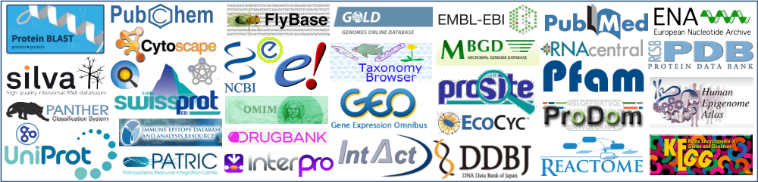
Public Databases in Health and Life Sciences
“the potential to translate big data into big discovery”
Academic year 2023-2024

Slide 2
  A collection of related data elements
    Tables
      columns (fields)
      rows (records)
    Documents
      Key -> Value
  Records retrieved using a query language
  Database technology is well established
Relational Databases
Rows (records)
  actual data
  whereas fields describe what data is stored, the rows of a table are where the actual data is stored
Columns (fields)
  attributes of tables, e.g. for citation table, title, journal, volume, author
What is a database?

Slide 3
Accession numbers and Identifiers
How is information organized in databases?
    An Identifier is essentially a name of a database, table, or table column.
      As the creator of the database, you are free to identify these objects as you please.
      The identifier can change (based on the curator)
Each record (row in the table) has a unique identifier, alone or combined with another column is unique for that table. The primary key (accession number or accession code).
  The primary key should not change.
  Data is indexed according this primary key
  The unique identifier serves to identify the data stored in this record across all the tables in the database (relational database).
  Usually, a string of letters and digits that uniquely identifies an entry in its database.
    The accession number for TPIS_CHICK in Uniprot/Swissprot is P00940

Slide 4
Accession numbers and Identifiers
How is information organized in databases?
    Some DBs have both Identifiers and accession as unique for each entry in the DB.
    In these cases, the main difference is that Identifiers are Human readable and accession are just "random" codes.
    Example Pfam_ID: MlaC; Pfam_AC: PF05494
    In some cases Identifiers are mutable (but remain unique) while accessions are not
    in UniprotKB accession P0AAP1 Use to have ADRA_ECOLI as Id (Name) but now it is DGCC_ECOLI
    The fact that they are called "unmutable" does not mean that can not be considered obsolete and removed from the database.
    Sometimes accessions can have a version number, which means that something has changed, but whatever they represent remains
Examples:
In Pfam the current accession with version for the MlaC family is PF05494.15
In ncbi refseq nuccleotide, the current accession for Neisseria meningitidis MC58 complete genome is NC_003112.2

Slide 5
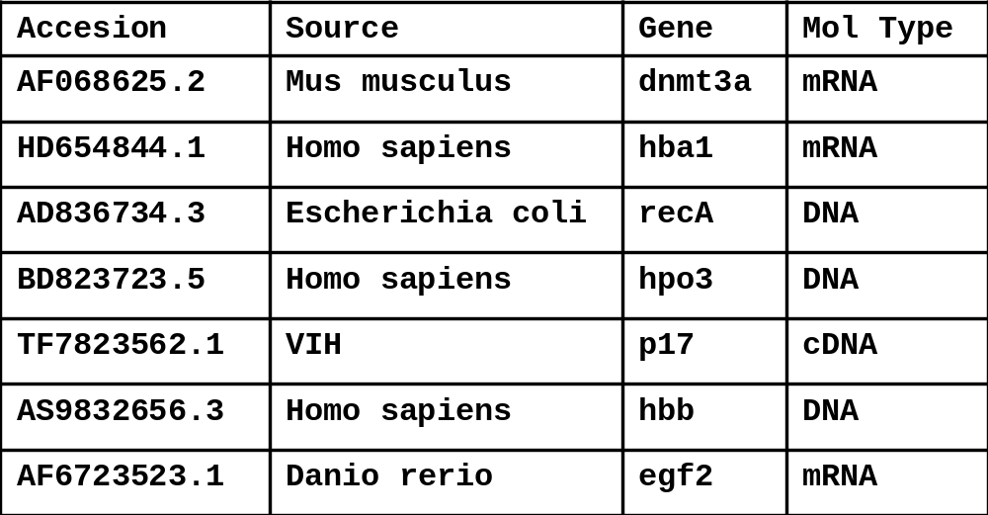
What is a flat file database?
Sequential collection of entries, stored in a set of text files
Flat-File databases can be represented as holding all of their data in one table only (two-dimensional table)
Files written in plain text, standard defined format. Examples:
  Each line is a record. Fields are separated by delimiters: tabs, commas…
  Each file is a record. Fields expressed as key->value (eg: json db)
Searching issues!
Notes:
Searching is sequential
A lot of redundancies
Hard to search with a DBMS
Could contain associated metadata

Slide 6
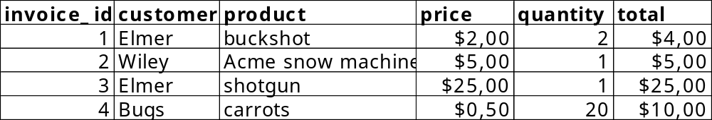
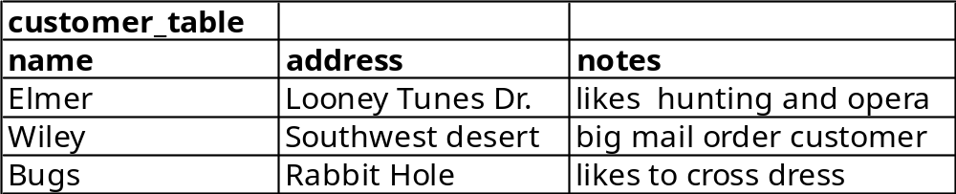
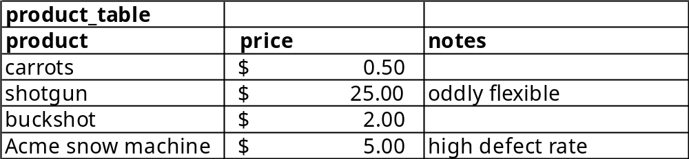
What is a relational database?
A relational database contains multiple tables and defines the relationships between them.
Virtually all use SQL (Structured Query Language) as a language for querying and maintaining
database scheme
Notes:
A relational database is a digital database whose organization is based on the relational model of data, as proposed by E. F. Codd in 1970.[1] The various software systems used to maintain relational databases are known as a relational database management system (RDBMS). Virtually all relational database systems use SQL (Structured Query Language) as the language for querying and maintaining the database.
Thus a table represents a collection of relationships.

Slide 7
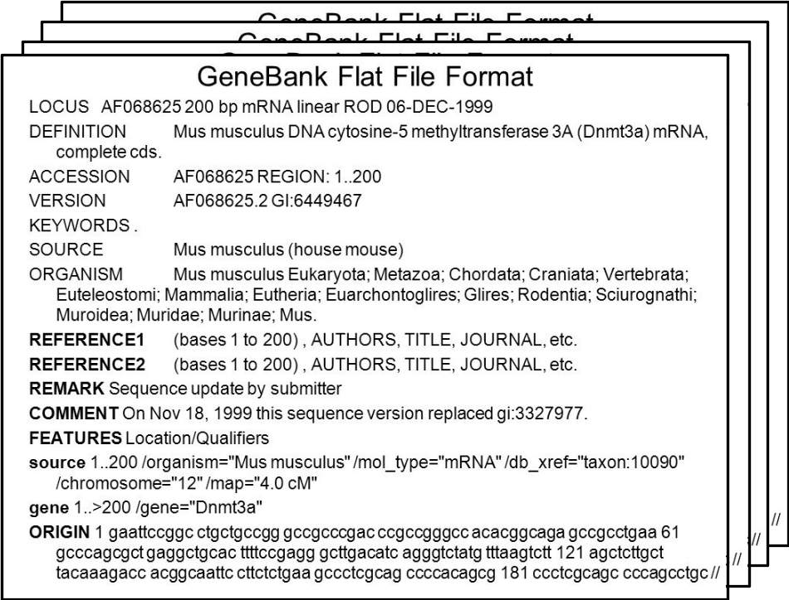
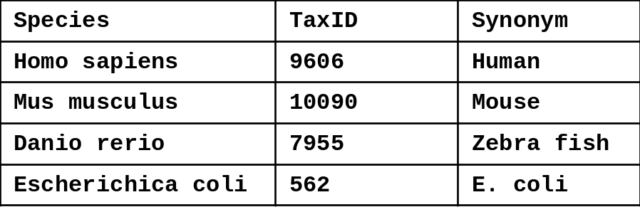
A common way of storing biological data in a structured manner is to use a relational database
tab1
tab2
Notes:
Structured data is data that has been organized into a formatted repository, typically a database, so that its elements can be made addressable for more effective processing and analysis.
Relational databases using structured data.
Structured data refers to any data that resides in a fixed field within a record or file. This includes data contained in relational databases and spreadsheets.
Unstructured data is data that contains information without any structure, such as content inside emails or books or images.

Slide 8
Essential aspects of primary and secondary databases.
 | Primary database | Secondary database
Synonyms | Archival database | Curated database; knowledgebase
Source of data | Direct submission of experimentally-derived data from researchers (database staff organize but don’t add additional information) | Results of analysis, literature research and interpretation, often of data in primary databases
 | Once given a database accession number, the data in primary databases are never changed: they form part of the scientific record. | Continuously updated Biocuration
EMBL-EBI Train online
Bioinformatics for the terrified
https://www.ebi.ac.uk/training/online/courses/bioinformatics-terrified/what-makes-a-good-bioinformatics-database/primary-and-secondary-databases/

Slide 9
Definition and aims of biocuration
  Biocuration involves the interpretation and integration of information relevant to biology into a database or resource that enables integration of the scientific literature as well as large data sets.
  Primary goals of biocuration.
  Accurate and comprehensive representation of biological knowledge
  Easy access to this data for working scientists and a basis for computational analysis

Slide 10

How to access the data in public databases ?
Human Web interface (web based, small scale)
  Free text search
  Common mode of search are keywords with modifiers or identifiers
  Cross-references link the information of different databases
  You do not see the underlying database structure
  Output defined by host/provider
Web services and Programmatic data access
  Application Programmers Interface (API)
  To approach database programmatically
Download the data: File Transfer Protocol (FTP), rsync, http
  Flat files (script based, bulk data download)
“click your way”
Programming Utilities Web Service
Notes:
In general terms, it is a set of clearly defined methods of communication between various software components. It defines methods of communication between various software components and provides access to data of an operating system, application, or other service

Slide 11
Fielded searching using any of the indexed fields (advanced searches)
Entering the phrase with a [field descriptions]:
robotic surgery [title]
Miller MJ [author]
“protein domain” [TI]
human [Organism]
insulin [Protein Name]
Combining fielded searching with booleans
enzymes [TI] NOT Gonzales P [AU]
human [Organism] AND insulin [Protein Name]

Slide 12
Search for Field Descriptions are different in each Database
NCBI
NC_0000*[Accession]
Human[Organism]
horse[taxonomy]
neoplasms[MeSHTerms]
prolactin[Protein Name]
APOE[gene]
srcdb_refseq[Properties]
2010/06[Publication Date]
110:500[Sequence Length]
gene_symbol[sym]
1.1.1.53[ecno]
gbdiv_est[PROP]
: : :
etc
UNIPROT
accession:p62988
organism:human
taxonomy:40674
keyword:neoplasms
name:"prion protein“
gene:HSPC233
database:(type:pfam) created:[20121001 TO *]
length:[100 TO 500]
go:0015629
ec:3.2.1.23
reviewed:yes
: : :
etc
http://www.ncbi.nlm.nih.gov/entrez/query/static/help/Summary_Matrices.html#Search_Fields_and_Qualifiers
https://www.ncbi.nlm.nih.gov/books/NBK49540/
https://www.uniprot.org/help/query-fields

Slide 13

The NCBI is a comprehensive website for biologists (database of databases (of databases) )
http://www.ncbi.nlm.nih.gov/gquery/
The National Center for Biotechnology Information (NCBI)
Created in 1988 as a part of the National Library of Medicine at NIH
Establish public databases
Research in computational biology
Develop software tools for sequence analysis
Disseminate biomedical information
Over 30 databases (primary, secondary, specialized, meta-databases, etc.)

Slide 14
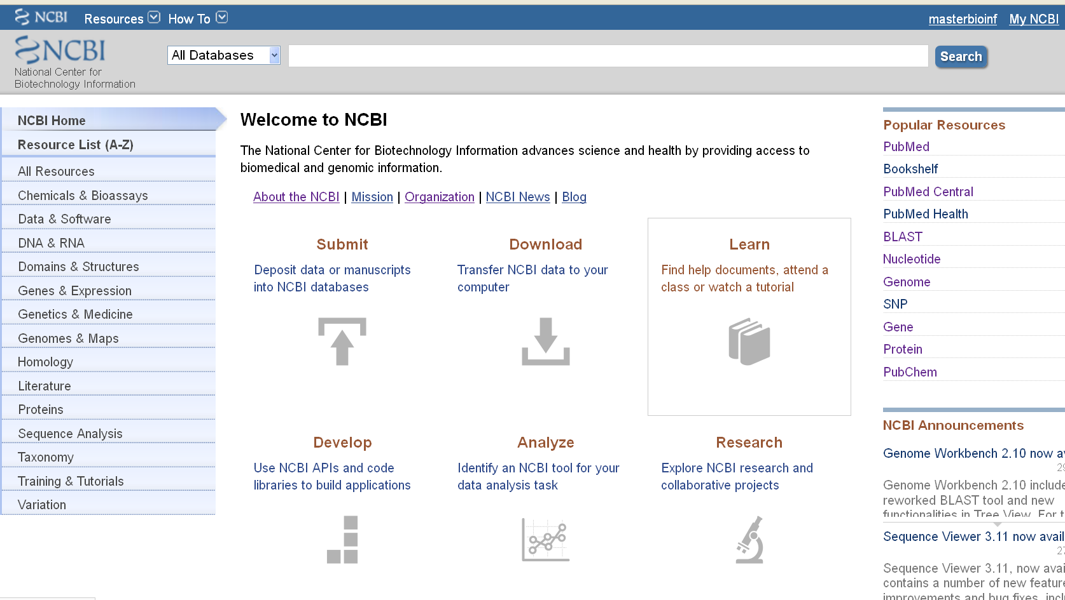
The NCBI home page
http://www.ncbi.nlm.nih.gov/

Slide 15
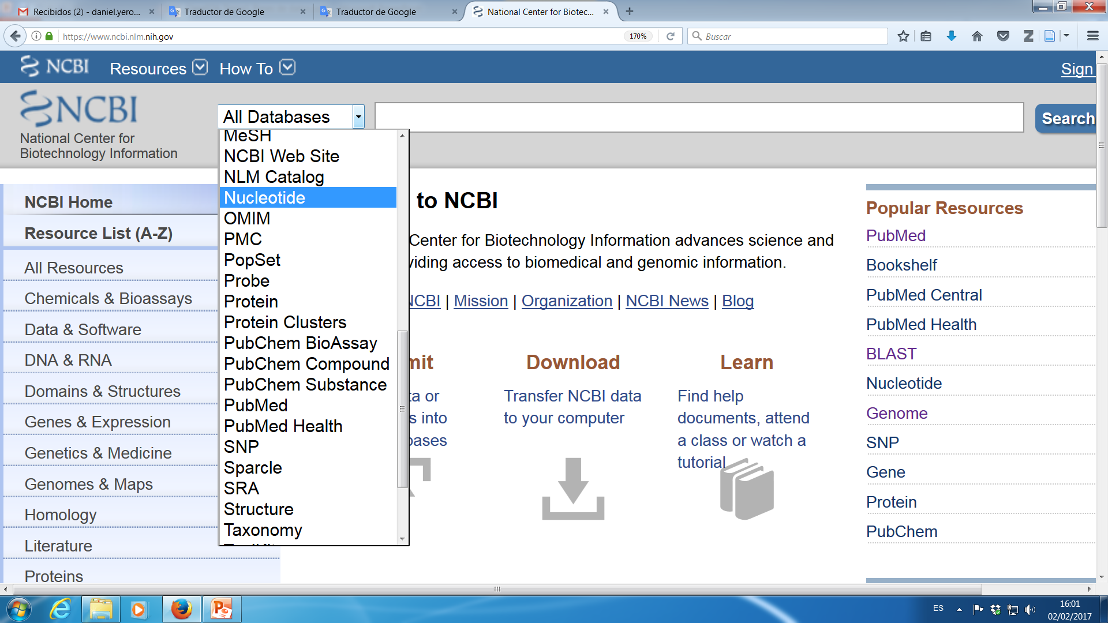
NCBI hosts over 30 databases

Slide 16
How to access the NCBI data ?
  Entrez: An Integrated Database Search and Retrieval System
Human Web interface (web based, small scale)
      Free text search
      List of identifiers (Batch Entrez)
Web service (Programmatic data access)
      Entrez Utilities Web Service (NCBI): The E-utilities
        Entrez Direct: E-utilities on the Unix Command Line
Searching sequence databases using a sequence query
  BLAST
File Transfer Protocol (FTP)
  Flat files (script based, bulk data download)

Slide 17
Entrez: An Integrated Database Search and Retrieval System
Access all NCBI resources (Database Integration)
Entrez Databases
  All Molecular Database entries are organized by organism (Taxonomy Database).
  Each record is assigned a UID “unique integer identifier” for internal tracking
  Each record is indexed by data fields: [author], [title], [organism], and many others
  Each record is given a Document Summary (DocSum).
  Each record is manually or computationally assigned links to biologically related UIDs in and across databases.

Slide 18
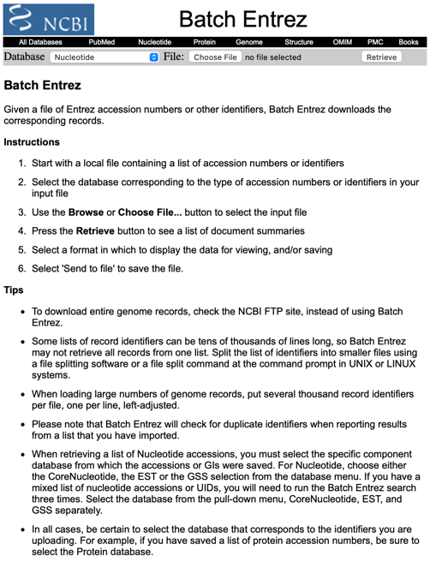
https://www.ncbi.nlm.nih.gov/sites/batchentrez

Slide 19
Access Entrez through programs or scripts
Entrez Utilities Web Service (NCBI) The E-utilities http://www.ncbi.nlm.nih.gov/books/NBK25500/
Entrez Programming Utilities are tools that provide access to Entrez data outside of the regular web query interface. You can access them by constructing the right URL and retrieving results. This is the base:
https://eutils.ncbi.nlm.nih.gov/entrez/eutils/
And then you add the desired tool with the appropriate parameters.
Some tools:
  ESearch: Searches and retrieves primary IDs and retains results in the user's environment.
  EFetch: Retrieves records from one or more primary IDs or from the user's environment.
  Also: EGQuery, EInfo, ELink, ESpell, Esummary
Example: Get the PubMed IDs (PMIDs) for articles about breast cancer published in Science in 2008:
  https://eutils.ncbi.nlm.nih.gov/entrez/eutils/esearch.fcgi?db=pubmed&term=science[journal] AND breast cancer AND 2008[pdat]&retmode=json
There is a set of programs implementing these functions. They allow to access the same servicies form the UNIX-like Command Line interface : Entrez Direct. (https://www.ncbi.nlm.nih.gov/books/NBK179288/ )
Example: Download all protein sequences in fasta format from Stenotrophomonas maltophilia with the word “lactamase” in their title:
  ~]$ esearch -db protein -query "txid40324[porgn] AND lactamase[TI]"|efetch -format fasta

Slide 20
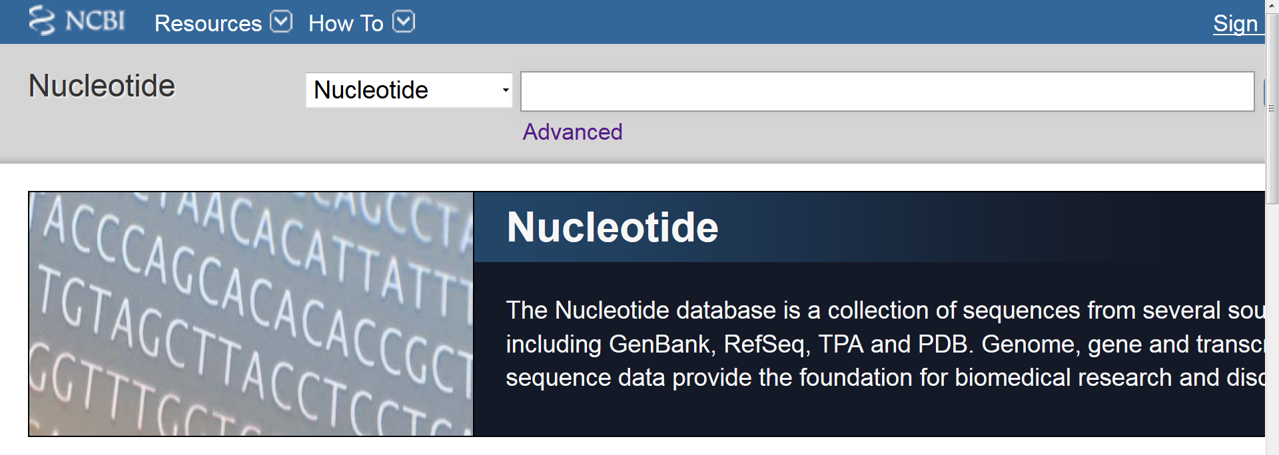
NCBI:Molecular Sequence Databases
Sequence Databases (Primary)
Nucleotide (GenBank)
PopSet
SRA, GSS
Protein
Marker Databases
Single Nucleotide Polymorphisms (SNP’s, dbSNP)
Sequence Tagged Sites (STS’s, dbSTS)
Expressed Sequence Tags (EST’s, dbEST)
https://www.ncbi.nlm.nih.gov/nuccore/

Slide 21
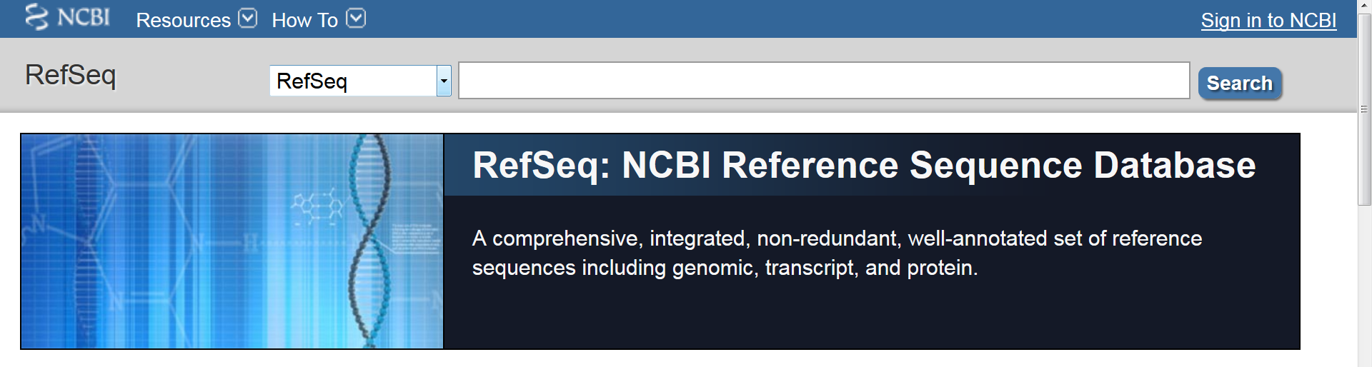
NCBI: Derivative Databases
Nucleotide derived
Example: RefSeq, GENE
Protein-derived
Example: CDD
Structure-derived
Example: Structure
Human curated, compilation and correction of data
Example: RefSeq
Computationally Derived
Example: UniGene
Combinations
Example: NCBI Genome Assembly
https://www.ncbi.nlm.nih.gov/refseq/

Slide 22
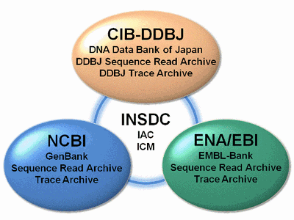
Primary (archival) nucleotide sequence databases
  The three databases are synchronized on a daily basis
  The accession numbers are consistent.
  There are no legal restriction in the usage of these databases. However, there are some patented sequences in the database

Slide 23
Sequence submission to nucleotide databases
Direct submissions from the authors:
  Free submissions.
  Authors can annotate the sequences.
  Only minor staff supervision and quality assurance checks.
Submissions through the Internet:
  Web forms / Web services.
  Email.
Sequences shared/exchanged between the 3 centers on a daily basis:
  The sequence content of the banks is identical.

Slide 24
What is GenBank ?
GenBank is the NIH (NCBI) genetic sequence database
Nucleotide only sequence database (Beware: GenPept)
  Example: https://www.ncbi.nlm.nih.gov/nuccore/AM743169.1
Archival in nature
  Historical
  Reflective of submitter point of view (subjective)
  Redundant
GenBank Data
  Direct submissions (traditional records)
  Batch submissions (EST, GSS, STS)
  ftp accounts (genome data)
Three collaborating databases (all data from INSDC)
  GenBank
  DNA Database of Japan (DDBJ)
  European Molecular Biology Laboratory (EMBL) Database

Slide 25
The GenBank at the National Center for Biotechnology Information (NCBI)
http://www.ncbi.nlm.nih.gov/nuccore

Slide 26
The source databases for NCBI nucleotide and protein sequences
Nucleotide (NCBI)
GenBank
EMBL
DDBJ
genbank[Filter]
EMBL[Filter]
ddbj[Filter]

Slide 27
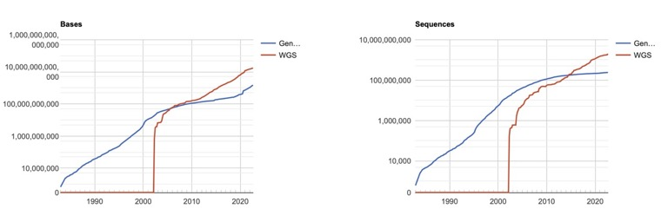
Growth of GenBank (1982-2022)
See the current GenBank release notes for up-to-date information.
http://ftp.ncbi.nih.gov/genbank/gbrel.txt
And GenBank statistics page:
https://www.ncbi.nlm.nih.gov/genbank/statistics/

Slide 28
GenBank vs Nucleotide
Nucleotide: a collection of sequences from several sources, including GenBank, RefSeq, TPA and PDB. Genome, gene and transcript sequence data provide the foundation for biomedical research and discovery.
GenBank: An archival database of primary nucleotide sequences that were directly sequenced by the submitter.
RefSeq: A curated, non-redundant database that includes genomic DNA, transcript (RNA), and protein products, for major organisms. The sequence data are derived from GenBank primary data, and the annotation is computational, from published literature, or from domain experts. All RefSeq ids have a prefix
TPA: A database designed to capture experimental or inferential results that support submitter-provided annotation for sequence data that the submitter did not directly determine but derived from GenBank primary data.
PDB: Repeat with me: ”PDB is not a protein database” (2UVG, 4E1U)

Slide 29
What information is requested from authors when submitting a sequence?
Search Field Descriptions
The sequence
  Automatic assignment of a unique accession number [accession]
Source
  The organism [organism]
  Type of molecule [properties]
References
  Authors [author]
  Publication [journal]
Coding Sequence (CDS) features
  Gene [gene name]
  Coordinates (automatic translation - protein sequence)
  Genetic elements [feature key]
  Protein [protein name]
  Comments [text word]
etc., etc.,…….
Primary key
Identifiers

Slide 30
Advanced Searches
Search Field Descriptions and Tags at NCBI
[Accession] | [ACCN] | The accession number assigned by NCBI.
[All Fields] | [ALL] | All terms from all search fields in the database.
[Author] | [AU] | All authors from all references in the records.
[EC/RN Number] | [ECNO] | Enzyme Commission (EC) number for an enzyme activity.
[Feature Key] | [FKEY] | Biological features listed in the Feature Table of the sequence records.
[Gene Name] | [GENE] | Gene names annotated on database records.
[Issue] | [ISS] | The issue number of the journals cited on sequence records
[Journal] | [JOUR] | The name of the journals cited on sequence records.
[Keyword] | [KYWD] | Keywords applied by submitter
[Modification Date] | [MDAT] | The date of most recent modification of a sequence record.
[Organism] | [ORGN] | The scientific and common names for the complete taxonomy of organisms
[Properties] | [PROP] | Molecular type, source database, and other properties of the sequence
[Protein Name] | [PROT] | The names of protein products as annotated on sequence records.
[Publication Date] | [PDAT] | The date that records were made public in Entrez.
[Sequence Length] | [SLEN] | The total length of the sequence
[Text Word] | [WORD] | Text on a sequence record that is not indexed in other fields.
[Title] | [TI] | Words and phrases found in the title of the sequence record.
ETC…….. | ETC……… | ETC……. https://www.ncbi.nlm.nih.gov/books/NBK49540/

Slide 31
GenBank Flat Files (.gbff)
LOCUS HUMCYPB 1868 bp mRNA linear PRI 27-APR-1993
DEFINITION Human cytochrome P-450 1 mRNA, complete cds, clone Hp1-2.
ACCESSION M17398 J03472
SOURCE Homo sapiens (human)
ORGANISM Homo sapiens
Eukaryota; Metazoa; Chordata; Craniata; Vertebrata; Euteleostomi;
Mammalia; Eutheria; Euarchontoglires; Primates; Haplorrhini;
Catarrhini; Hominidae; Homo.
REFERENCE 1 (bases 1 to 1868)
AUTHORS Okino,S.T., Quattrochi,L.C., Pendurthi,U.R., McBride,O.W. and
Tukey,R.H.
TITLE Characterization of multiple human cytochrome P-450 1 cDNAs. The
chromosomal localization of the gene and evidence for alternate RNA
splicing
JOURNAL J. Biol. Chem. 262 (33), 16072-16079 (1987)
FEATURES Location/Qualifiers
source 1..1868
/organism="Homo sapiens"
/mol_type="mRNA"
/db_xref="taxon:9606"
CDS 2..1183
/note="cytochrome P-450 1"
/codon_start=1
/protein_id="AAA35740.1"
/db_xref="GI:181328"
/translation="MEPFVVLVLCLSFMLLFSLWRQSCRRRKLPPGPTPLPIIGNMLQ
IDVKDICKSFTNFSKVYGPVFTVYFGMNPIVVFHGYEAVKEALIDNGEEFSGRGNSPI
SQRITKGLGIISSNGKRWKEIRRFSLTNLRNFGMGKRSIEDRVQEEAHCLVEELRKTK
ASPCDPTFILGCAPCNVICSVVFQKRFDYKDQNFLTLMKRFNENFRILNSPWIQVCNN
FPLLIDCFPGTHNKVLKNVALTRSYIREKVKEHQASLDVNNPRDFMDCFLIKMEQEKD
NQKSEFNIENLVGTVADLFVAGTETTSTTLRYGLLLLLKHPEVTAKVQEEIDHVIGRH
RSPCMQDRSHMPYTDAVVHEIQRYSDLVPTGVPHAVTTDTKFRNYLIPKSFDNKIMLA
A"
ORIGIN 337 bp
1 aatggaacct tttgtggtcc tggtgctgtg tctctctttt atgcttctct tttcactctg
61 gagacagagc tgtaggagaa ggaagctccc tcctggcccc actcctcttc ctattattgg
121 aaatatgcta cagatagatg ttaaggacat ctgcaaatct ttcaccaatt tctcaaaagt
181 ctatggtcct gtgttcaccg tgtattttgg catgaatccc atagtggtgt ttcatggata
241 tgaggcagtg aaggaagccc tgattgataa tggagaggag ttttctggaa gaggcaattc
301 cccaatatct caaagaatta ctaaaggact tggaatcatt tccagcaatg gaaagagatg
361 gaaggagatc cggcgtttct ccctcacaaa cttgcggaat tttgggatgg ggaagaggag
421 cattgaggac cgtgttcaag aggaagctca ctgccttgtg gaggagttga gaaaaaccaa
481 ggcttcaccc tgtgatccca ctttcatcct gggctgtgct ccctgcaatg tgatctgctc
541 cgttgttttc cagaaacgat ttgattataa agatcagaat tttctcaccc tgat......
//
Identification codes
Source and References
Feature Table
DNA sequence
accession
organism
division
journal
Identifiers
type of molecule
CDS coordinates
protein name
protein sequence

Slide 32
NCBI: Understanding the mess (Databases)
1)
Go to:
https://www.ncbi.nlm.nih.gov/guide/all/
click on All Databases
find Nucleotide Database
find GenBank Database
find Reference Sequence (RefSeq)
find Protein Database
find GenPept (Where is it?)
2)
Count the previously reported Databases (58)
Go to: https://www.ncbi.nlm.nih.gov
open the Dropdown menu for the databases and count them (36)
Go to: https://eutils.ncbi.nlm.nih.gov/entrez/eutils/einfo.fcgi
and count them (40)

Slide 33
NCBI: Understanding the mess (Data and Databases)
Go to:
https://www.ncbi.nlm.nih.gov/nuccore
Search this:
Neisseria meningitidis MC58 complete[TI]
Open in new tab:
- Neisseria meningitidis MC58, complete genome
- Neisseria meningitidis MC58, complete sequence
Focus on AE002098.2
  LOCUS, ACCESSION and VERSION
  DBLINK
  KEYWORDS (to compare with NC_003112.2)
  SOURCE
  REFERENCE
  COMENTS
  FEATURES
GenBank vs RefSeq
Compare AE002098.2 with NC_003112.2
  GenBank vs RefSeq
  Search (Ctrl+F) NMB1736
Open https://www.ncbi.nlm.nih.gov/nuccore/NG_011877
Read COMENTS

Slide 34
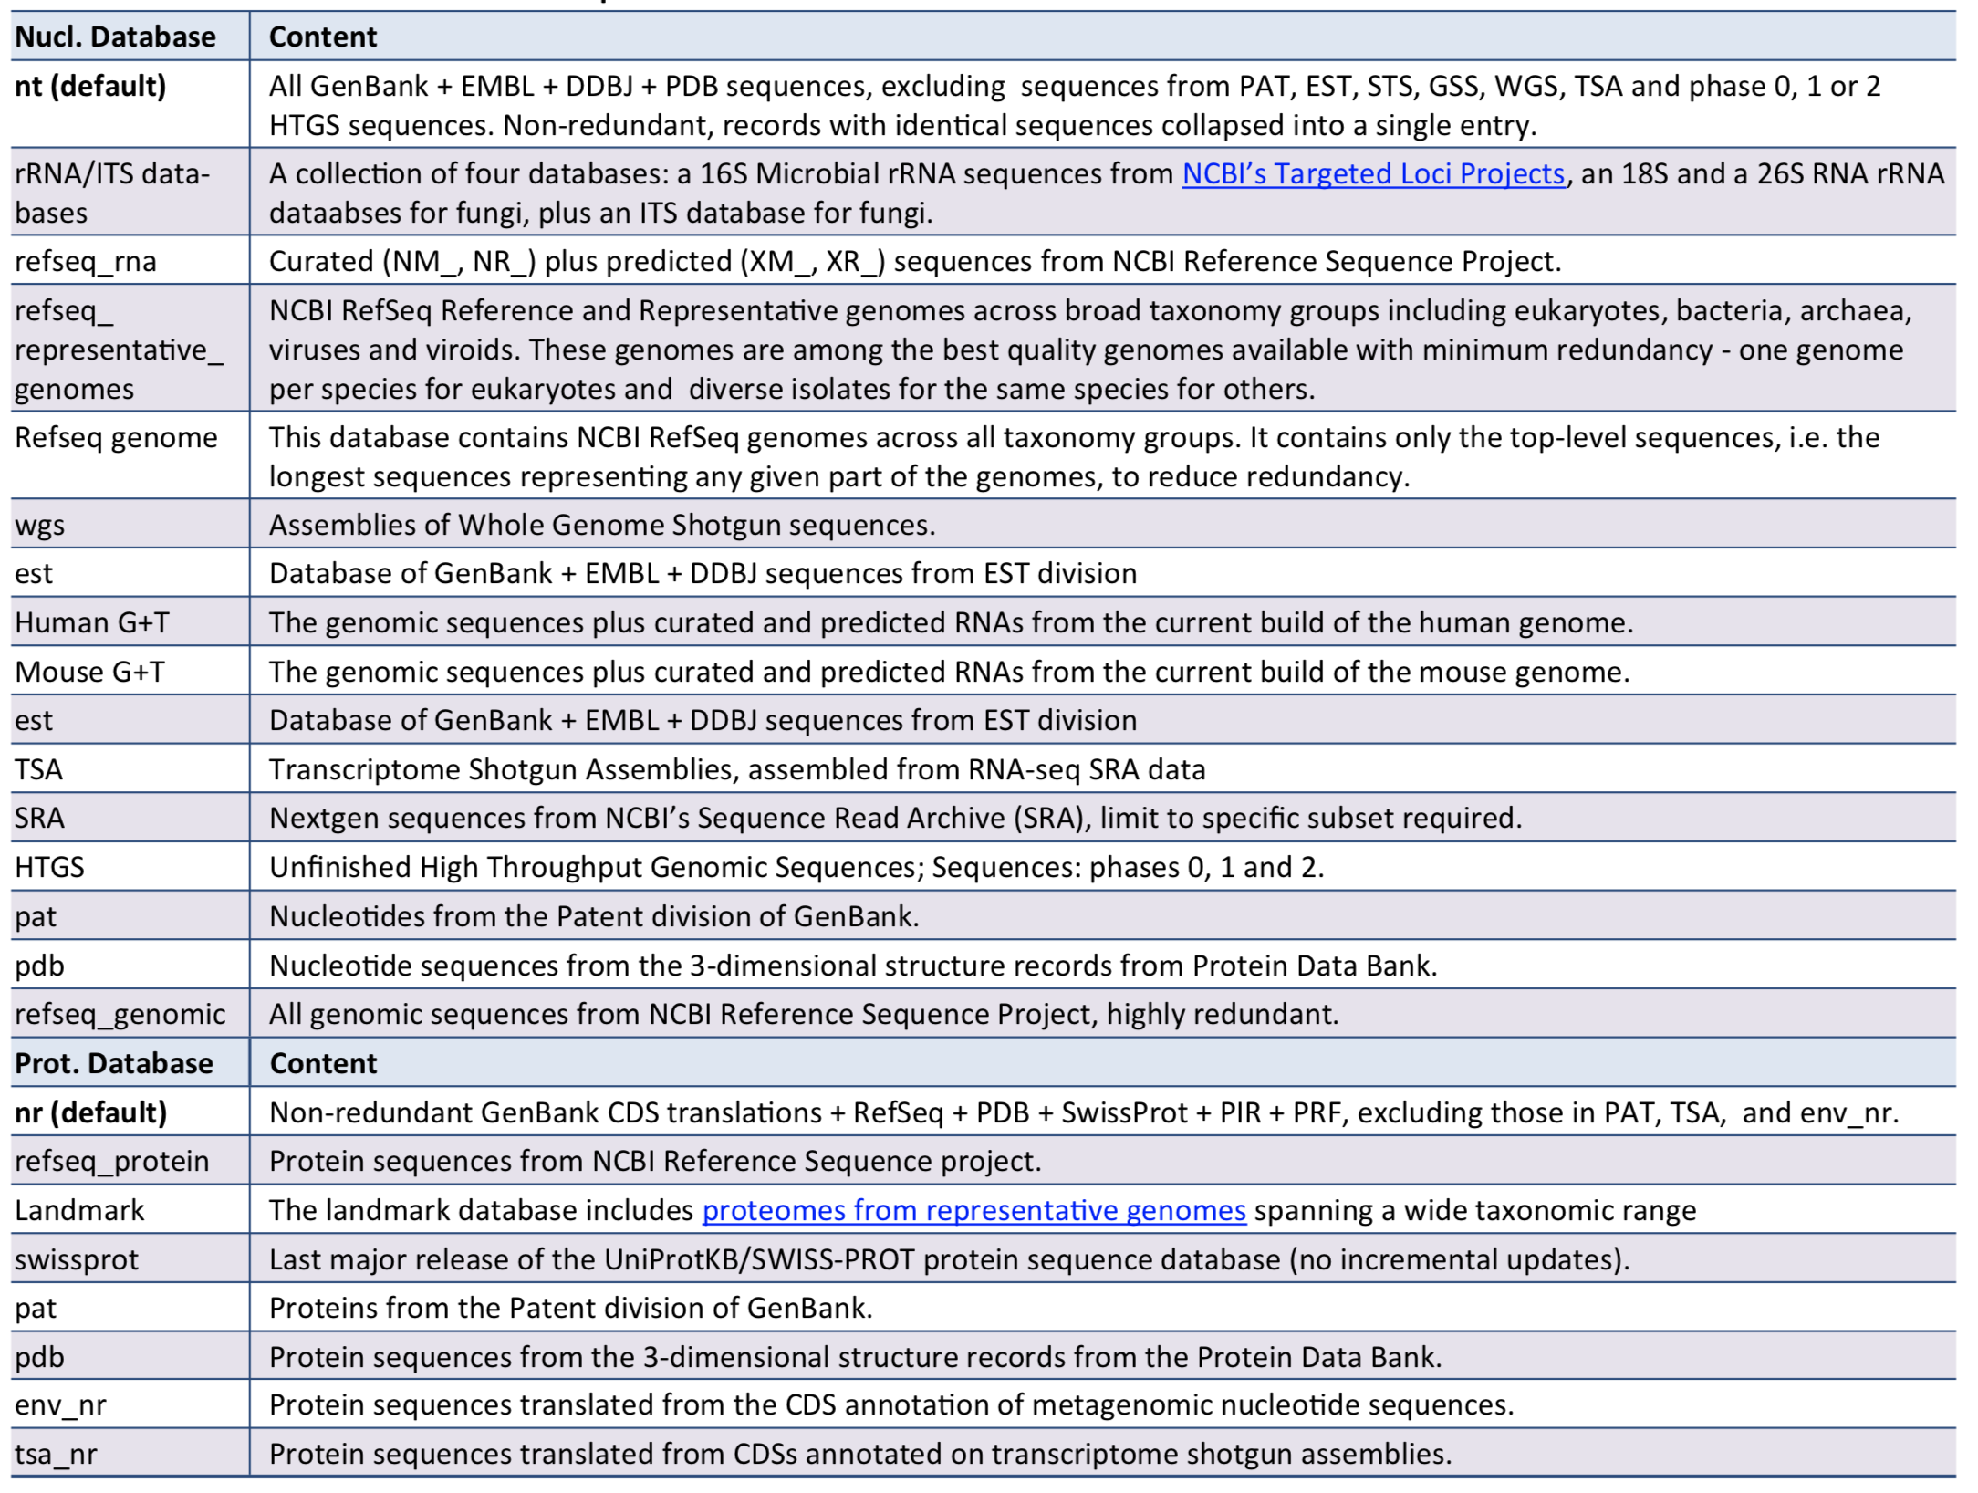
BLAST databases:
https://ftp.ncbi.nlm.nih.gov/pub/factsheets/HowTo_BLASTGuide.pdf

